Slide 1
Creating a PostGIS Database and Connecting in QGIS

Slide 2
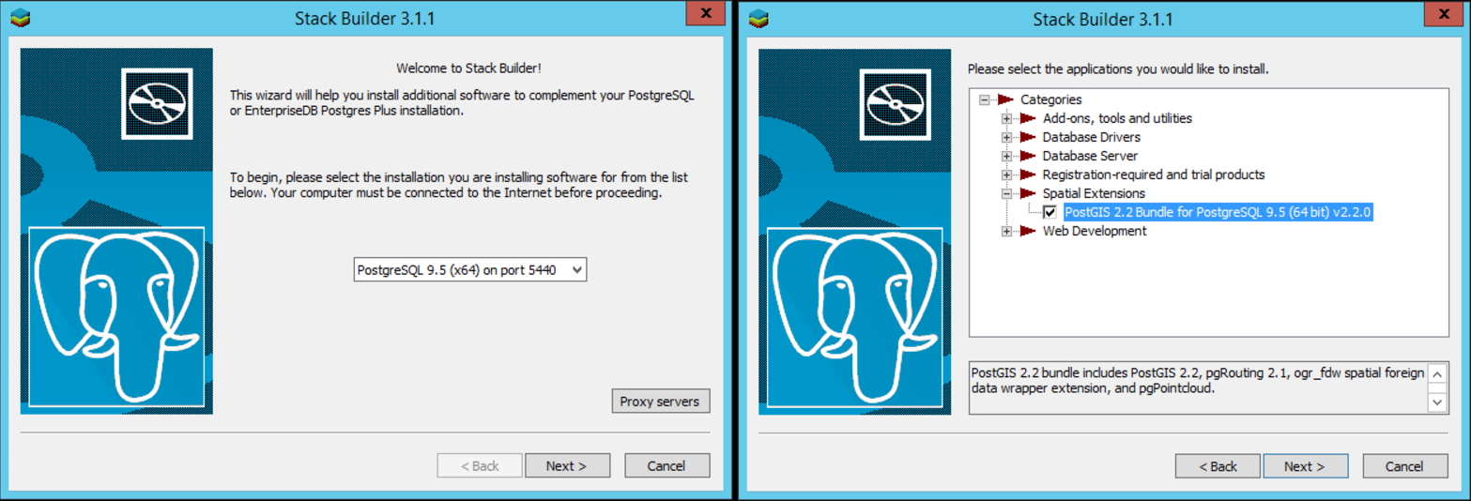
1) Install PostgreSQL (Postgres) / PostGIS
Download PostgreSQL and Install: https://www.enterprisedb.com/downloads/postgres-postgresql-downloads
After it finishes, it will give you the option to run Stack Builder. Install PostGIS.
Create a username and password (“postgres” for both is ok for now)
If it asks if you want to create a spatial database, either way is OK – we will create a new one anyway
Press “Yes” to all dialogue boxes that pop up

Slide 3
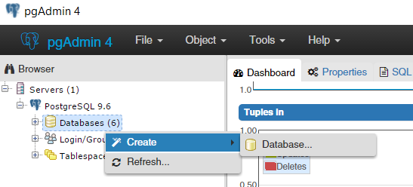
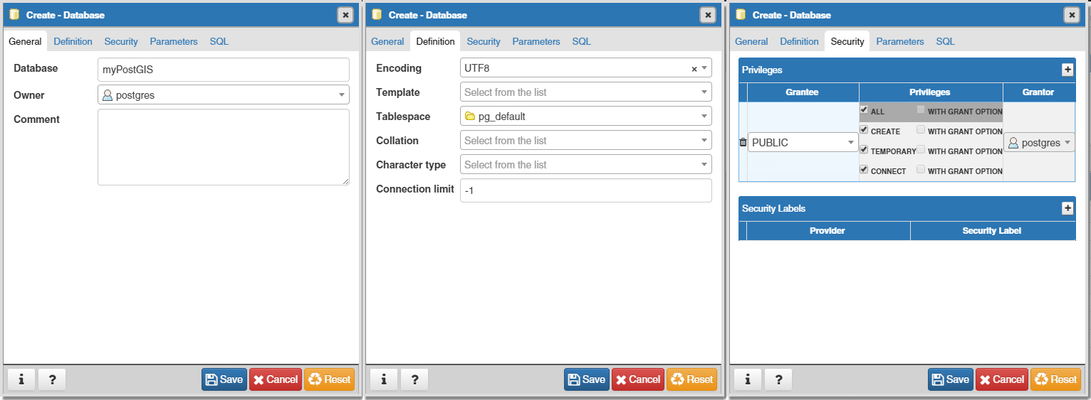
2) Create a New Database in PGAdmin
Right click on Database, then Create > Database…
Go to each of these tabs and select the options shown here. Press save.

Slide 4
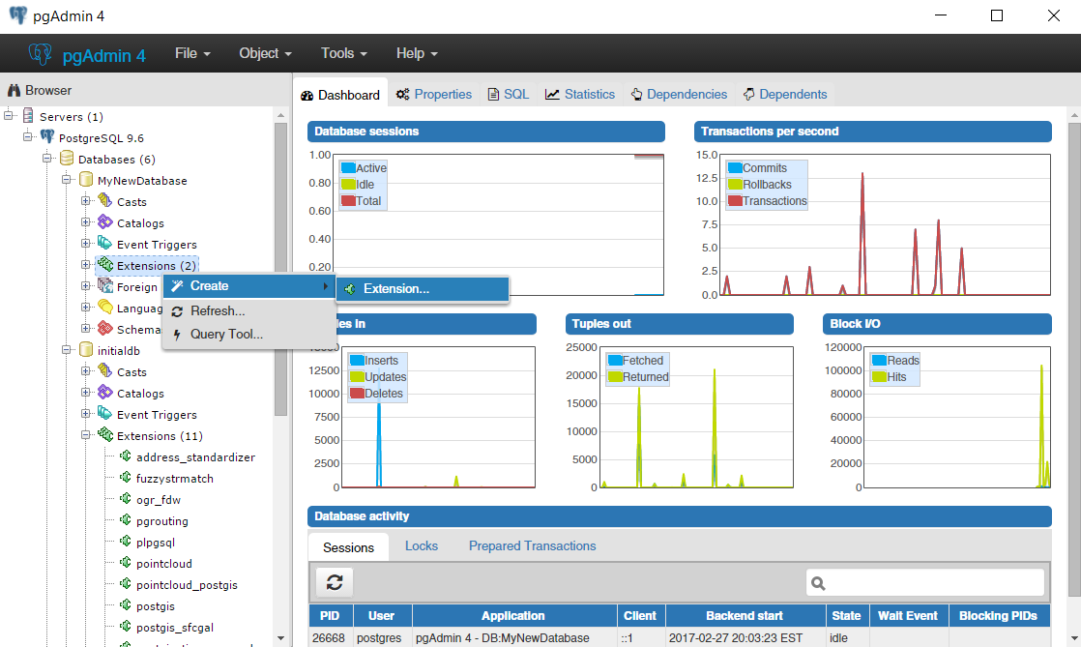
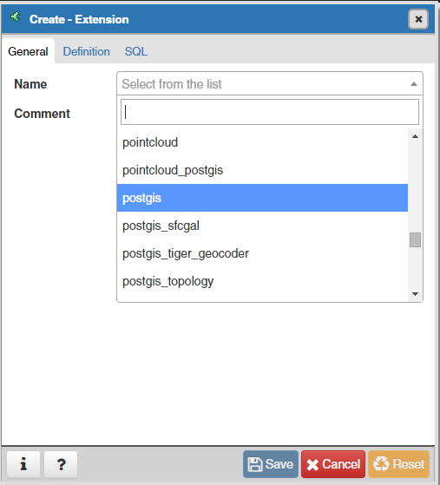
3) Add PostGIS Extension to the Database
Right click on extensions, then Create > Extension…
Select postgis and press Save

Slide 5
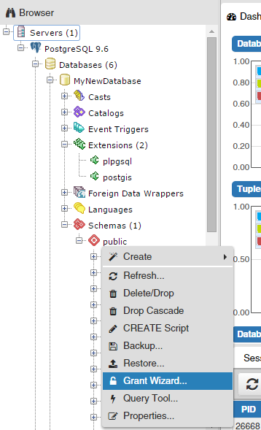
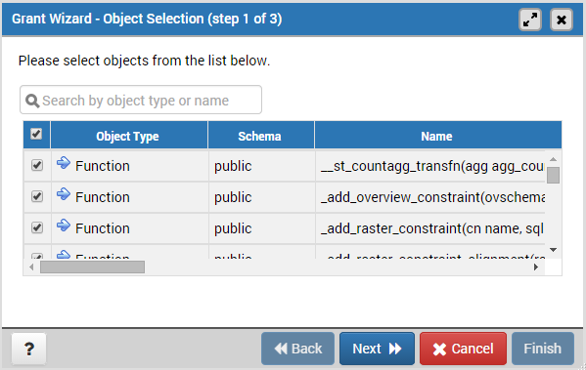
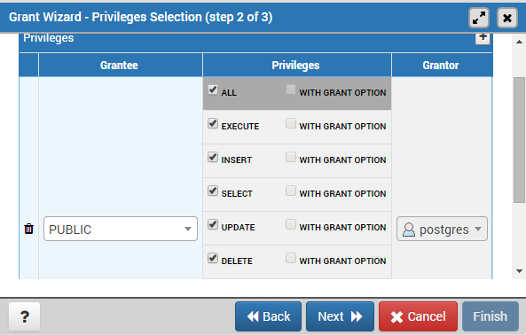
4) Grant Database Permissions
Open the database schemas section and right click on public, then Grant Wizard…
Add PUBLIC as a Grantee with all privileges. Then press Next, then Save.
Check everything, then press Next

Slide 6
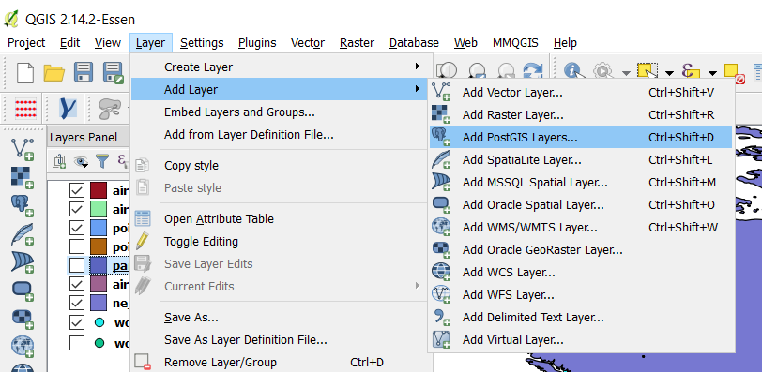
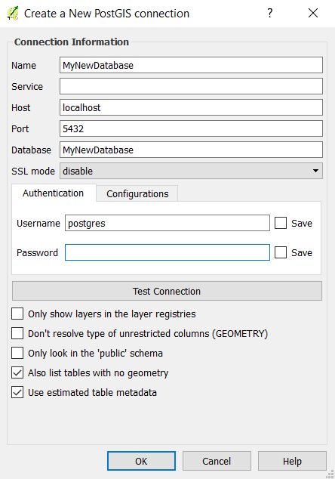
5) Connect to the Database in QGIS
Create a new connection with the settings below
Database = the database you just created
Username = the username you created when you installed PGAdmin
Open QGIS. In the menu at the top select Layer > Add Layer > Add PostGIS Layers

Slide 7
If you are able to connect in QGIS, then your database is set up properly. It’s still empty, so there is not much you can do with it yet. We will go through how to import data in class.

