Slide 1
Spatial Databases Cont. /
Data Reshaping
Topics
Setting up a PostGIS database
Spatial queries
Data reshaping / manipulation: dplyr & tidyr
D3.js ???
MUSA 620: Week 7

Slide 2
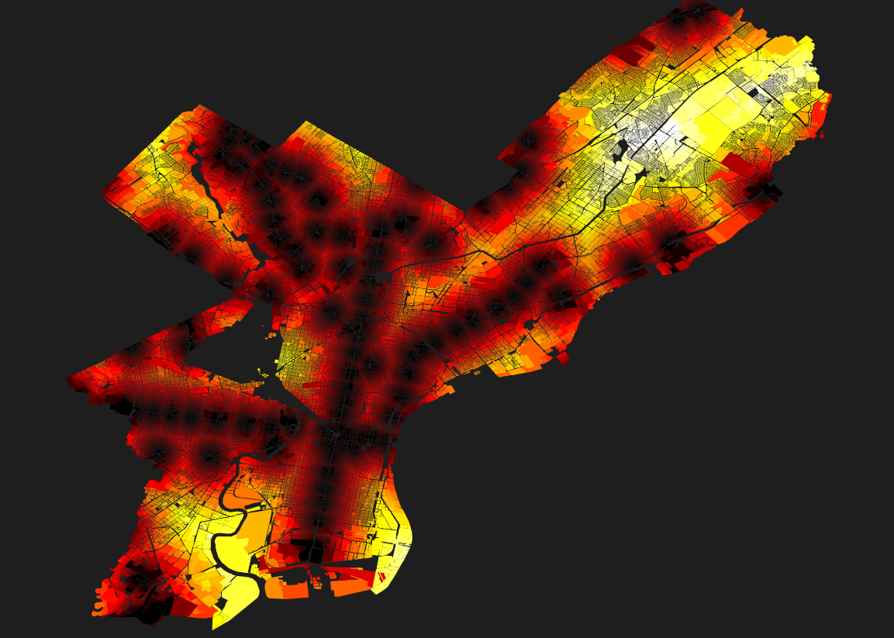
Distance from Nearest SEPTA Station
Philadelphia’s 600k real estate parcels

Slide 3
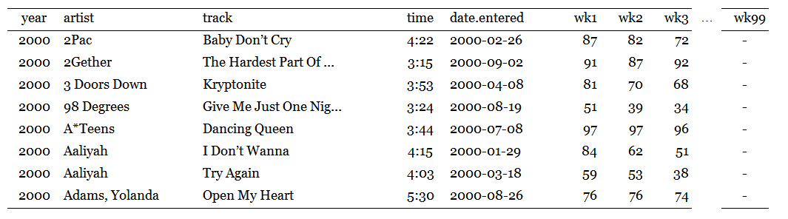
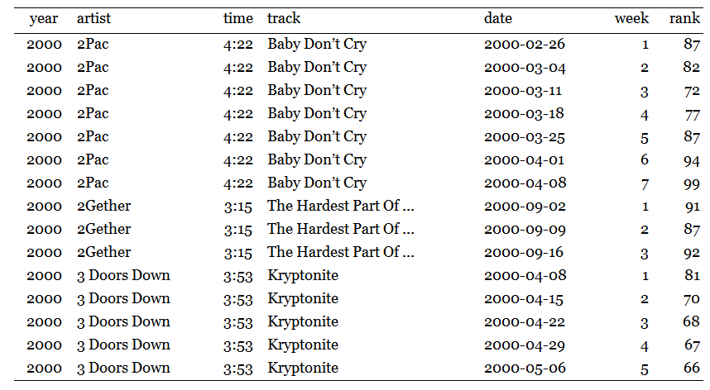
Data Shaping: Same Data, Different Format
Wide format
Tall format
(usually better)

Slide 4
Data Shaping: Tall Format
ID variables
-vs-
measured variable(s)
Each measured variable gets one column
Each row is one observation

Slide 5
D3?

Slide 6
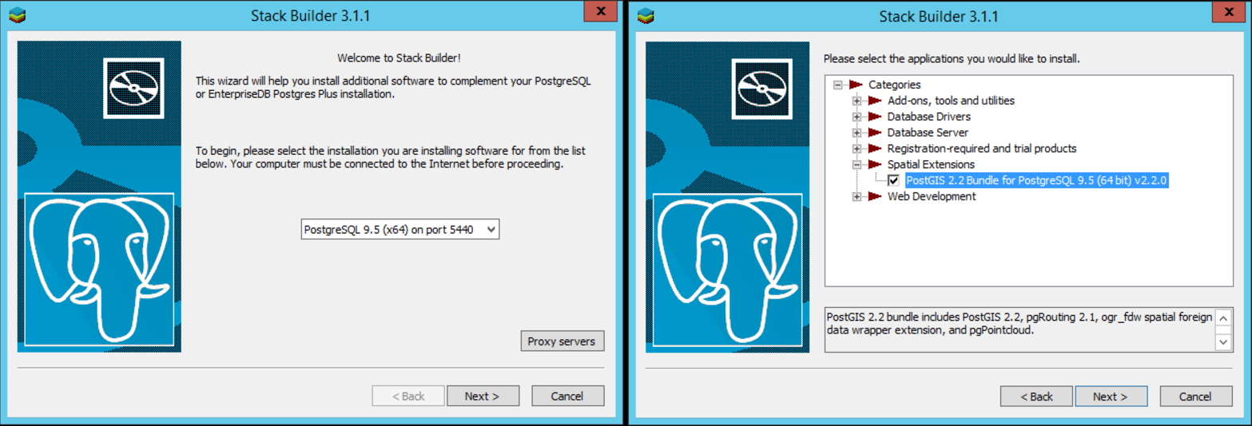
PostgreSQL (Postgres) / PostGIS
Getting set up: https://www.enterprisedb.com/downloads/postgres-postgresql-downloads

Slide 7
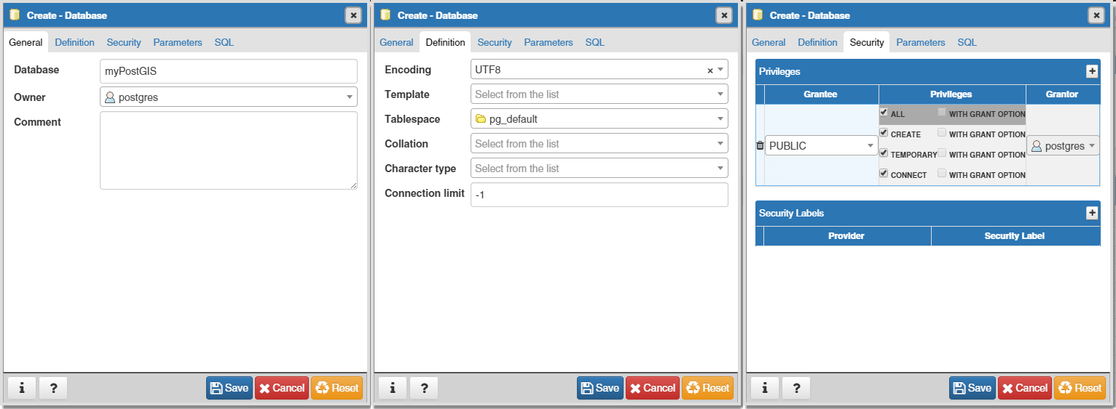
Create a New Database in PGAdmin

Slide 8
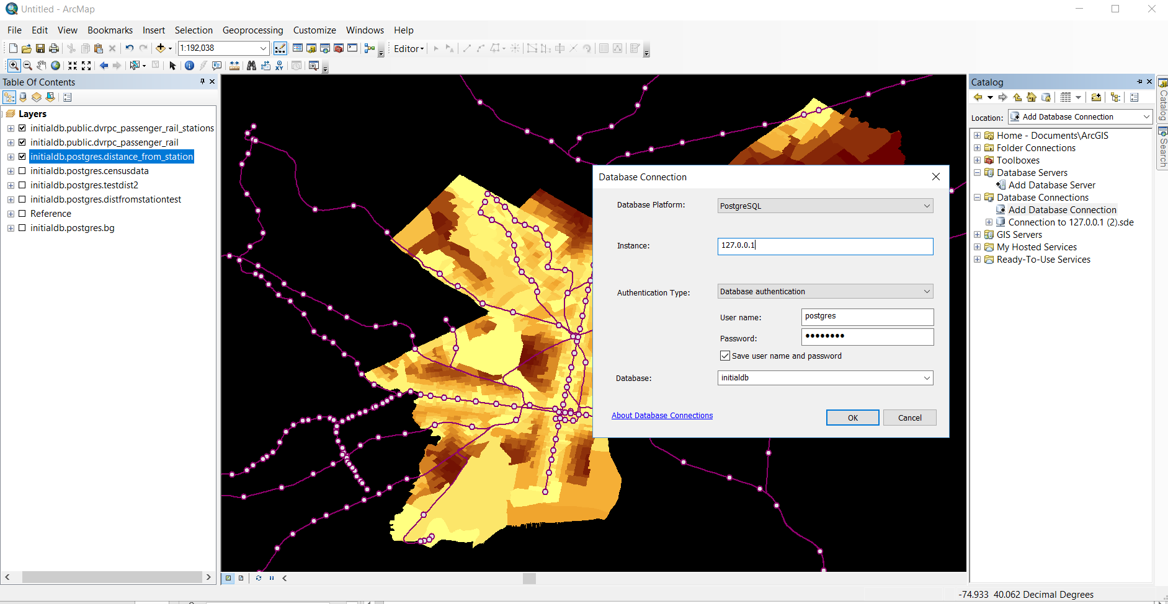
Database Connections in ArcMap
Catalog > Add Database Connection

Slide 9
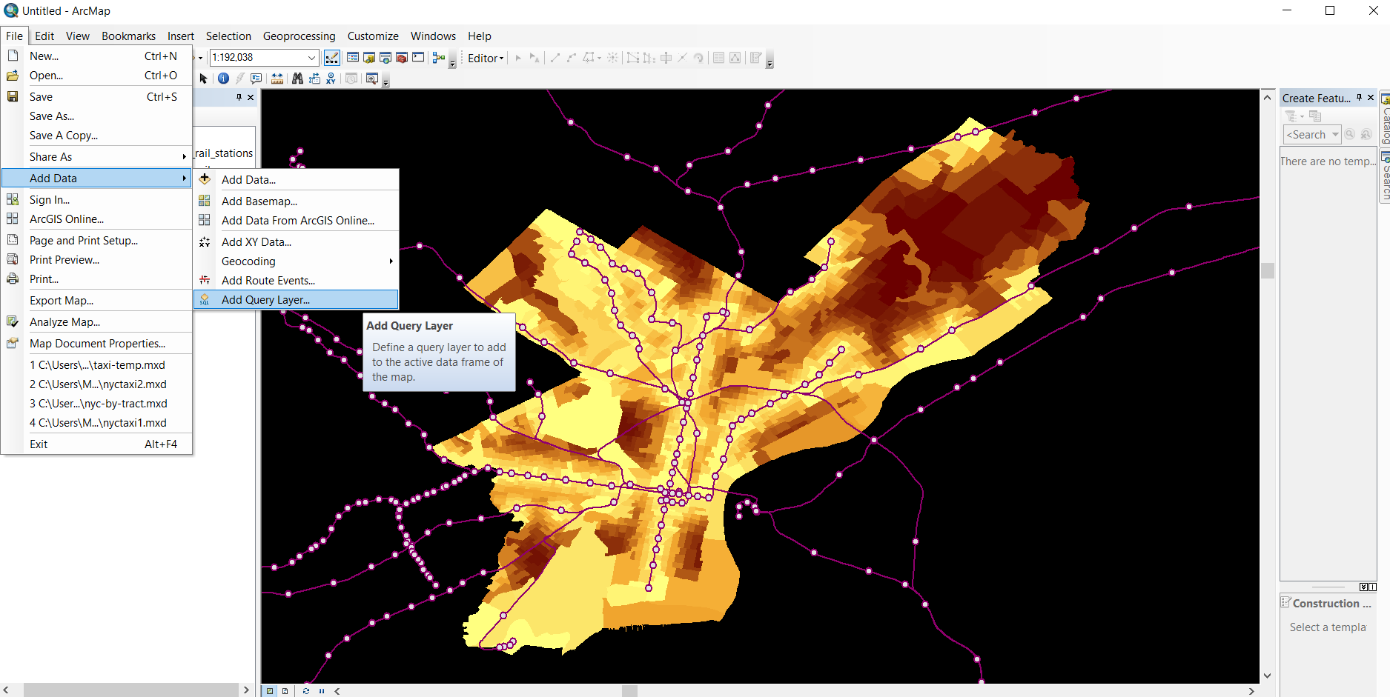
Spatial Queries in ArcMap
File > Add Data > Add Query Layer

Slide 10
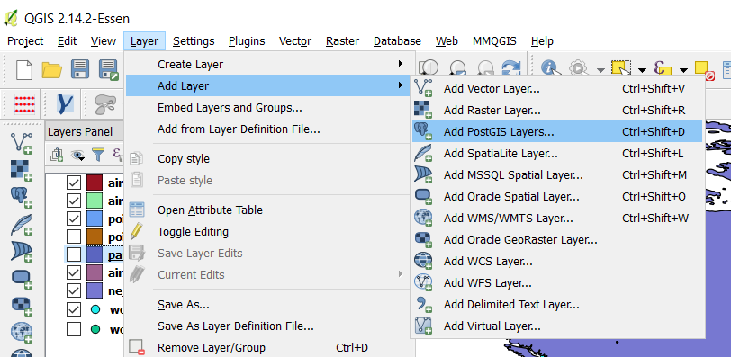
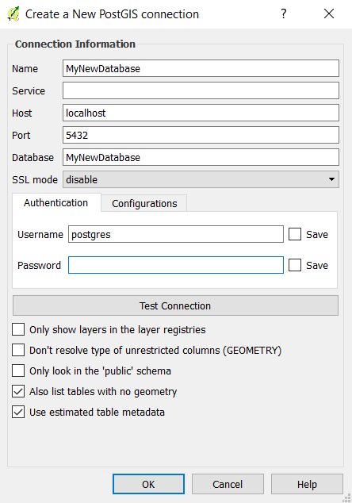
Database Connections in QGIS
Create a new connection with the settings below
Database = the database you created in PGAdmin
Username = the username you created when you installed PGAdmin
Open QGIS. In the menu at the top select Layer > Add Layer > Add PostGIS Layers

Slide 11
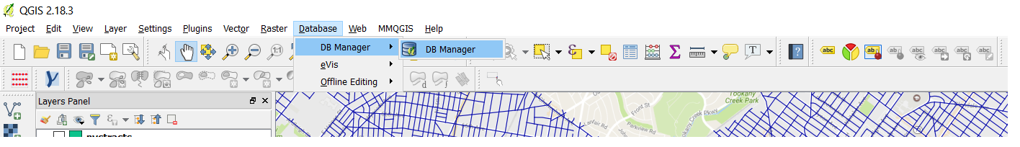
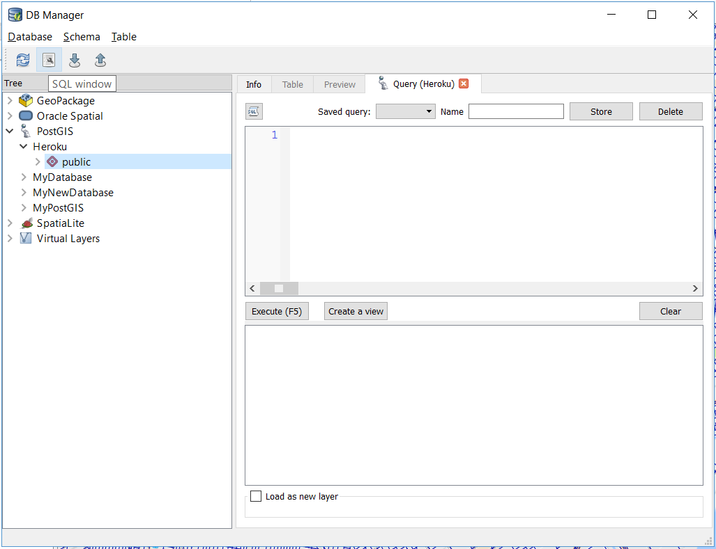
Spatial Queries in QGIS (With DB Manager Plugin)
1. Database > DB Manager > DB Manager
2. Select the database and press the “SQL window” button

