Slide 1

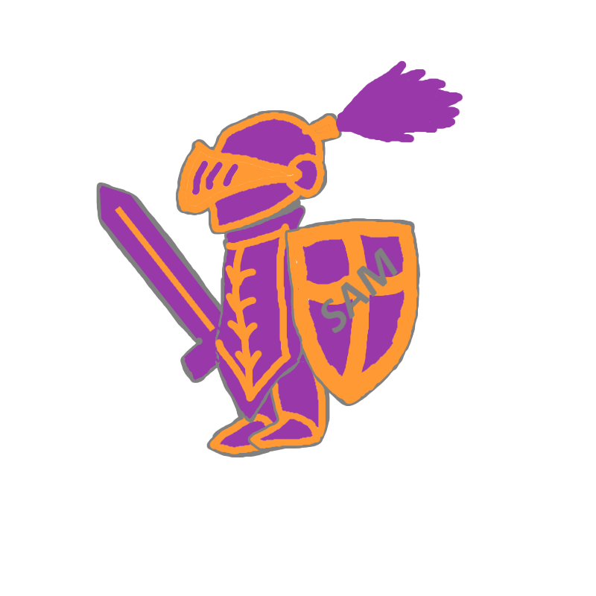
DR...AW
A project by “I sam voinut e sam”

Slide 2
OUR PROJECT:
Technologies used:
JavaScript
Node.js
p5.js
Project idea:
3-player multiplayer game.
2 players compete.
1 player guesses.
The most creative wins the round!
Play until a player gets to 8 points!

Slide 3
FUTURE PLANS:
Website
Login database
Lobbies
Additional gamemodes
Word banning
Microtransactions || ads

