Slide 1

SQL Injection
Structured Query Language Injection
Database Dumping
by aa133 & EternalBeats

Slide 2




Database ?
Structured set of data
And many more other database management systems

Slide 3
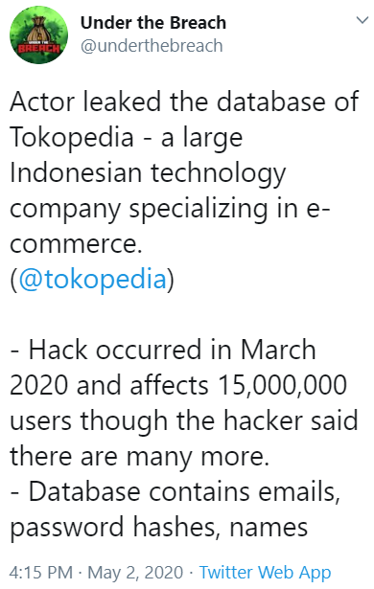

Why dump a database?
You wanted swag among criminals
Dump database get cash :D
I love being in prison
5000 USD MANNNN

Slide 4
How to dump a database?
Learn SQL Injection
Try manual payloads like a champ
Fire away with an SQLmap like a chimp
Whatever your method of choice is, we need to learn the basics of SQL Injection

Slide 5
Normal Query VS Evil Query
Normal Query
Evil Query
Select * From Users where Username=‘Yah Sona’
Select * FROM Users where UserId=‘’OR 1=1-- -’
Ah the classic OR 1=1-- -
What is OR 1=1-- - ?
It’s a Tautology !
Apapun yang di OR dengan True maka akan jadi True !

Slide 6
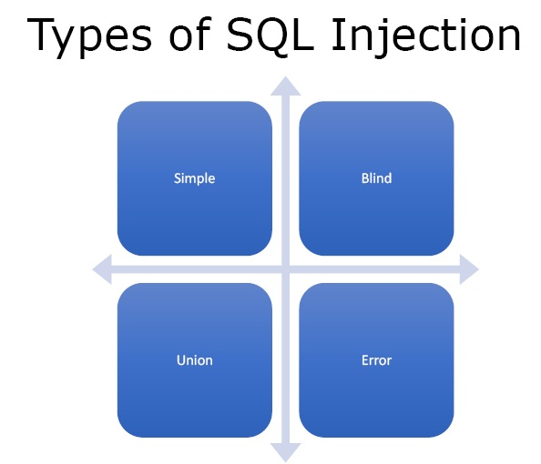
What are the types of attack ?
Error Base
Union Base
Blind Boolean
Blind Time Base
There are only a few types, but hundreds of way to execute it

Slide 7
How do I learn it?
Try out DVWA, TryHackMe, HackTheBox, play CTFs
Binusmaya
Try out small insignificant websites that PROBABLY wont get you arrested
Today we’re going to learn from DVWA and TryHackMe !

Slide 8

Lets do this

