Slide 1


Slide 2
Elements needed
Obtain the skills for combining interactive plots
Understanding how to host on Github
Exporting plots to HTML

Slide 3


Implementation plan
Preliminary Data analysis
Creating interactive plots
Converting to HTML
Hosting on Github.com

Slide 4
Preliminary data-analysis
The shape of dataset 1 is: (19956, 28) The shape of dataset 2 is: (59580, 183)
Two data sets, one is contained within the other.
5.9 MB and 52.5 MB
Dataset 1:
19956 rows
28 features
Dataset 2:
59580 rows
183 features (Most of which are empty)

Slide 5
Data features
The most important features are:
Type of tree
District
Location (Coordinates)

Slide 6
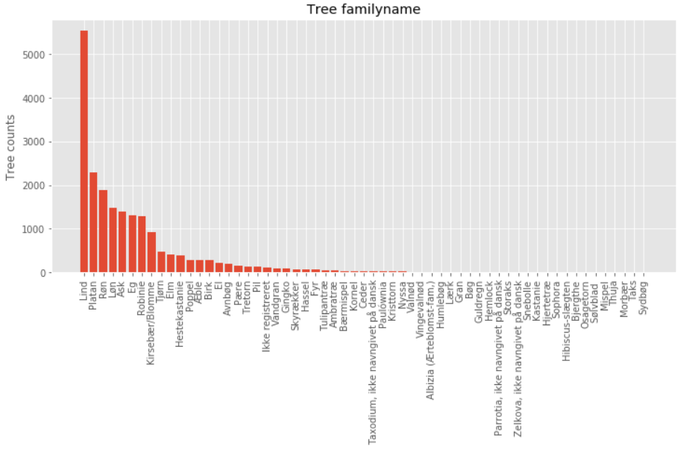
Most common trees

Slide 7
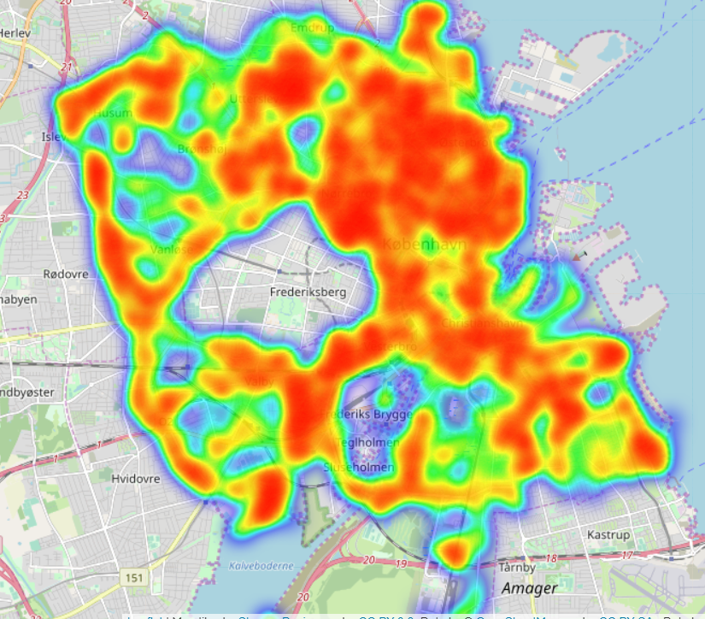
Heat map of all trees

Slide 8
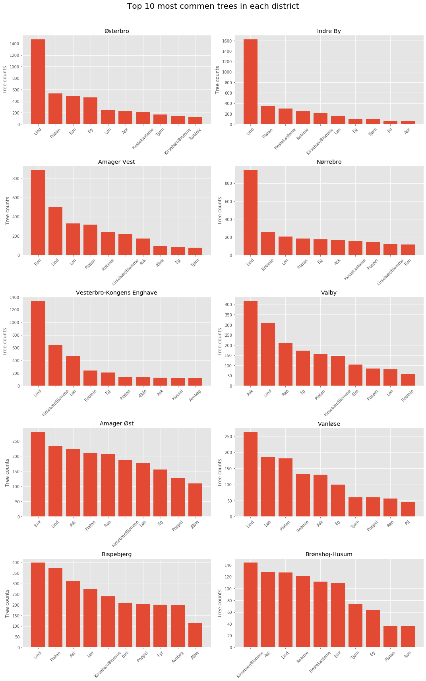
Most common trees in each district

