Slide 1
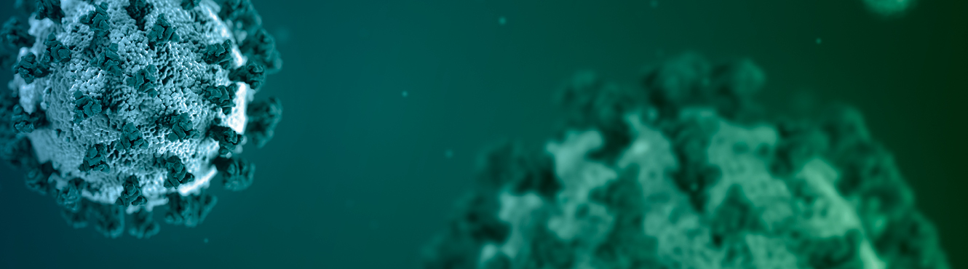
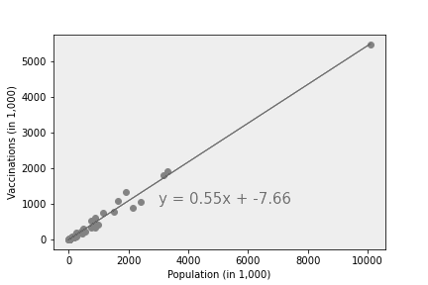
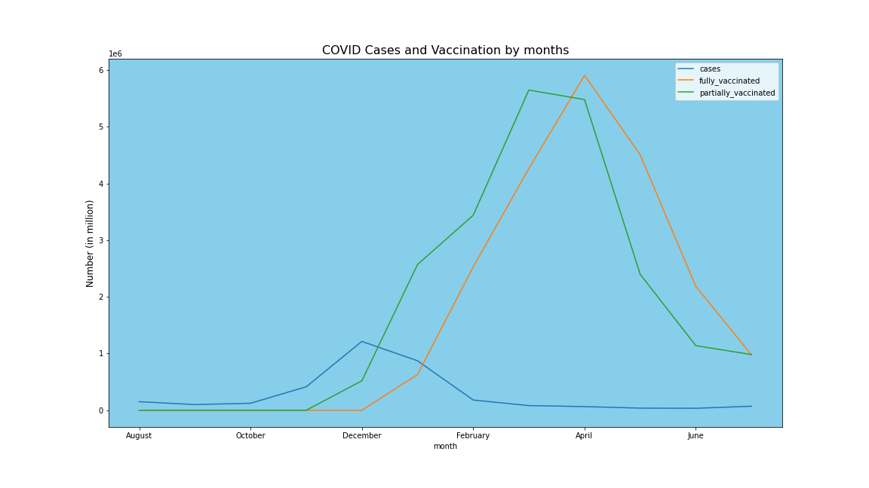
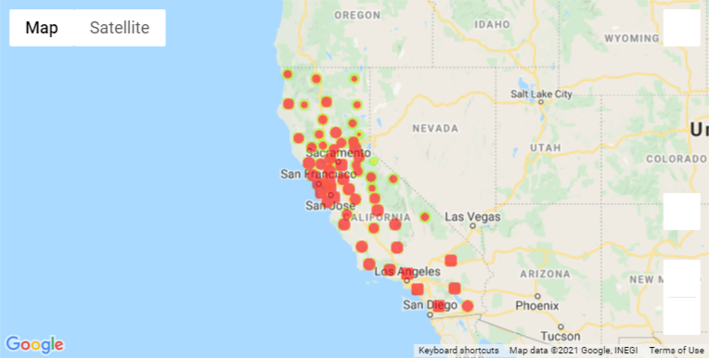
COVID-19 Vaccination California
Team members:
- Tikaram Subedy
- Kristian Hamilton
- David Koski

Slide 2
What Affects Vaccination Rates in CA?
Is there a correlation between cases and deaths affect vaccination rates?
Do demographics affect vaccination rates?
Does location and time affect vaccination rates?

Slide 3
Is there a correlation between cases and deaths affect vaccination rates?

Slide 4
Do demographics affect vaccination rates?
Kristian

Slide 5
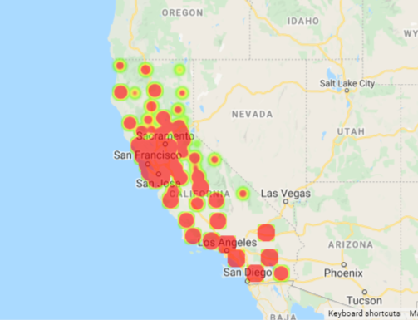
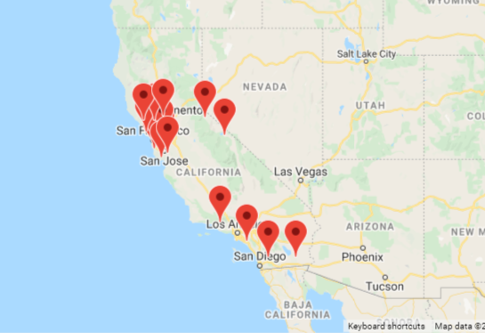
Does location affect vaccination rates?
Counties - Complete Vaccination
Counties- higher average vaccination than State average

Slide 6

Project analysis slide 5
Project Analysis
Total Population in California
Completely Vaccinated
Partially Vaccinated
39,283,497
21,025,768
(53.52%)
22,224,679
(56.57%)

Slide 7
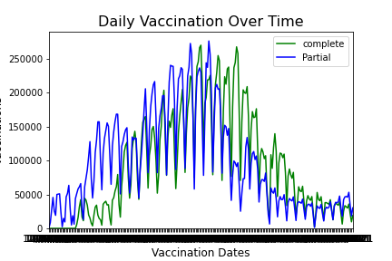
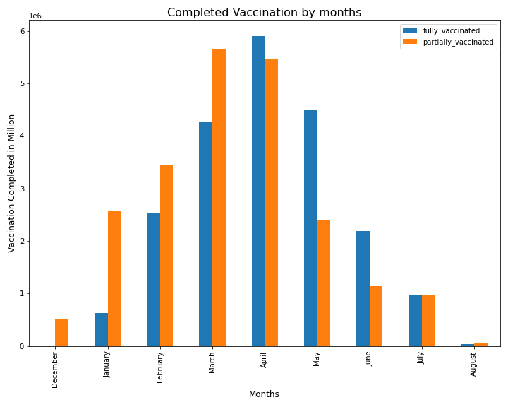
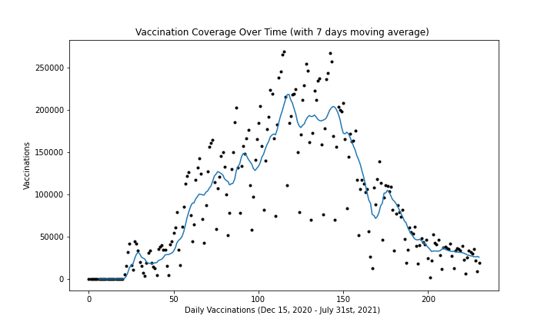
Project analysis slide 5
Project Analysis

Slide 8
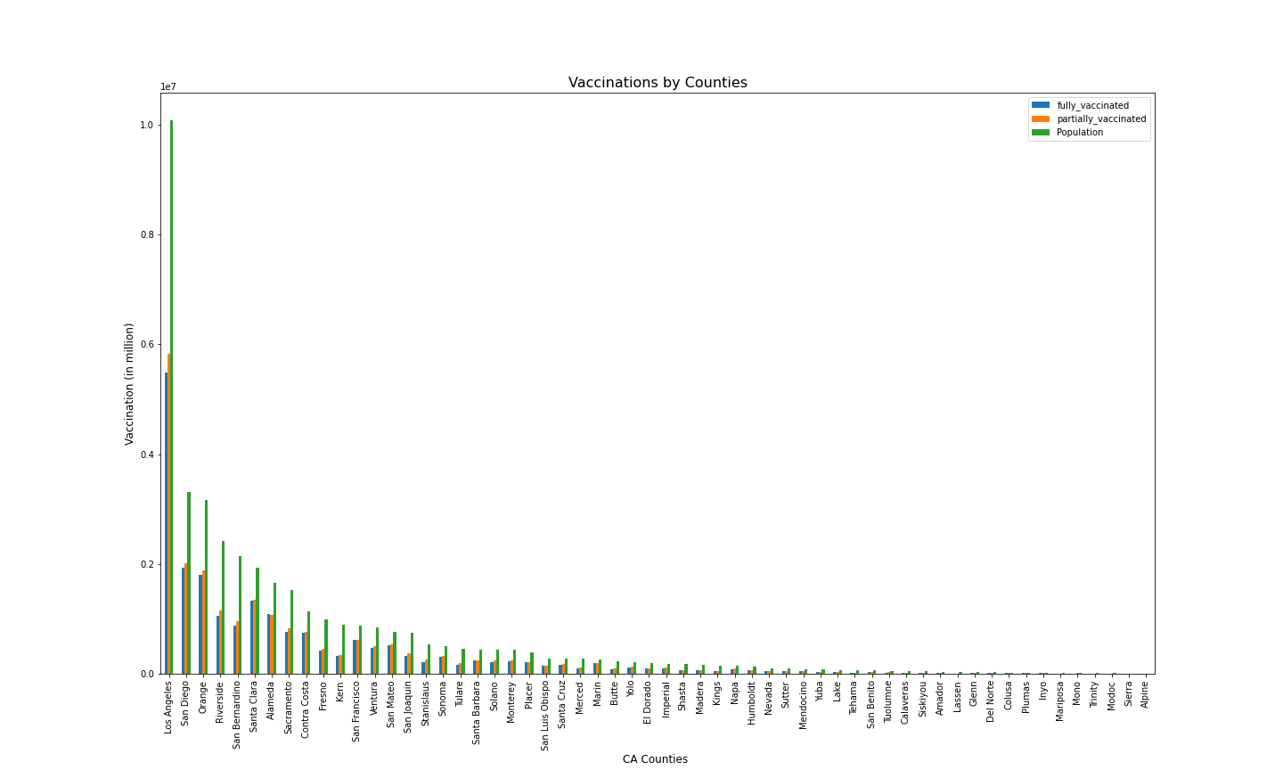
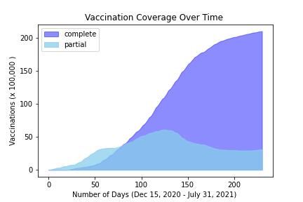
Project Analysis

Slide 9
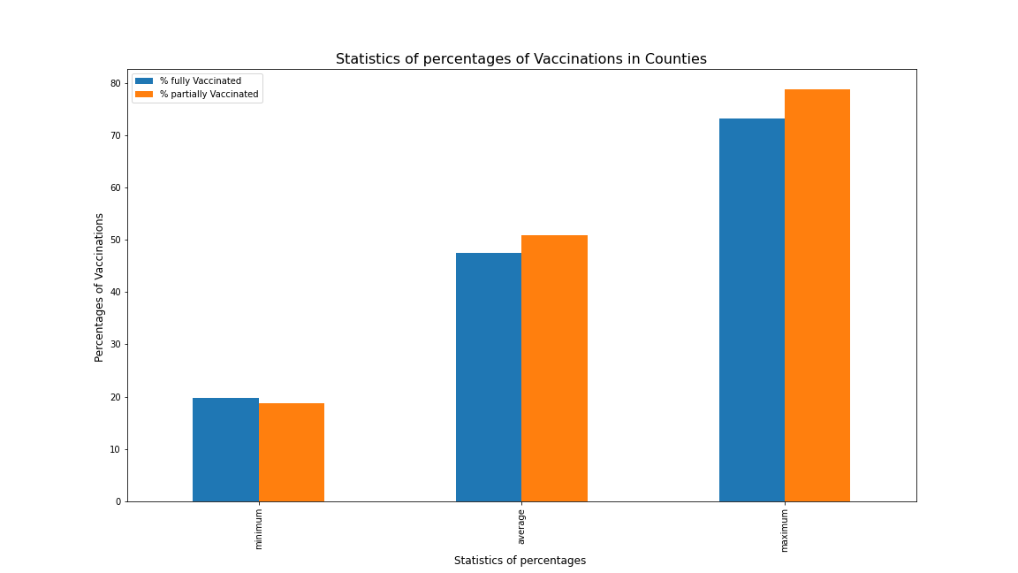
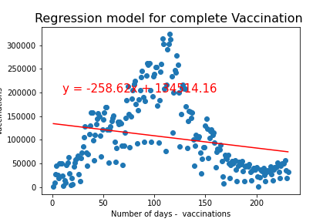
Project Analysis
As the statistics shows it can be estimated that the vaccination will be completed in about 521 days from the beginning, while remaining all other compounding factors unchanged.

Slide 10
CDC
Summarize where and how you found the data you used to answer these questions
Importing COVID19 dataset and preparing it for the analysis by dropping columns and aggregating rows.
Deciding on and calculating a good measure for our analysis.
Merging datasets and finding correlations among our data.
Visualizing our analysis results using Python and Pandas.

Slide 11
California Health and Human Services Covid-19 Vaccination Data by County
Kristian
Summarize where and how you found the data you used to answer these questions

Slide 12
Federal Census Bureau American Community Survey Data by County
Kristian
Summarize where and how you found the data you used to answer these questions

Slide 13
USAFacts.org
David
Summarize where and how you found the data you used to answer these questions

Slide 14
Data Cleanup Tikaram
Data source:
- CDC data (in csv format)
-
Describe the data exploration and cleanup process (accompanied by your Jupyter Notebook)

Slide 15
Data Cleanup David
Describe the data exploration and cleanup process (accompanied by your Jupyter Notebook)

Slide 16
Data Cleanup Kristian
Describe the data exploration and cleanup process (accompanied by your Jupyter Notebook)

Slide 17
Describe the Analysis Process
Screen shots of code and output
Describe the analysis process (accompanied by your Jupyter Notebook)

Slide 18
Describe the Analysis Process
Screen shots of code and output
Describe the analysis process (accompanied by your Jupyter Notebook)

Slide 19
Describe the Analysis Process
Screen shots of code and output
Describe the analysis process (accompanied by your Jupyter Notebook)

Slide 21
Project analysis slide 2
Project Analysis
Reporting
Data collection and Source
Analysis of COVID 19 Vaccination
In
California
Analyzing
Data Cleaning
Testing and bugging
Coding

Slide 22
Project analysis slide 3
Project Analysis
California Data
Data Cleaning and Preparation
ANALYSIS
Trends and Charts
Report and Presentation
Performed Analysis on
Overall California, Cases, Demographic, Vaccination, by counties and demographic categories
Cases, Vaccination and Demographic data
Data Cleaning and Preparation using Python and Pandas
Cases and Vaccination trends were analyzed.
Fitted regression models (linear)
Prepared data analysis report. Recommendations and further ……

Slide 23
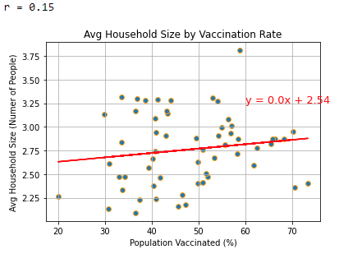

Slide 24
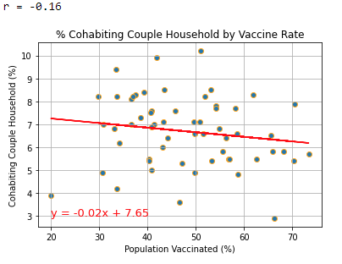
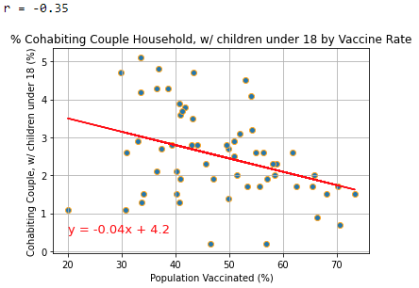

Slide 25
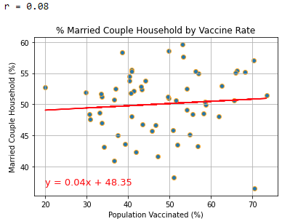
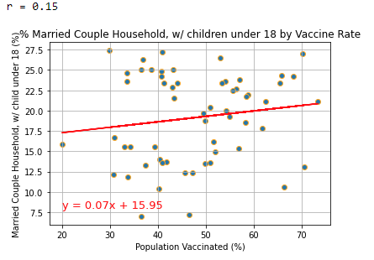

Slide 26
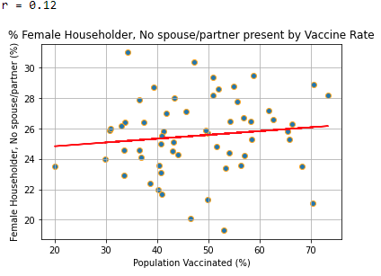
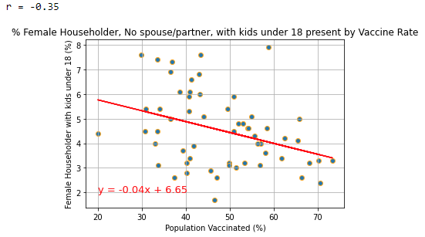

Slide 27
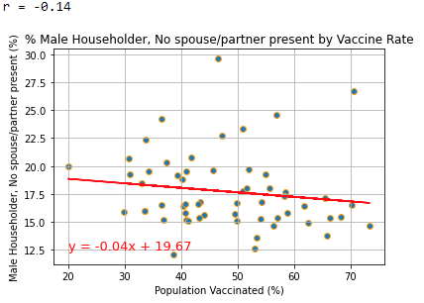
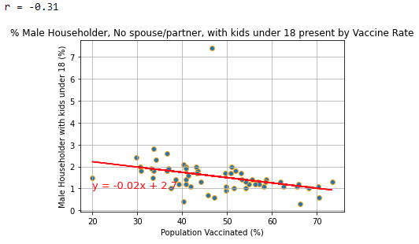

Slide 28
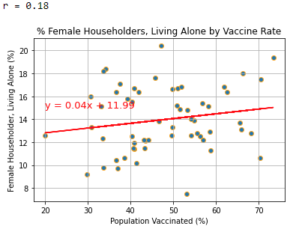
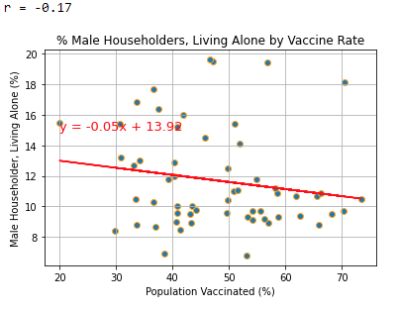

Slide 29
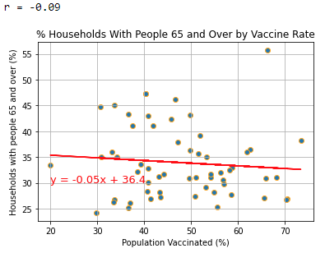

Slide 30
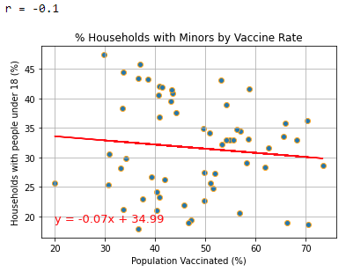

Slide 31
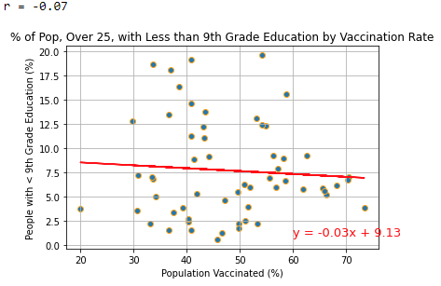

Slide 32
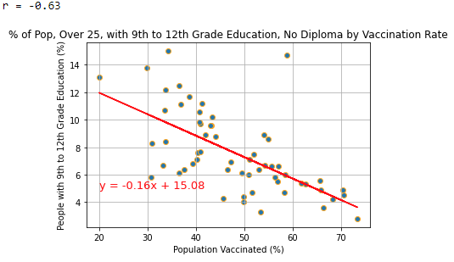

Slide 33
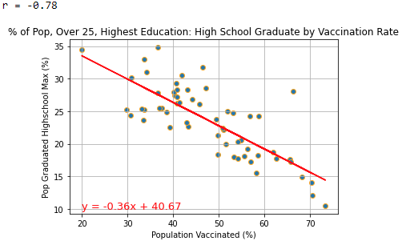

Slide 34
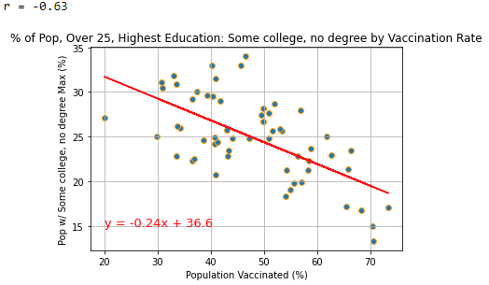

Slide 35
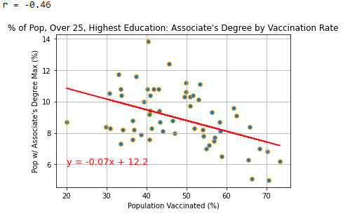

Slide 36
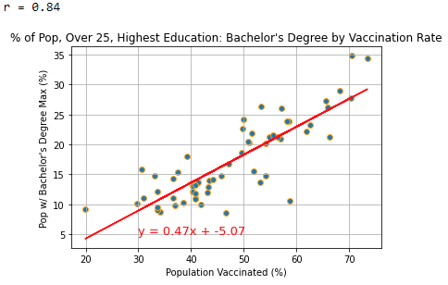

Slide 37
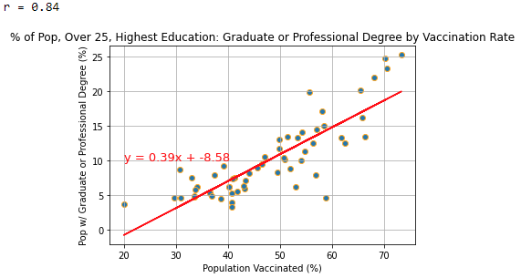

Slide 38
Limitations

Slide 39
Recommendations

Slide 40
Thank You

