Slide 1
OBDII Data Logger Design for Large-Scale Deployments
Kristian Smith
University of Alaska anchorage

Slide 2
Introduction to On-Board Diagnostics (OBDII)
OBDII is a standardized communication protocol used to retrieve diagnostic information from motor vehicles in effort to monitor emissions
Starting in 1996, all new vehicles sold in the US were required to have OBDII technology (other countries maintain a similar protocol)
Common monitors:
Catalytic converters
Oxygen sensors
EGR (Evaporative Gas Recirculation)
 Detection of engine misfire
 PCV (Positive Crankcase Ventilation) 
Fuel system -- closed loop fueling performance
 Coolant, ambient, and air intake temperatures

Slide 3
Design Goals
Design a device capable of the following
Translating OBDII data
Collecting GPS coordinates
Streaming data through cellular network
Adaptability
Access different vehicle PID’s for desired application
Communicate with server and database for data logging
Price point
Cost must be low enough to allow for bulk purchases

Slide 4
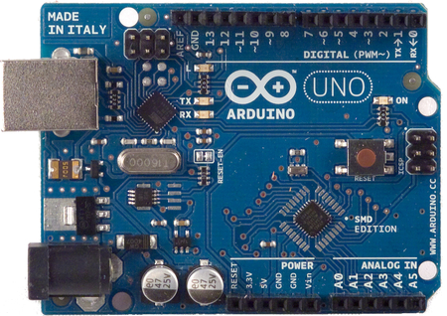
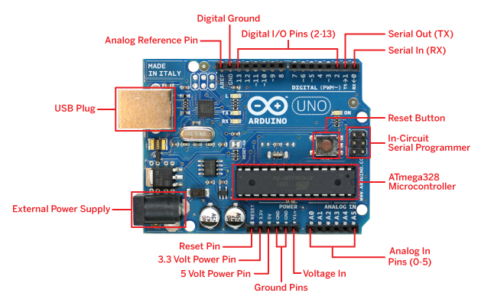
Arduino Uno Microprocessor
Based on ATmega328 processor
16 MHz, 32 KB flash memory
Stackable design
Simple programming construct (subset of C)
6 analog inputs
14 digital inputs/outputs
http://arduino.cc/en/uploads/Main/ArduinoUnoSmd450px.jpg
http://cdn.makezine.com/make/arduino/Arduino-callouts1.jpg

Slide 5
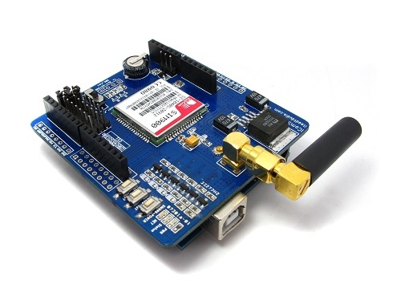
SIM900 GSM/GPRS Shield
Quad-Band 850/900/1800/1900MHz
Control via commands (GSM 07.07, 07.05 and SIMCOM enhanced AT Commands)
Short message service
3.5 inch standard sockets for MIC and speaker
Operation temperature: -40℃ ~ +85℃
http://blog.iteadstudio.com/wp-content/uploads/image/2011_05/sim900-gprs-shield-icomsat-preview_1.jpg

Slide 6
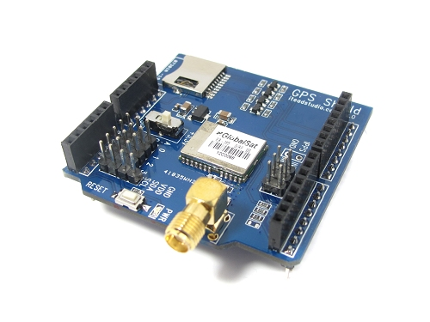
GPS Shield from ITEAD Studio
Acquires position and speed at 2 Hz
Micro SD interface
Active antenna design with high receive sensitivity
Extremely fast time to first fix at low signal level
UART interface
Operation temperature: -40℃ ~ +85℃
http://www.exp-tech.de/images/product_images/original_images/gpsshield4.jpg

Slide 7
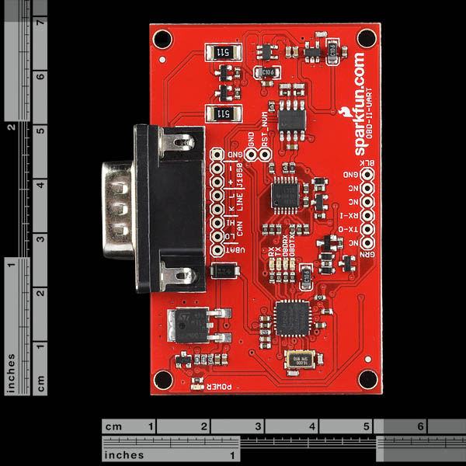
OBD-II UART (Sparkfun electronics)
UART interface (baud rates from 38 bps to 10 Mbps)
Secure boot-loader for easy firmware updates
Support for all legislated OBD II protocols:
ISO 15765-4 (CAN)
ISO 9141-2 (Asian, European, Chrysler vehicles)
SAE J1850 VPW (GM vehicles)
SAE J1850 PWM (Ford vehicles)
Support for non-legislated OBD protocols:
ISO 15765
ISO 11898 (raw CAN)
Support for SAE J1939 OBD protocol
Superior automatic protocol detection algorithm
Large memory buffer
Voltage input for battery monitoring
https://www.sparkfun.com/products/9555
images are CC BY-NC-SA 3.0

Slide 8
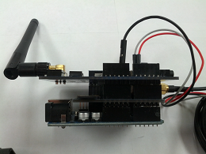
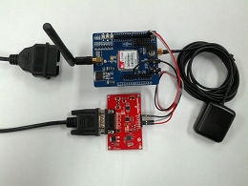
Assembled OBDII Logger
Requires no modification of vehicle
Cell and GPS shields stack vertically to Arduino
OBDII board must be connected externally
Images shown include cellular and GPS antennas as well as OBDII port connector
A standard baud rate of 9600 programmed from the Arduino can be used for communication between all boards

Slide 9
OBD II ACQUISITION TEST SPEEDS
Model Year | Make/Model | Data Points/Second
N/A | ECUSim 5100 | 38.0
1996 | Ford Bronco | 5.5
1998 | Oldsmobile Bravada | 19.6
1999 | Dodge Ram 1500 | 22.0
2000 | Ford F350 | 20.9
2001 | Chevrolet Tahoe | 26.4
2001 | Mazda B3000 | 25.7
2003 | Saturn L200 | 26.8
2004 | Chevrolet Avalanche | 26.2
2004 | Chevrolet 2500 HD | 24.5
2004 | Chevrolet Astro | 22.8
2005 | Jaguar X-Type | 4.2
2005 | Honda Accord | 4.5

Slide 10
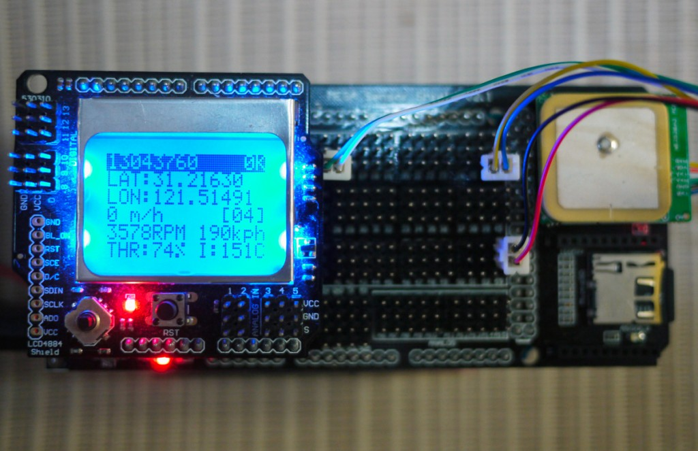
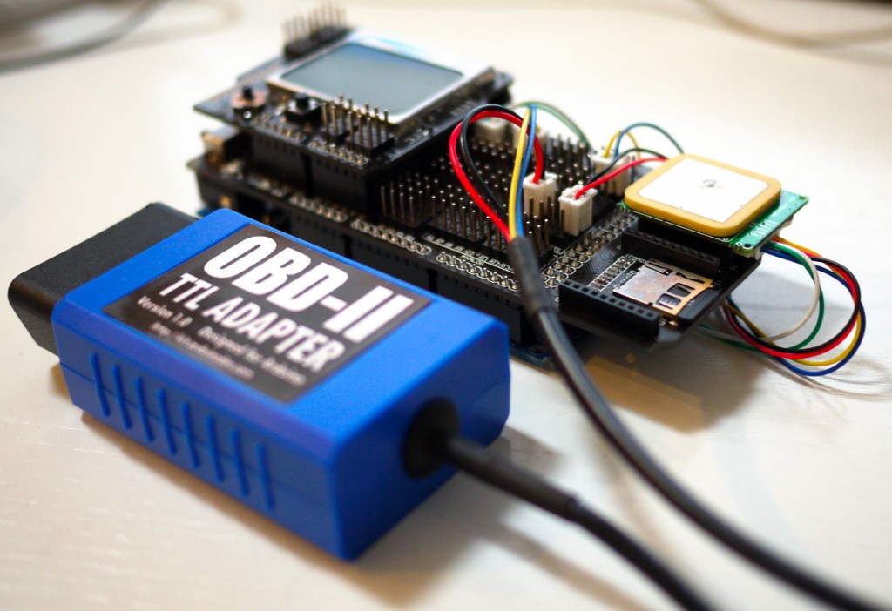
Related work
”The ultimate GPS and OBD-II data logger based on Arduino MEGA”
Designed for vehicle owner/operator to monitor OBDII parameters
No data transmission functionality, stores mined data locally on SD card
Arduino MEGA main board
Arduino MEGA IO extension board
LCD4884 shield for Arduino
MTK3389 GPS receiver (with 5Hz update speed)
OBD-II UART adapter
http://arduinodev.com/ultimate-gps-obd-data-logger-displayer/

Slide 11
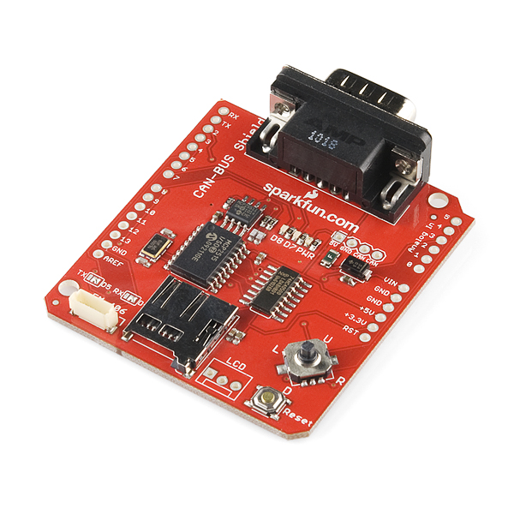
Related work
UAA “CANOPNR” project using Arduino framework
Utilized SIM900 cellular shield to send data to a remote server
GPS module connected directly to CAN board (seen in image below)
MySQL integrated web app was designed to view the data in real-time
Strictly CAN protocol, neglects most vehicles older than 2008
images are CC BY-NC-SA 3.0

Slide 12
OBD II Logger comparison
Device | Stand-Alone | GSM-Enabled | Programmable | GPS | Data Logger | CAN | Approx. Cost (USD)
Bluetooth OBD Scanners |  | √ | √ | √ | √ |  | $150-$500
PC Scan Tools | √ |  |  |  |  | √ | $30-$400
Hem Data Mini Logger | √ |  |  | √ | √ |  | $800-$1500
Car Chip Pro | √ |  |  | √ | √ |  | $305
Data Scout |  |  |  |  | √ | √ | $500
DashDyno SPD ProPack | √ |  |  |  | √ | √ | $320
IOSiX OBD-II Datalogger | √ | Opt. |  | Opt. | √ |  | $700
Arduino/GSM/GPS/OBDII Device | √ | √ | √ | √ | √ | √ | $160

Slide 13
Future research
Cold weather oxygen sensor analysis
Closed vs. Open loop oxygen sensor analysis
Determine effect of colder climates on sensor warm-up time
Discover whether or not it’s feasible to utilize other oxygen sensors designed to operate at extremely low temperatures
Adaptive maintenance strategies
Conditions in which a failure occur can be collected and used for diagnosis

