Slide 1


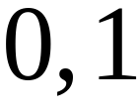
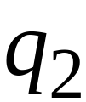
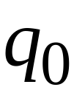


Another NFA Example

Slide 2
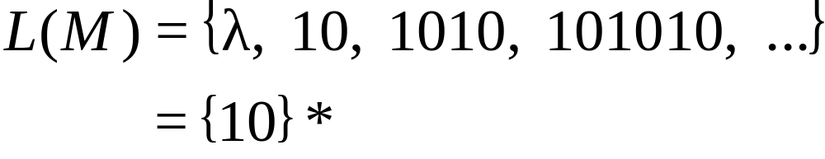
Language accepted
(redundant
state)

Slide 3
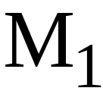
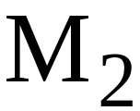
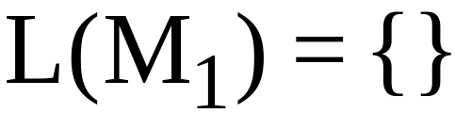
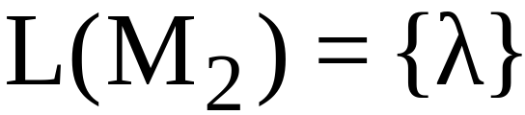
Remarks:
The symbol never appears on the
input tape
Simple automata:

Slide 4




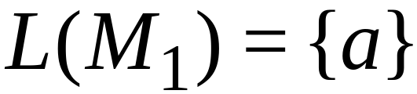
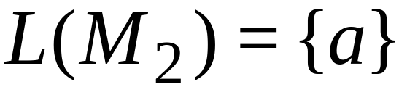
NFAs are interesting because we can
express languages easier than DFAs
NFA
DFA

Slide 5
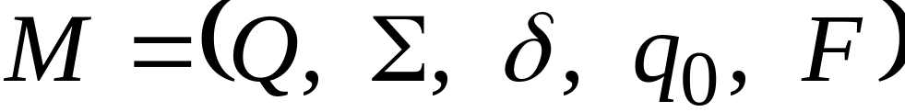
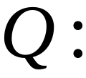
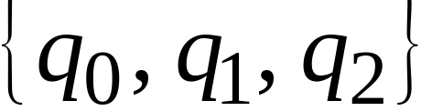

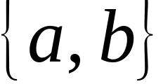

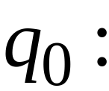

Formal Definition of NFAs
Set of states, i.e.
Input aphabet, i.e.
Transition function
Initial state
Final states

Slide 6

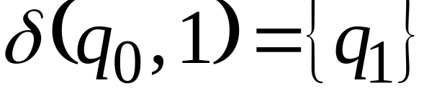
Transition Function

Slide 7
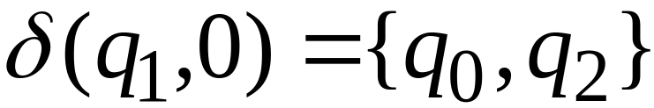

Slide 8
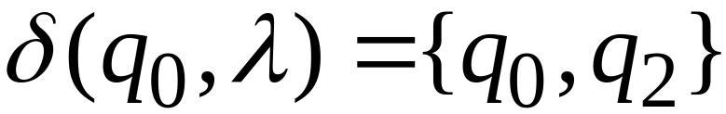

Slide 9
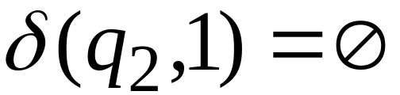

Slide 10

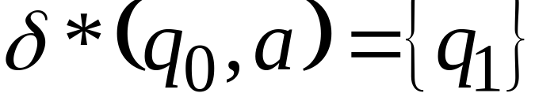





Extended Transition Function

Slide 11
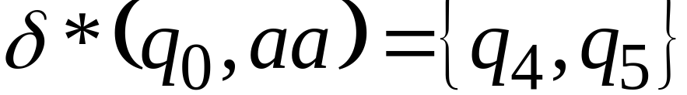

Slide 12
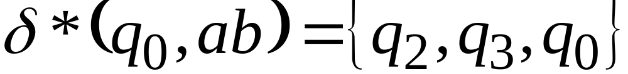

Slide 13
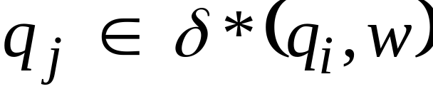

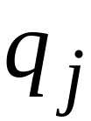




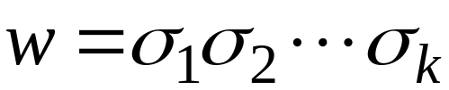



Formally
: there is a walk from to
with label

Slide 14

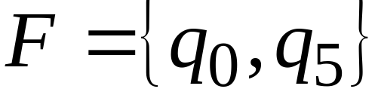
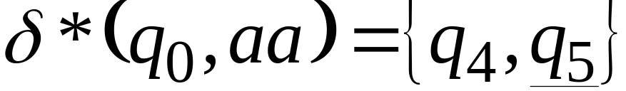
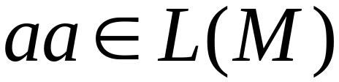

The Language of an NFA

Slide 15
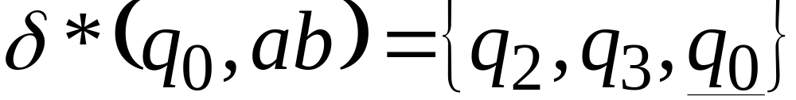
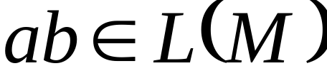

Slide 16
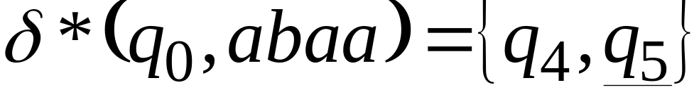
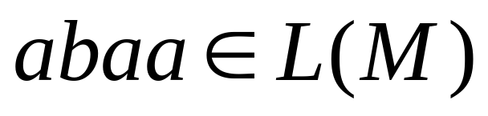

Slide 17
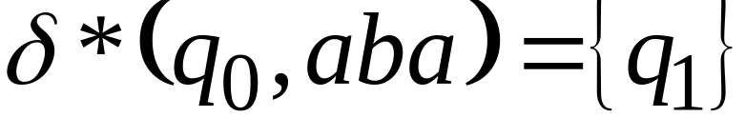
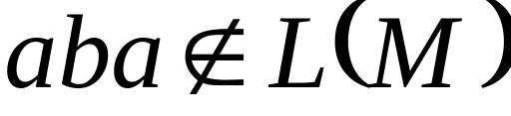


Slide 18
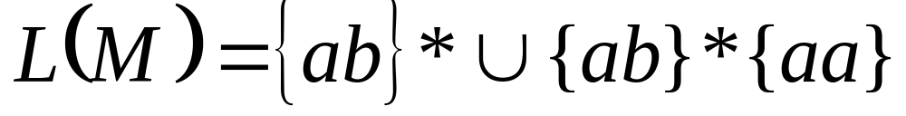

Slide 19
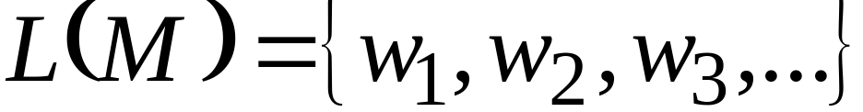
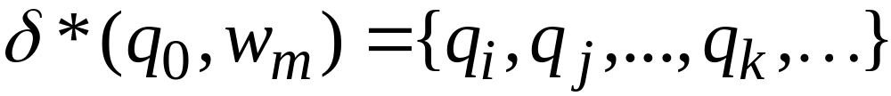
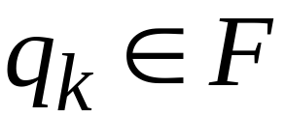
Formally
The language accepted by NFA is:
where
and there is some
(final state)

Slide 20
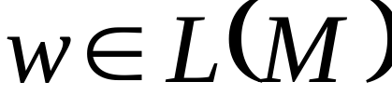
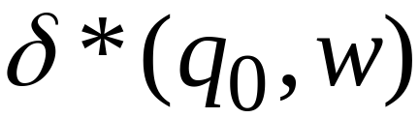





Slide 21
NFA accept Regular Languages

Slide 22


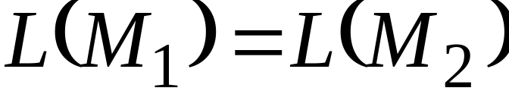
Equivalence of FA
Definition:
An FA is equivalent to FA
if
that is if both accept the same language.

Slide 23

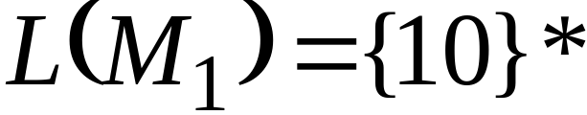


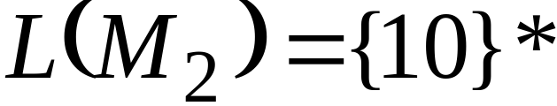
Example of equivalent FA
NFA
DFA

Slide 24

We will prove:
Languages
accepted
by NFA
Regular
Languages
Languages
accepted
by DFA
That is, NFA and DFA have
the same computation power

Slide 25


Step 1
Languages
accepted
by NFA
Regular
Languages
Proof:
Every DFA is trivially an NFA
Any language accepted by a DFA
is also accepted by an NFA

Slide 26

Step 2
Languages
accepted
by NFA
Regular
Languages
Proof:
Any NFA can be converted into an
equivalent DFA
Any language accepted by an NFA
is also accepted by a DFA

Slide 27

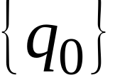
Convert NFA to DFA
NFA
DFA

Slide 28
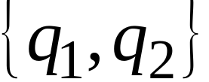
Convert NFA to DFA
NFA
DFA

Slide 29

Convert NFA to DFA
NFA
DFA

Slide 30
Convert NFA to DFA
NFA
DFA

Slide 31
Convert NFA to DFA
NFA
DFA

Slide 32

Convert NFA to DFA
NFA
DFA

Slide 33
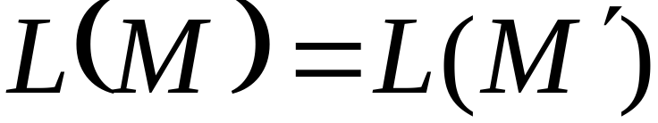
Convert NFA to DFA
NFA
DFA

Slide 34
NFA to DFA: Remarks
We are given an NFA
We want to convert it
into an equivalent DFA
That is,

Slide 35
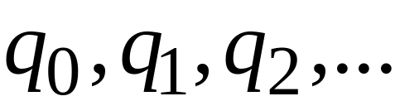
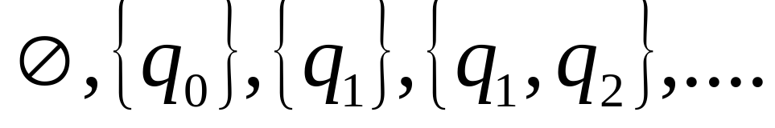
If the NFA has states
Then the DFA has states in the powerset

Slide 36
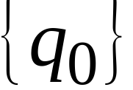
Procedure NFA to DFA
1. Initial state of NFA:
Initial state of DFA:

Slide 37
Example
NFA
DFA

Slide 38
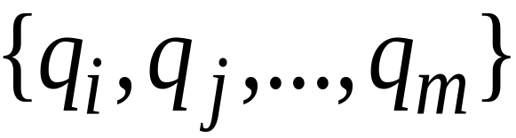


Procedure NFA to DFA
2. For every DFA’s state
Compute in the NFA
Add the following transition to the DFA

Slide 39


Example
NFA
DFA

Slide 40
Procedure NFA to DFA
Repeat step 2 for all symbols in the alphabet ∑, until no more transitions can be added.

Slide 41
Example
NFA
DFA

Slide 42

Procedure NFA to DFA
3. For any DFA state:
If some is a final state in the NFA
Then,
is a final state in the DFA

Slide 43


Example
NFA
DFA

Slide 44

Theorem
Take NFA
Apply the procedure to obtain DFA
Then, and are equivalent:

Slide 45


Proof
AND

Slide 46


First we show:
Take arbitrary string :
We will prove:

Slide 47




Slide 48



We will show that if

Slide 49











More generally, we will show that if in :
(arbitrary string)

Slide 50


Proof by induction on
The basis case:

Slide 51







Induction hypothesis:

Slide 52



Induction Step:

Slide 53



Induction Step:

Slide 54
Therefore if

Slide 55
We have shown:
We also need to show:
(proof is similar)

