Slide 1
BERT
NLP COE
Meet Paradia
3/29/2022

Slide 2
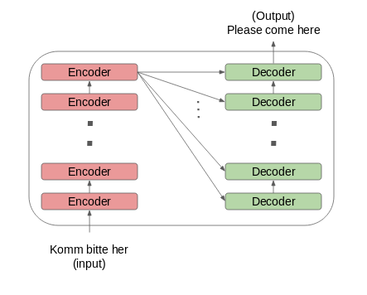
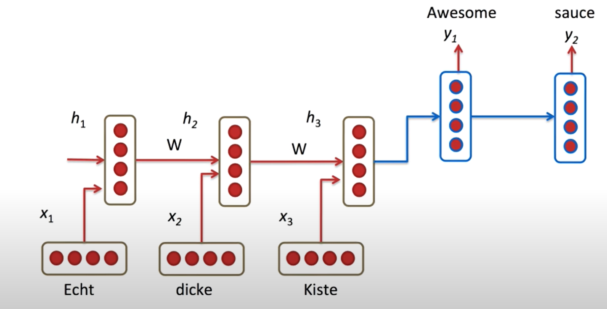
Background
LSTM Network
Transformer
Slow
Not the best at capturing the context
Faster
Deeply Bidirectional – captures context more efficiently

Slide 3
BERT (Bidirectional Encoder Representation from Transformers)
Derived from stacking encoders from the transformer architecture
Advantages
Neural Machine Translation
Question Answering
Sentiment Analysis
Text Summarization
Released in 2 sizes: BERTBASE and BERTLARGE
BERT
GPT

Slide 4
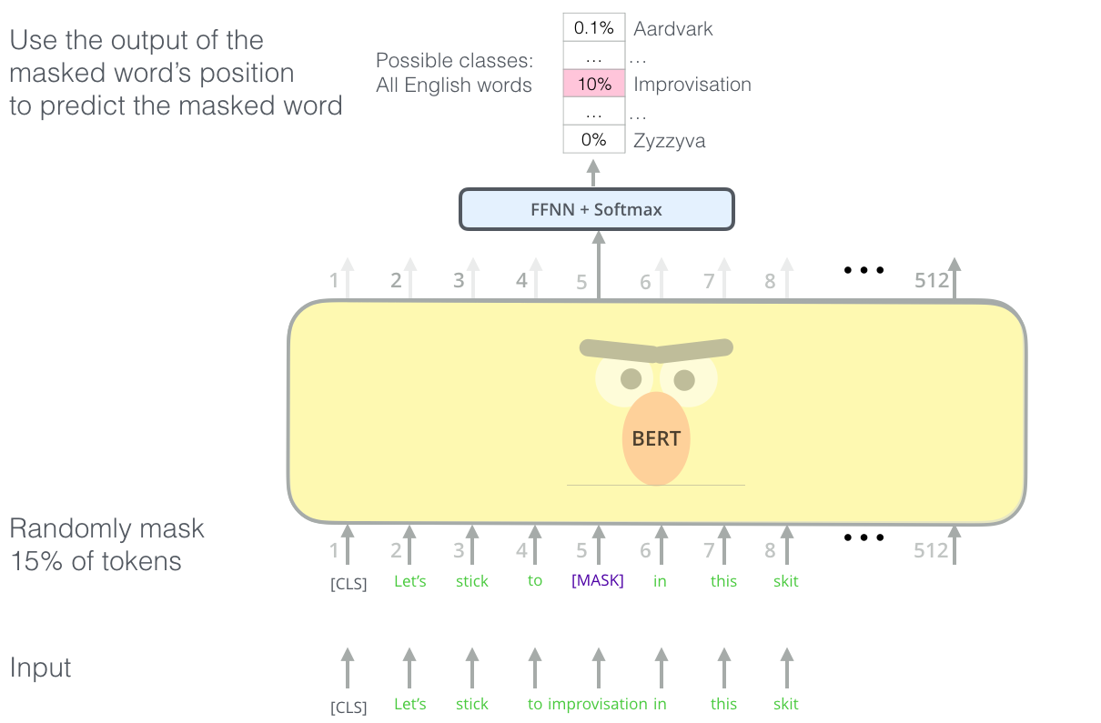
Pre training
Objective: To understand the language and the context
Masked Language Modelling (MLM):
Understand bidirectional context
~15% of words are replaced with a [MASK] token
Prediction is based on the context learned and provided
Loss function considers prediction of masked word only and not the unmasked words

Slide 5
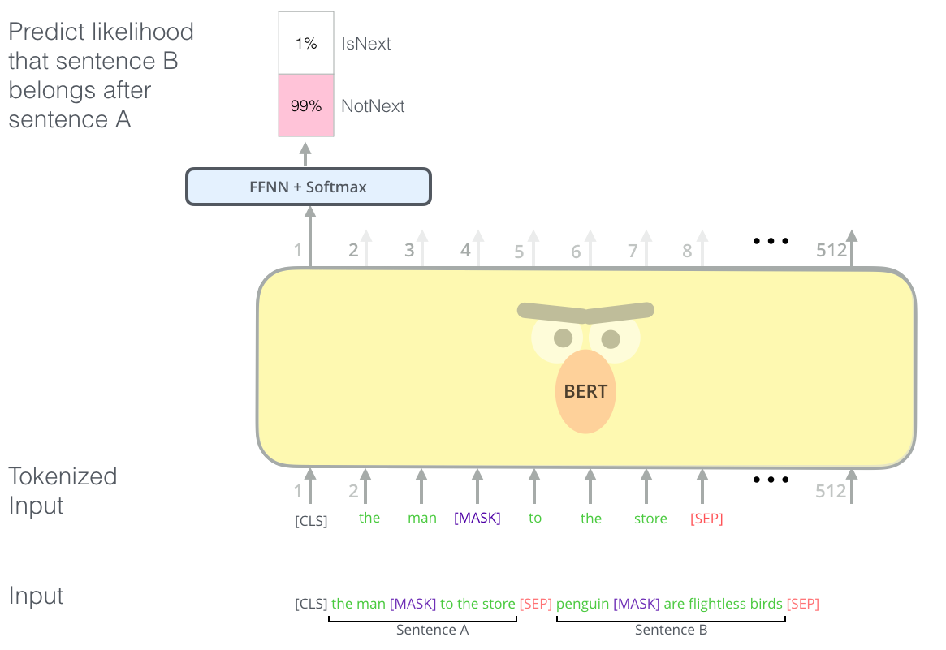
Pre training
Next Sentence Prediction (NSP):
Understand context across different sentences
50% inputs are pairs of contiguous sentences, 50% are random sentences
Token Embedding is the pre trained embedding
Sentence/ Segment Embedding is the sentence number encoded into a vector
Positional embedding is the position of each token

Slide 6
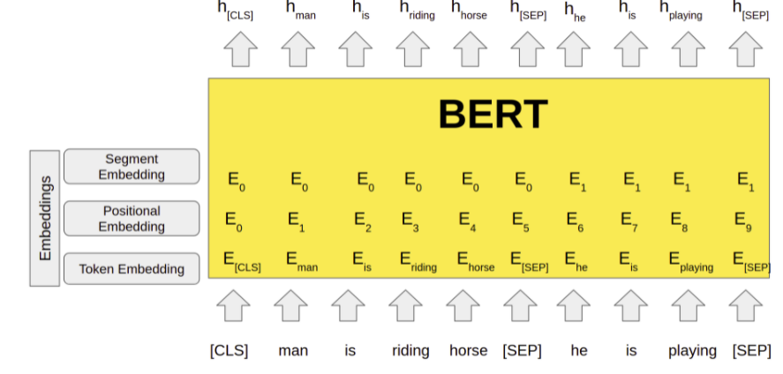
Embedding Layer

Slide 7
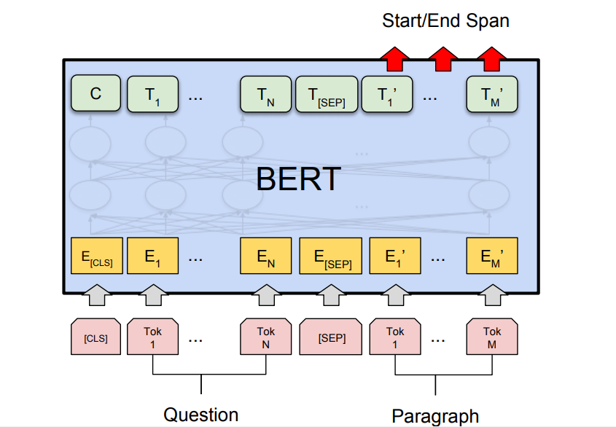
Fine Tuning
Objective: To learn specific task
Supervised training
Takes less time
Replace the fully connected output layers with a fresh set of output layers
Output: start and end words that encapsulate the answer
We assume the that the answer is contained in the paragraph itself

Slide 8
References
https://towardsdatascience.com/bert-explained-state-of-the-art-language-model-for-nlp-f8b21a9b6270
https://huggingface.co/blog/decision-transformers
https://www.geeksforgeeks.org/sentiment-classification-using-bert/?ref=lbp
https://jalammar.github.io/illustrated-bert/
https://www.youtube.com/watch?v=xI0HHN5XKDo&t=356s&ab_channel=CodeEmporium
https://www.analyticsvidhya.com/blog/2021/05/all-you-need-to-know-about-bert/#:~:text=The%20output%20of%20the%20BERT,used%20for%20various%20NLP%20tasks.

