Slide 1
Exploratory Data Analysis Meet Paradia, Kristin Chen, Aishwarya Bhangale, Wenxi Li
NLP COE: Twitter Chatbot
2/24/2022

Slide 2
Training Data
895,514 back-and-forth conversation
794,299 back-and-forth conversation interacted with companies
@sprintcare is the worst customer service,@115712 Hello! We never like our customers to feel like they are not valued.
@sprintcare is the worst customer service,@115712 I would love the chance to review the account and provide assistance.
@sprintcare is the worst customer service,"@115712 Can you please send us a private message, so that I can gain further details about your account?“
somebody from @VerizonSupport please help meeeeee 😩😩😩😩 I'm having the worst luck with your customer service,"@115719 Help has arrived! We are sorry to see that you are having trouble. How can we help?^HSB“
amazonのfireTVstickが見れない😢,@115770 こんにちは、アマゾン公式です。Fire TV Stickが見れないというのは、どのような状況でしょうか。一般的なトラブルシューティングを記載したヘルプがございますので、ご参照ください。https://t.co/2pbG55qJ7h E

Slide 3
Twitter Agent Description
With 1.5MM total responses sent by Twitter agents and 1.27MM total responses received, following is a table showing agents classified into various businesses.
Business Name | Agents
Airline | AirAsia Support, Delta, AmericanAir, SouthwestAir, VirginAtlantic, AlaskaAir, VirginAmerica, JetBlue
Software | AdobeCare, YahooCare, SpotifyCare, AskeBay, DropBoxSupport, AzureSupport, GoDaddyHelp, asksalesforce, GooglePlayMusic, OfficeSupport, TwitterSupport, NortonSupport, SCsupport, AWSSupport, mediatemplehelp, AskTigogh, PandoraSupport, AmazonHelp
Super Market | Morrisons, Tesco, sainsburys, ArgosHelpers, AskTarget, Walmart, AldiUK
Transport | Nationalrailenq, AskLyft, UPSHelp, VirginTrains, GWRHelp, TfL, LondonMidland
*Additional business include Beauty, Education, Clothing, Electronics, Finance, Food, Gaming, Hotel and Rentals

Slide 4
Most Frequently Used Words By Customers
Agent | Responses Sent | Responses Received | Most Common Words Used By Customer
 |  |  | 1st | 2nd | 3rd | 4th | 5th
Sprintcare | 22,381 | 13,876 | phone | store | bill | account | upgrade
ChipotleTweets | 18,749 | 21,593 | burrito | order | queso | bowl | chip
XboxSupport | 24,557 | 28,083 | update | account | live | buy | console
JetBlue | 8,020 | 9,475 | delay | seat | book | bag | cancel
AskPayPal | 11,298 | 10,164 | account | money | bank | card | hold

Slide 5
Sentiment Analysis
Filtered top 20 companies with maximum tweets (to and from customers)
Performed sentiment analysis on the tweets by customers and responses by agents
Negative statement: -1 to -0.36
Neutral statement: -0.35 to 0.33
Positive statement: 0.34 to 1
Company | Response to customer |  |  | Customer tweet to agent
 | negative | neutral | positive | negative | neutral | positive
Southwest Air | 8.31% | 29.81% | 61.88% | 12.77% | 41.42% | 45.81%
Delta | 7.78% | 39.33% | 52.90% | 14.03% | 45.93% | 40.03%
Spotify | 2.85% | 42.17% | 54.99% | 9.95% | 54.46% | 35.60%
Chipotle | 9.44% | 55.75% | 34.81% | 17.13% | 48.74% | 34.14%
American Air | 6.36% | 39.09% | 54.55% | 19.53% | 46.54% | 33.94%
Target | 2.55% | 22.55% | 74.91% | 11.32% | 54.85% | 33.82%
Lyft | 3.88% | 62.14% | 33.98% | 15.97% | 55.05% | 28.98%
PlayStation | 10.54% | 53.54% | 35.92% | 16.18% | 56.03% | 27.79%
Amazon | 8.88% | 56.18% | 34.94% | 13.32% | 61.12% | 25.56%
Apple | 0.80% | 30.91% | 68.30% | 19.47% | 57.69% | 22.84%

Slide 6
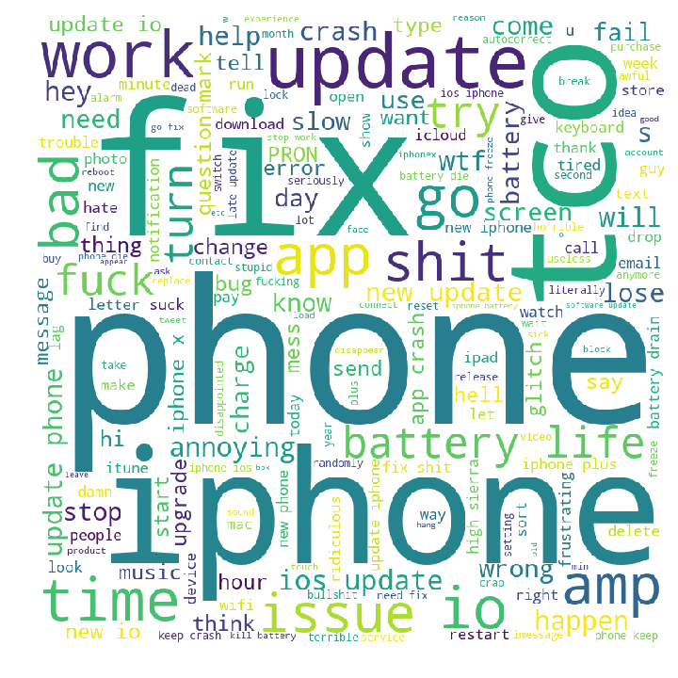
Apple negative user tweets
Word | Count
update | 4,889
phone | 4,680
iphone | 3,903
ios | 3,610
fix | 3,208
battery | 2,429
tco | 2,077
app | 1,970
work | 1,445
crash | 1,403

Slide 7
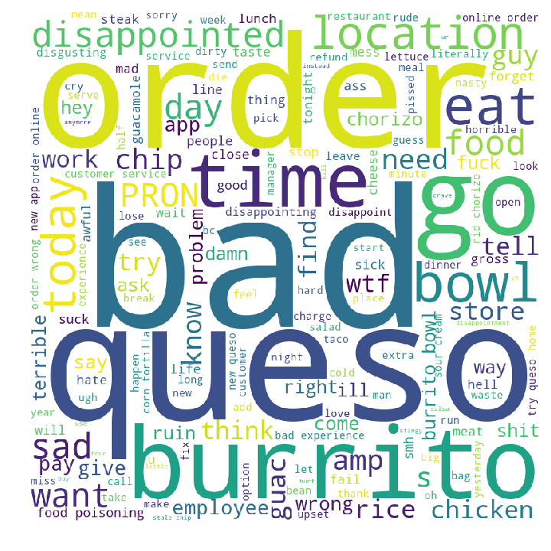
Chipotle negative user tweets
Word | Count
order | 494
queso | 440
bad | 413
bowl | 352
burrito | 345
time | 293
food | 246
eat | 231
chip | 222
location | 182

Slide 8
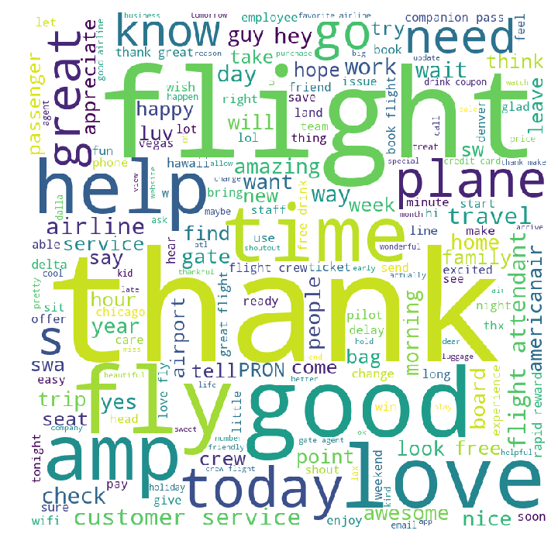
Southwest Airline positive user tweets
Word | Count
thank | 4,570
flight | 4,268
fly | 1,812
good | 1,705
love | 1,425
great | 1,322
help | 916
like | 872
time | 871
service | 811

