Slide 1
The role of resveratrol on aging transcriptome in oocytes
Unsupervised Machine Learning

Slide 2
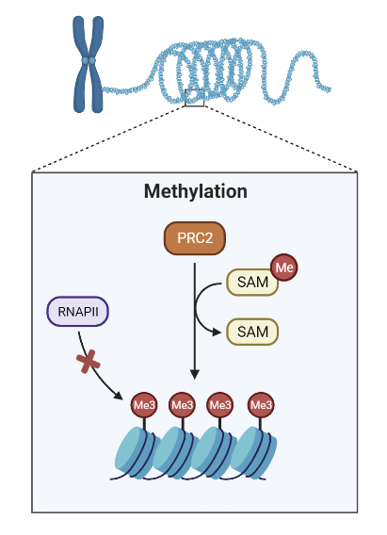
Background
As we age, changes occur in the way our genes are expressed. These patterns of gene expression, referred to as the aging transcriptome, are studied to unravel the molecular mechanisms of the aging process.
A way gene expression changes is through epigenetics, which are chemical modification (e.g., methylation) on the DNA that can switch a gene on or off.

Slide 3
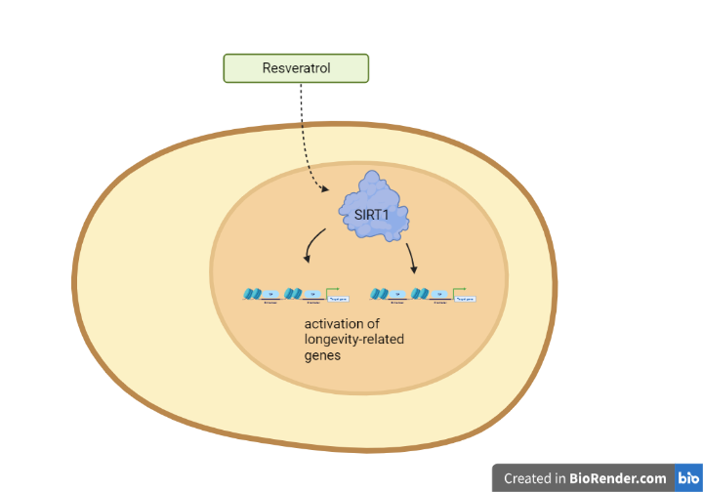
Background: Potential life prolonging benefit of resveratrol
Resveratrol, a compound found in the skin of red grapes, have been shown to have lifespan prolonging effects in organisms such as C. elegans and mice.
Resveratrol exerts its effects is via SIRT1, an enzyme that modifies gene expression through epigenetics.

Slide 4
Aging and infertility
Aging-associated infertility is partially contributed by altered gene expression.
This analysis sought to examine the aging transcriptome and whether resveratrol can reprogram the aging transcriptome.

Slide 5
Research Question
Can resveratrol reverse aging-related gene expression in mice oocytes (e.g., egg cells)?

Slide 6
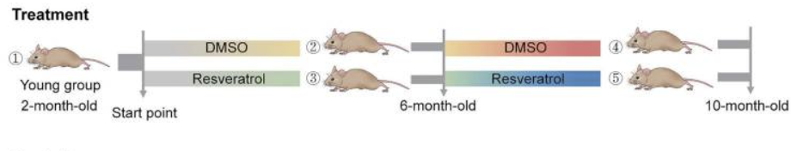
Experimental conditions:
Group name | Age (months) | Resveratrol?
YWT | 2 | -
MWTC | 6 | -
MWTR | 6 | +
OWTC | 10 | -
OWTR | 10 | +

Slide 7

Dataset: gene expression levels under different experimental conditions
Genes
Oocyte samples
Source: https://www.ncbi.nlm.nih.gov/geo/query/acc.cgi?acc=GSE184635

Slide 8
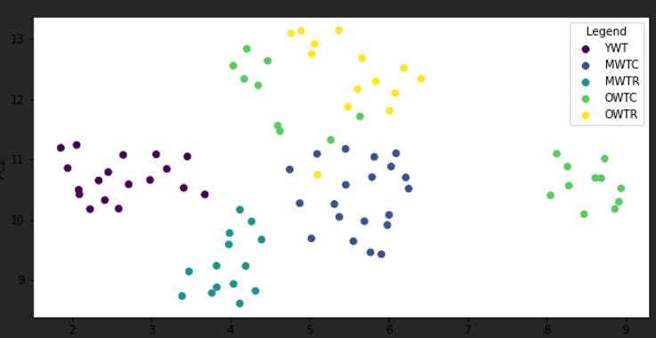
Data visualization
Umap plot based on mice oocyte transcriptome data.
Legend | Age (months) | Resveratrol?
YWT | 2 | -
MWTC | 6 | -
MWTR | 6 | +
OWTC | 10 | -
OWTR | 10 | +

Slide 9
Agglomerative Clustering:
 | Adjusted Rand Index | Silhouette score
KMeans | 0.77 | 0.54
Hierarchical - Ward | 0.41 | 0.49
GMM | 0.76 | 0.54

Slide 10
Conclusion
KMeans and GMM clustering algorithms identified the distinct experiment groups with reasonable accuracies. This reflects that there are distinct differences in the transcriptome across different experimental conditions.
More specifically, middle-aged (6-mo) mice treated with resveratrol is differentiable from middle-aged mice without intervention. The distinction among old mice, however, is not as clear.

Slide 11
Outlook
While the findings obtained from mice may have limited relevance to humans, comprehending the molecular mechanisms of reproductive aging can still provide valuable insights into human health. The significance of reproductive health has grown as more women are choosing to delay childbirth compared to previous years.

