Slide 1
Card Fraud Data: Fraud detection analysis based on merchant category, location, transaction time, and amount
Individual assignment
Kristina Kazlauskaitė
2025

Slide 2
Task overview
Dataset: Card fraud data (1.2M+ transaction records)
Goal: identify fraud characteristics using PySpark for big data processing. To examine fraud patterns across multiple features, including merchant categories, transaction amounts, geographic distribution, and time of day

Slide 3
Method and approach
Parallel data processing with PySpark DataFrames
Statistical aggregation and grouping
Time-series analysis for temporal patterns
Geographic analysis for location-based insights
Data visualization for result presentation

Slide 4
Implementation
fraud_analysis.py
├── Java setup configuration
├── Spark session initialization
├── Data loading and preprocessing
├── Fraud analysis functions:
│ ├── analyze_fraud_by_category()
│ ├── analyze_fraud_amounts()
│ ├── analyze_geographic_patterns()
│ └── analyze_time_patterns()
├── Visualization generation
└── Summary table generation

Slide 5
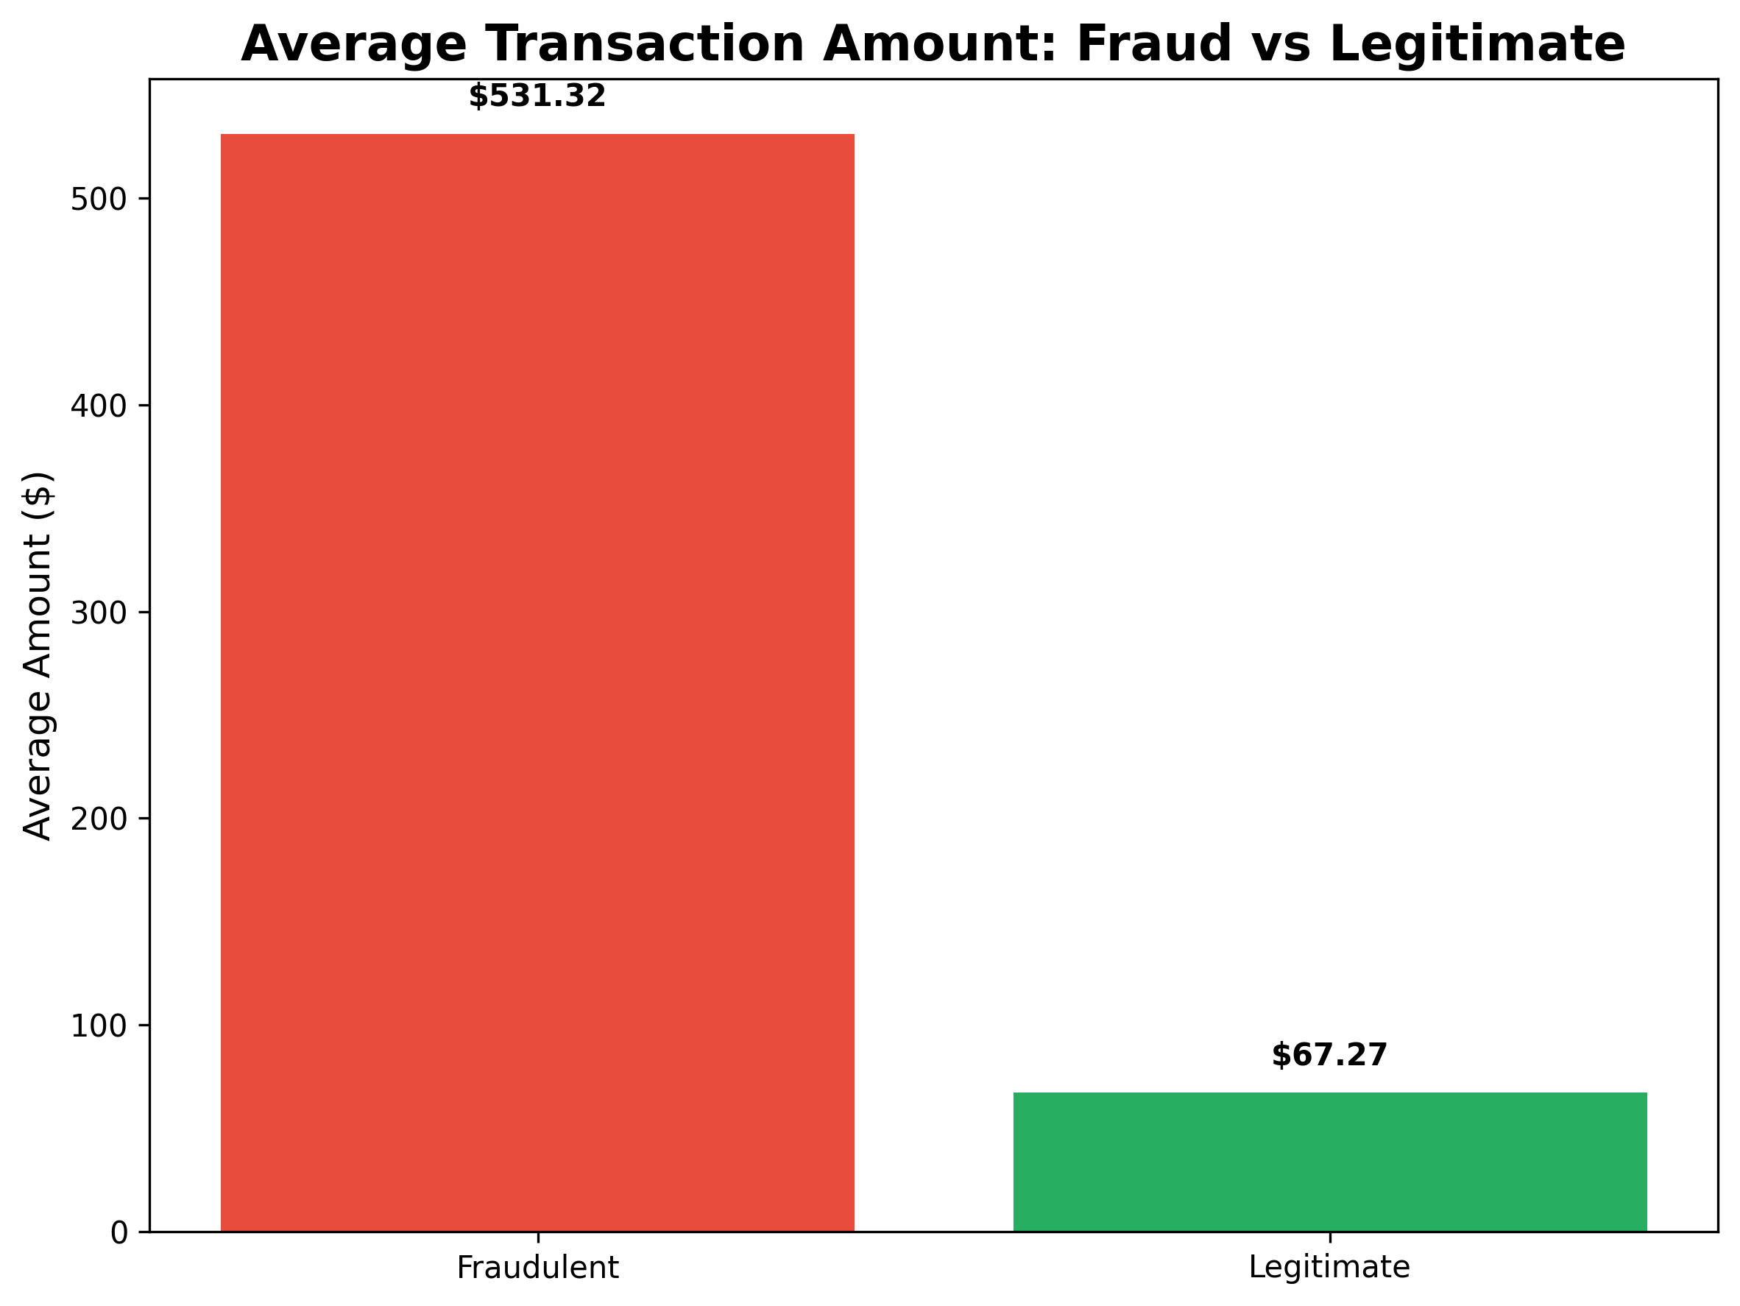
Results I
Fraud rate: 0.58%
Fraudulent transactions are 8 times larger than legitimate ones.

Slide 6
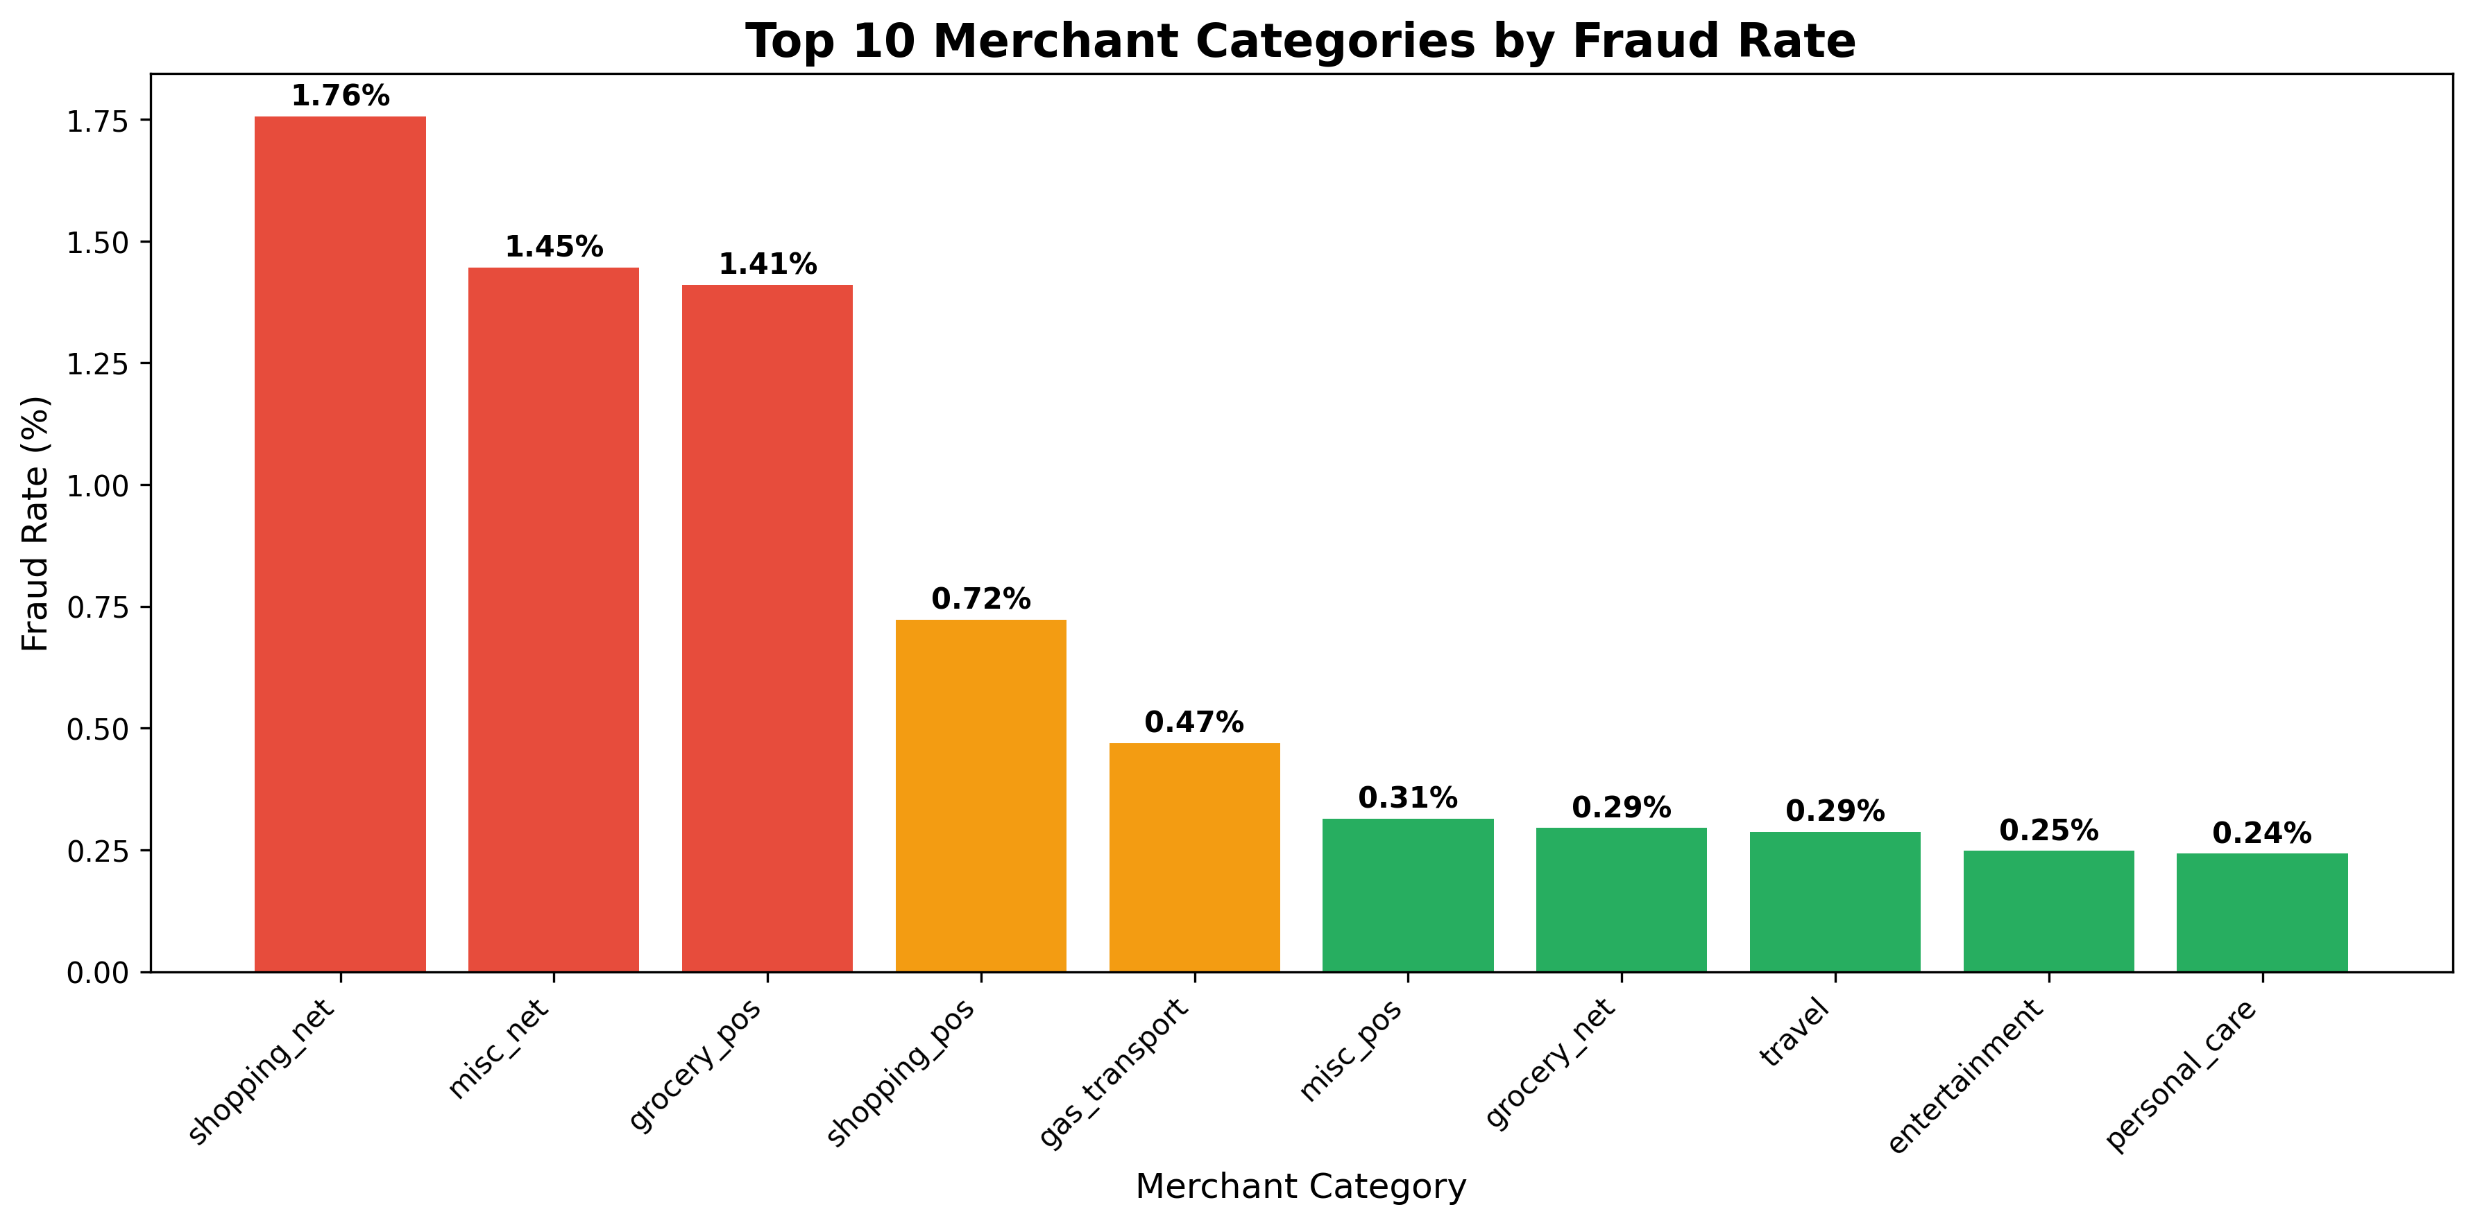
Results II
Highest risk categories: Shopping NET, Misc NET, Grocery POS

Slide 7
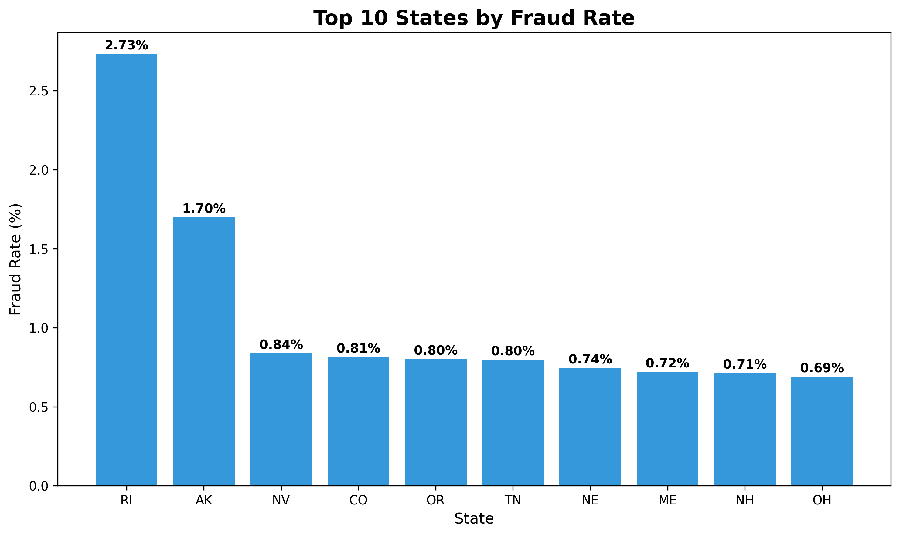
Results III
Top states by fraud rate: Rhode Island, Alaska, Nevada

Slide 8
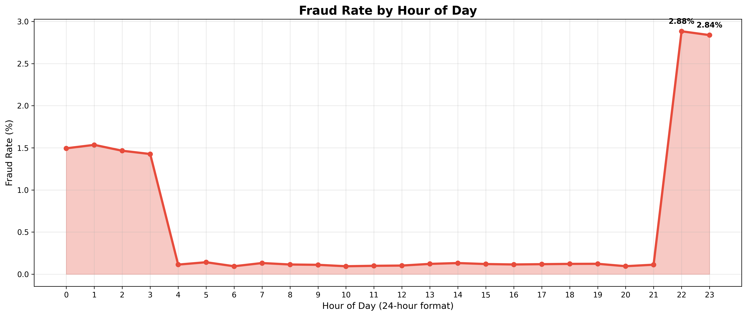
Results IV
Peak fraud hours: 22:00-23:00

