Slide 1
Notes on data
I am using the original manually extracted small dataset as it has all correct information needed
Issues with updated large dataset:
Many follicle measures that do not add up → new dates for the different follicle count/size scans, dates do not match between the 2 datasets, needs to be clarified, all measures for one follicle parameter should be from the same date for it to be consistent, cannot use any extra info without knowing if all of the measures are from the same scan
Follicle counts per size do not add up to total baseline or final follicle count? Possibly from some other scan? Or missing info?
Natural follicle count in new dataset = Baseline total follicle info in manual small dataset
But basically, all missing
Although there is info on if the patient had multiple cycles (in the form of dates and patient entered into multiple rows), there is no parameter telling me the cycle number → the first entered cycle might actually be their 2nd/3rd etc. → the manual dataset tells us this, sometimes a patient was entered for the first time on their 3rd cycle, so I exclude from the first analysis
Cannot just assume - important to know and differentiate between the cycles as that will inform protocol choices
Large dataset has no info on FSH/hMG dose changes → just tells us total dose, cannot make assumptions on daily doses, and days of stimulation
Sometimes says the starting protocol dose
But dividing total/starting dose to calculate days of stim gives decimals, suggesting the dose was changed
Large dataset has no info on days of stim → cannot assume doses and they are mainly missing
The large dataset has no information on Fyramadel/GnRH antagonist (always starts from day 6), could calculate duration if we knew days of stim, but this is missing, do not know dose either
No information on whether the patient had a dual trigger (hCG & GnRH) → just says a single trigger medication and dose, in the manual patient dataset there was this info, so datasets do not add up
Number of mature oocytes (D0, D16), number inseminated → lots of oocyte measures which don’t add up/make sense
Age of patients: in manual dataset: 36.4, in big dataset 36.5 → possibly some rounding issue during extraction?

Slide 2
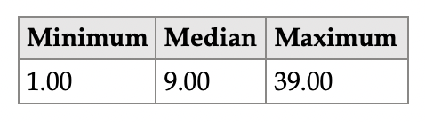
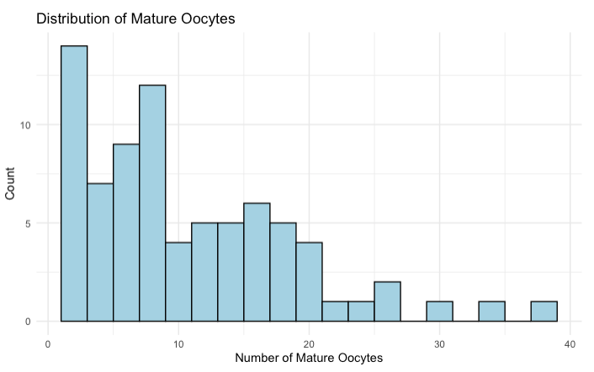
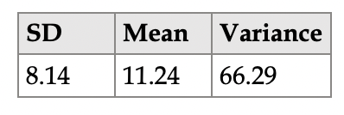
N=78
Rightly skewed distribution
Mean is greater than median
Over dispersed data → the variance is much greater than the mean

Slide 3
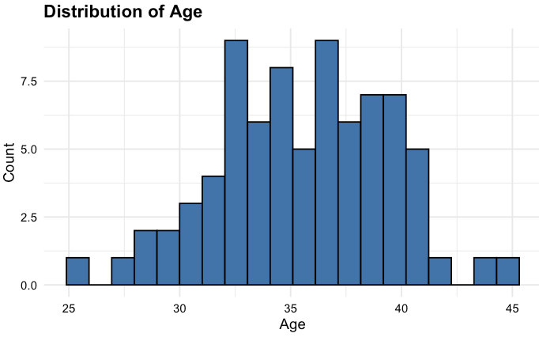
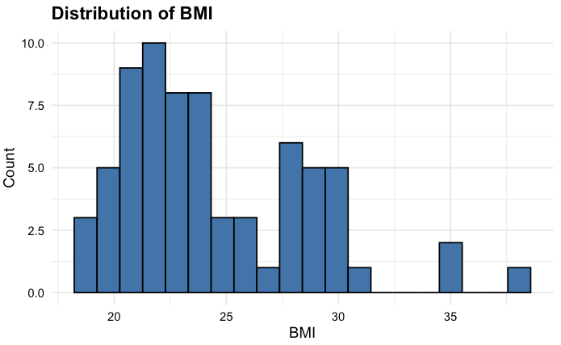
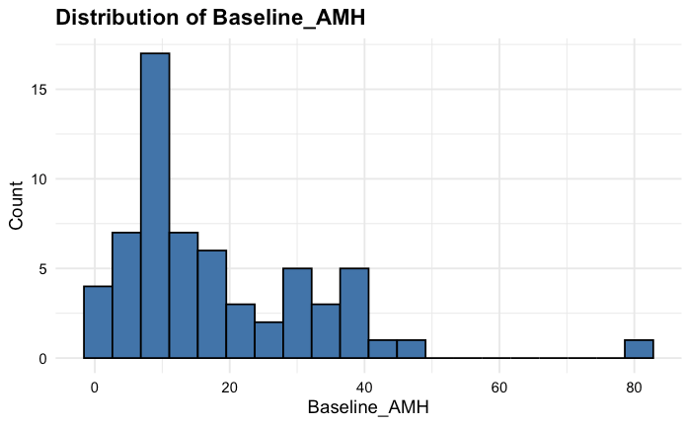
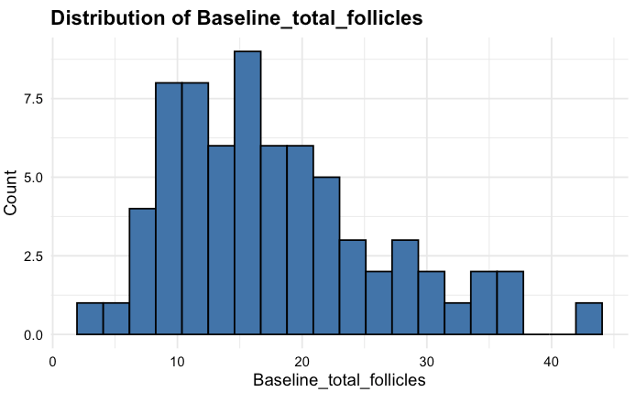
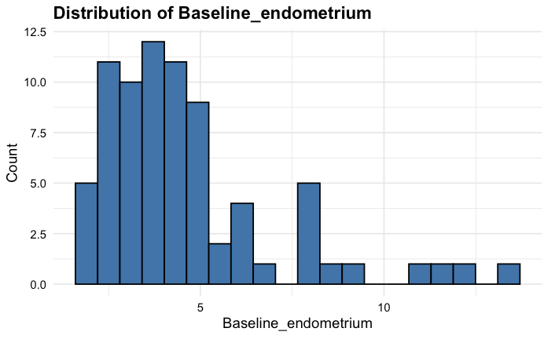

Slide 4
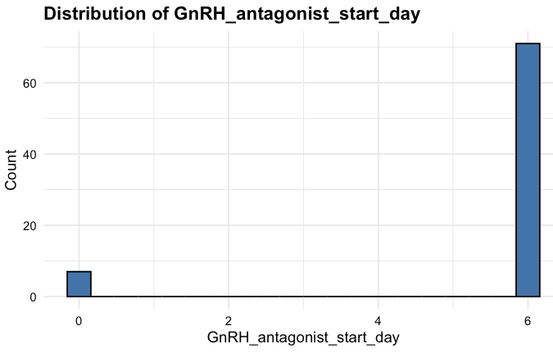
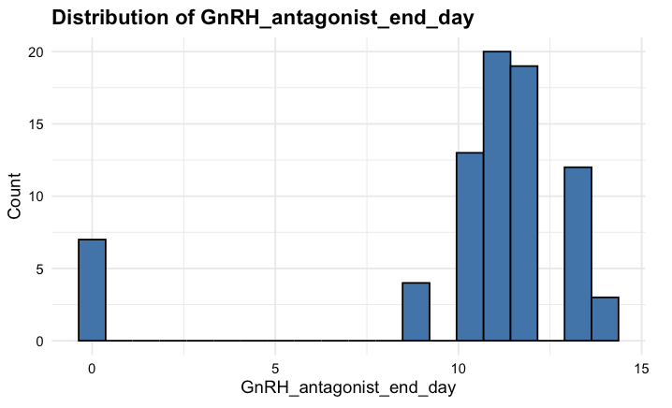
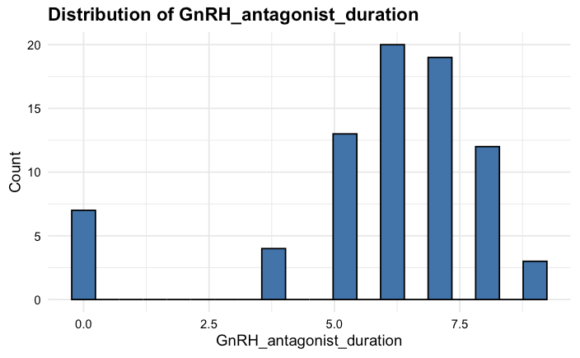
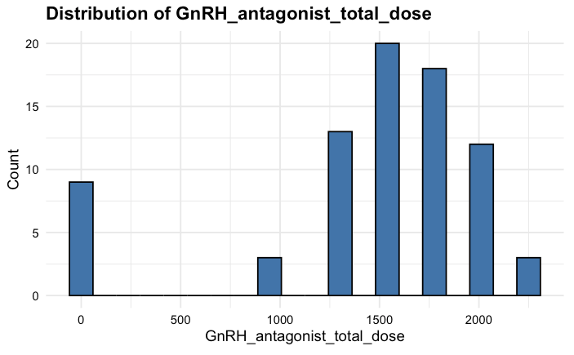

Slide 5
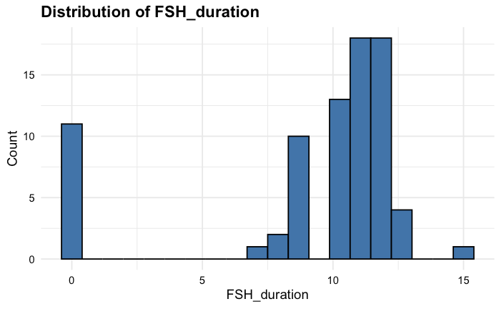
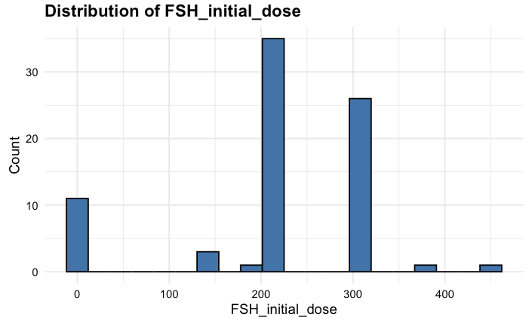
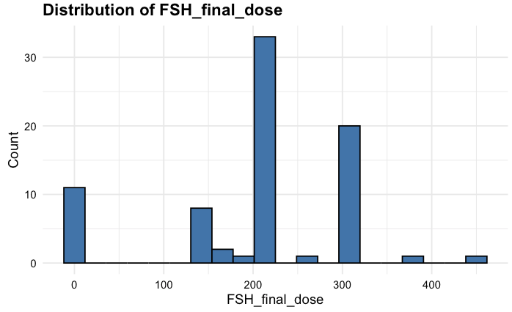
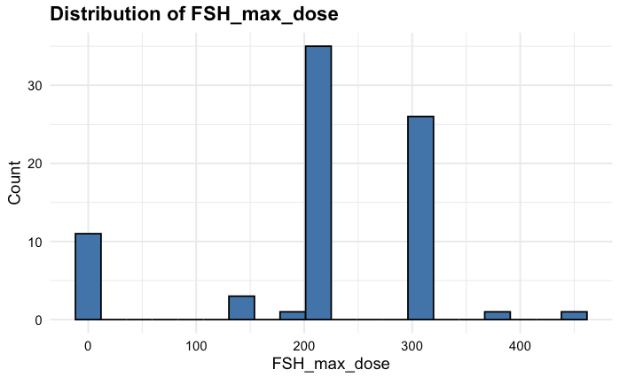
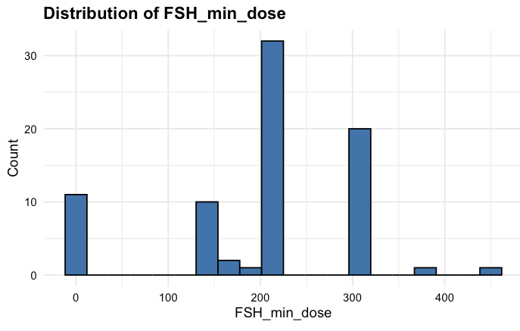
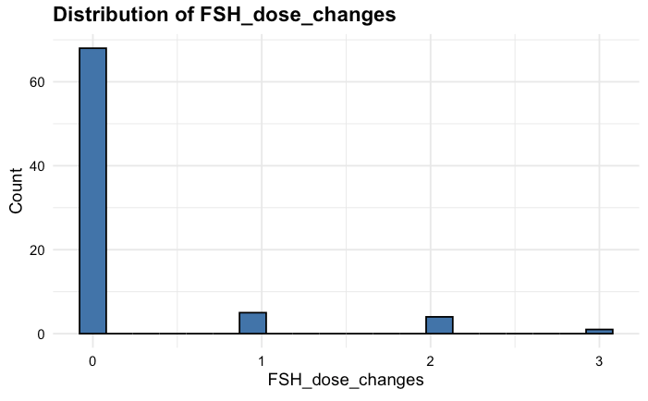
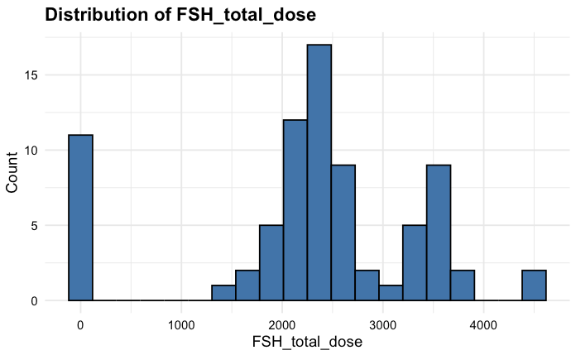
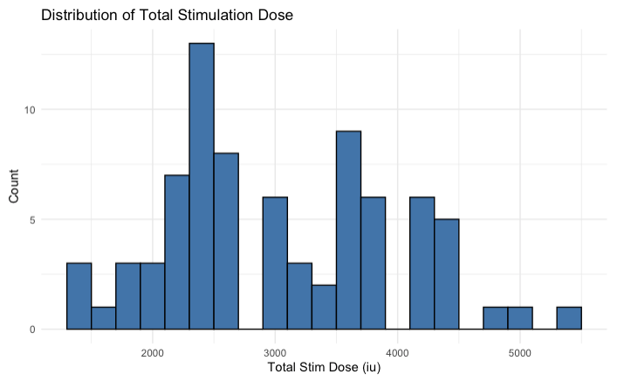

Slide 6
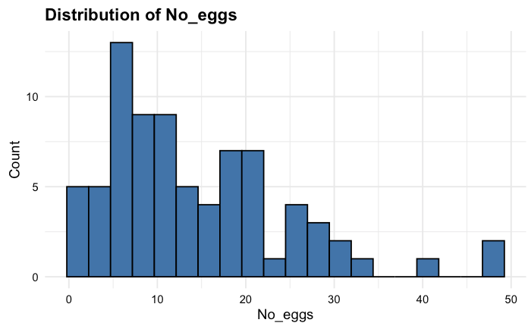
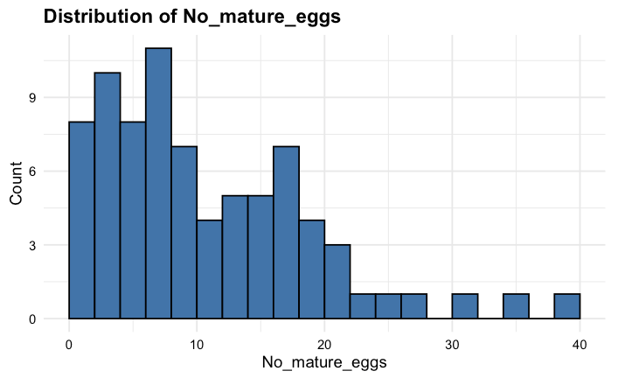
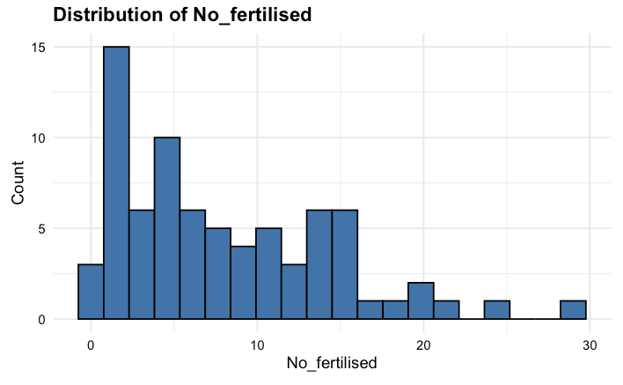
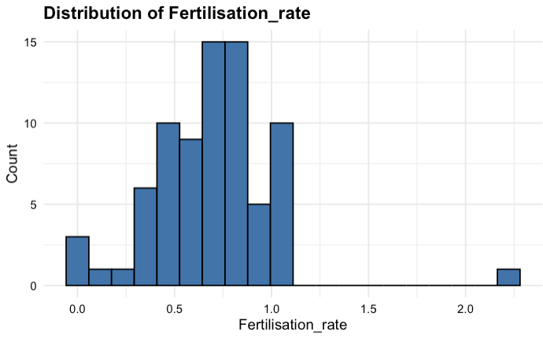

Slide 7
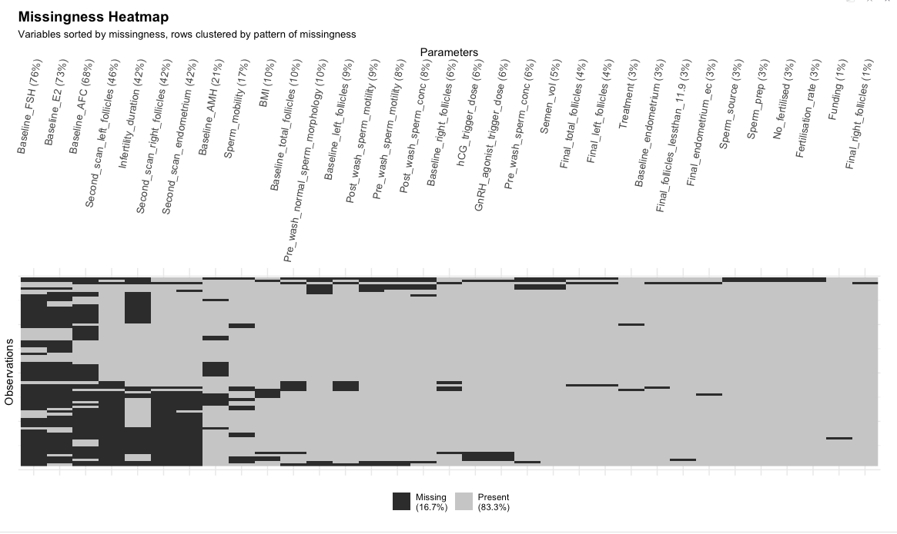

Slide 8
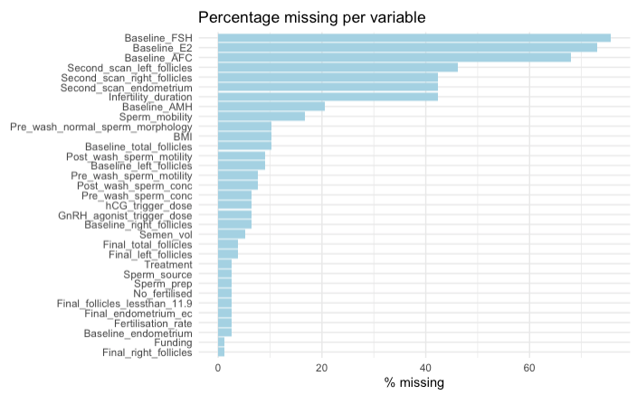
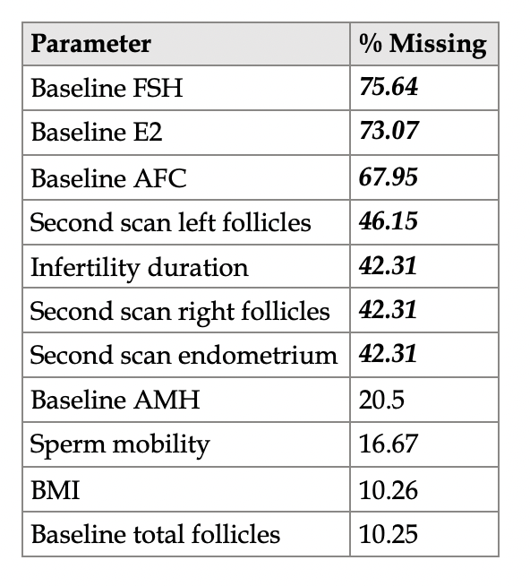
Missingness

Slide 9
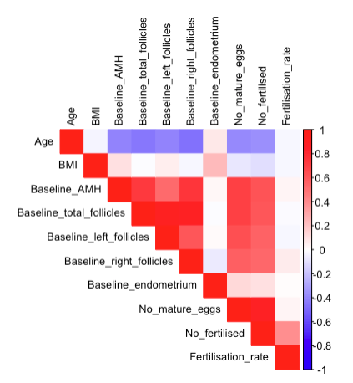
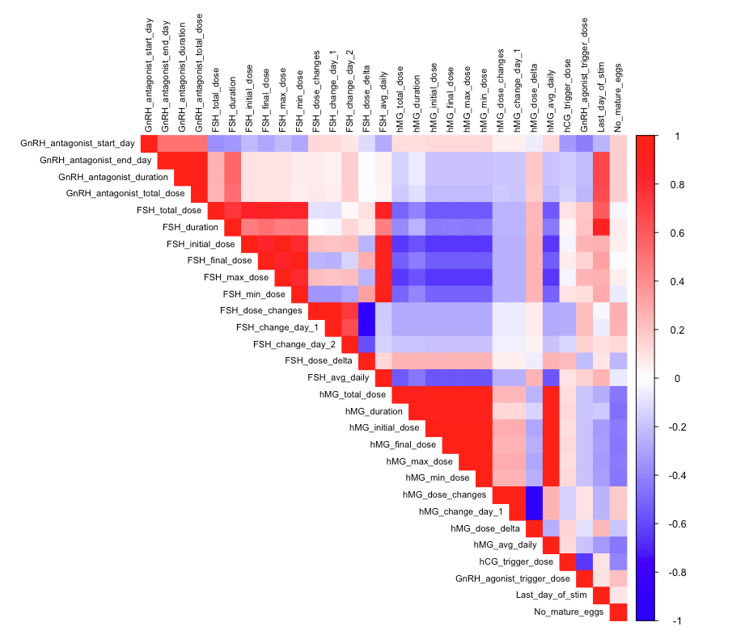
Baseline parameters
Protocol parameters

Slide 10
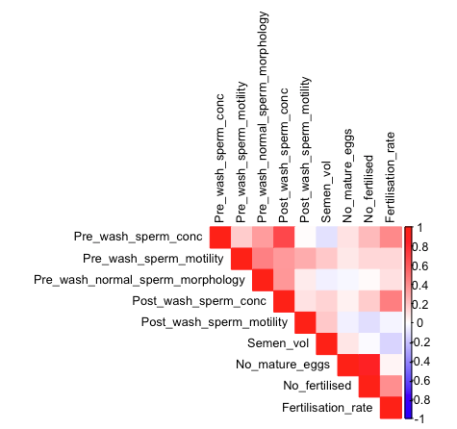
Male parameters

Slide 11
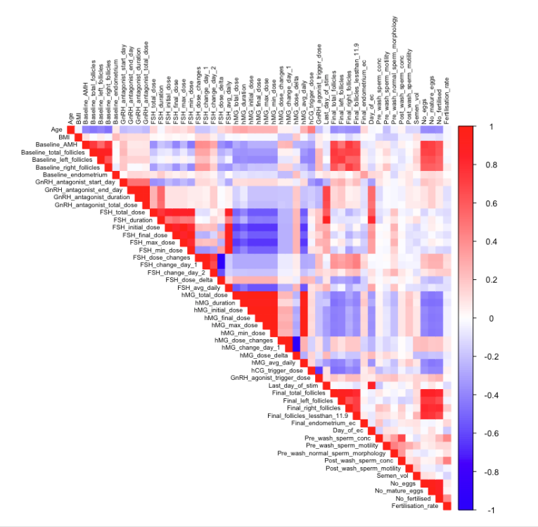
All parameters – including near end parameters which will be excluded from analyses

Slide 12
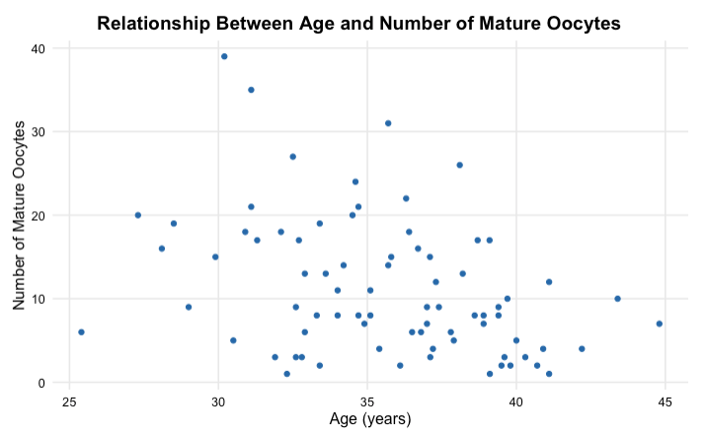
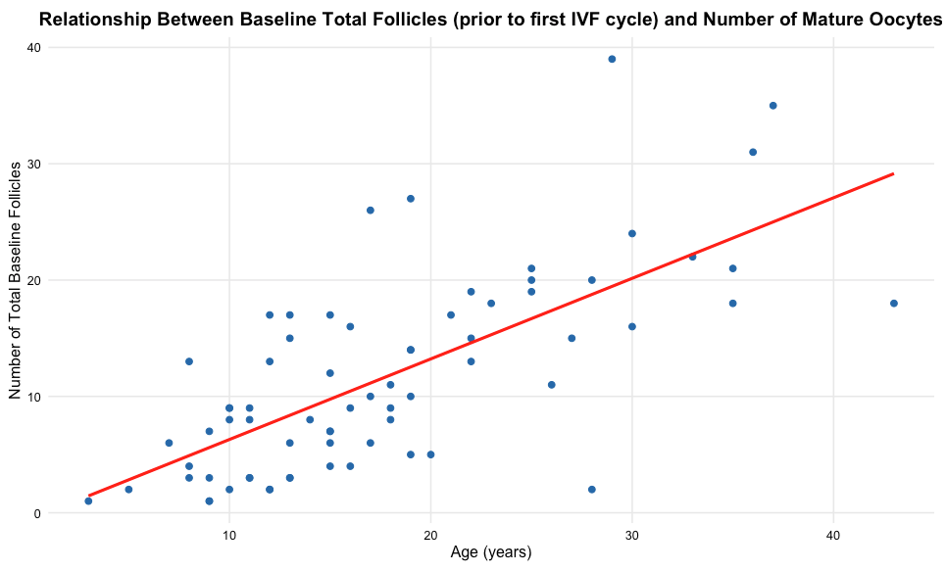
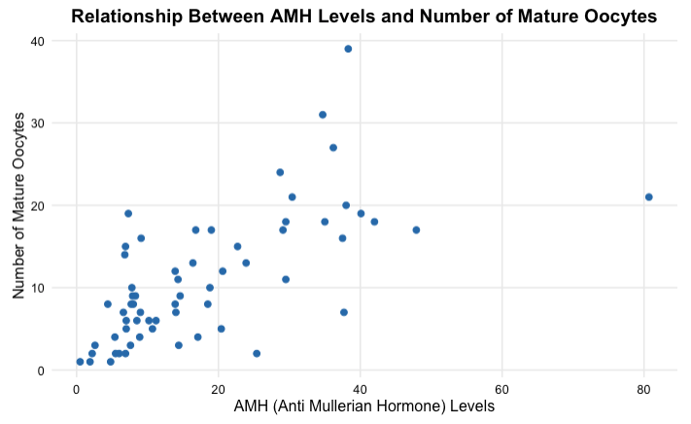
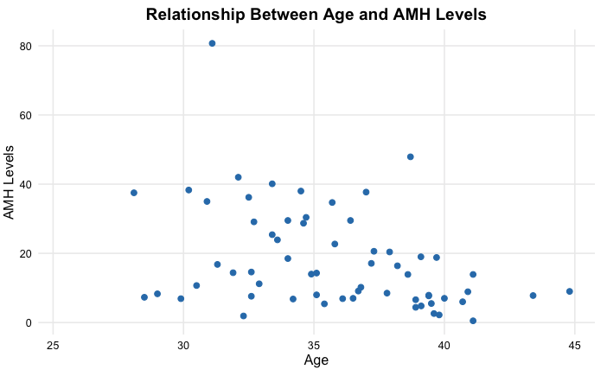

Slide 13
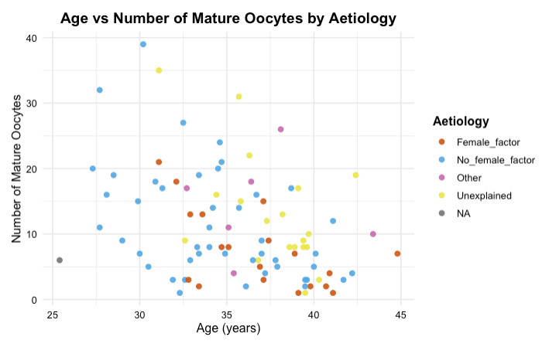
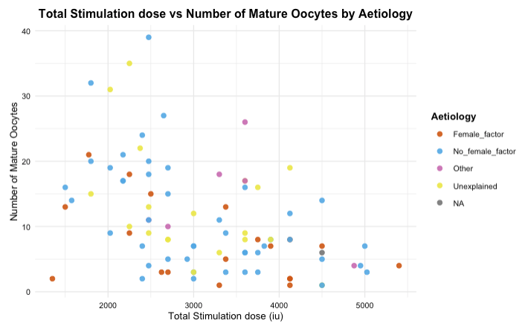
Notes:
Have got other graphs on FSH dose and hMG dose individually
Boxplots too

Slide 14
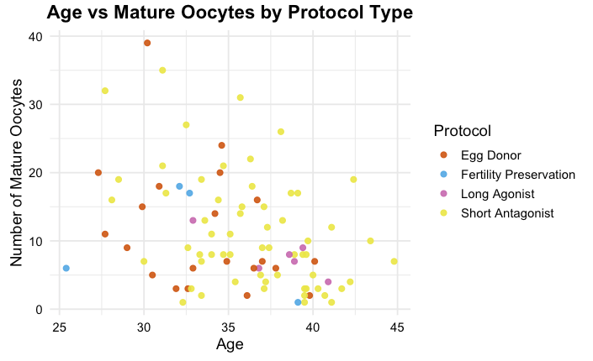
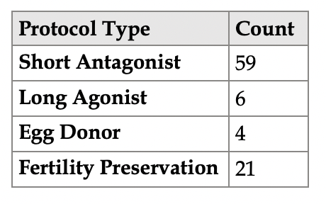

Slide 15
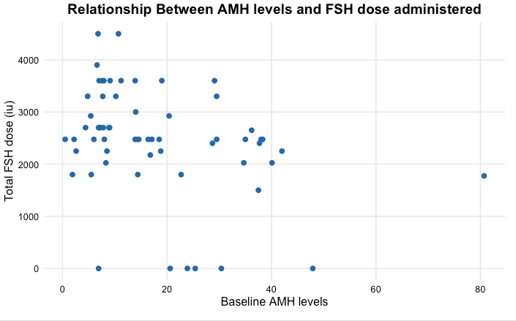
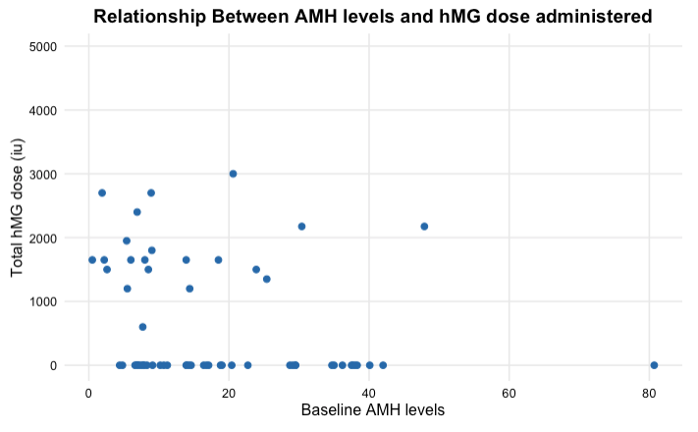
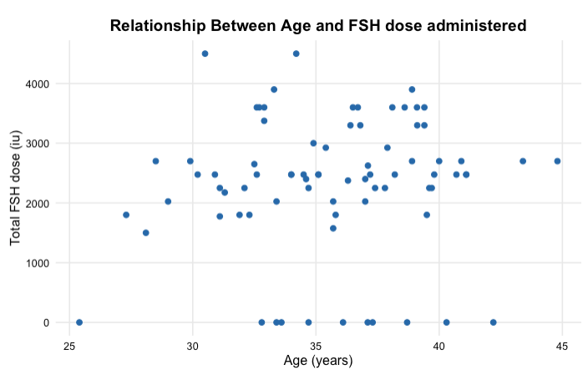
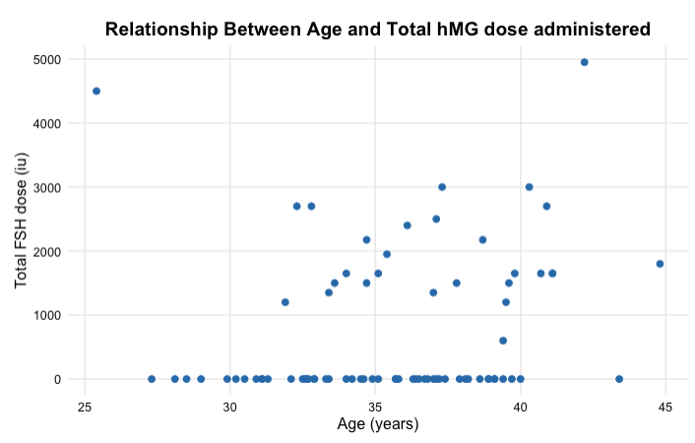
Dose is not random
Very high variability
FSH
Low AMH → wide range of doses
Higher AMH → slightly lower doses
Clinicians may adjust dose based on ovarian reserve/AMH
Very large spread → inconsistent decision making
Probs something else involved
Older patients → slightly higher dose of FSH? Noisy
hMG
Not used in many patients
hMG doses appear more in lower AMH patients
hMG is likely used selectively, in patients with low ovarian reserve/AMH or poor responders?
In model hMG had a negative association with outcome because it is given to worse prognosis patients?
Appears slightly more frequent in older patients
Dose may not be predictive as clinicians adjust dose based on profile --> effect is confounded
Notes:
Gonadotropin dosing appears to be influenced by ovarian reserve/AMH
Perhaps to a lesser extent by age
Substantial variability → inconsistency in clinical decision-making
Negative Binomial Regression model (Mature eggs ~ AMH + Dose) did not show dose effects → AMH explains everything and dose adds little independent info
Model showed negative effects of hMG (hMG → fewer eggs)
- Low AMH → administer hMG → fewer eggs
Dose is correlated with AMH
FSH total dose x AMH = -0.36
FSH final dose x AMH = -0.40
FSH min dose x AMH = -0.45
FSH dose changes x AMH = 0.41
FSH change day 1 = 0.40
FSH avg daily = -0.43
hMG duration = -0.34
hMG total dose = -0.28
Clinically 2 decisions: give hMG (y/n), if y how much?
hMG likely used in poorer responders, low AMH patients, maybe older
Explore: treatment is not random --> it is assigned based on patient characteristics/profile
Treatment assignment modelling → which patient characteristics influence the dose prescribed, model dose classes and the probability of getting a certain dose
P(Dose|Patient characteristics)

Slide 16
Statistical Modelling – Understanding the underlying biology
Multiple linear regression
Predicting log(Baseline AMH) based on Age and Aetiology
Using log(AMH) → better meets the assumption of the GLM (normality of residuals and homoscedasticity)
Aetiology has been grouped into 4 levels:
Female Factor → Tubal factor, DOR, Endometriosis, Uterine factor, PCO
Other → Other, Same sex relationship, Fertility preservation, Single woman, Surrogate
No Female Factor → Male factors (Azoospermia, Oligozoospermia), PGD
Unexplained
2 models
Using age alone to predict log(Baseline AMH)
Using Age x Aetiology group interaction to predict log(Baseline AMH)
Notes:
15 values dropped due to missing values → even smaller n
Multiple R2 higher than Adjusted R2 as expected → not massive difference therefore not massive overfitting
Low R2 but likely ok for this kind of clinical data and the sample size

Slide 17
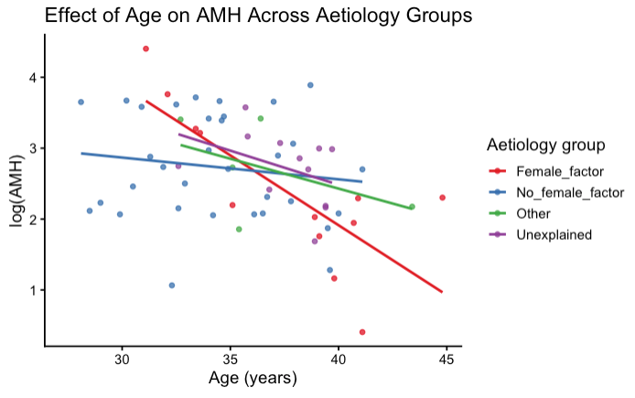
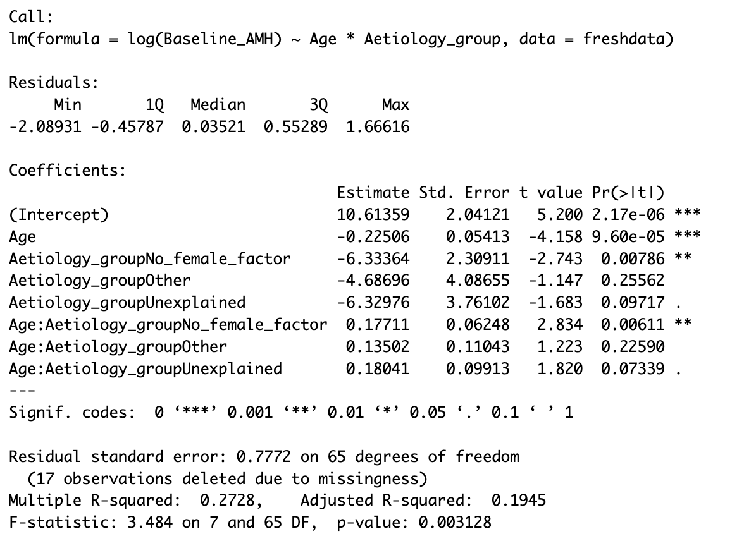
Model 1: beta = -0.083, p = 0.0008, Radj = 0.137
For every 1-year increase in age, log(AMH) decreases by 8%
Model 2 (interaction) Radj = 0.195
Reference group = Female factor
In the Female factor group each year of age is associated with a 0.225 (20%) decline in AMH, significant
Relationship between age and AMH differs by aetiology
In the no female factor group each year of age is associated with a 0.054 (5%) decline in AMH (-0.255 + 0.171) → smaller degree of age related AMH decline (p=0.006)
Steepest decline for women in female factor group
Female factor pathology maybe accelerates AMH depletion alongside ageing.
Notes:
Female factor patient ovarian reserve is depleted by ageing and underlying aetiology

Slide 18
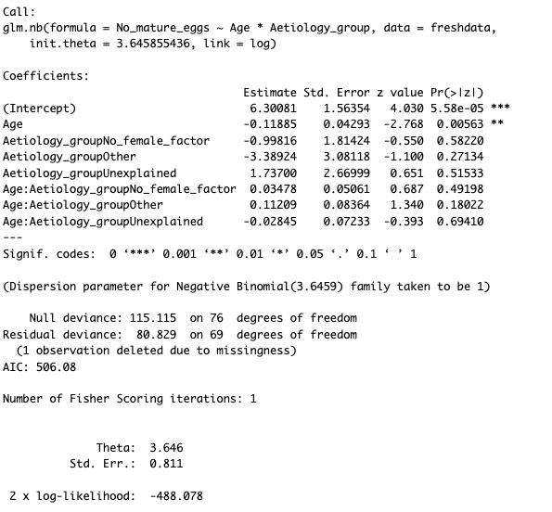
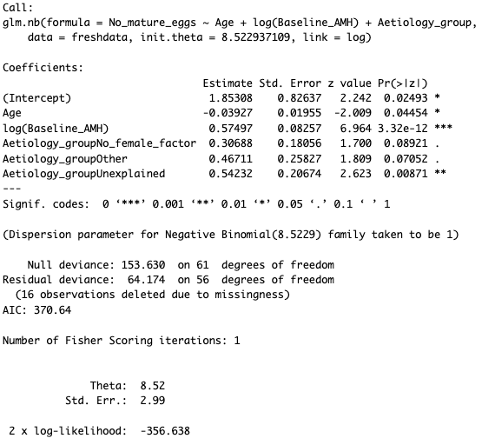
Statistical Modelling → Mature Oocytes and Baseline Factors
Negative Binomial Regression Model
Predicting the number of mature oocytes
Number of mature oocytes = count data which is very over-dispersed
Variance (66.29) > Mean (11.24)
Models which include AMH and do not
Including AMH in the model leads to decrease in AIC (better model) → Baseline AMH is an important predictor
Age remains a significant independent predictor (smaller effect)
Effect of age is reduced in the model which includes AMH (-0.0119 --> -0.0393) → the effect of age on oocyte yield through AMH rather than independently?
Log(AMH) = strongest predictor (p<0.0001), double AMH = 78% more mature oocytes
Women within the unexplained aetiology group yield more mature oocytes vs. female factor group, even when controlling for age and baseline AMH

Slide 19
Age is statistically significant → Every additional year of age is associated with fewer mature oocytes (-0.119) (11% fewer), and this is statistically significant (0.006)
There is no evidence that age affects mature oocyte yield differently across aetiology groups → including aetiology in modelling does not change relationship
Interaction terms add nothing
CI very wide
Including AMH in the model leads to decrease in AIC (better model)
Baseline AMH is strongest predictor → (p<0.0001), double AMH = 78% more mature oocytes
Age remains a significant independent predictor (smaller effect → effect of age is reduced in the model which includes AMH (-0.0119 --> -0.0393) → AMH is capturing age-related ovarian decline?
Is the effect of age on oocyte yield through AMH rather than independently?
Women within the unexplained aetiology group yield more mature oocytes vs. female factor group, when controlling for age and baseline AMH
Notes:
Including AMH + Age x Aetiology → increases AIC

Slide 20
Statistical Modelling – Protocol Decisions
Outcome = derived parameter: Total Stimulation Dose
Total FSH + Total hMG
Asking: what predicts the total stimulation dose?
Predicting the clinician's decision
What factors are important in deciding dose
Models
Predicting total stimulation dose from Baseline AMH, Age, Aetiology group, Treatment type
Reference for Aetiology = Female factor
Reference for Treatment type = Dual stim
2 models: with and without AMH
Notes:
Best prediction stats

Slide 21
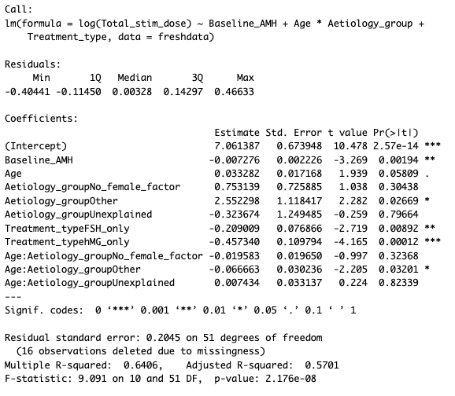
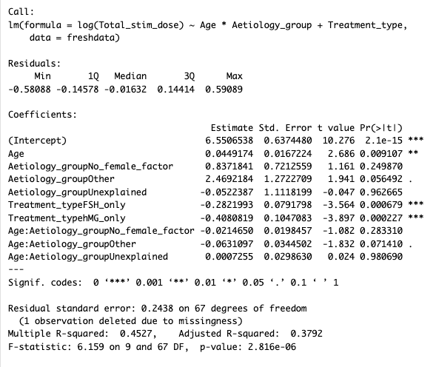
Baseline AMH is significantly associated with total stimulation dose
Beta = -0.0072, p=0.00194 → Patients with lower AMH receive higher stimulation doses
Age trend: older → slightly higher doses (+0.033, p>0.05), small association
Treatment type is strongly and significantly associated with total dose
Dual therapy = higher total dose vs. single FSH or hMG therapy
FSH only (-0.209, p=0.009)
hMG only (-0.457, p=0.0001)
Interaction between age and Other aetiology group (-0.0607, p=0.032)
Clinicians responding to age may vary by aetiology (not sure there is enough info to make a proper conclusion)
Radj = 0.570, improves by 0.19 when including AMH ibn model
When modelling without baseline AMH → age is a significant predictor of total dose
When including AMH → significance of age disappears
AMH is mediating the effect of age
Age appears important because is correlates with AMH (r=-0.41)
When AMH is in the model, age does not explain anything new

Slide 22
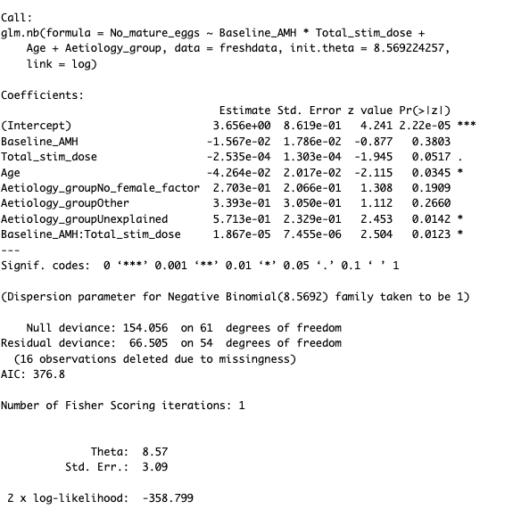

Statistical modelling → Mature oocytes and baseline factors + protocol decisions
Age
Baseline AMH
Total stim dose
Aetiology
AMH x Stim dose interaction
AMH x Stim dose interaction is significant (p=0.012)
Alone AMH → not significant
Alone Stim dose → not significant
Age independent predictor of mature eggs when controlling for other factors
Relationship between stimulation dose and oocyte yield is modified by baseline AMH and vice versa?
AMH is driving treatment decisions (previous model)
AMH is modifying the effect of treatment on mature oocytes
However, the AMH trend is negative: higher dose → fewer eggs
This is likely reflecting those that respond poorly? Have low baseline characters, are given higher doses but do not produce many eggs
Notes:
How do I deal with this trend?

Slide 23

Notes:
Looks like higher doses are producing less mature oocytes but this is not the case
Its because they have lower AMH, so they are given higher doses, but they aren’t responding
Those with high AMH get lower doses yet produce more oocytes
Treatment is not equally effective for all patients
The relationship between stimulation dose and mature oocyte yield varies according to baseline AMH. Patients with higher AMH demonstrate a stronger positive response to increasing stimulation, whereas those with lower AMH show limited improvement

Slide 24
1. Compare characteristics and treatment strategies between older and younger women
Do older women receive different stimulation strategies from younger women?
Compare older vs. younger women (define age groups)
Descriptive characteristics, boxplots, stats tests of protocols, doses
2. Identify factors associated with optimal mature oocyte yield across all women. Then explore only ageing women.
What protocol decisions are seen in better responders?
Need a success definition = threshold of mature oocytes = ‘optimum’
Compare characteristics of ‘optimum’ responders vs. ‘non-optimum responders’ across whole dataset
Among older women, are some protocol patterns/characteristics associated with better mature oocyte yield? Optimum vs. non optimum responders
Protocol type, doses, FSH vs. hMG use, baselines etc.
Do higher doses benefit a subgroup?
3. Assessing whether protocol-outcome relationships vary by ovarian reserve with older women?
Interactions
Notes:
Describe as:
- protocol characteristics associated with optimal mature oocyte yield in older women
- treatment patterns observed among older women who achieved a clinically favorable response
What predicts success among older women?
What predicts the protocol/dose older women receive?
For older women does the effect of treatment differ by AMH?
Do lower reserve older women benefit from different stimulation patterns?
Does a higher dose only help in certain subgroups?
NOTE: Better looking protocols in older women are not necessarily the cause of better outcomes --> treatment is not randomly assigned - clinicians assign based on baselines

Slide 25

Mann-Whitney U Tests for variables between 2 age groups
Baseline, patient info
Difference in baseline AMH (W=642.5, p=0.001)
Difference in baseline total follicles (W=894, p=0.00016)
No difference in baseline endo, BMI
Protocol Choices
Difference in total stimulation dose (W=499, p=0.0161
Difference in total hMG dose (W=561.6, p=0.0394)
No difference between total FSH dose
Final measures
Difference in final total follicles (W=964.5, p=0.00239)
Difference in final follicles <11.9 (W=950, p=0.005732)
Difference in number of eggs (W=998.5, p=0.007713)
Difference in number of mature oocytes (W=1040.5, p=0.00199)
Difference in number of fertilized eggs (W=944, p=0.01156)

Slide 26





Slide 27

For women on the Short Antagonist Protocol, what influences mature oocyte yield?
For ageing women on the Short Antagonist Protocol, what influences mature oocyte yield?
Optimum mature oocyte yield chosen 9-15
Low <9
High >15
Binary logistic regression
Total stimulation dose affects the optimal response
Significant (p=0.031)
Effect appears to be negative → the higher the dose the lower the number of mature oocytes
Increasing doses but diminishing returns
Sample size is very small for this group (N=59, 44 after missing values dropped), can I test interaction with such low N?
If I did this analysis only within ageing women would be even smaller N

Slide 28
Do ageing women with low AMH produce a different number of eggs compared to younger women?
Are AMH levels lower in obese/overweight ageing women vs. non-obese/overweight ageing women?
BMI
Does AMH vary in the menstrual cycle? Does it depend what day it is measured? → Kim said no
Does increasing the starting FSH dose for expected poor responders help?
Dose decreasing the starting FSH dose for expected high responders (/those at risk of OHSS) help?
Optimal dose for optimum responders/poor/high responders → whole population
Stratify to age groups
Do younger low AFC patients respond better to higher FSH starting doses vs. older patients?
Is there a difference in the number of oocytes retrieved between hCG or GnRH trigger?

