Slide 1
Aims
Explore and predict IVF outcomes
In terms of Ovarian Stimulation (not yet expanded to LB)
‘Optimize’ the IVF protocol (ageing women) to head towards improving the IVF ovarian stimulation response
Predict mature oocytes
Responder Classification
Model that classifies a woman as a low responder or not low responder
Model that classifies a woman as a high responder (OHSS risk) or not
Model: maximize expected mature oocytes without getting a very low response or increasing the OHSS risk
Predict response (mature oocytes) at given dose
Predict risk (low/high response) at given dose

Slide 2
Number of mature oocytes
Since I am exploring IVF stimulation protocols mature oocytes is an appropriate outcome
Modelling just baseline factors as predictors
Modelling baseline factors + protocol parameters
Methods
Linear regression
Negative Binomial Regression
RandomForest Regression
XGBoost Regression
Emerging results
AMH and Baseline Total Follicles are more significant than age
AMH and Baseline Total Follicles have higher permutation importance than age
Interaction between AMH and total dose clinicians are prescribing → mature oocytes
Baseline factors still significant when controlling for protocol decisions
Differences in feature importance between models
Differences between female factor aetiology vs. unexplained aetiology

Slide 3
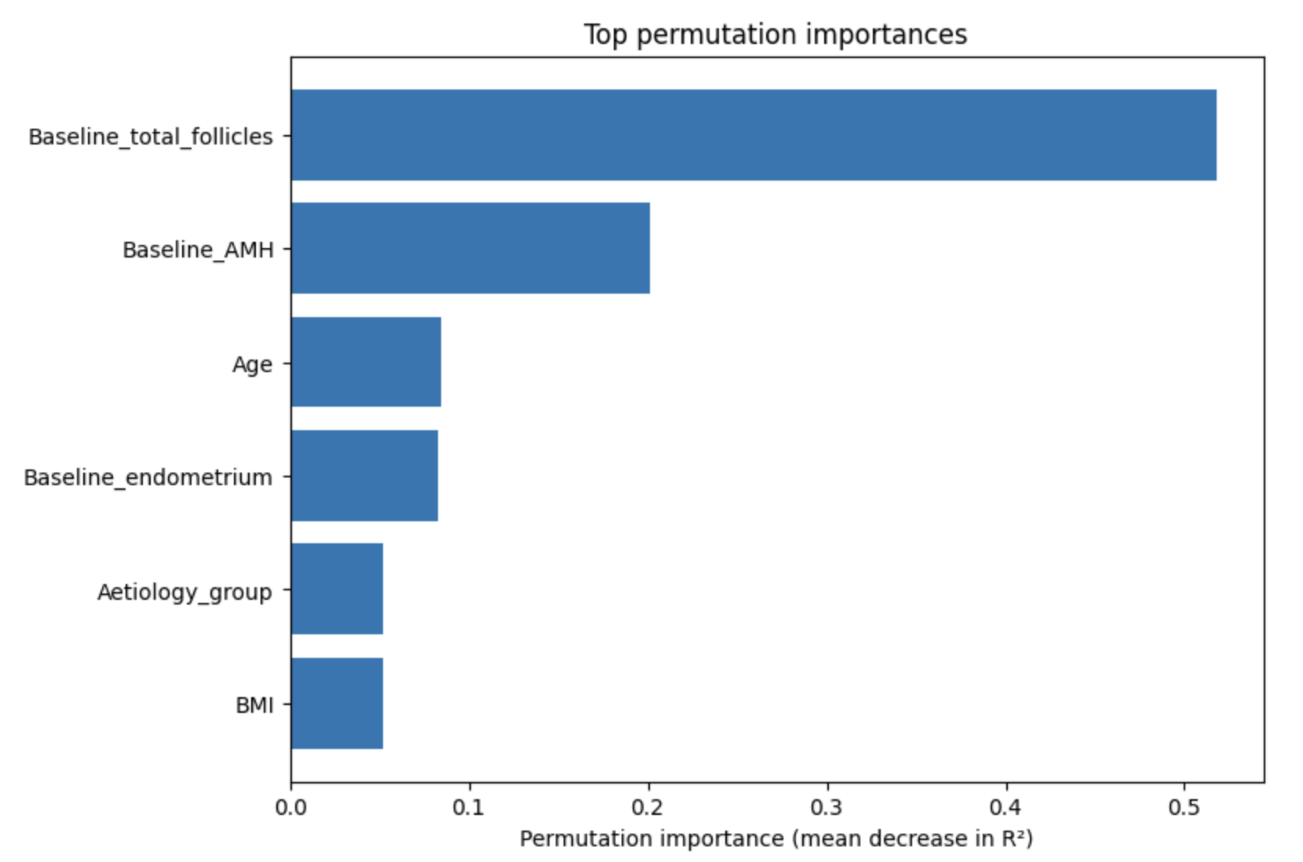
RandomForest with just Baseline Predictors
Median Imputing or KNN imputing (have seen papers do MICE imputing too)
GridSearchCV
5 cross fold validation
CV validation R2 = 0.42
Training R2 = 0.78

Slide 4
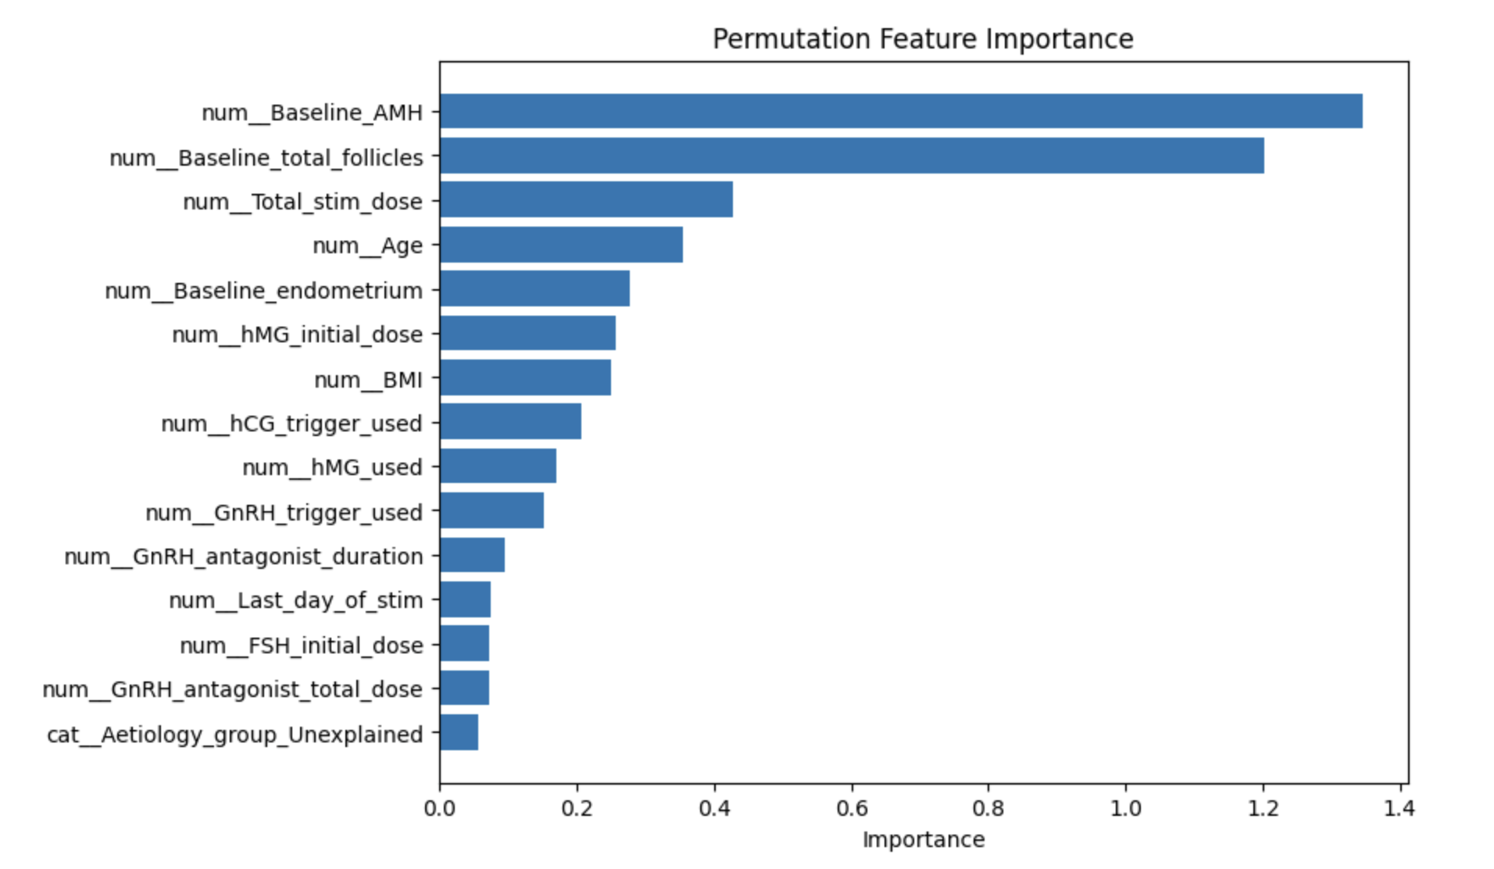
RandomForest with Baseline + Protocol Parameters
Validation R2 = 0.40

Slide 5
Pre-treatment support: Classify Responder Type
Classification Model – Binary Logistic Regression + ML
Low responders vs. Not low responders
High responders (OHSS risk) vs. Not
Before treatment, is the patient likely to under-respond
Look at baseline predictors
Then, extend model to include protocol choices
Make predictions
For each patient stimulate a small set of plausible starting doses (based on literature: (150-250/300iu)
Use the fitted models to predict mature oocytes, low-response probability, high-response probability
Try to create a framework which recommends treatment based on multiple prediction models
Does increasing the starting FSH dose for expected poor responders help?
Does decreasing the starting FSH dose for expected high responders (/those at risk of OHSS) help?

Slide 6
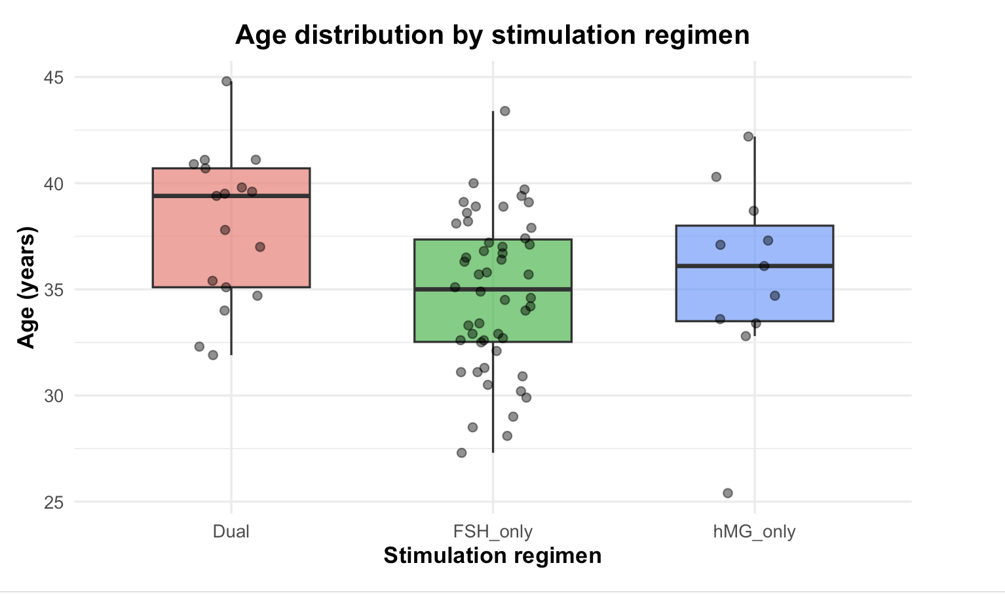
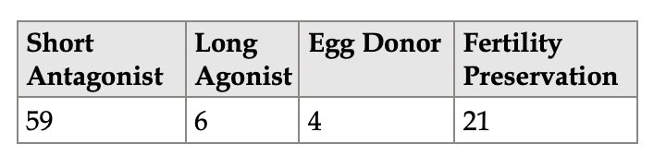
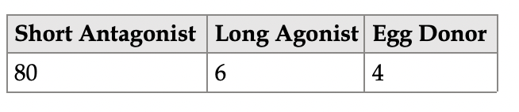
Q: When looking at dose
Separate by protocol: Short Antagonist vs. Long agonist?
Separate by stimulation drug
Both will likely cause some sample size issues

Slide 7
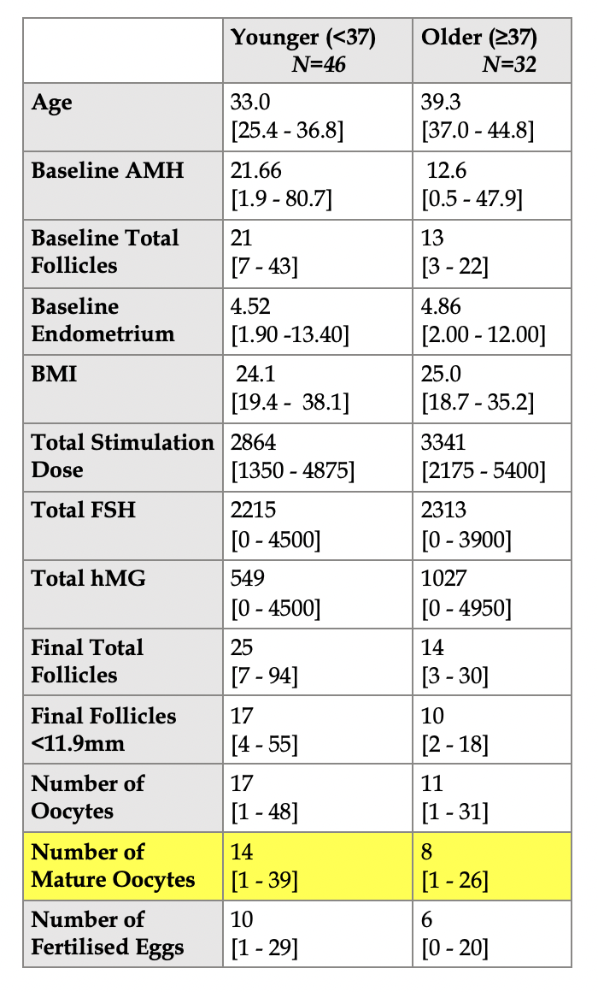
Extra areas to explore
Split women into 2 age groups
Mann-Whitney U Tests for variables between 2 age groups
Baselines
Difference in baseline AMH (W=642.5, p=0.001)
Difference in baseline total follicles (W=894, p=0.00016)
No difference in Baseline endometrium or in BMI
Protocol Choices
Difference in total stimulation dose (W=499, p=0.0161
Difference in total hMG dose (W=561.6, p=0.0394)
No difference between total FSH dose
Final measures
Difference in final total follicles (W=964.5, p=0.00239)
Difference in final follicles <11.9 (W=950, p=0.005732)
Difference in number of eggs (W=998.5, p=0.007713)
Difference in number of mature oocytes (W=1040.5, p=0.00199)
Difference in number of fertilized eggs (W=944, p=0.01156)

Slide 8
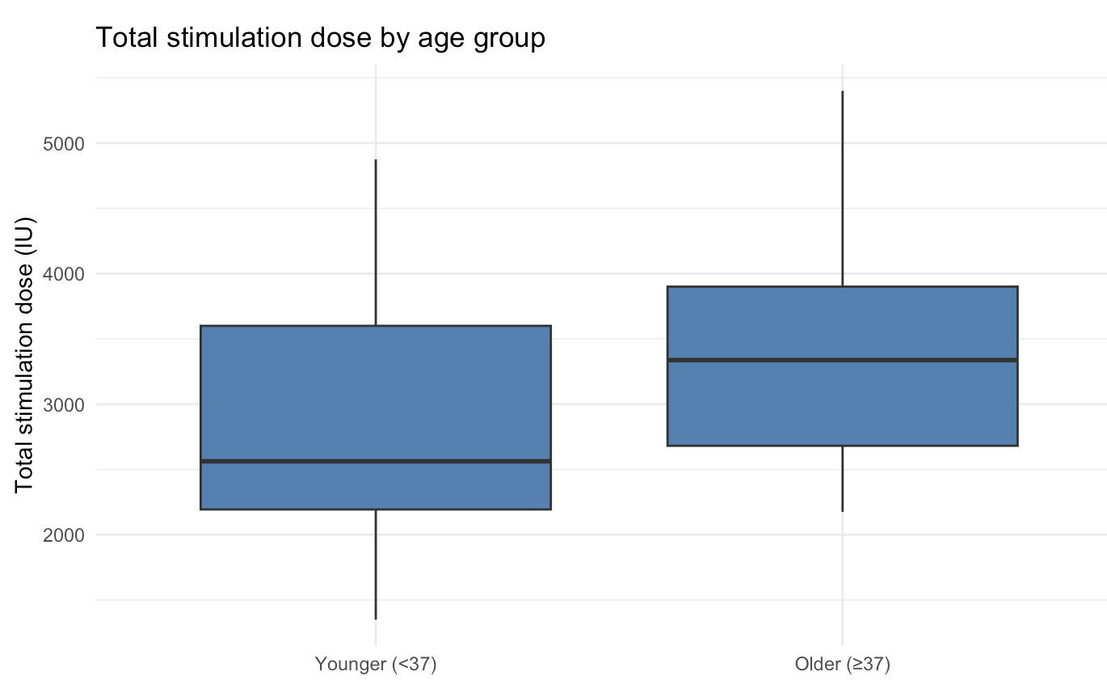
For ageing women on the Short Antagonist Protocol, what influences mature oocyte yield?
Regression → mature oocyte yield count
Binary logistic regression/Classification → create 2 groups low/high
E.g. optimum: 9-5
Low <9
High >15

Slide 9
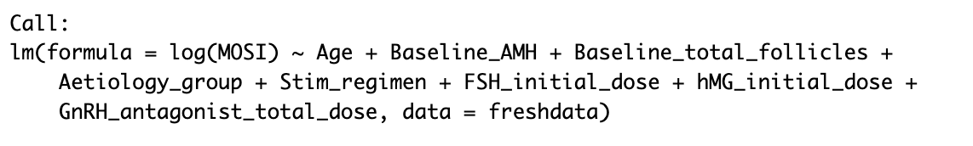
Further questions
Do ageing women with low AMH produce a different number of eggs compared to younger women with low AMH?
Are AMH levels lower in obese/overweight ageing women vs. non-non obese/overweight ageing women?
BMI
No difference in BMI so likely this is necessary, just emerged in a paper
OSI = Oocyte Sensitivity Index = Number of oocytes retrieved / Total FSH dose (iu) x 1000
How can this be used?
R2 = 0.69

