Slide 2
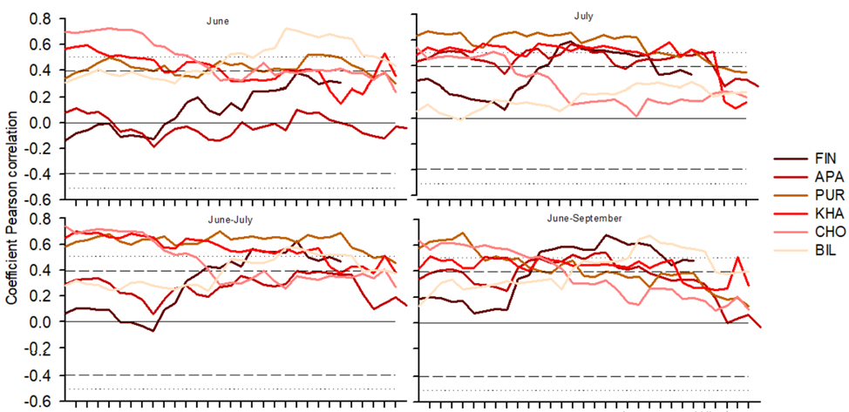
1970
1975
1980
1985
1990
1995
1970
1975
1980
1985
1990
1995

Slide 3
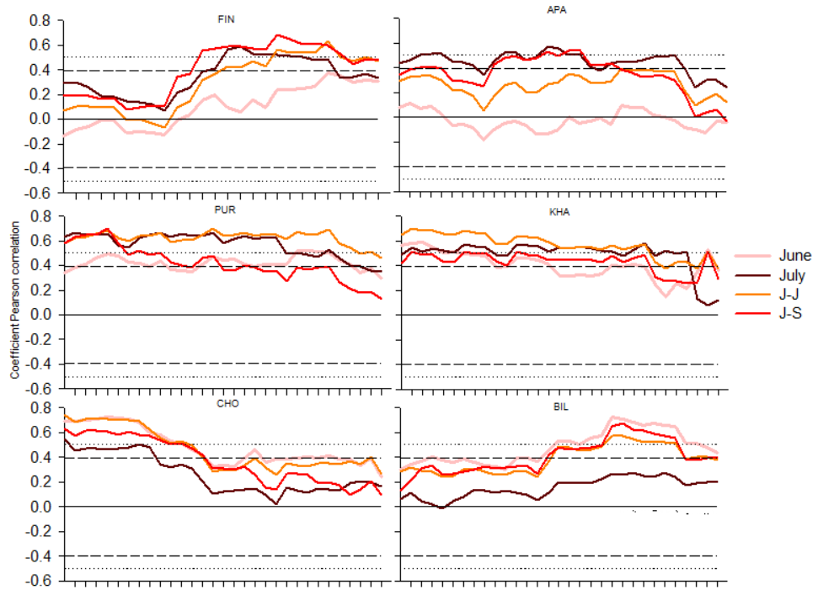
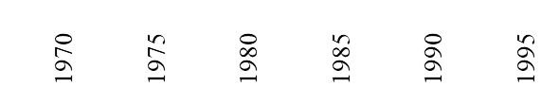

Slide 4
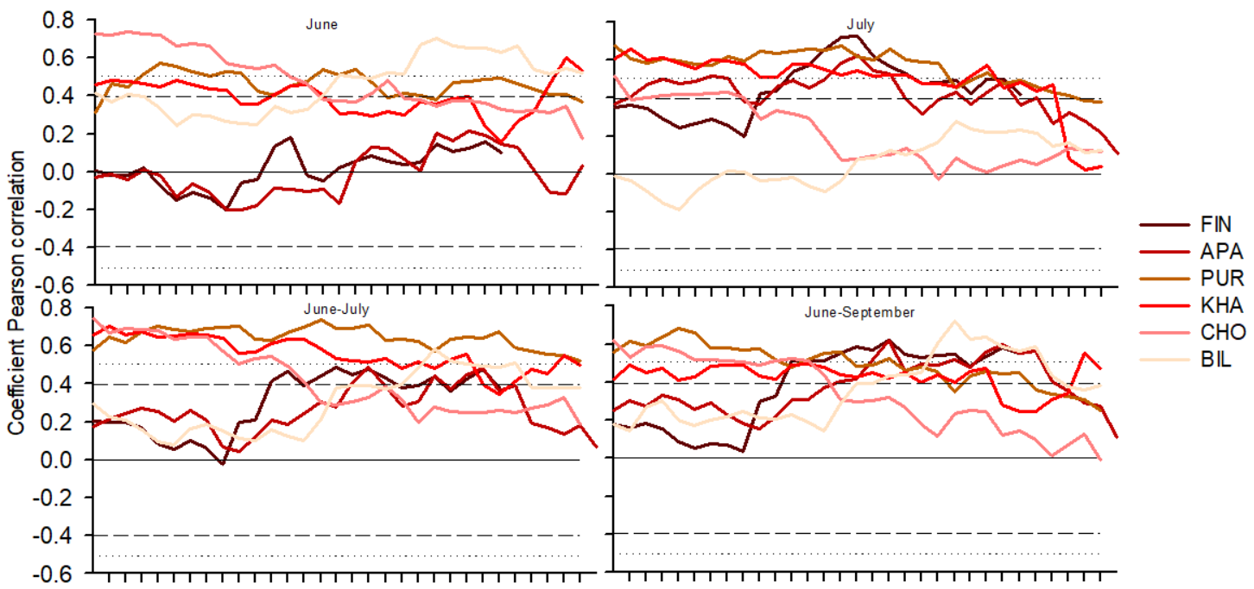
1970
1975
1980
1985
1990
1995
1970
1975
1980
1985
1990
1995

Slide 5
