Slide 1
Chronic Pain and Pharmaceutical Grade Opioids: the use of painkillers in different demographic groups
Presentation by: Ting Lu, Kristina Todic, Jeffrey Tran

Slide 2
The data:
Survey of Non-Medical Use of Prescription Drugs Program (NMURx)
Canada 17Q3 Launch
Contribution of drug poisoning deaths to changes (over 1 and 5 years) in life expectancy at birth, by sex
https://www150.statcan.gc.ca/t1/tbl1/en/tv.action?pid=1310043401&pickMembers%5B0%5D=4.2&pickMembers%5B1%5D=3.1&cubeTimeFrame.startYear=2015+%2F+2017&cubeTimeFrame.endYear=2015+%2F+2017&referencePeriods=20150101%2C20150101

Slide 3
Goal
Our primary focus will be on the role chronic pain plays in opiate use throughout different demographics.
Question:
What relationships exist between chronic pain and pharmaceutical grade opiates (pain killers) and in which demographic groups is this relationship most prevalent. What factors potentially influence opiate misuse with respect to chronic pain?

Slide 4
Methodology
We have isolated key demographic variables as well as variables relating to chronic pain and We will look at OP_USE to explore use of prescription opioids related to the previously listed variables.
We used tableau to visualize the various relations pertaining to the variables above.

Slide 5
Demographic Breakdown

Slide 6
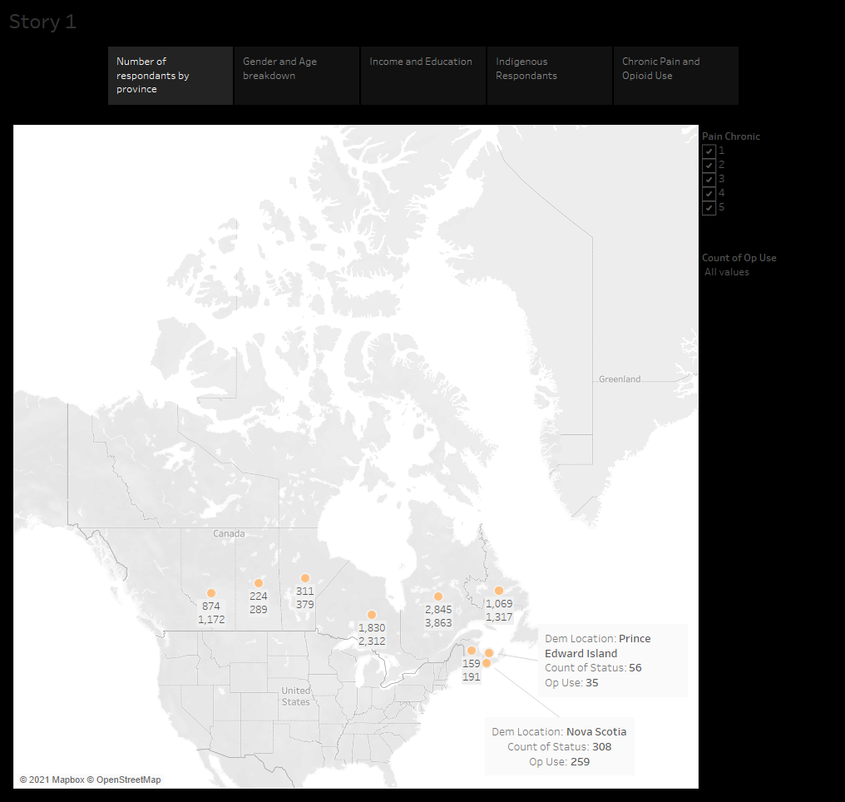

Slide 7
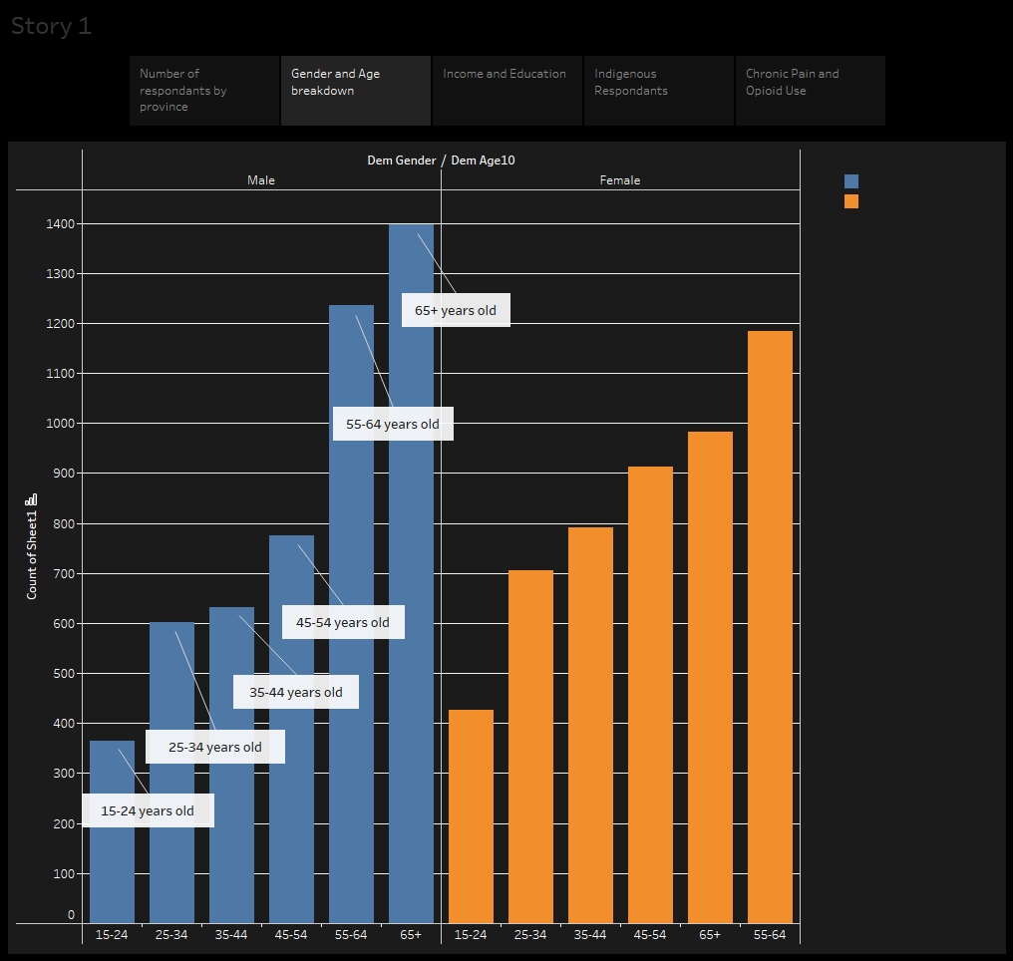

Slide 8
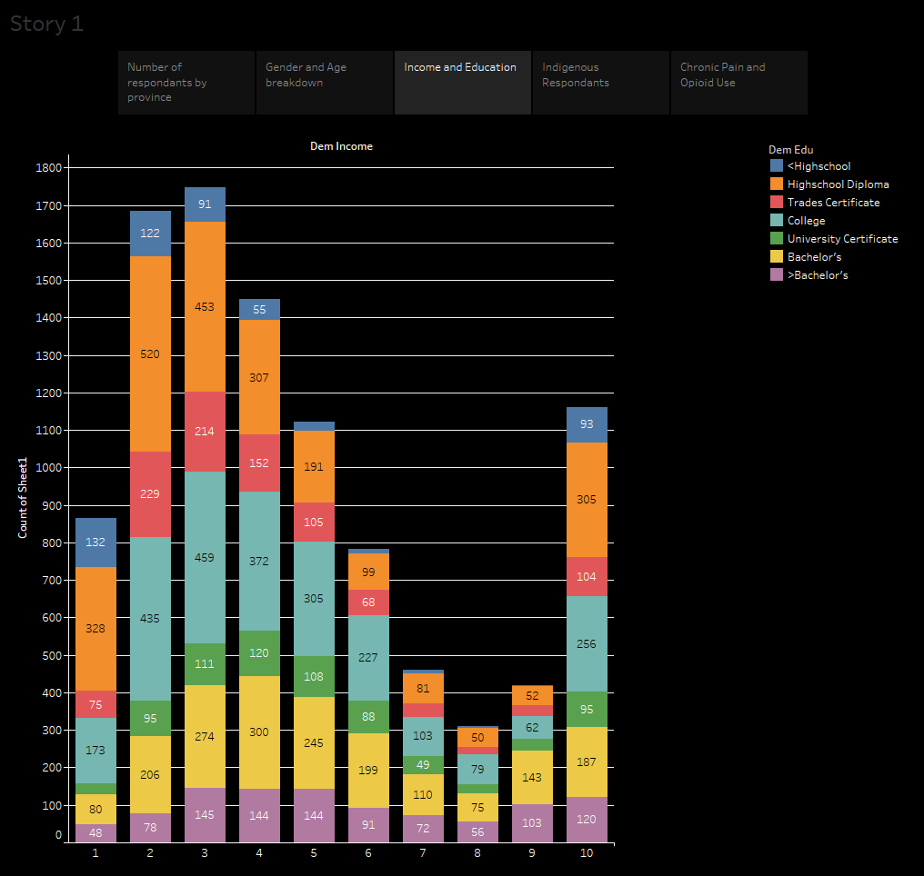

Slide 9
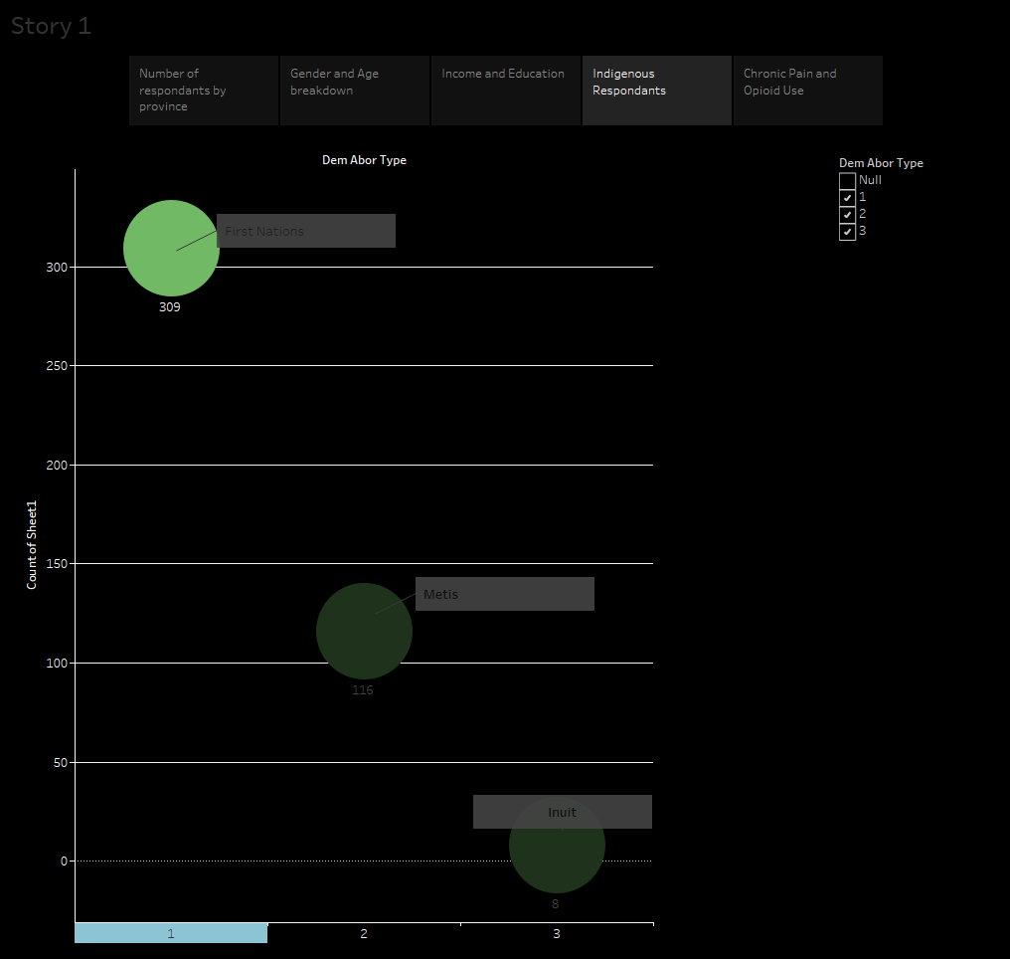
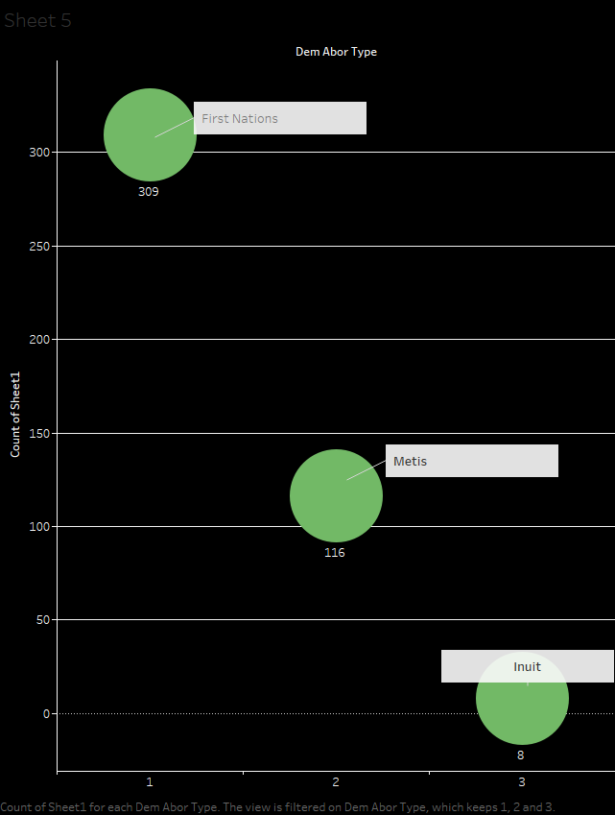

Slide 10
Patterns investigated

Slide 11
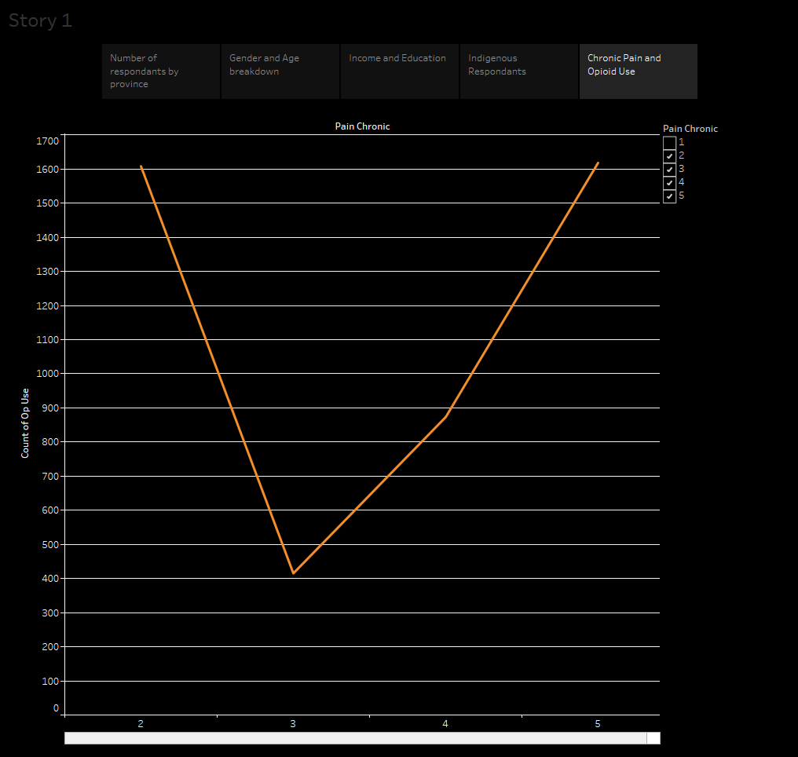

Slide 12
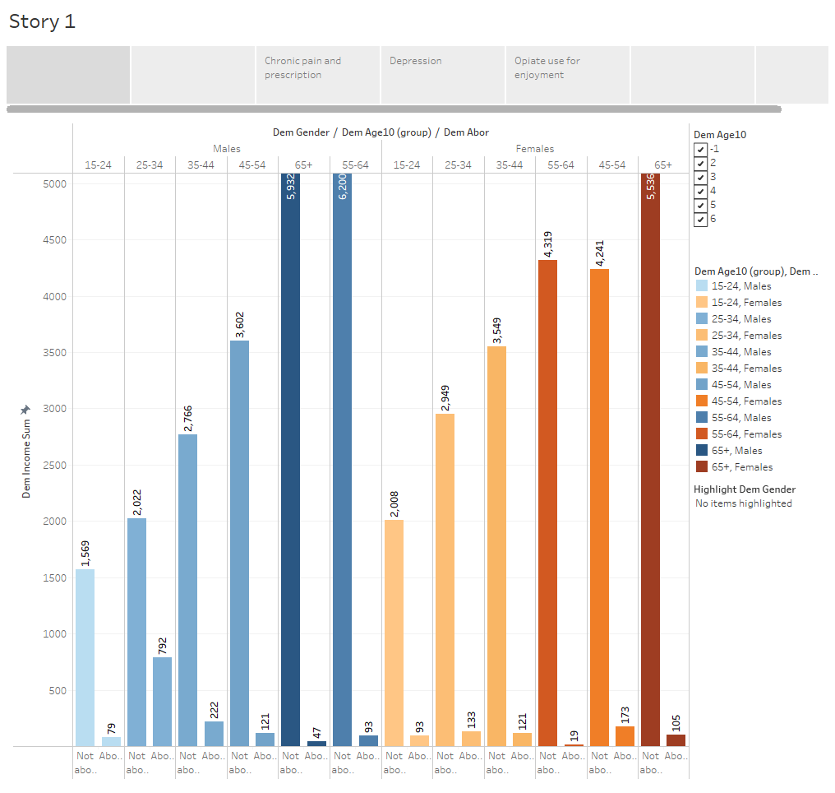

Slide 13
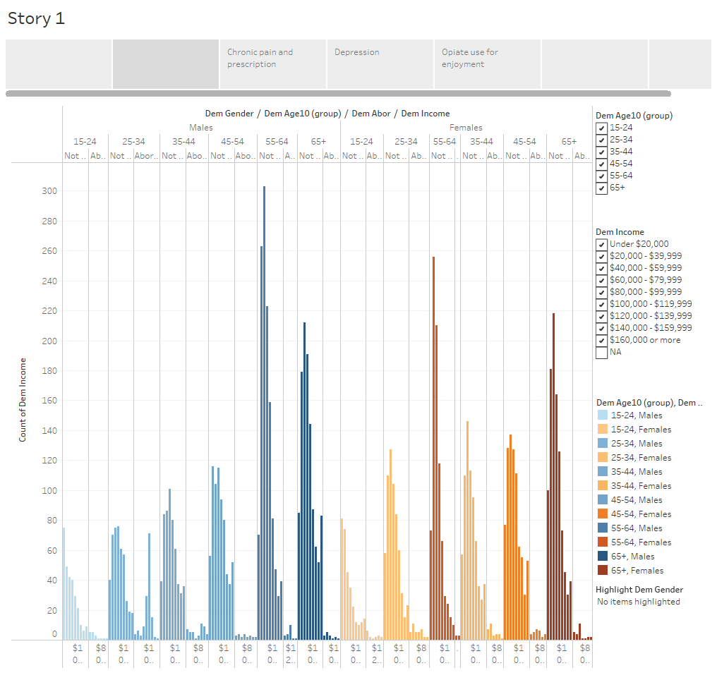

Slide 14
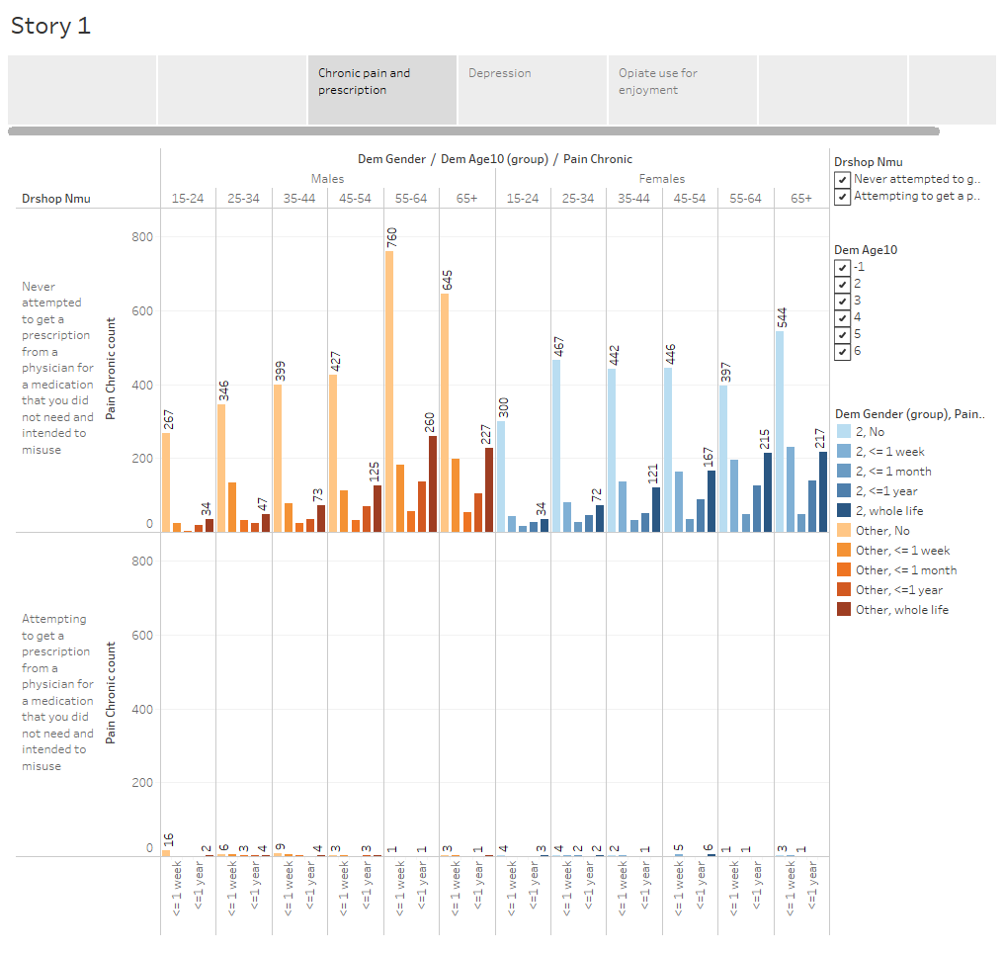

Slide 15
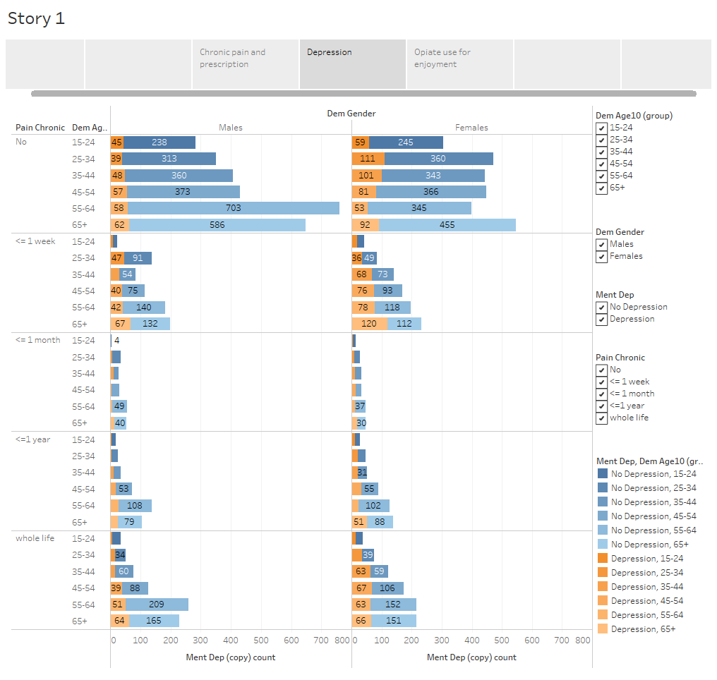

Slide 16
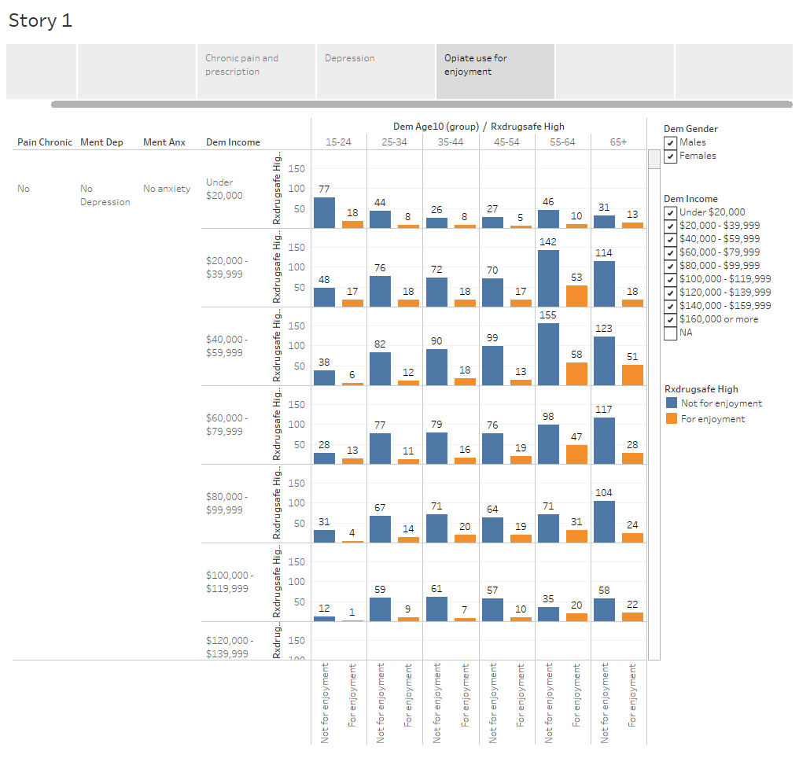

Slide 17
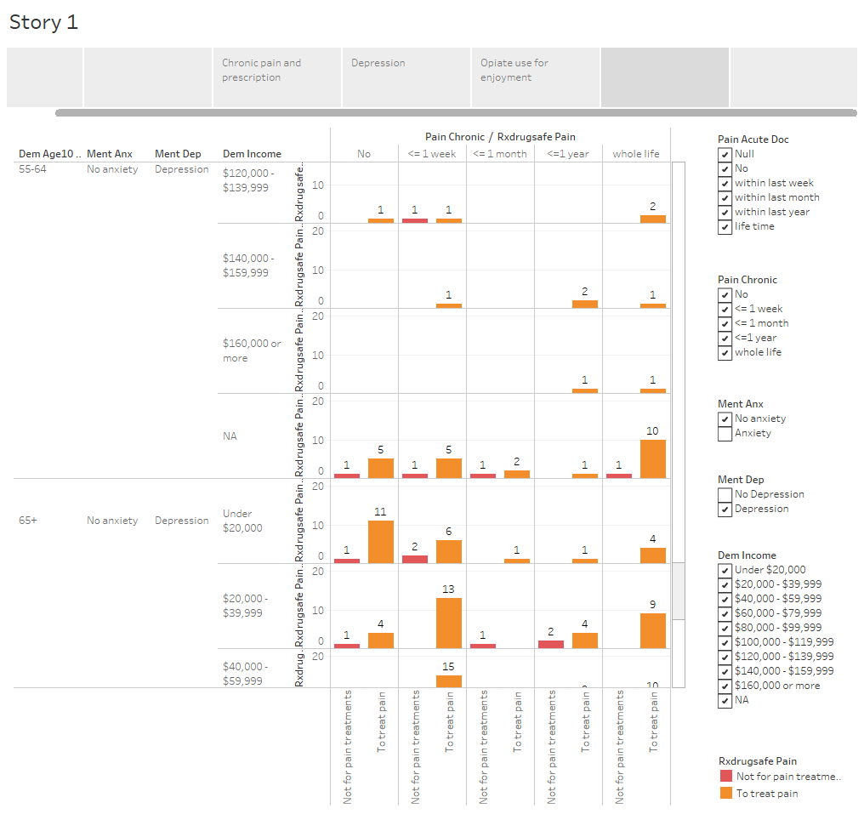

Slide 18
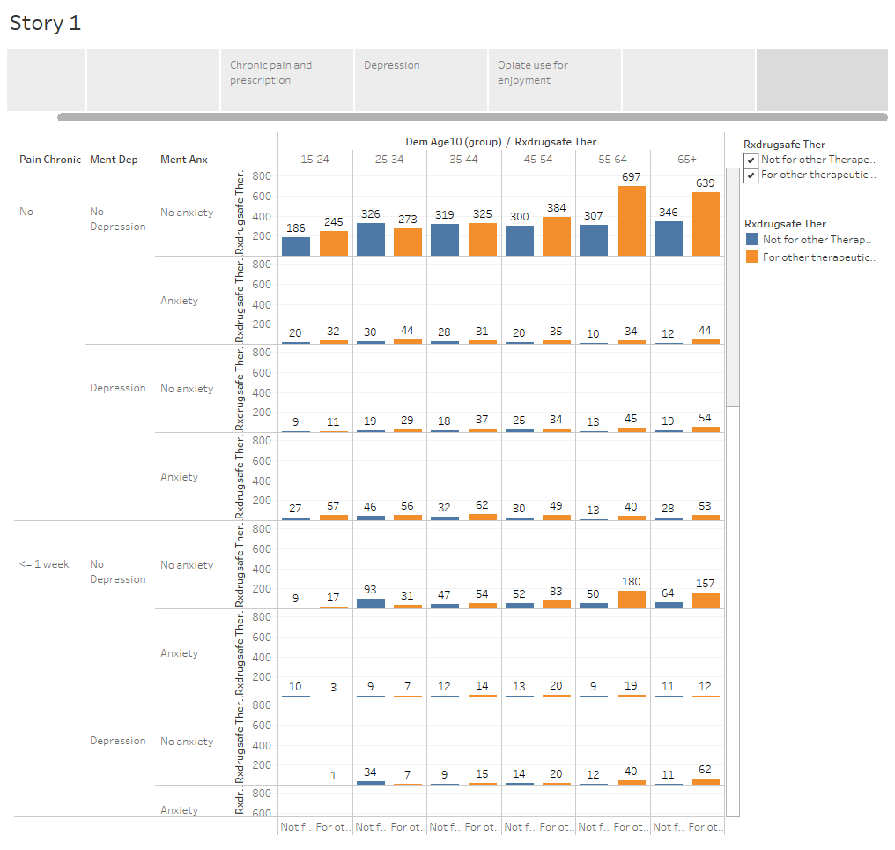

Slide 19
Drug Overdose and Drug Misuse

Slide 20
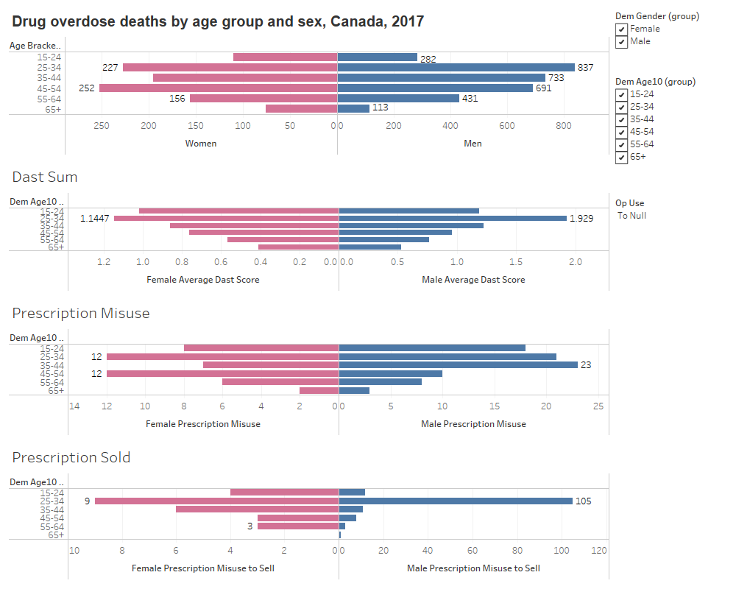

Slide 21
For further investigation:
Questions for further investigation:
Is illicit drug use for medical treatment of chronic pain higher in lower income groups, racialized groups, and other minorities and is the use of illicit drugs linked to lack of adequate healthcare for these communities?
It is important to look at how all of these factors relate so that we can ensure that all Canadians are able to safely treat chronic pain.

Slide 22
Thank you for listening

