Slide 1


Slide 2
Who are we ?
Kristiyan Georgiev JAVA EE 3
Teodor Parapanov JAVA EE 3

Slide 3
What did we do ?
Website for :
Video sharing

Slide 4
What does it do ?
Watch video
Comment video, add video to playlist
Search video, channel or playlist
View user profile
Rate video, rate comment

Slide 5
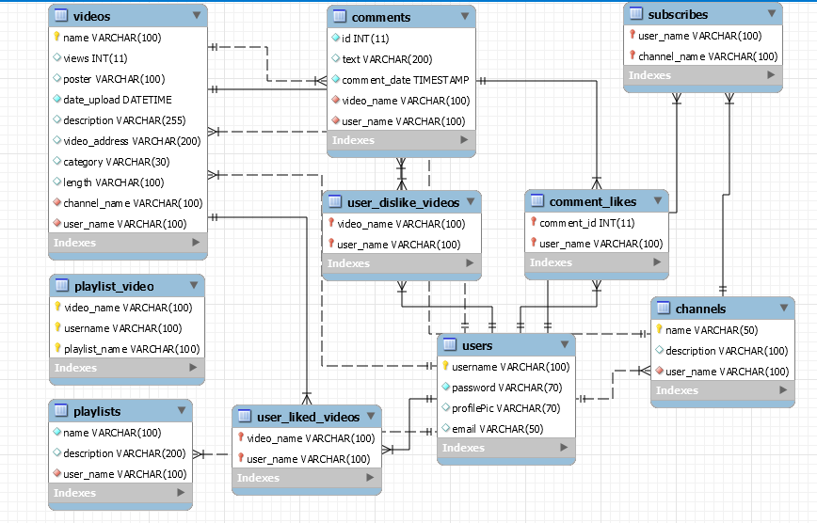

Slide 6
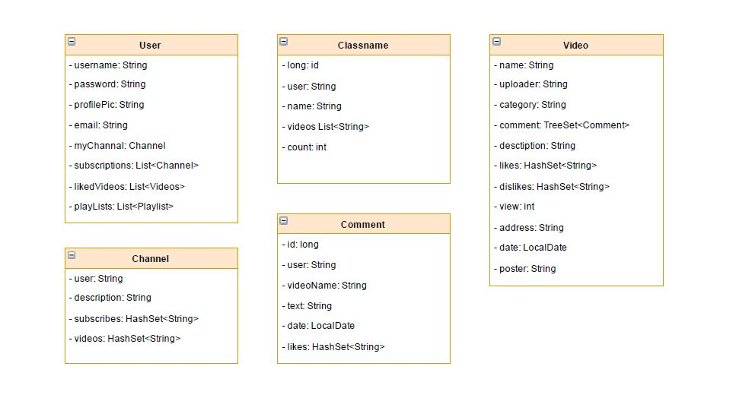

Slide 7
What technologies does it use ?

Slide 8
Front-end
HTML,CSS
JSTL
JAVASCRIPT
AJAX
jQuery

Slide 9
Back-end
Java
Singleton
DAO
Spring MVC
JDBC
MD5

Slide 10
Future plans
Login and share video with Facebook
Multilingual website
Save videos in Amazon storage service

Slide 11
Demo

