Slide 1
Risk-Bounded Policy
via
Denoising Diffusion Model
for
Stochastic Nonlinear Systems
Ashkan Jasour, 2026

Slide 2
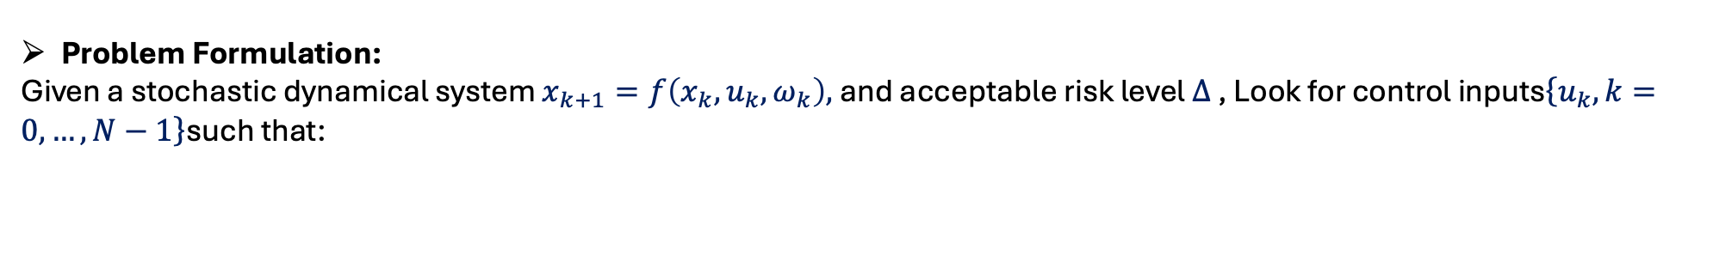
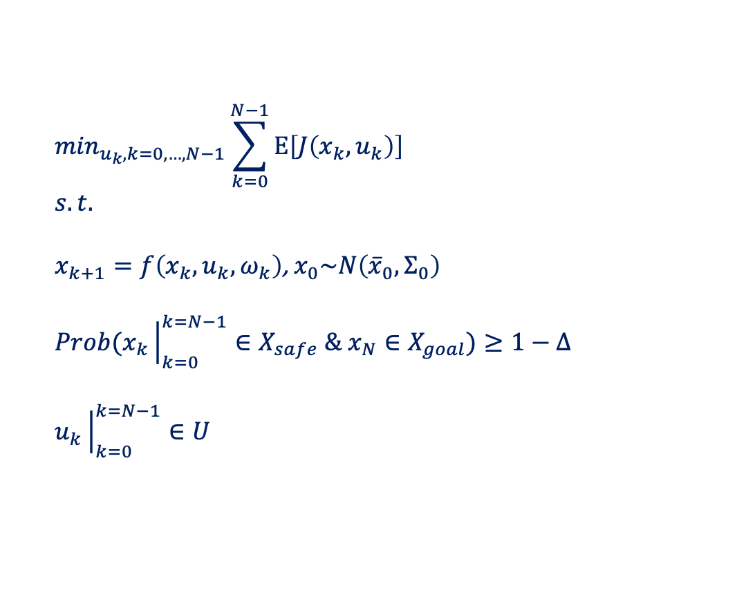




obs
obs

Slide 3






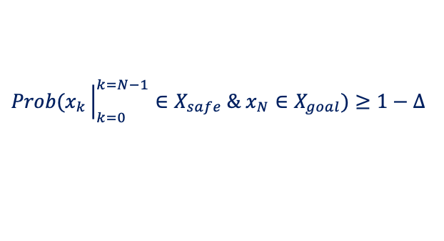
obs
obs
Planner
(Diffusion Model)

Slide 4
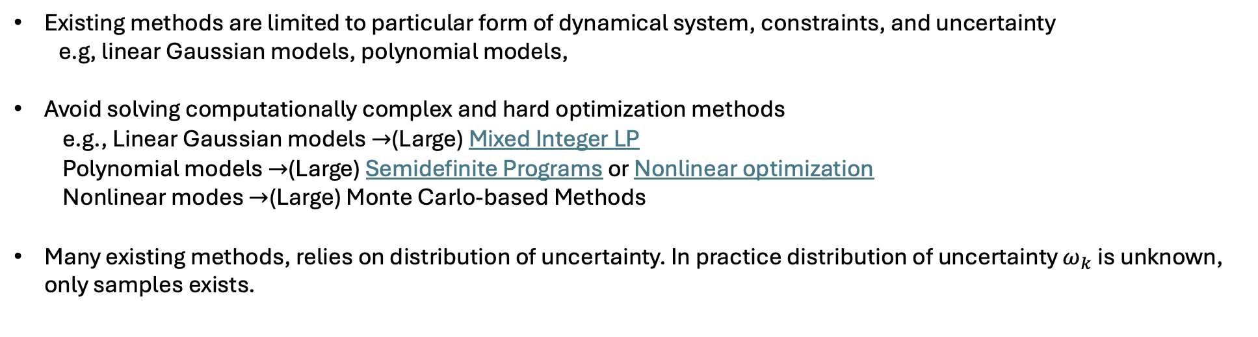
Why diffusion-based planning:
Planner
(Diffusion Model)

Slide 5
Risk-Bounded Diffusion Model:
  Risk-bounded Training: to generate plans that satisfies risk constraints.
  Risk-bounded Sampling: to bias samples toward safe plans

Slide 6
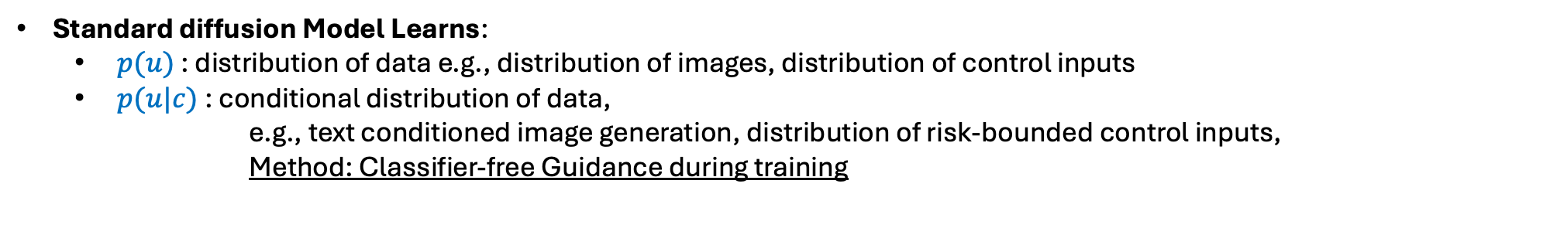

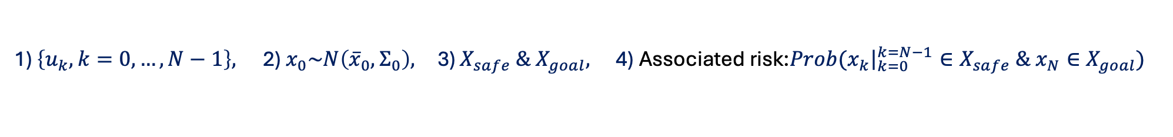
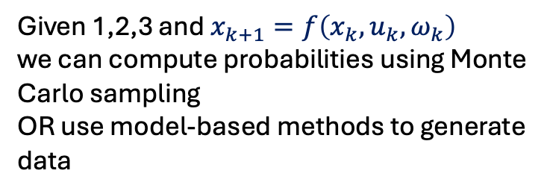












Risk-Bounded Diffusion Model:
Each training set includes:
obs
obs
Issue: find a good training data

Slide 7
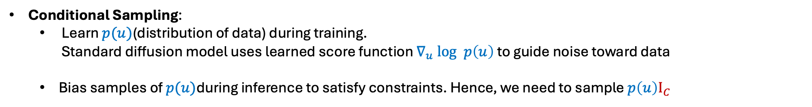
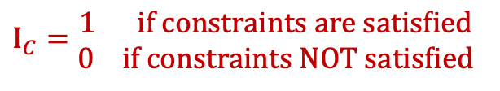



Risk-Bounded Diffusion Model:
Risk-bounded Sampling:
Conditional Sampling
Projection-based Sampling
Training phase
Sampling using
Score function learned during training that guides noise to data
guides noise toward constraint satisfaction

Slide 8

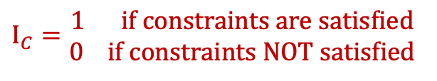



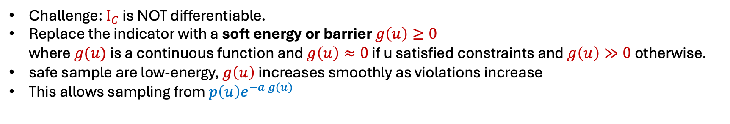

Training phase
Sampling using
Score function learned during training that guides noise to data
guides noise toward constraint satisfaction

Slide 9

Risk-Bounded Diffusion Model:
Risk-bounded Training
Risk-bounded Sampling
Projection-based Sampling:
  project to a nearby safe action
  Inpainting for all diffusion steps to impose the constraints on the trajectory.

Slide 10
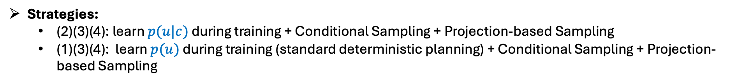
Risk-Bounded Diffusion Model:
1
Risk-bounded Training
2
3
Risk-bounded Sampling
Projection-based Sampling:
  project to a nearby safe action
  Inpainting for all diffusion steps to impose the constraints on the trajectory.
4

Slide 12
Chance-Constrained Based Formulation: (non-sampling, linear Gaussian based)
Works with probabilistic constraints
CVaR Based Formulation: (Sample)
Expected value given risk is greater than the acceptable level

Slide 13
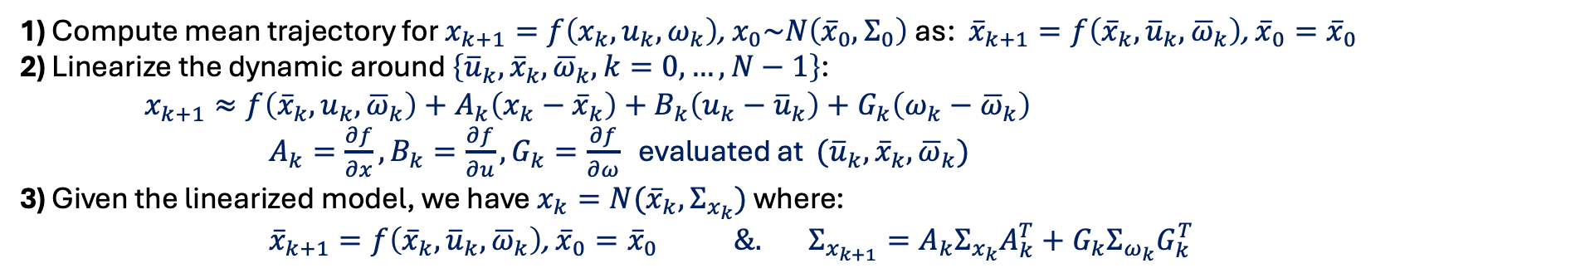
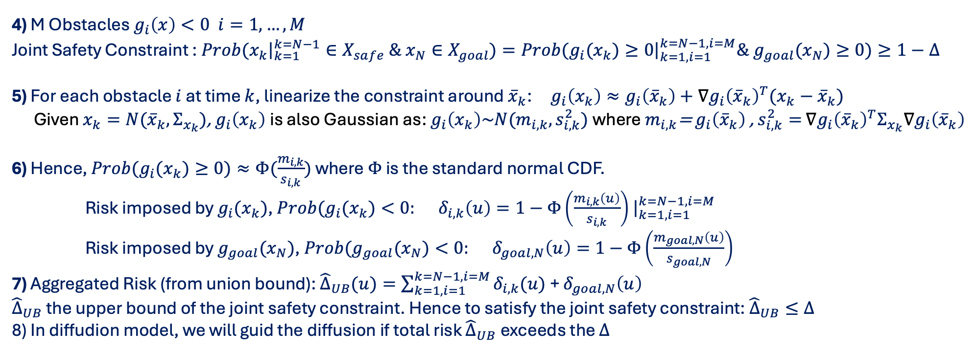

Slide 14
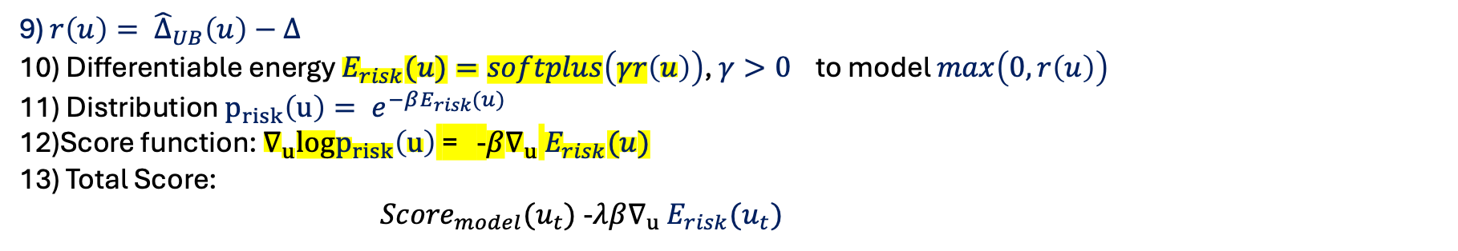
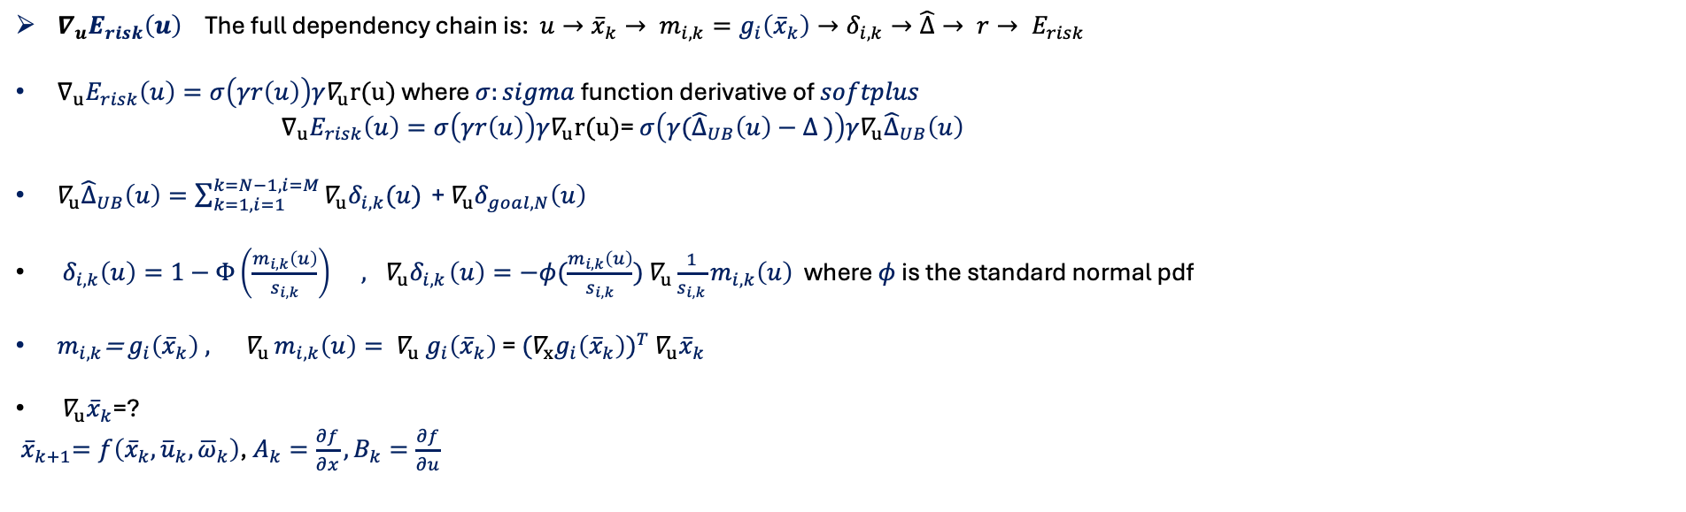
E = compute_energy(u)
E.backward()
grad_u = u.grad

Slide 15
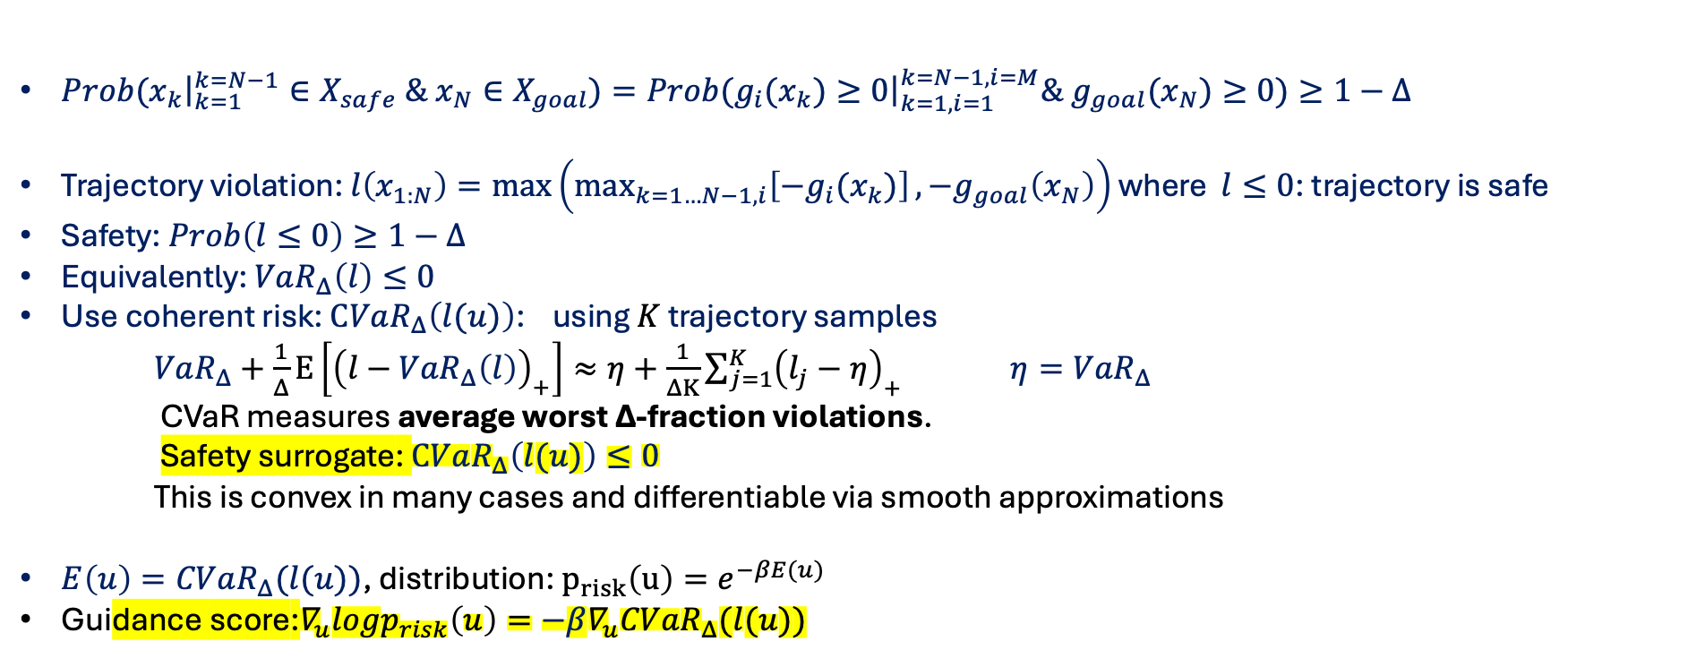

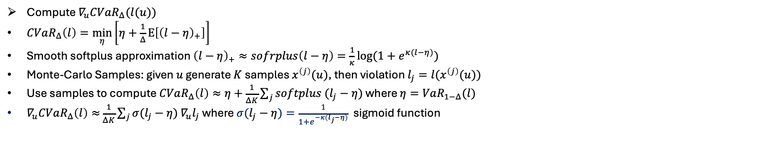
CVaR:

Slide 16
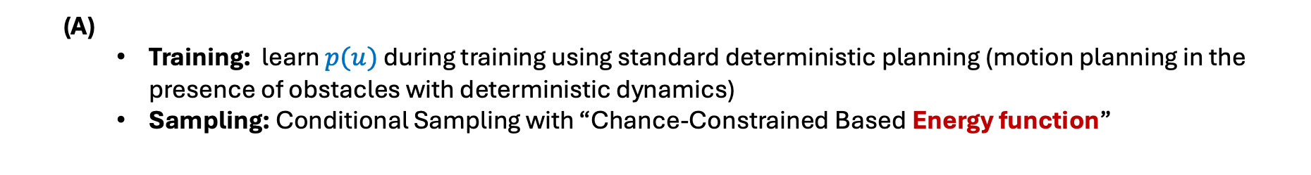

Strategies:
  (C)
    Does CVaR-based conditional sampling help?
    Does Projection-based Sampling help?

Slide 17
Gaussian Linear Formulation:
Blackmore, Lars, Masahiro Ono, and Brian C. Williams. “Chance-Constrained Optimal Path Planning With Obstacles.” IEEE Transactions on Robotics 27, no. 6 (December 2011): 1080-1094.
https://dspace.mit.edu/bitstream/handle/1721.1/80914/Williams_Chance-constrained.pdf?sequence=1
Page 12 https://ocw.mit.edu/courses/16-s498-risk-aware-and-robust-nonlinear-planning-fall-2019/resources/mit16_s498f19_l12/
Non-Gaussian Nonlinear Formulation:
Non-Gaussian Risk Bounded Trajectory Optimization for Stochastic Nonlinear Systems in Uncertain Environments ICRA 2022, https://arxiv.org/pdf/2203.03038
Convex risk-bounded continuous-time trajectory planning and tube design in uncertain nonconvex environments
https://journals.sagepub.com/doi/pdf/10.1177/02783649231183458?casa_token=E8dK2AUzNiUAAAAA:bXBp23DF-7LMBgv1eM_WIdFlhVgKV7erV9FlQ7Ty0CxSLdZzZJGHwhxkmCTMQl__gk6EMmk_dg
Risk-Guided Diffusion: https://arxiv.org/pdf/2506.17601
Diffusion-based Trajectory planning https://arxiv.org/pdf/2501.00915

Slide 18
Appendix

Slide 19
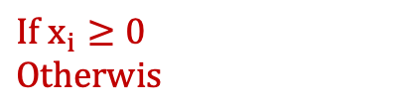
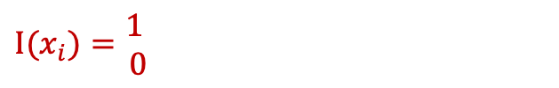
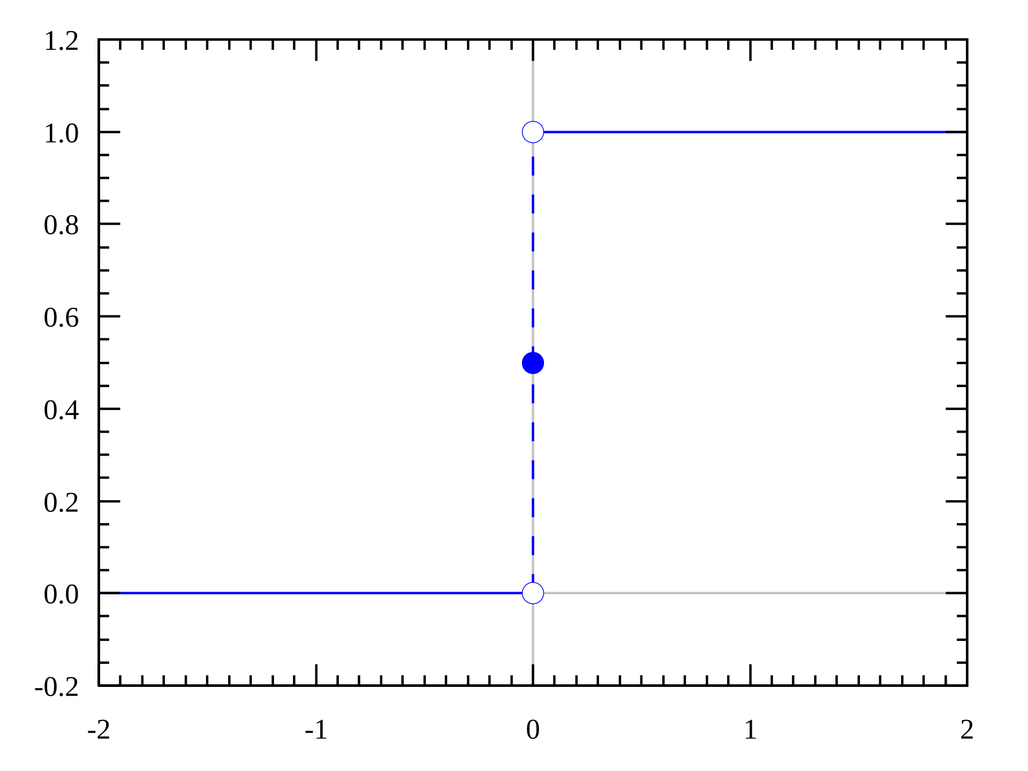
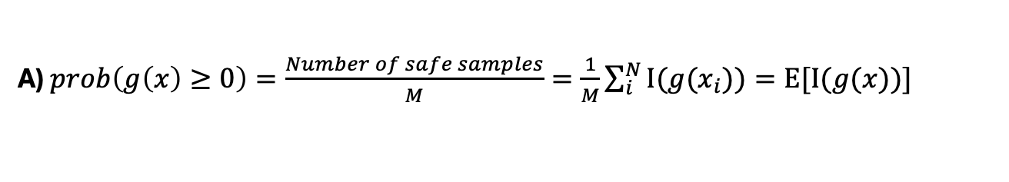
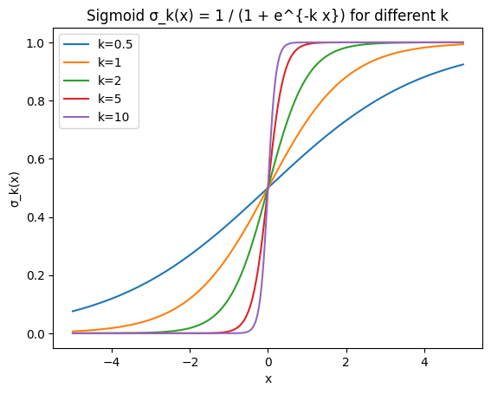

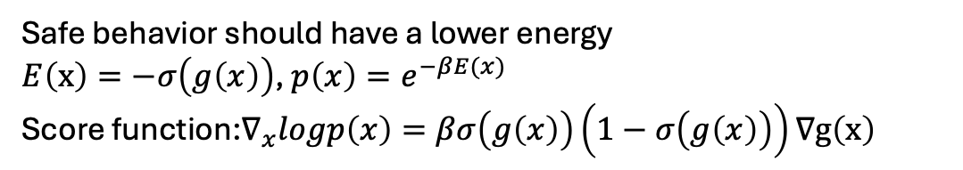
Indicator function
Not differentiable
Weak theoretical link to chance constraint.

Slide 20
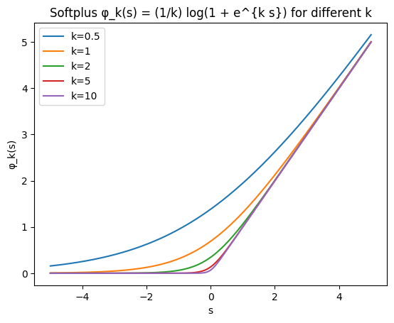
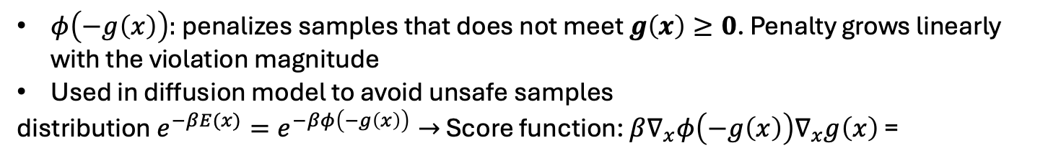



Indicator function
Not differentiable
: Unsafe points

Slide 21


