Slide 1




OhMyREPL.jl
This is my REPL. There are many like it,
but this one is mine.
Kristoffer Carlsson
https://kristofferc.github.io
kristoffer.carlsson@chalmers.se
@KristofferC
@KristofferC89

Slide 2
Outline
The Julia REPL (0.6)
OhMyREPL.jl
Demo
Summary

Slide 3
The Julia REPL

Slide 4
The Julia REPL
REPL - Read Eval Print Loop
Written in Julia since #6270 (Mar 2014)
Features
History
Search mode (reverse / forward)
Keybindings (customizable)
Tab completion (Unicode, fields)
Extensible (RCall.jl REPL mode)
Some color customization (prompt color, text color)

Slide 5
The Julia REPL 0.6
Prompt pasting (#17599)
Common with code snippets starting with the julia> prompt
Doctests
Code copied from a REPL session
Annoying to manually have to scrub code before executing it
Now, automatically detect the julia> prompt when pasting, remove the prompt and output
julia> Char(0x110000)
'\U110000': Unicode U+110000 (category Cn: Other, not assigned)
julia> isvalid(Char, 0x110000)
false

Slide 6
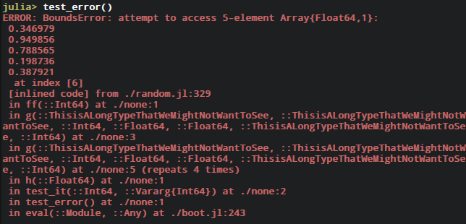
The Julia REPL 0.6
New stack traces (#19569)
Old:

Slide 7
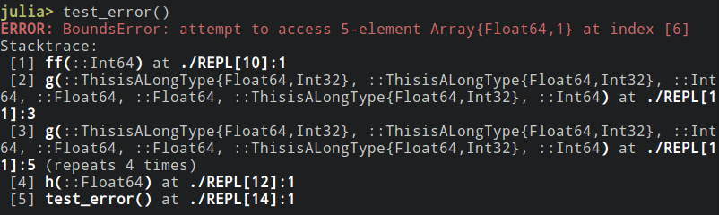
The Julia REPL 0.6
New stack traces (#19569)
New:
Numbered list of stackframes
Open editor at stackframe with shortcut Ctrl +Q

Slide 8
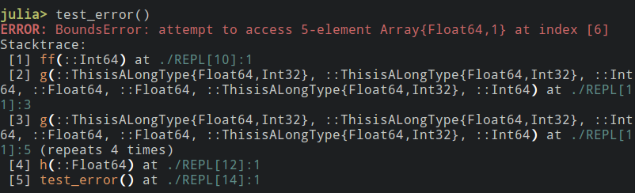
The Julia REPL 0.6
New stack traces (#19569)
New:
ENV["JULIA_STACKFRAME_LINEINFO_COLOR"] = :cyan;
ENV["JULIA_STACKFRAME_FUNCTION_COLOR"] = :yellow;

Slide 9
OhMyREPL.jl

Slide 10

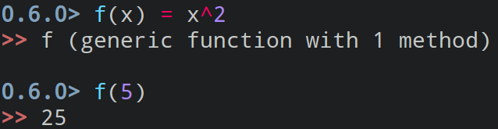
OhMyREPL.jl
Passes - Modify color/style of entered text
Syntax Highlighting
(Active) Bracket Highlighting
Rainbow brackets
Other
Bracket completion
Prompt changing

Slide 11
Passes
What is needed (e.g for syntax highlighter)?
Tokenizer / Lexer - Tokenize.jl¹
Simple interface for colors in terminal - Crayons.jl²
[1]: https://github.com/KristofferC/Tokenize.jl
[2]: https://github.com/KristofferC/Crayons.jl

Slide 12
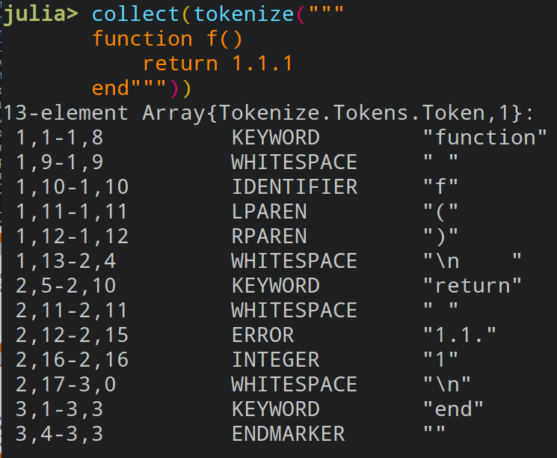
Tokenize.jl
Tokenization: text (source code) -> "words with meaning"
Interactive usage:
non error throwing
Roundtrippable:
keep whitespace
Backend for
CSTParser.jl (@ZacLN):
VSCode Julia plugin:
Juno (Atom IDE):
Module detection

Slide 13

Crayons.jl
Colored / styled text in terminal is done by printing special "ANSI Codes"
Nice to have a higher level system for terminal colors than raw strings.

Slide 14
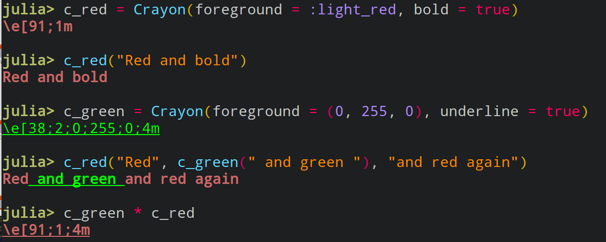
Crayons.jl

Slide 15
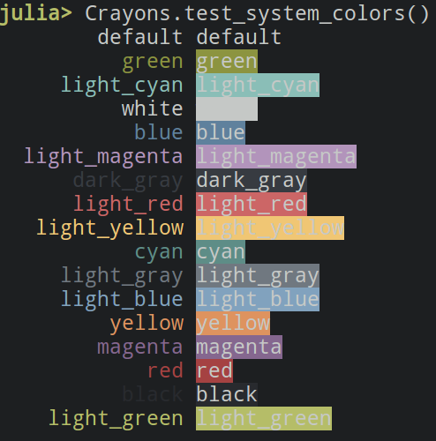
Crayons.jl

Slide 16
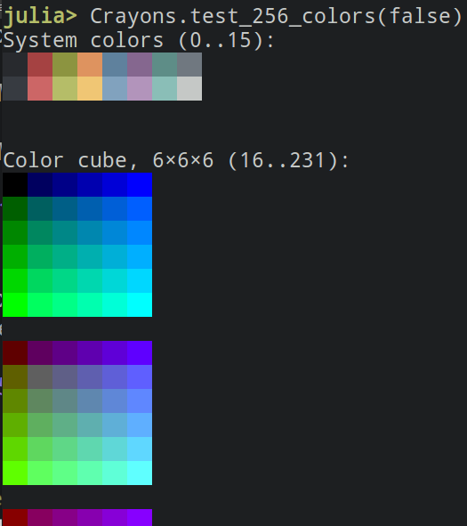
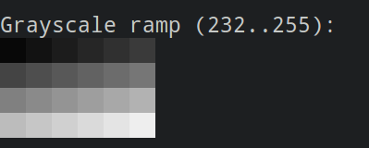
Crayons.jl

Slide 17
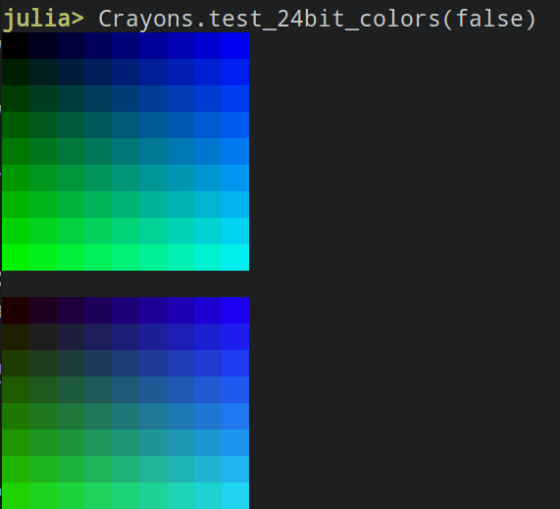
Crayons.jl

Slide 18
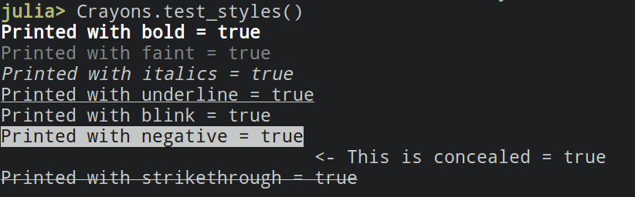
Crayons.jl

Slide 19
Input string
Tokenization (Tokenize.jl)
Run passes (Crayons.jl)
function f(x::Float64)
return sqrt.([x; [1,2]])
end
18-element Array{Tokenize.Tokens.Token,1}:
1,1-1,8 KEYWORD "function"
1,9-1,9 WHITESPACE " "
1,10-1,10 IDENTIFIER "f"
1,11-1,11 LPAREN "("
1,12-1,12 IDENTIFIER "x"
1,13-1,14 OP "::"
1,15-1,21 IDENTIFIER "Float64"
1,22-1,22 RPAREN ")"
...
3,4-3,3 ENDMARKER ""
Syntax highlighting
function f(x::Float64)
return sqrt.([x; [1,2]])
end
Cursor position
Active brackets
function f(x::Float64)
return sqrt.([x; [1,2]])
end
41
Rainbow brackets
function f(x::Float64)
return sqrt.([x; [1,2]])
end
Merging
function f(x::Float64)
return sqrt.([x; [1,2]])
end

Slide 20
Demo

Slide 21
Summary / Acknowledgments
Presented OhMyREPL.jl, package to customize the REPL.
Two packages split out from package:
Tokenize.jl - Lexing of Julia code
Crayons.jl - Colors in terminal
Thanks to:
Zac Nugent @ZacNL & Sebastian Pfitzner @pfitzseb for bugfixes to Tokenize.jl
- Everyone who filed issues / PRs for my packages

Slide 22
Thank you! Questions / Comments?

