Slide 1
ILIGAN CITY URBAN TRANSIT PLATFORM
TrikeIligan
On-Demand Tricycle Ride-Hailing & Fleet Dispatch Management System
A synchronized tripartite platform engineered to empower commuters with transparent fares, uplift local tricycle drivers with efficient bookings, and provide city administrators with rigorous dispatch oversight.
Target Stakeholders: Citizens of Iligan (Passengers) | Tricycle Operators / TODA (Riders) | City Dispatch Administrators

Slide 2
CURRENT COMMUTER PAIN POINTS
The Transportation Challenge in Iligan City
Why the traditional roadside hailing model is failing both passengers and drivers
01
02
03
Unregulated & Arbitrary Fares
Safety & Driver Legitimacy
Inefficient Street Hailing
Commuters frequently encounter unpredictable price negotiations, overcharging during late hours or rain, and a lack of standardized fare enforcement despite official city ordinances.
Lack of centralized driver verification leaves passengers vulnerable. Lost personal belongings are almost impossible to recover without digital ride records or TODA identification.
Passengers face prolonged waiting times in residential areas, while tricycle drivers waste significant fuel roaming empty streets ('dead mileage') hunting for fares.
Impact: Inconsistent Fare Calculation
Impact: Zero Ride Traceability
Impact: High Operating Fuel Waste

Slide 3
SYSTEM OVERVIEW
The TrikeIligan Solution
A specialized digital ecosystem connecting passengers, drivers, and city administrators
PASSENGER APP
DRIVER / RIDER APP
ADMIN WEB PORTAL
Safe & Predictable Rides
Optimized Driver Incomes
Centralized Fleet Oversight
Built for Iligan citizens to hail verified tricycles from anywhere.
Built for legitimate TODA members to accept nearby passenger trips.
Built for city dispatchers to enforce safety and policy compliance.
• Automated fare calculation based on city matrix
• Verified driver profiles with photo, TODA ID, and plate
• In-app GPS ride tracking and safety trip logs
• Cashless and cash payment options
• Instant booking notification via real-time WebSockets
• Minimized cruising fuel costs with localized dispatch
• Integrated digital wallet with automated earnings balance
• Clear trip breakdown and customer rating feedback
• Driver document verification (License & TODA registration)
• Live map monitoring of active tricycle fleets
• Dispute resolution hub for fare or breakdown complaints
• System fare configuration and weekly/monthly audit exports

Slide 4
OPERATIONAL FLOW
How TrikeIligan Works in 4 Steps
A transparent, friction-free journey from booking request to administrative logging
STEP 1
STEP 2
STEP 3
STEP 4
Ride Request
Smart Dispatch
Trip & Payment
Admin Audit
Passenger enters destination. Backend computes standardized base + per-km fare.
System pings verified nearby drivers via WebSockets. First available driver accepts.
Driver picks up passenger. Ride completed with Cash or E-wallet deduction.
Trip logs are permanently recorded for dispute resolution, safety, and analytics.

Slide 5
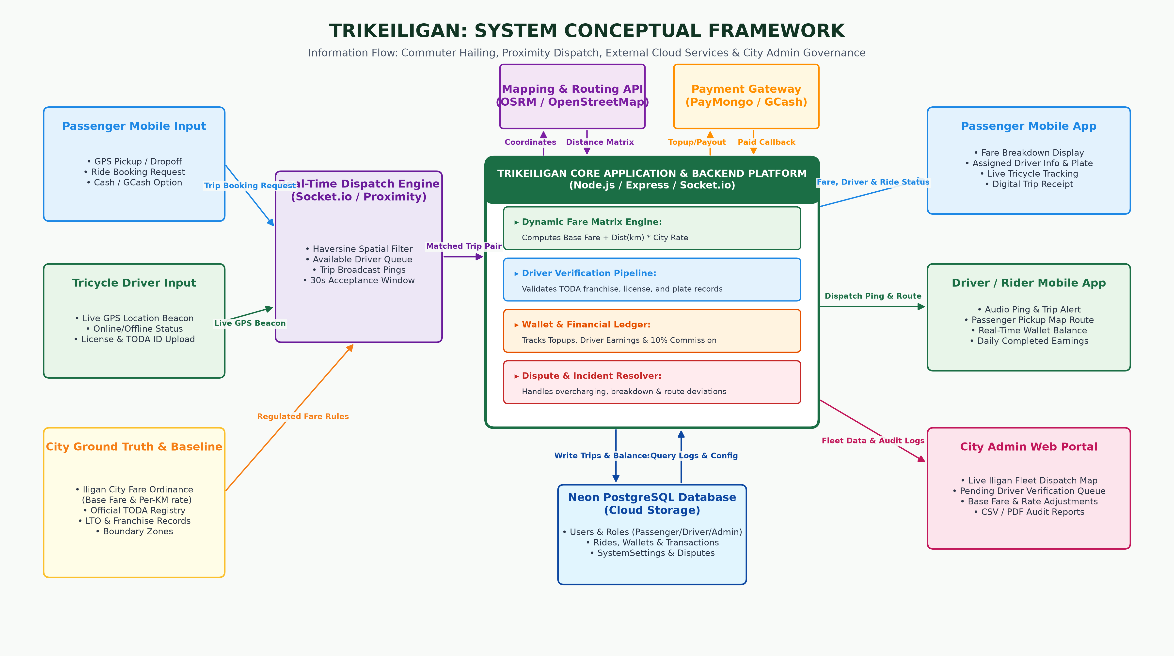
SYSTEM ARCHITECTURE
Conceptual Framework & Information Flow
End-to-end data pipeline from inputs, dispatching engine, and external APIs to client applications

Slide 6
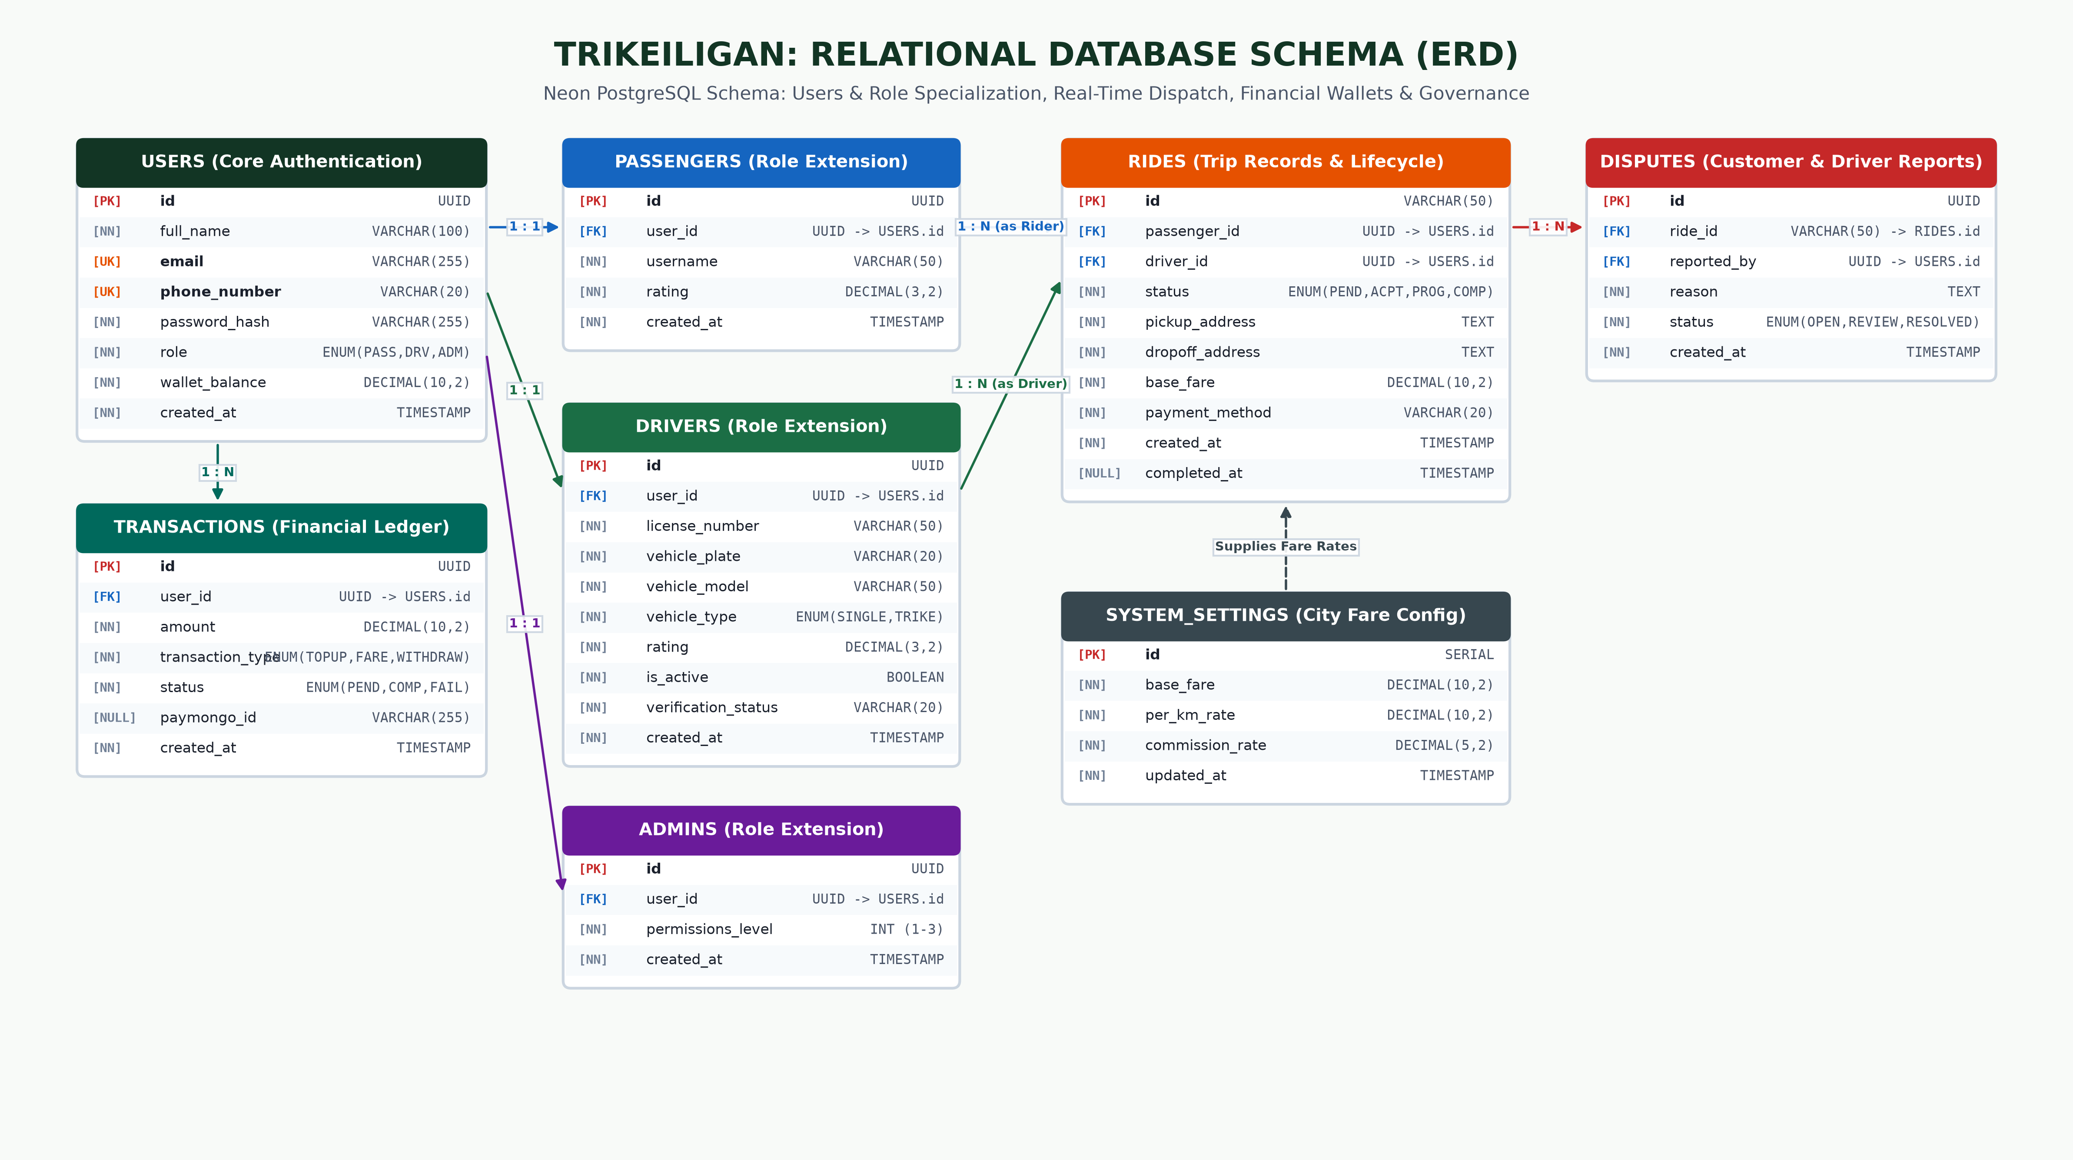
RELATIONAL DATABASE SCHEMA
Entity-Relationship Diagram (ERD)
Normalized PostgreSQL schema detailing tables, primary/foreign keys, and data relationships

Slide 7
ADMIN WEB PORTAL CAPABILITIES
Admin Operations: Paths A, B, C, & D
How the City Dispatcher manages approvals, active fleets, settings, and audits
PATH A
PATH B
PATH C
PATH D
Verification
Monitoring
Configuration
Reports & Analytics
Reviews pending driver applications, verifies TODA IDs and driver's licenses, and triggers instant SMS/push approval notifications.
Live dispatch view of active tricycles on an interactive map, monitoring ongoing trips and handling emergency breakdown or overcharging disputes.
Dynamic control to update standard city base fares, per-kilometer travel rates, and platform commission percentages without recompilation.
Generates weekly and monthly revenue summaries, driver performance reports, and exports raw dispatch data to CSV/PDF.

Slide 8
Moving Iligan City Forward
Safe Commutes for Citizens. Empowered TODA Drivers. Transparent City Governance.
TrikeIligan proves that localized technology can revolutionize everyday public transport without displacing existing transport livelihoods.
Thank you for your attention! Open for Questions & Demonstration.

