Slide 1
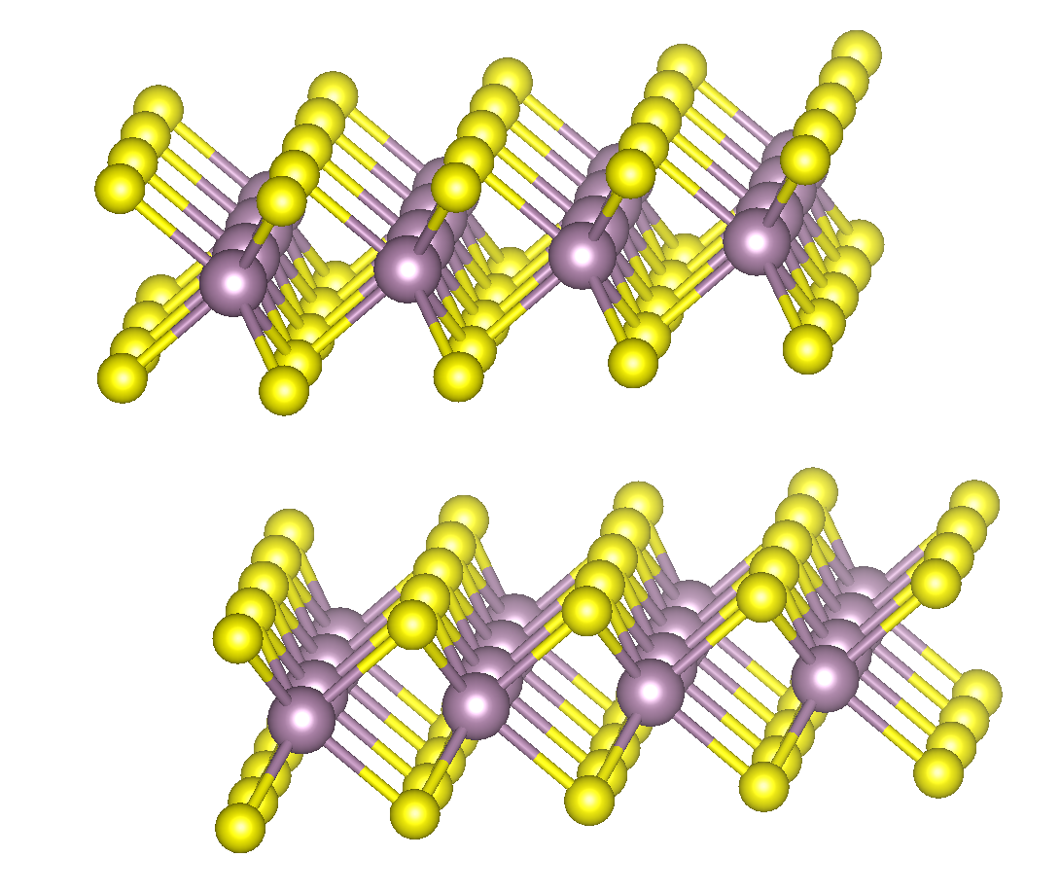
DFT-analysis of 3D & 2D model of MoS₂ [2H] Density of states & band structure
Notes:
Ikke snakk så altfor mye her.

Slide 2
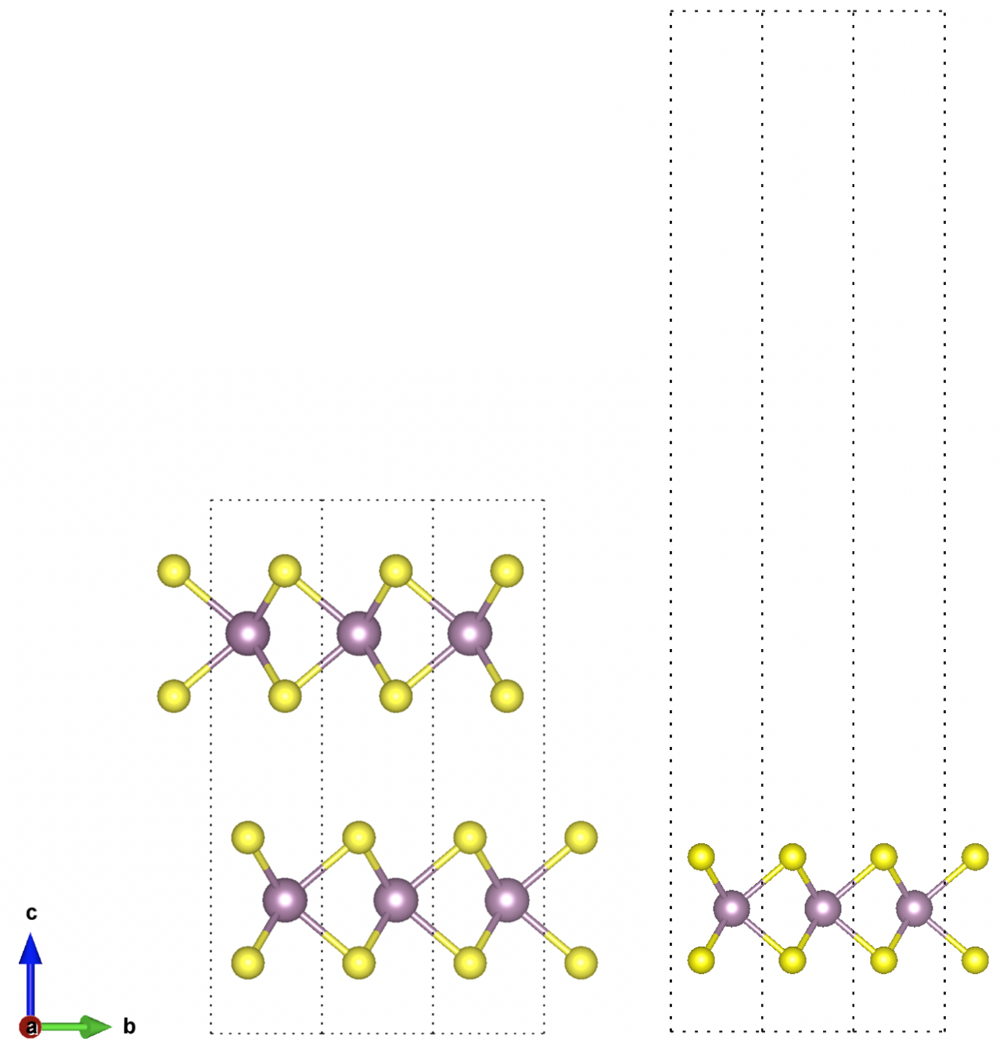
Crystal structure
MoS₂ [2H], classified as transition metal dichalcogenide (TMD)
Hexagonal crystal structure as indicated by [H]
Initial lattice paramteres given by POSCAR-file: a = 3.190Å and c = 14.879Å
Bulk and monolayer MoS2 2H, consist of 6 and 3 atoms respectively.
Trigonal prismatic arrangment of MoS₂ [2H]
Notes:
-2 indicates that the unitcell containes 2 layers.
-purple ball is Molybednum, yellow sulphide
-Trigonal prismatic arrangment means that the sulphides atoms is symmetric around the Molybednum atom.

Slide 3
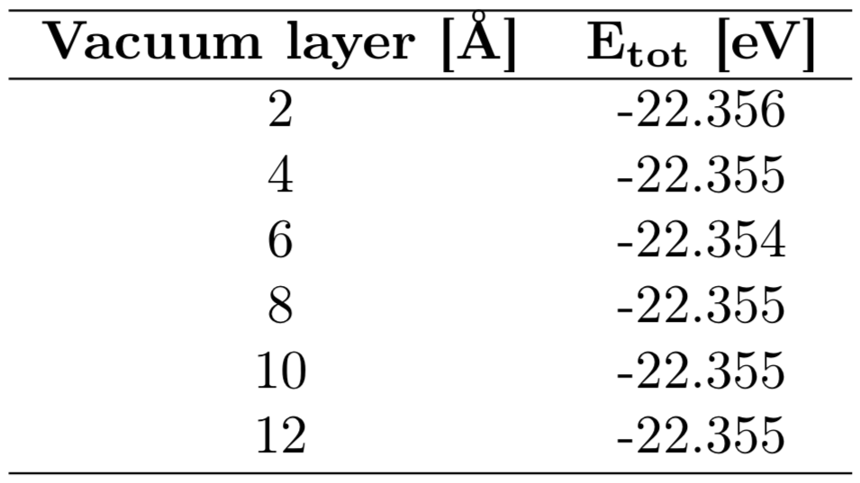
Creation of monolayer MoS₂ [2H]
Gradually increasing the vacuum layer with 2Å
tag IVDW = 1 inserted in INCAR-file
12Å where used as converged vacuum layer.
Tab.1 Vacuum layer inserted in c-direction in the initial POSCAR-file.
Notes:
Van der Waals forces acting between the layers. Inserting IVDW = 1, illustrating Van der Waals forces.

Slide 4
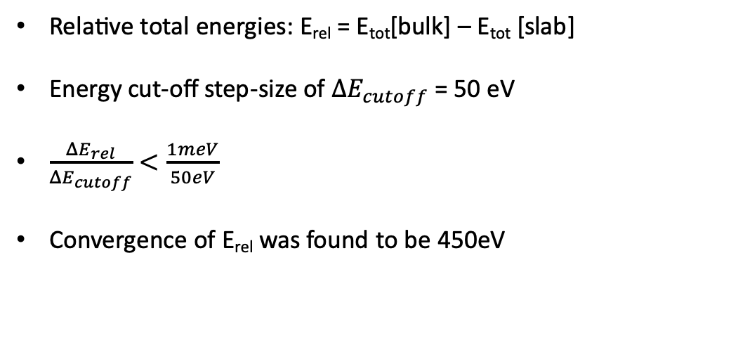
Convergence of energy cut-off
Relative total energies: E_{rel} = E_{tot}[bulk] – E_{tot} [slab]
Energy cut-off step-size of $ΔE_{cutoff}$= 50 eV
$\frac{{ΔE}_{rel}}{ΔE_{cutoff}}<\frac{1meV}{50eV}$
Convergence of E_{rel} was found to be 450eV

Slide 5
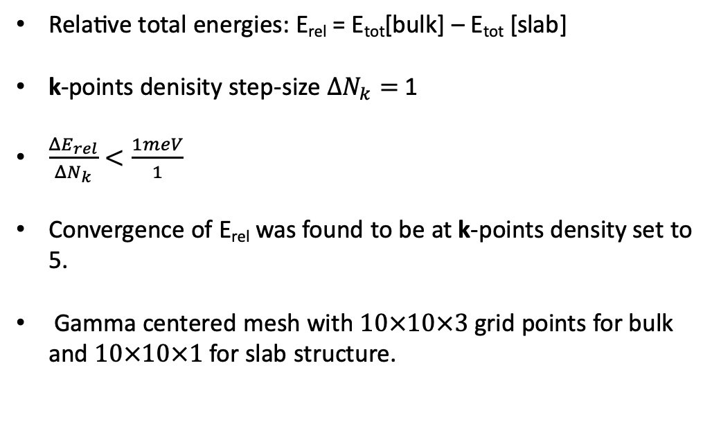
Convergence of k-points density
Relative total energies: E_{rel} = E_{tot}[bulk] – E_{tot} [slab]
k-points denisity step-size $ΔN_{k}=$1
$\frac{{ΔE}_{rel}}{ΔN_{k}}<\frac{1meV}{1}$
Convergence of E_{rel} was found to be at k-points density set to 5.
Gamma centered mesh with $10×10×3$ grid points for bulk and $10×10×1$ for slab structure.
Notes:
-Hexagonal structure, preferred to use gamma centered mesh.
-reason for 10x10x1 is due to increased vacuum layer increases the lattice parameter c, giving a "small" dimension in reciprocal space. Do not need many k-points in c-direction then.

Slide 6
Relaxtion of bulk MoS₂
Poor initial guess of atomic position.
INCAR-tag IBRION = 2
Initial lattice parameters set to: a = 3.190Å and c = 14.879Å, which yields a c/a-ratio of 4.66
After relaxation the new lattice parameters where calculated to a = 3.188Å and c = 12.403Å, with a c/a-ratio of 3.89
c/a-ratio has decreased with approximately 16.5%
In good agreement with experimental values of c/a = 3.90 [1]
Notes:
IBRION = 1 Close to the local minimum
IBRION = 2 conjugate gradient algorithm

Slide 7
Density of states
VASP using PAW-PBE potential with PE-GGA functional.
Notes:
-Point to bandgap, larger for monolayer than bulk.
-Higher density of states near valence band for monolayer compared to bulk.
- Peaks in DOS is Hove singularites, where the slope of DOS changes discontinously

Slide 8
Band structure
Bulk MoS₂ [2H] exhibits an indirect bandgap
Monolayer MoS₂ [2H] exhibits a direct bandgap
high-symmetry path: Γ − M − K − Γ
Notes:
Bulk - gamma centered bandgap.
Monolayer - K-centered bandgap

Slide 9
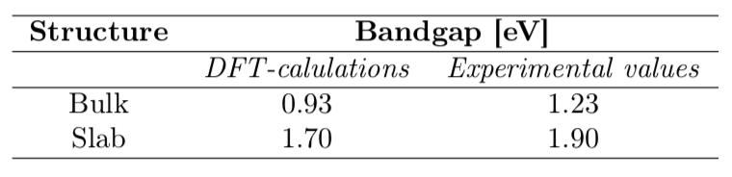
Band structure
Tab.2 Bandgap of both structures shown for DFT-calculations using PE-GGA functional and experimental values [2] [3]

Slide 10
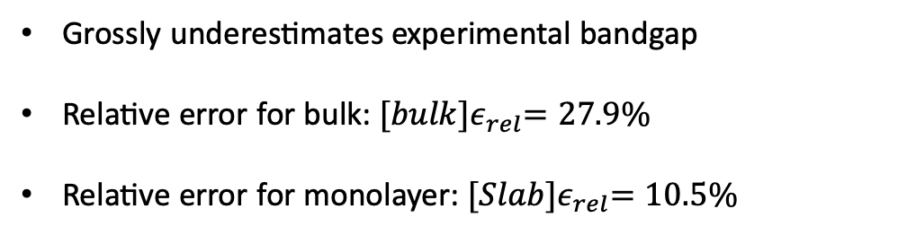
Band structure
Tab.2 Bandgap of both structures shown for DFT-calculations using PE-GGA functional and experimental values [2] [3]
Grossly underestimates experimental bandgap
Relative error for bulk: ${[bulk]ε}_{rel}=27.9\%$
Relative error for monolayer: ${[Slab]ε}_{rel}=10.5\%$

Slide 11
Applications of monolayer & DFT-Improvements
Beneficial in application such as:
Photodetectors
Photovoltaics
Photocatalysis

Slide 12
Applications of monolayer & DFT-Improvements
Beneficial in application such as:
Photodetectors
Photovoltaics
Photocatalysis
Improvments of DFT-calculation:
Hybrid functional; HSE06 functional

Slide 13
References
[1] Wakabayashi, N., Smith, H. G., & Nicklow, R. M. (1975). Lattice dynamics of hexagonal Mo S 2 studied by neutron scattering. Physical Review B, 12(2), 659.
[2] Lee, C., Yan, H., Brus, L. E., Heinz, T. F., Hone, J., & Ryu, S. (2010). Anomalous lattice vibrations of single-and few-layer MoS2. ACS nano, 4(5), 2695-2700.
[3] Mak, K. F., Lee, C., Hone, J., Shan, J., & Heinz, T. F. (2010). Atomically thin MoS 2: a new direct-gap semiconductor. Physical review letters, 105(13), 136805.

