Slide 1
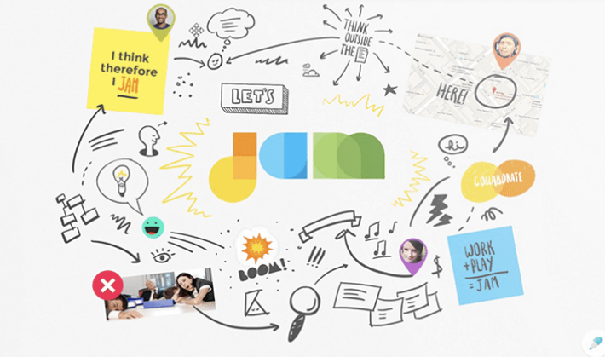
Google Jamboard Demo

Slide 2
Welcome to Jamboard! A great way to collaborate online with projects, brainstorming, and instructional sessions.
Previous Next

Slide 3
Whenever you’re ready to get started, click on Share to get the link or to add people and groups.
Previous Next

Slide 4
It’s easy to “Jam” on the whiteboard with numerous tools!
Previous Next

Slide 5
Several presets are available to facilitate demonstrations: grids, lines, dots, or even select a background of your own choosing like a map or room layout!
Previous Next

Slide 6
Writing and communicating on the board is a breeze with the pen utensil…
Previous Next

Slide 7
Writing and communicating on the board is a breeze with the pen utensil… and text box.
Previous Next

Slide 8
And if you make a mistake—no biggie! Just use the undo feature…
Previous Next

Slide 9
And if you make a mistake—no biggie! Just use the undo feature…or the erasing tool...
Previous Next

Slide 10
…or clear it all with “Clear Frame.”
Previous Next

Slide 11
Working remotely has its challenges, but selection tools like the arrow…
Previous Next

Slide 12
Working remotely has its challenges, but selection tools like the arrow… and laser pointer make it easy to be on the same page.
Previous Next

Slide 13
Best of all, you can call out great work with the sticky note!
Previous Next

Slide 14

Best of all, you can call out great work with the sticky note!
Previous Next

Slide 15
These are just the basics—Jamboard has many features! To check it out, type in Jamboard into your search engine and play away!
Previous Start Over

