Slide 1
Week-4 Homework: Tours
A Tour Mock-Up of the Blackboard software using Callouts.

Slide 2
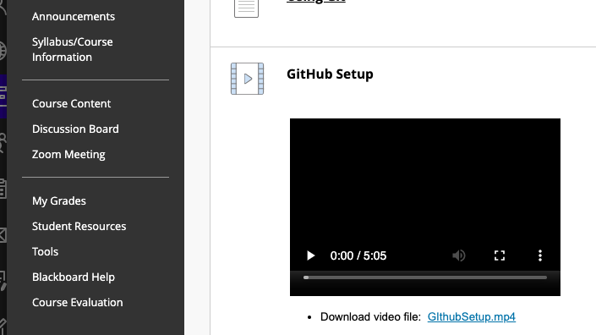
Discussion Board: Please click here to view the class discussion board.

Slide 3
GitHub Setup: Please click here to view the video recording of how to set up Github Desktop and your Github account.

Slide 4
GitHub Setup: Please click here to download the video file recording of the GitHub setup.

Slide 5
My Grades: Please click here to view your grades for this course.

