Slide 1
Sphinx and RST
Mark Hoeber

Slide 2
Topics
Quick Intro
What is Sphinx?
Sphinx examples
The tech stack
Elements of A Sphinx project
What is RST?
Some RST Syntax
Theming Sphinx
Build a Sphinx Project
Hosting a Sphinx Project
Sphinx Advantages

Slide 3
Quick Intro
Sr. Director, Customer Experience, Cybereason
Responsible for all documentation, training, online support.
Various related roles over last 20 years, focus on content systems.
First used Sphinx at edX in 2013. Since then built Sphinx-based solutions at several other companies.
Taught “Tools and Technologies for Technical Writers” at Middlesex Community College for 3 years.
hoeber.m.c@gmail.com

Slide 4
What is Sphinx?
Static doc generator
Web sites
PDFs
ePub
more . . .
Open source and free
Platform independent
First released 2008
Originated in Python community
Used extensively for documenting Python projects
Literally, an extensible Python package that takes RST content and creates websites, PDFs, and other documents

Slide 5
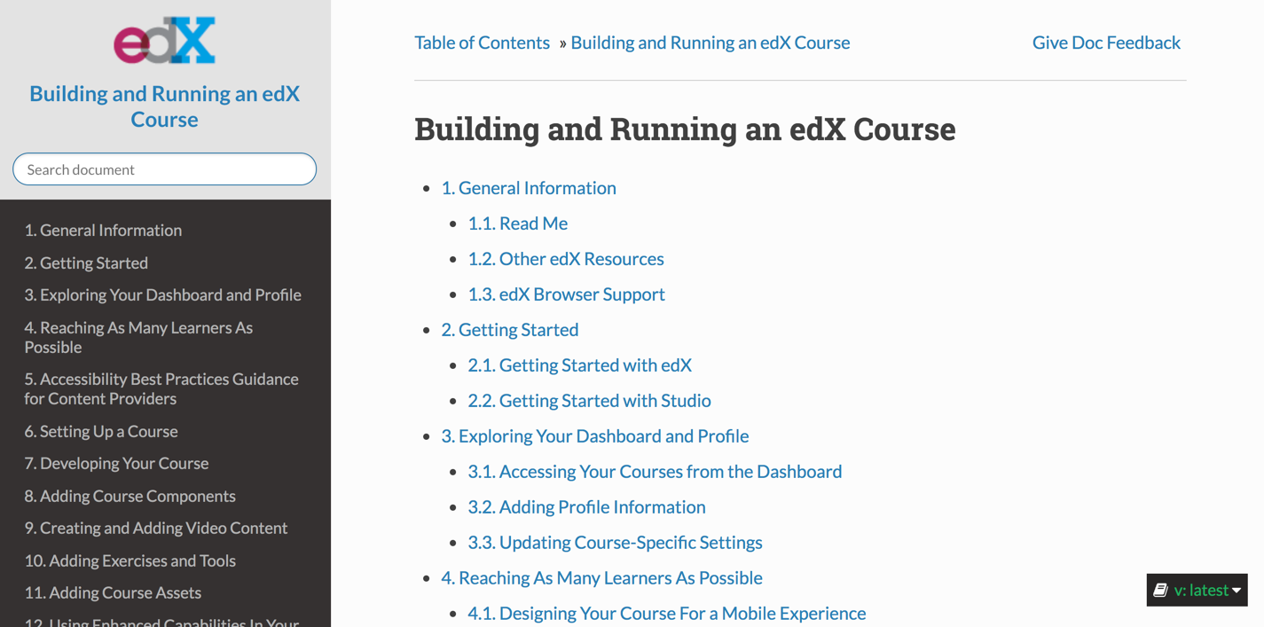
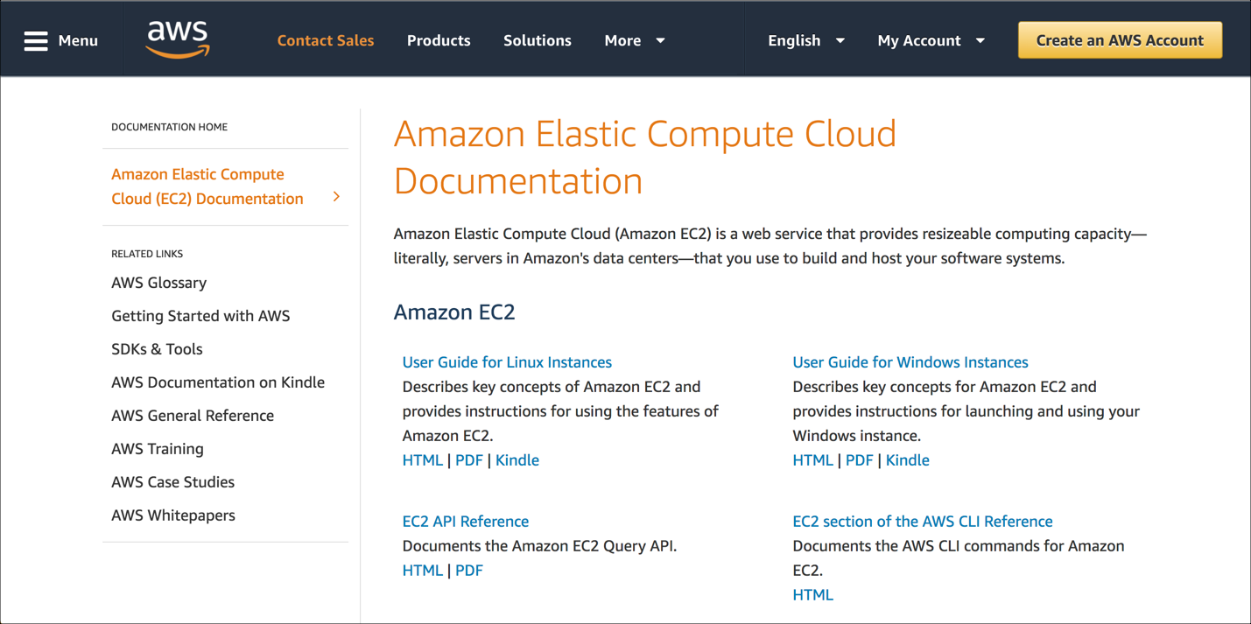
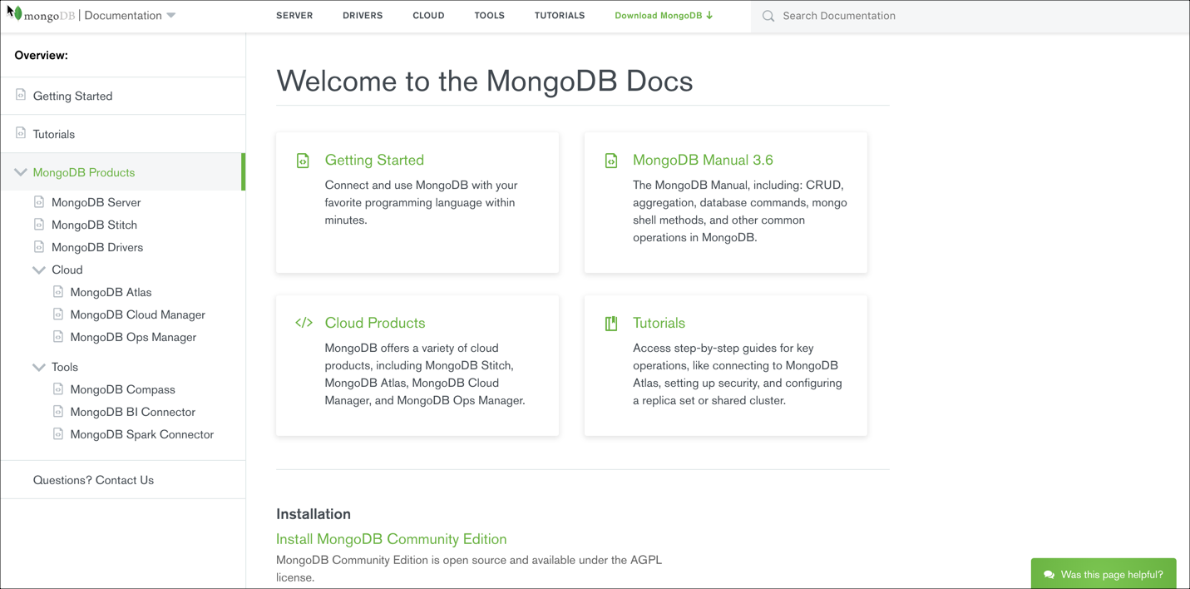
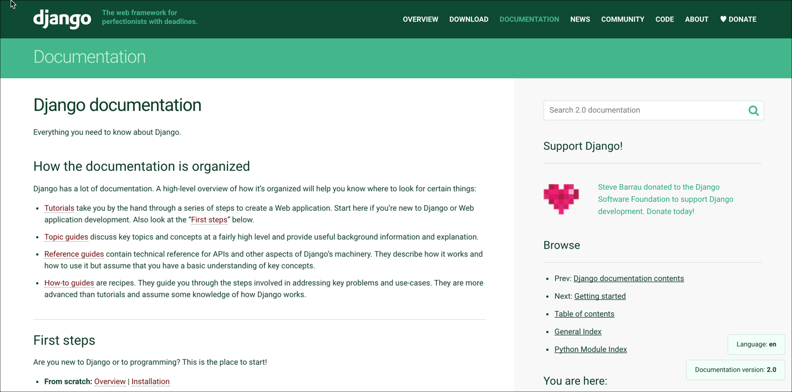
Examples of Sphinx Websites

Slide 6
Elements of a Sphinx Project
Basics
conf.py –contains configuration settings for project
index.rst – main TOC/structure file for project
Any other RST and images files for content
Make file – to build website/PDF, etc.

Slide 7
What is RST?
Just text
A markup language designed to be simple and unobtrusive
Like Markdown, with a few more options to support Sphinx functions
Editor independent – however you like to edit text

Slide 8
Basic RST Syntax
paragraph of text
with **bold**
with *italics*
with ``code``
* ul item one
# ol item

Slide 9
Basic RST Headings
H1
###########
H2
********
H3
==========

Slide 10
RST Directives
.. note:: note text
.. image:: image file
.. warning:: warning text
.. class:: css class
.. youtube:: video ID
.. glossary::
term
definition
.. codeblock::
code
.. |RST| replace:: reStructured Text

Slide 11
Theming
Themes are independent of content – apply any theme to your content
Dozens of publicly available themes
Typical workflow:
Find a theme that’s close to what you want
Override styles in your project
Build your website

Slide 12
Building a Project
Build commands in make file
Run from command line

Slide 13
Hosting Sphinx
Free hosting through ReadtheDocs.org
Easy setup
Automatic updates
(not secure)
Or for corporate projects, just host static HTML in a protected location

Slide 14
Sphinx Advantages
Free and lightweight
Extensible
Open source – 50+ extensions available
Likely that someone else as solved your problem
Any output, any customization
Built in translation management

Slide 15
References
Sphinx doc
Read the Docs
Sphinx extentions
RST Primer
Online RST primer
My Sphinx/RST guide

