Slide 1
The Good, the Bad, and the Not so Ugly Scenario
Tools and Technologies for Technical Writing:Final Project

Slide 2
The Good and the Bad
In Tools and Technologies for Technical Writing, many different tools in the form of applications, programs, languages, and standards were discussed.
This author found utility in everything we used.
However, when taking efficiency and adaptability into account, some tools were better than others.
Good: Microsoft Suite, HTML, Markdown, MadCap Flare, DITA, Oxygen Author
Bad: Adobe FrameMaker, reST
Notes:
I felt like I learned a lot from everything we discussed and I found utility in everything we used, or at least utility in some aspect of everything we used.
Good: MS office, PPT and Excel are all good tools and very common. HTML I really enjoyed because even though it’s hard at first, it makes sense, There’s a rule for everything, so if something’s broken you can figure it out. Markdown was simple and straightforward. MadCap Flare, hard but very useful. DITA with Oxygen Author, also challenging, but very useful.
Bad: Adobe FrameMaker I’ll get to in a bit. But, reST I thought was too much and preferred simple lightweight markdown.

Slide 3
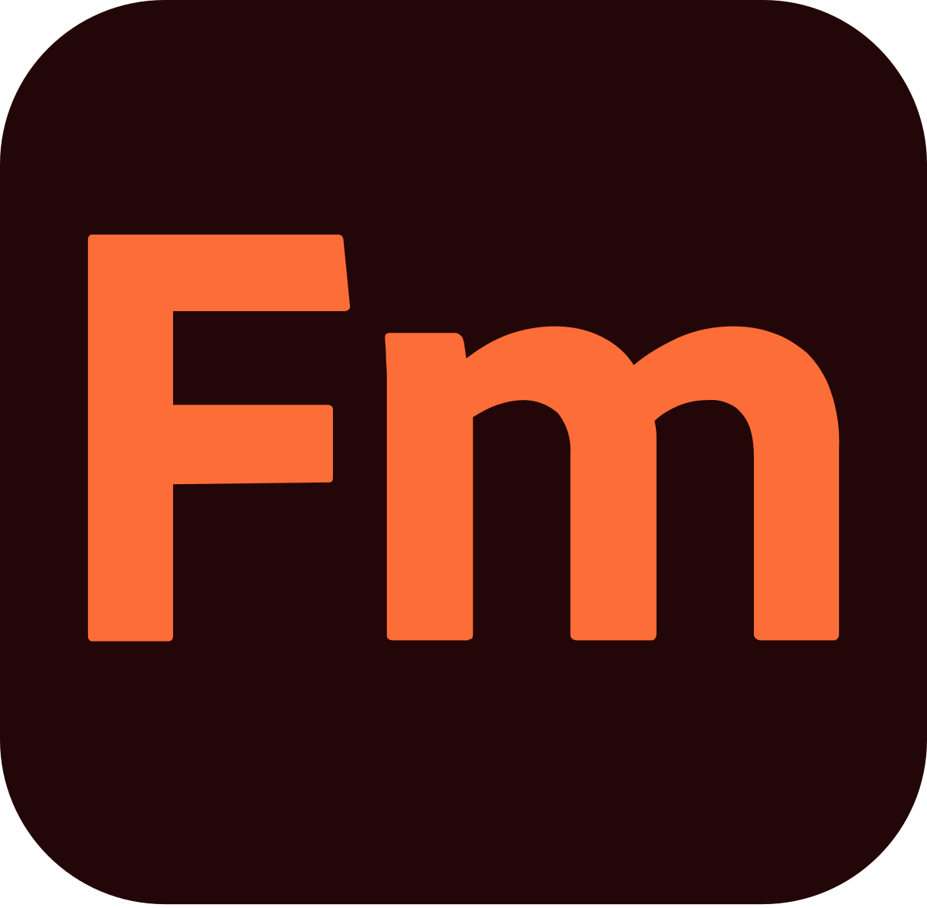
Least Favorite Tool: FrameMaker
Why do I dislike this tool?
Unnecessarily complex
Will seem foreign to younger users
Doesn’t seem to be looking forward
Notes:
While I feel the interface is somewhat comparable to Microsoft’s Office Suite which allows for ease of use for my generation and maybe one more after it, it seems unnecessarily complex. Just like with Office, to change a setting for something, you might be able to do it off the top menu or you might have to go ten windows deep. Because of its design, I think those entering the workforce in the next ten years (who have been using the Google Suite just as much as MS Office if not more) will have difficulties with its complex interface and when seeking employment would look elsewhere. For those who do end up taking a job that uses FrameMaker, hopefully their coworkers are helpful and very patient!

Slide 4
Least Favorite Tool: FrameMaker
Even though you really don't like this tool, why would you still use it? What are its advantages?
Because my company uses it
Good for consistency
Seems better suited for larger projects
It’s similar to MS products
You can work in chunks
Indexes and variables
Notes:
I would use it because my company uses it😊 Seriously, I think that larger more established organizations with multiple tech writers and product experts contributing to a product would want FrameMaker for consistency’s sake. Also, for organizations that need to have lots of documentation because it’s required (government) or complex (medical devices), FrameMaker seems to be better suited than something like MadCap Flare.
Its advantages are that it’s similar in structure to MS Office, a template can be used, one can work in chunks, and it is able to use indexes and variables to help with organization and material reuse.

Slide 5
Least Favorite Tool: FrameMaker
What would you use instead (and why)?
DITA/Oxygen
Better user interface
Skill transfer seems more likely with DITA/Oxygen
Notes:
It would depend on the scope of the project and how much money/how many resources my company had, but I think would pick DITA/Oxygen over FrameMaker. Yes, they are complicated (and much of the difficult work was done for me in our exercise—thank you Zoë), but at the same time the Oxygen interface seems much more user-friendly, and DITA’s structure is great for consistency. With anything new, there is much to learn and it’s uncomfortable at first. However, I feel the understanding and skills acquired with DITA and Oxygen are more likely to transfer than what one would learn on FrameMaker. Caveat…this is under the assumption there is already a person on the team with DITA Oxygen experience.

Slide 6
The Not so Ugly Scenario
Scenario 1

Slide 7

Scenario 1
• Sole writer
• Small startup
• Limited funds
• New web app with mobile version
• No translation

Slide 8

ProteSang
ProteSang a neurotech startup. For the last ten years most of their funds have gone to research and development. But now they have EO.
EO is a neural implant with an external port. When coupled with the company’s external jack and proprietary API, the user can actively engage with the online world.
With a working prototype, they are eager to increase public knowledge of their device with the hopes of building excitement and investors.
They want an interactive website and mobile app that provides a clear picture of the product, the operation, the costs, how the consumer will engage when “jacked-in,” frequently asked questions, legal, opt-in for updates on releases, and ProteSang’s vision for the future.

Slide 9
Which Tools Are Best?
Before deciding which tools to use, I would want to get as much information as possible.
We know ProteSang wants an interactive website and mobile app but before looking at tools and approaches we need know more.
Is EO the only project or are there others in the pipeline?
Would they eventually want to offer products through the web and mobile apps?
What do the CEO, CTO, etc. want?
Are there branding, marketing, or publicity components?
Notes:
Does ProteSang have other products they’re working on or do they plan to? To pick a platform for one product and find out six months down the road that there’s another and it needs A,B, and C…well that can happen at any time, but if you can plan for it all the better.
If the company eventually wants to sell products and services online, it may be better to pick a service that caters to that.
Getting the theme, the sense, the drive, the wants, the needs of the key players helps bring the presentation to life. Not to mention it will likely keep me from having to go back to the drawing board multiple times because I had a different vision than the people in charge.
Branding, marketing, publicity? Even if they aren’t a part of the team to start, the company would likely add them in the future. They are the presentation and trend experts!

Slide 10
Clean, Crisp, and Cheap
What do they want?
Now
In the future.
Basic info about product
Legal
FAQ’s
Opt-in for updates and release dates
Clean, crisp, cheap
CGI videos to help visualize user experience
Going worldwide (translation required)
Want the website/mobile app to be a place to customize avatar
Customization of smell/touch experience
Notes:
ProteSang wants clean, crisp, and cheap (inexpensive) to start. However, if they do gain more investors, they would like to double-down on their outreach, spending more money on things like CGI to imitate the user experience when jacked-in, and brand advisors/publicity managers.
ProteSang’s vision is that eventually the user will be able to customize the interface so they are projected however they would like to be (as opposed to one of 27 avatars currently available). And with future versions they hope to have incorporated touch and smell into the jacked-in experience, but the users will be able to opt-out or tone down the effects if the sensory input is too much. This changes would be done through the website, mobile app, or when jacked-in.
They also anticipate going worldwide in two years, which will require translations.

Slide 11




Which Tools are Best?
Based off ProteSang’s immediate wants and needs, I would recommend:
WordPress and MadCap Flare offer a clean, crisp presentation of material.
Notes:
Given ProteSang’s needs, I believe both WordPress ($25/mo) and MadCap Flare ($182/mo/user) would be good candidates to start. Both can produce a clean, crisp look on websites and mobile aps. Both would require obtaining a domain name and host.
.

Slide 12
But Which One?
WordPress
MADCAP FLARE
Pros:
Inexpensive $25/mo
Numerous templates
Easy customization
Opt-in Widgets/Plugins
Ecommerce ready
Cons:
No simplified workflow/shared content
No checks
Online help
Pros:
Several templates
Shared content across platforms/mediums
Lots of extras/professional
Easier to organize large amounts of content
Online help
Cons:
Not cheap $182/mo/user
Looks are not as varied or unique as WordPress
Steep learning curve
Notes:
WordPress Pros: Very inexpensive at $25/mo. The number of templates available is almost overwhelming and after you pick one you can still customize it to make it exactly what you want (thank you open source). There are a number of widgets/plugins you can add to your site so visiting folks can sign up for newsletters. Ecommerce is easy to set up.
Cons: While the difference between websites and mobile apps is easy to configure, there are no options to use the same content in a manual, or an email to new subscribers, or brochures at medical conferences. Also, unlike MadCap Flare, there are few tools for insuring your content is clean and crisp before you put it out there in the world. Also, online help…it’s there, but there’s so much variety that when looking for help it’s hard to nail down.
MadCap Flare Pros: MadCap Flare has several clean easy to use templates. You can share content between different platforms/mediums using conditional tags, variables, and snipets allowing what you want to go where you want (in/on a website, mobile app, brochure, manual, etc) without having to write it several times over (single source). MadCap Flare’s indexing is pretty good too!
Cons: Though MadCap is great for making materials look consistent, clean, and crisp between mediums, if you want to stand out or at least look different from your competetors, MadCap Flare lacks in this area. Also, MadCap Flare is expensive! Lastly, MadCap Flare has a steep learning curve, especially when compared to Wordpress.

Slide 13
Start with WordPress…
…but prepare for MadCap Flare.
WordPress - Clean,crisp layout that is relatively inexpensive.
Ten years later,
MadCap Flare - Single source publishing for the virtual tutorials, online manuals, email brochures, web and mobile apps.
Notes:
WordPress is the best choice to start because it is cheap, relatively easy to use, and can quickly get off the ground with just the one tech writer. But, if the company finds success, it will need manuals, brochures, and virtual tutorials in addition to the web and mobile apps. It needs single source publishing. I’d expect they should be able to afford it in a couple years.

Slide 14
Demo Time!
MadCap Flare and Wordpress: Themes and changing header images

