Slide 1
Tools and Technologies for Tech Writers
Sarim Proeung

Slide 2
MadCap Flare
Content management application
Can use to create, manage, and publish content
Has both HTML and XML editor
Can create online Help sites, software document, training guides, policies & procedures, instructor & student manuals for use online and in print

Slide 3
Advantages
Can reuse content so it saves time maintaining and updating topics
Can create content from scratch and can drag and drop topics into Table of Contents (TOC)
Can import from other sources such as PDF, Microsoft Word, Excel, Adobe Framemaker, DITA, and Markdown
Can publish content as HTML5, WebHelp, PDF, Word, XHTML
Easy to add in content in XML Editor or you can edit the code manually in the Text Editor. You can focus on your content.

Slide 4
Single Source Authoring & Templates
Single source authoring – can reuse content (topics) in different formats
Can save money, time, consistency, flexibility, less repetition
Built-in project templates and pre-written manuals

Slide 5
Content Organization
Stored as topics and other files such as images and videos.
Content organized into topics makes it easier to assemble and create user guides, user manuals, employee handbooks, policies & procedures, and online help.
Content in separate topics makes it easy to edit and add content.

Slide 6
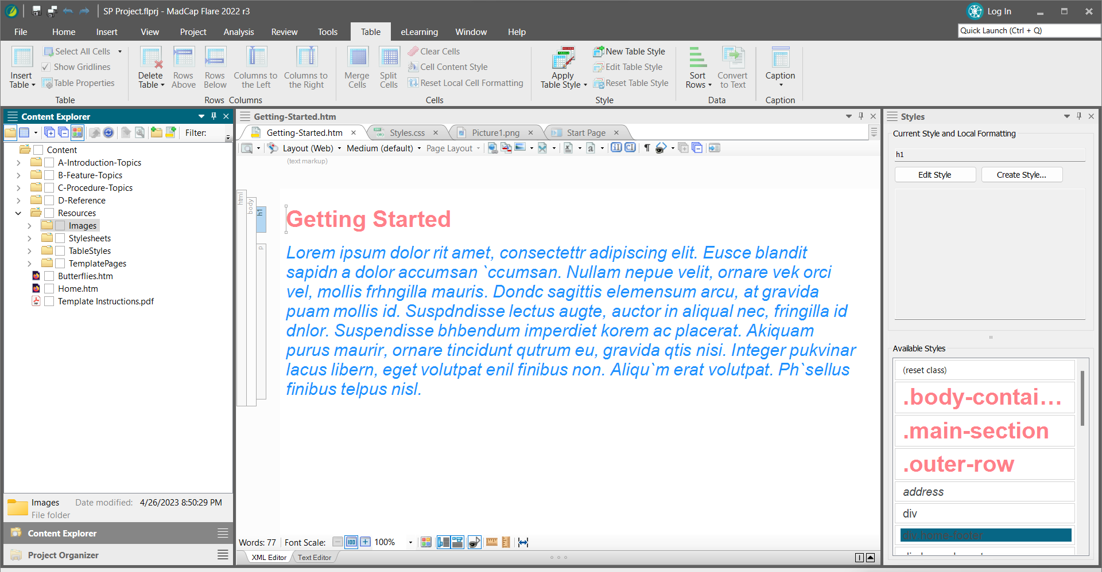

Slide 7
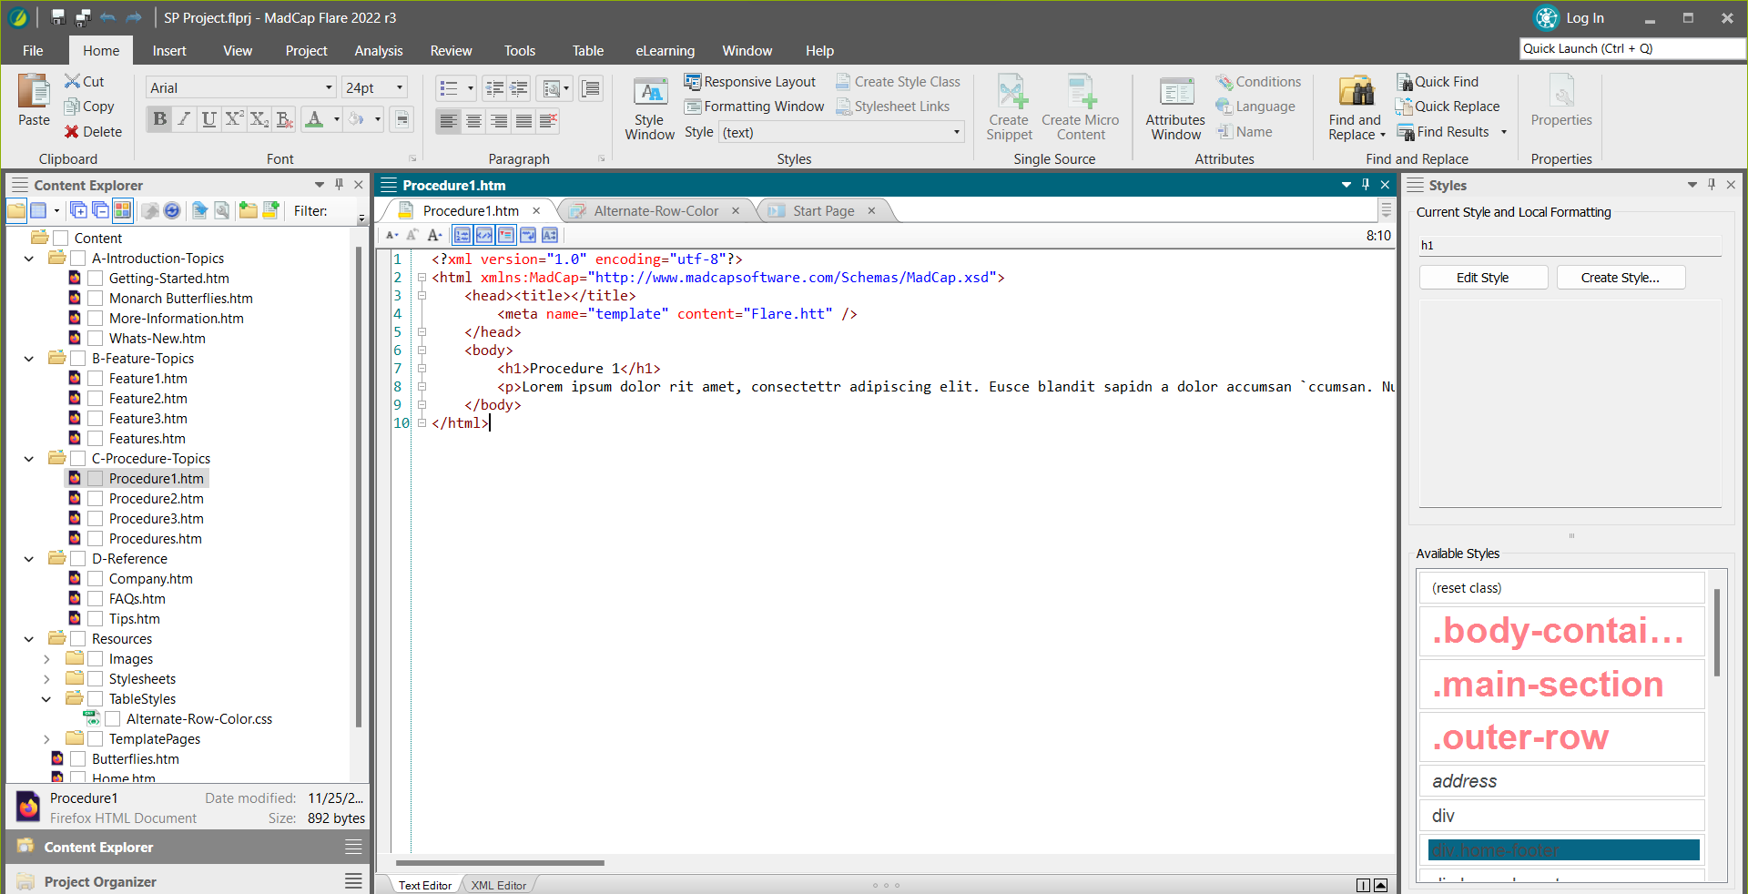

Slide 8
Disadvantages
Cost - $182 per user/per month
May need to watch their tutorial videos to learn how to use all their capabilities

Slide 9
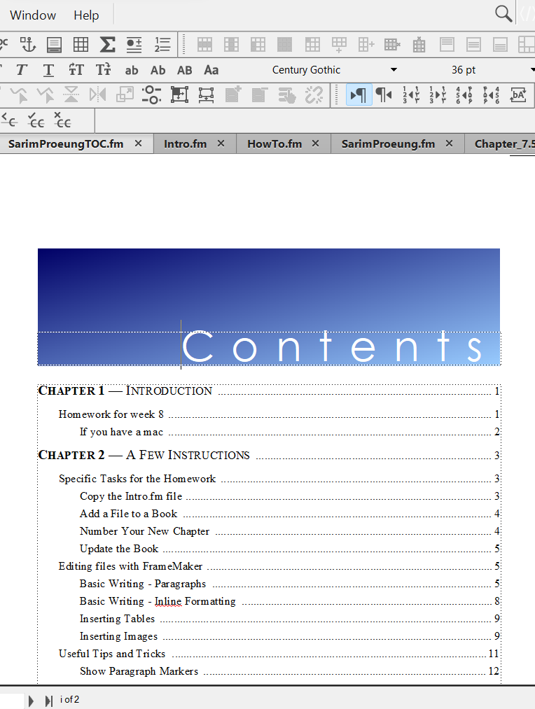
Least Favorite Tool
Adobe FrameMaker

Slide 10
Adobe FrameMaker
Can handle huge documents and reports
$39.99/month or $479.88/year
Can be used to manage and publish books

Slide 11
What it can do?
Author
Include tables, content, and graphics, XML
Manage
Use and share within a team for reviews and collaboration
Publish
PDF, HTML, Kindle, EPUB, Kindle, IOS, Android, Web Help

Slide 12
Challenges
Template-based approach to create documents but must be careful to follow exact processes.
Not intuitive and wasn’t very user-friendly.
Cross references were hard to resolve. If you were to inherit document files with problems with formatting it would take time to clean it up.
Could be a problem as technical documents needs to be regularly edited and updated.

