Slide 1
Concord Town Website Mock Up
By KS

Slide 2
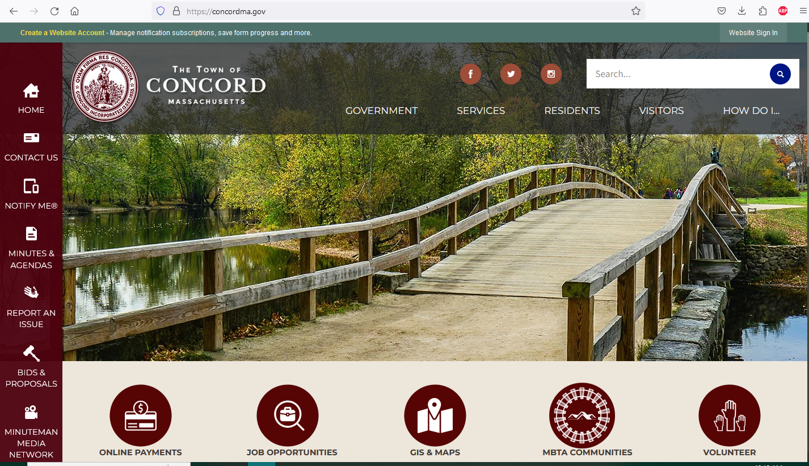
Find information on elections/voting and birth/death certificates here!

Slide 3
Pay property and excise taxes and utility bills here!

Slide 4
Need information on trash and recycling? Find it here!

Slide 5
Looking to visit Minuteman National Park? Find information here!

