Slide 1
Intro to GitHub

Slide 2
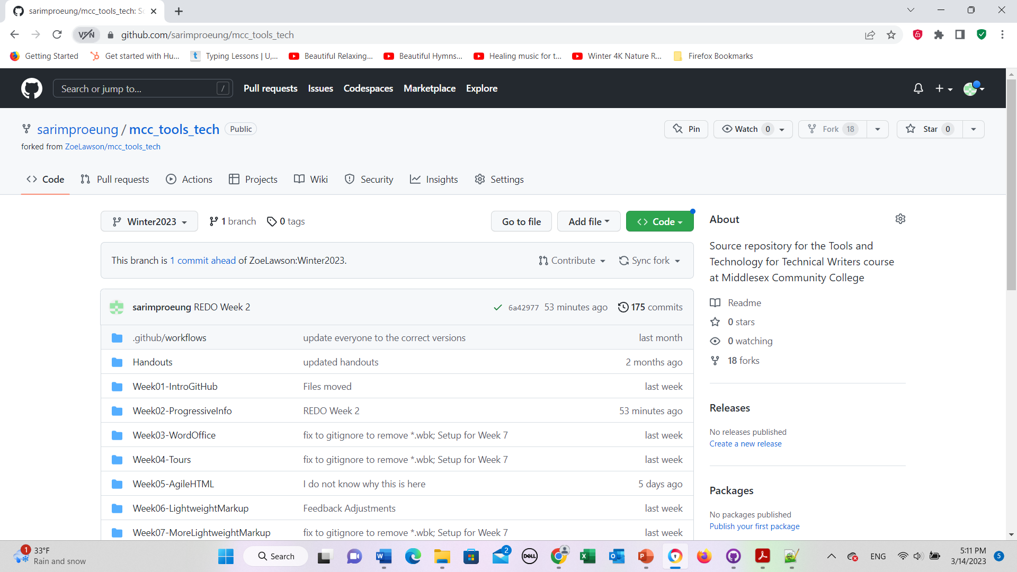
Click here after you push to origin on GitHub Desktop

Slide 3
This is the settings tab

Slide 4
Click to update

Slide 5
This is the settings tab

Slide 6
This is the actions tab

