Slide 1
OCCO
Project Status Report
Adam Visegradi adam.visegradi@sztaki.mta.hu

Slide 2
Outline
Goals, what OCCO intends to be
SotA
OCCO’s relation to the SotA; why we are making it
Extendability, flexibility
The state of the project
Architecture; how we are doing it
Base principles
Small, well-defined components (flexibility)
High abstraction of internal components help extensibility (plug-ins)
Communication model
OOP design with RMI kept in mind
Monolithic (self-contained) executable for integration is possible
Most class connections are separable: fully distributed architecture is also possible
And anything in-between
Message queues (why instead of REST interfaces—built-in asynchrony, arbitrarily long queues with persistence (cf. socket), simple scalability for independent messages)
Information and data model; the InfoBroker; YAML;
Abstract solution: control circuit; Enactor maing decisions (programmer), IP executing instructions (CPU), on the SC and CH (hardware)

Slide 3
Motivation
Automated infrastructure instantiation and management
Offline description how an infrastructure should look like
An infrastructure can be instantiated automatically, or with a single click of a user
Hence the name: One-Click Cloud Orchestrator
Automation in a cloud
Node instantiation
Through an API or a UI
Node configuration management
Chef, Puppet, etc.
Our goal is a extending these to infrastructures

Slide 4
Motivation Use cases
Automated infrastructure instantiation and management
Starting demo, tutorial, testing, or any other throw-away infrastructures
Original use case idea
Dynamic workflow support
If a wf node needs a specific kind of infrastructure to run, OCCO can be used to instantiate, manage, and tear down the necessary infrastructure as necessary
Data-driven workflow infrastructures
One could convert a WF into an infrastructure of data-driven services
This infrastructure can be kept running for as long as there is incoming data (possibly for long term)
The infrastructure components can be scaled dynamically
Taking devops to the next level: an extension to Chef/Pupper/etc.

Slide 5
State of the Art
feature\System | Juju | OneFlow | Cloud- Formation | Heat | SlipStream | OpsWorks | "OneClick" plans | "OneClick" plans | "OneClick" “vision”
 |  |  |  |  |  |  | 31-Jul-14 | 31-Jul-15
OS Support | Ubuntu | Hypervisor dependant | Fixed list of Linux distributions Windows Server FreeBSD | Hypervisor dependant | Supports wide variety of OS | Amazon Linux, | Supports wide variety of OS | Supports wide variety of OS | Supports wide variety of OS
 |  |  |  |  |  | Ubuntu 12.04 LTS
Supported cloud backends | AWS EC2, HP Cloud Services, Windows Azure, Openstack | OpenNebula | AWS EC2 | OpenStack | OpenStack, AWS EC2, OCCI, Microsoft Azure, etc. | AWS EC2 | General EC2, | General EC2, | All widely accepted Cloud Interfaces
 |  |  |  |  |  |  | could be easily extended later | OCCI(?),
 |  |  |  |  |  |  |  | could be easily extended later
Node management method | Service Composer | Image Based | Service Composer | Service Composer | Image Based | Service Composer | Service Composer, | Service Composer, Chef, other SotA composer(s) | Generic Service Composer, Integrated Abstract image management
 |  |  |  |  |  |  | Chef
Open source | Yes | Yes | No | Yes | Partly | No | Yes (?) | Yes (?) | Yes (?)
Hosted service | Hosted | No | Hosted | No | Hosted | Hosted | No | No | No + SaaS
Infrastructure Auto healing | No | Yes | Yes | Yes | No | Yes | Hopefully | Yes | Yes
Manual Infrastructure Scalability | Yes | Yes | Yes | Yes | Yes | Yes | No | Yes | Yes
Automatic Infrastructure Scaling | No | Yes | Yes | Yes | No | Yes | No | Yes(?) | Yes
UI | CLI, GUI | Web frontend, CLI | management console, CLI, API | CLI, API, Horizon dashboard | Web UI | management console, CLI, SDK | API, CLI | API, CLI, HTML5 Web frontend(?) | API, CLI, HTML5 Web frontend, SaaS
One Click UI | No | No | No | No | No | No | Yes | Yes | Yes
Service composer support | Juju | — | Chef, Puppet | Chef, Puppet | — | Chef | loose integration with Chef | loose integration with Chef, other SotA composer(s) | Generic Service Composer, Integrated Abstract image management
Multi-cloud provisioning | Yes | No | No | No | Yes | No | Yes | Yes | Yes
Maturity (subjectively between 1-5) | 3 | 1 | 5 | 2 | 2 | 1 | 1 | 2 | 4

Slide 6
State of the Art Why bother?
Best candidates
Juju
Uses self-developed configuration management—less mature than Chef or others
Script-based, imperative configuration management, hook method
Cf. Chef: declarative, idempotent definitions, converging method
Stuck with Ubuntu
OpsWorks
Chef’s developers, using Chef (much better than Juju in this sense)
Stuck with Chef, Amazon
Heat
OpenStack’s developers
Stuck with OpenStack

Slide 7
State of the Art Why bother?
Generally:
Most of these are vendor/technology-locked
Hosted paying services—hard to use from academy
Our goals
Being flexible: interchangeable internal parts, algorithms, services; compartmentalization
Being extensible: no vendor lock-in (Chef/Puppet/etc.; Amazon/ONE/OpenStack/etc.)
Scalable: ability to handle many instances of huge infrastructures
Robust: ability of handling failures if possible, recovering from failures

Slide 8
Architecture How do we achieve: Being flexible?
Well-defined components
Component roles are well-defined; there is no overlap among components
Changing a component is simple, and can be done without interfering with other components
Interchangeable internal parts, algorithms, services
Inserting new components (broker!) in the OCCO architecture is simple
Data abstraction
Components don’t rely on data they do not need
Changing the data content does not break components relying on only the schema
Hierarchical, distributed Information Broker with single access point
Single access point to all the information in the system simplifies the architecture a great deal
The Information Broker is split into semantically closed, interchangeable modules
Parts of the Information Broker can be changed without the clients realizing it

Slide 9
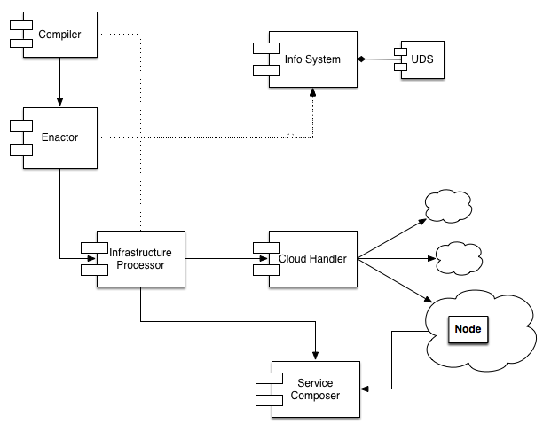
Architecture How do we achieve: Being flexible
Interchangeable internal components for flexibility
Each component has a well-defined role
Multiple implementations for the same role possible
E.g.: UDS (User Data Store)
Database manipulation abstraction layer
Can be implemented using RDMS, any kind of key-value-store, file system, mixed
Current implementation: Redis

Slide 10
Architecture How do we achieve: Being extensible
We want no vendor/technology lock-in
We need the abstraction of two external services:
Node handling: instantiation, status querying, management, destroying
Node configuration management: installing and configuring node instances
Internal data abstractions
Internal components must be oblivious to the content of offline descriptions
E.g.: a node of type ‘X’ has to be instantiated
Internal nodes may pass the definition of ‘X’ around, but must not rely on its content

Slide 11
Architecture How do we achieve: Being extensible
“External” services
Abstract external services for extensibility:
Cloud Handler
Responsible for node creation and management
Pluggable backends:
Boto EC2 done,
Etc. later
Service Composer
Responsible for node configuration
Pluggable backends:
Chef under development
Etc. later

Slide 12
Architecture How do we achieve: Being scalable?
Scalable architecture
Distributable components
Scalable algorithms in the implementation
E.g.: generators instead of lists wherever possible; explicit parallel implementation if preferable (Infrastructure Processor)
Message queues
Asynchronous communication wherever possible
Implicit parallelization of message processing (e.g. Cloud Handler)
The system can be split on any queue (distributed architecture)
Discretionary RMI
Every connection among classes is implemented with simple method calling (non-distributed, monolithic execution possible)
But the interfaces are designed with distributability in mind: inter-component connections are splittable: RMI through MQ (mostly distributed infrastructure)
Anything in-between
Notes:
Solving resumability for the IP could become a great feature: the IP could quit as a process after creating a node. Whenever an IP process is started, it must first check if it’s in a waiting session, and resume waiting if it is (i.e., check the node then quit again). So it will not use any resources.
Trivial part-solution: after starting a node, register this information in a database. When staring up, check there.
When failing/sleeping/anything (process exit), the message will remain in the queue. At next startup, this message will be delivered again automatically. This means that resuming is only a simple condition at the beginning of CreateNode.perform
This would also probably help aborting or changing the infrastructure while in a transient state: the Enactor could use this information too. (E.g.: consider the pending node as +1 for that node, and generate one less CreateNode instructions).

Slide 13
Architecture How do we achieve: Being robust?
Stateless and restartable components
Failing components can be simply restarted
Single critical point: between starting a node and waiting for it to become ready
Persistent message queues
Aborted tasks will not fail permanently
They remain in the message queue until ACK-ed or aborted explicitly

Slide 14
Components
InfoBroker (incl. the User Data Store)
Compiler
Enactor
InfraProcessor
ServiceComposer
CloudHandler

Slide 15
InfoBroker
In the architecture, as a role, the centralized source of all information
The implementation is not centralized
Hierarchical connection and aggregation of sub-brokers
Stand-alone, semantically closed, functionally disjoint info-broker modules (backends) can be implemented, then aggregated behind a single façade
The User Data Store (UDS), a persistent data store, is such a backend
Any connection in the hierarchy can be decoupled (remote info-brokers)
(Graffle UML)

Slide 16
Compiler
Passive component (essentially, just a library)
Loads an infrastructure description
Validates it against data in the UDS
The compiled and validated static description can be stored in the UDS
Currently quite trivial
Only a topological layering is implemented
No schema checking, no validation

Slide 17
Enactor
Passive component, acts only upon external trigger
Input: single infrastructure identifier
Loads the compiled static description of the infrastructure from the UDS
Acquires the dynamic state of the infrastructure through the InfoBroker
𝜹 := (dynamic state - static description)
𝜹 is a series of lists of instructions: list₁, list₂, …, list_{n}
Each list must be performed one after the other
Instructions in a list may be performed concurrently
𝜹 is pushed to the InfraProcessor

Slide 18
InfraProcessor
Active component, processing a message queue
Synchronously performs instructions of the Enactor
Communicates with the InfoBroker, the CloudHandler, and the ServiceComposer to perform a single instruction
One InfraProcessor handles one infrastructure
Includes a message queue dedicated to this infrastructure
Performs a list of instructions, and waits for all of them to finish
Instructions in a list may be performed concurrently
The next list in the sequence will be performed only after the previous list has finished

Slide 19
CloudHandler
A service with a class of actuators as backends
Operations: start_node, drop_node, get_node_status
A single cloud handler backend can perform tasks specific to a given class of cloud
E.g.: the Boto EC2 VM cloud handler can perform EC2 specific operations on VMs
For each class of backend clouds a cloud handler must be implemented
E.g. Boto EC2, CloudSigma
Not VM specific; not even cloud specific
I.e.: the operations declared can be interpreted in other environments
Not only VMs, but Floating IP-s specified as nodes in the graph (handler: BotoEC2-Net)
Back-ends could include local processes (start_node=start_process, drop_node=kill, etc.), Vagrant nodes, supervisord processes, whatever…

Slide 20
ServiceComposer
Component responsible of
Support composing nodes (if necessary; e.g. prepared images will not need it)
Connect interdependent nodes in an infrastructure
This will be Chef at first; can be extended later.
Details TBA

Slide 21
Development Environment
Python 2.7
Git [https://gitlab.lpds.sztaki.hu/groups/cloud-orchestrator]
Jira [https://jira.lpds.sztaki.hu/browse/OCD]
Documentation [http://c153-33.localcloud/util-doc/util.html]
Sphinx, docstrings
Testing: Python nosetests
Deployment: setuptools
Development pacakge repo: [http://c153-86.localcloud:8080/packages]
Works best with virtualenv
Package dependencies
PyYAML, argparse, python-dateutil, pika (for RabbitMQ), Boto, etc.
TODO: Integrating these into Jenkins
Automatic package repo updating
Automatic testing

Slide 22
Repositories
git
https://gitlab.lpds.sztaki.hu/groups/cloud-orchestrator
Each package has its own repository
Plus
Demo – containing standalone executables that can run OCCO (until an API package is released)
Documentation
Publications

Slide 23
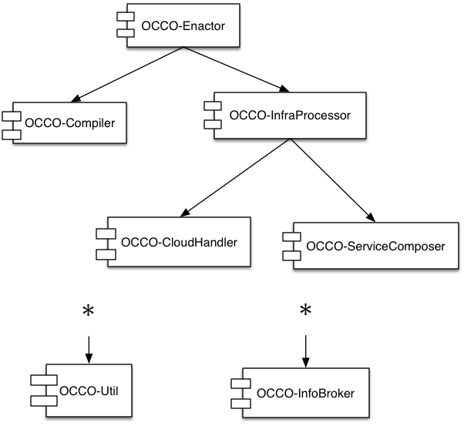
Deployment
Standard Python deployment: distutils
Each component has its own package
Independent components may not be installed
Package dependencies:
TODO: revise
E.g. We have namespace packages now

Slide 24
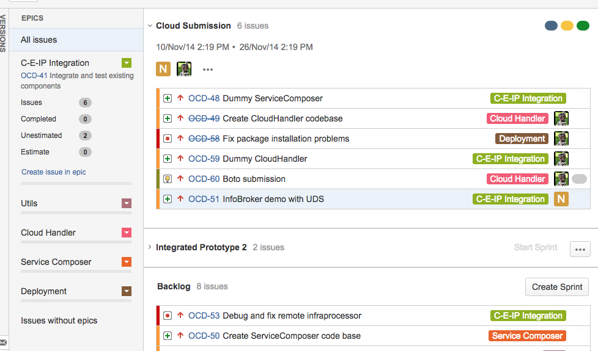
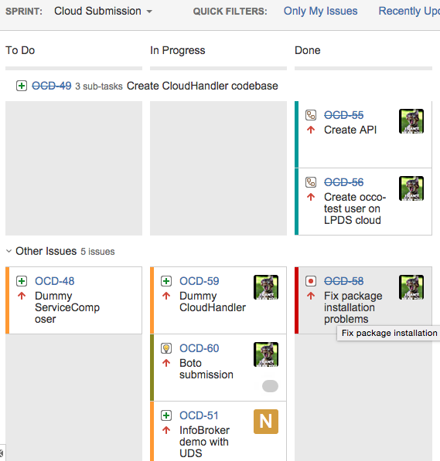
Development and Release
We’re using Jira with a Scrum board
https://jira.lpds.sztaki.hu/browse/OCD
https://jira.lpds.sztaki.hu/secure/RapidBoard.jspa?rapidView=14&view=planning.nodetail

Slide 25
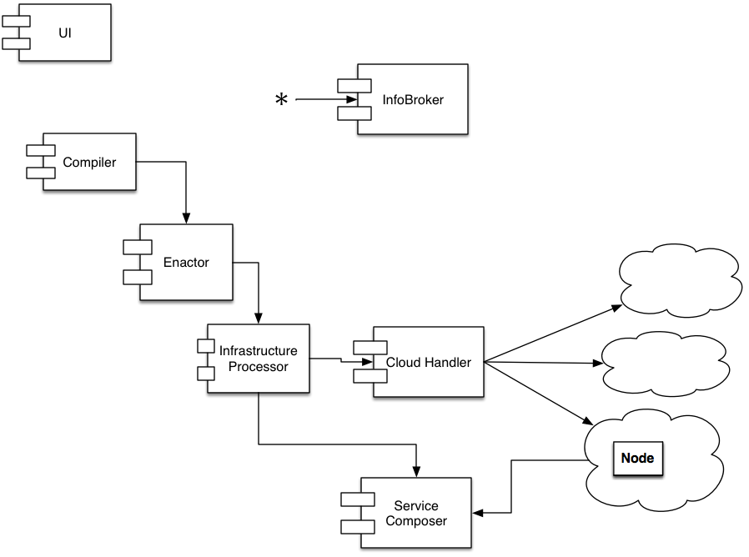
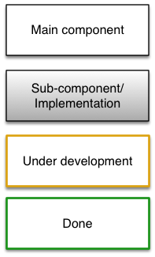
Components
Focus

Slide 26
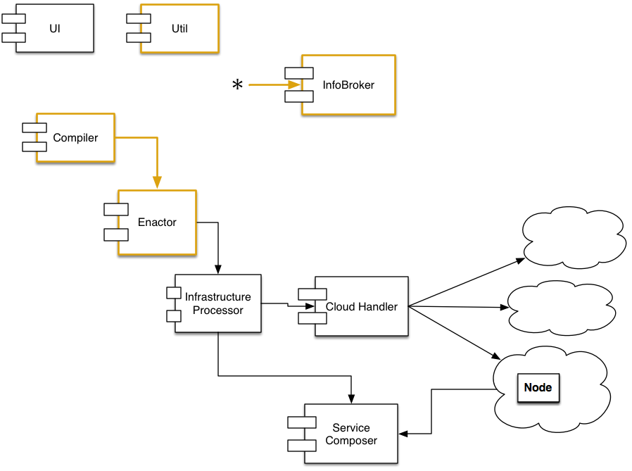
Codebase (May-August, ‘14)
Main goals:
Codebase skeleton
Packages, git repos, documentation, formal requirements, experimenting, utilities, testing
InfoBroker
Communications
By “accident”:
Compiler and Enactor
Focus

Slide 27
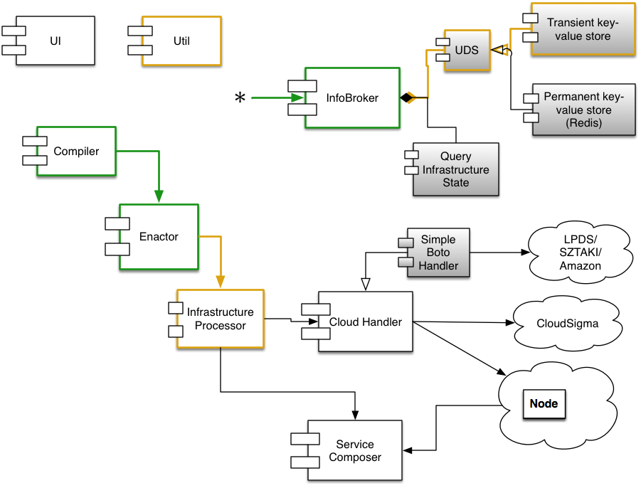
1st sprint (October, ‘14)
Main goals:
Infra Processor
Cooperation of existing components
Expected outcome:
Core prototype
The Compiler-Enactor-InfraProcessor triplet (the core) can work together using dummy cloud-handler and service composer; it simulates infrastructure creation successfully.
Focus

Slide 28
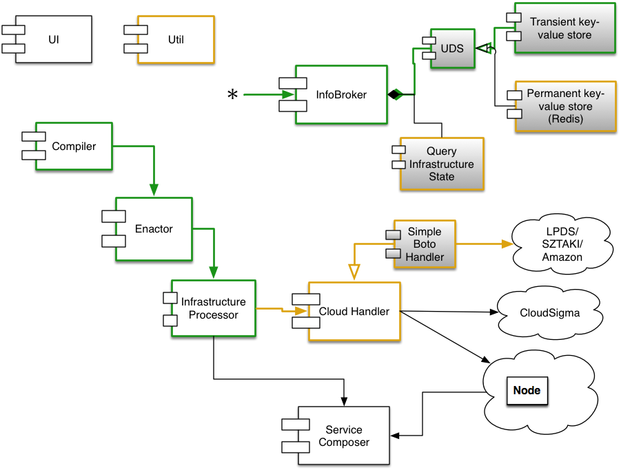
2nd sprint (November, ’14)
Main goals:
Cloud submitting without contextualization
Permanent UDS
Focus
Expected outcome:
Cloud submission prototype
OCCO can create an infrastructure using prepared images.
Using the service composer is not yet a goal.

Slide 29
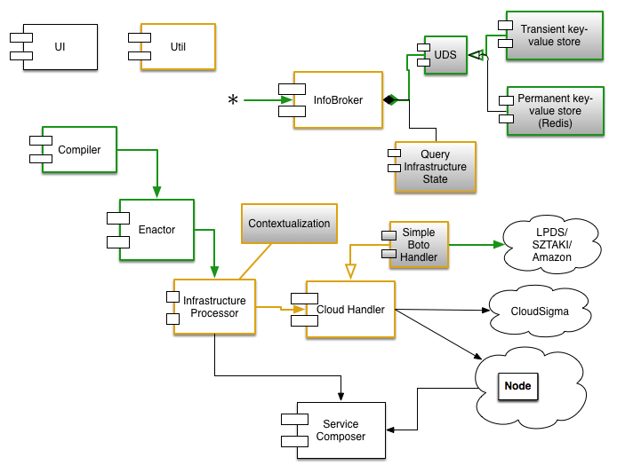
3rd sprint (December-January, ’14-15)
Main goals:
Integrating existing components
Excl.: ServiceComposer
Focus
Expected outcome:
Cloud submission prototype
OCCO can create an infrastructure using prepared images.
Using the service composer is not yet a goal.

Slide 30
Current Status
Aside the Service Composer and an API, OCCO is mostly functional
This means that an infrastructure can be instantiated from a description
VMs are started and contextualized as specified in the description [demo]
The codebase is about 80% extensively documented
Developer documentation: [http://c153-33.localcloud/util-doc] (from LPDS network only)
About 5000 lines of Python code, of which 3000 are documentation and comments; plus overhead (package definitions, etc.); plus lots of UML diagrams

Slide 31
Plans
Priority tasks (~in order)
Finishing documentation (2-3 days, immediate to-do; required to share code)
API to integrate the primitives provided by the existing system into coherent use-cases
Adam Novak
Update unit tests (they’ve been neglected in the sprinting)
Jenkins integration tests
Service Composer
Required before release

Slide 32
Acknowledgements
Mark Gergely, co-architect
Adam Novak, co-developer
Special thanks to:
Jozsef Kovacs, Gabor Kecskemeti

