Slide 1
OCCO
Project Status Report
Adam Visegradi adam.visegradi@sztaki.mta.hu

Slide 2
Outline
Goals, what OCCO intends to be
SotA
OCCO’s relation to the SotA; why we are making it
Extendability, flexibility
The state of the project
Architecture; how we are doing it
Base principles
Small, well-defined components (flexibility)
High abstraction of internal components help extensibility (plug-ins)
Communication model
OOP design with RMI kept in mind
Monolithic (self-contained) executable for integration is possible
Most class connections are separable: fully distributed architecture is also possible
And anything in-between
Message queues (why instead of REST interfaces—built-in asynchrony, arbitrarily long queues with persistence (cf. socket), simple scalability for independent messages)
Information and data model; the InfoBroker; YAML;
Abstract solution: control circuit; Enactor maing decisions (programmer), IP executing instructions (CPU), on the SC and CH (hardware)

Slide 3
Motivation
Automated infrastructure instantiation and management
Offline description how an infrastructure should look like
An infrastructure can be instantiated automatically, or with a single click of a user
Hence the name: One-Click Cloud Orchestrator
Automation in a cloud
Node instantiation
Through an API or a UI
Node configuration management
Chef, Puppet, etc.
Our goal is a extending these to infrastructures

Slide 4
Motivation Use cases
Automated infrastructure instantiation and management
Starting demo, tutorial, testing, or any other throw-away infrastructures
Original use case idea
Dynamic workflow support
If a wf node needs a specific kind of infrastructure to run, OCCO can be used to instantiate, manage, and tear down the necessary infrastructure as necessary
Data-driven workflow infrastructures
One could convert a WF into an infrastructure of data-driven services
This infrastructure can be kept running for as long as there is incoming data (possibly for long term)
The infrastructure components can be scaled dynamically
Taking devops to the next level: an extension to Chef/Pupper/etc.

Slide 5
State of the Art
feature\System | Juju | OneFlow | Cloud- Formation | Heat | SlipStream | OpsWorks | "OneClick" plans | "OneClick" plans | "OneClick" “vision”
 |  |  |  |  |  |  | 31-Jul-14 | 31-Jul-15
OS Support | Ubuntu | Hypervisor dependant | Fixed list of Linux distributions Windows Server FreeBSD | Hypervisor dependant | Supports wide variety of OS | Amazon Linux, | Supports wide variety of OS | Supports wide variety of OS | Supports wide variety of OS
 |  |  |  |  |  | Ubuntu 12.04 LTS
Supported cloud backends | AWS EC2, HP Cloud Services, Windows Azure, Openstack | OpenNebula | AWS EC2 | OpenStack | OpenStack, AWS EC2, OCCI, Microsoft Azure, etc. | AWS EC2 | General EC2, | General EC2, | All widely accepted Cloud Interfaces
 |  |  |  |  |  |  | could be easily extended later | OCCI(?),
 |  |  |  |  |  |  |  | could be easily extended later
Node management method | Service Composer | Image Based | Service Composer | Service Composer | Image Based | Service Composer | Service Composer, | Service Composer, Chef, other SotA composer(s) | Generic Service Composer, Integrated Abstract image management
 |  |  |  |  |  |  | Chef
Open source | Yes | Yes | No | Yes | Partly | No | Yes (?) | Yes (?) | Yes (?)
Hosted service | Hosted | No | Hosted | No | Hosted | Hosted | No | No (Yes) | No + SaaS
Infrastructure Auto healing | No | Yes | Yes | Yes | No | Yes | Hopefully | Yes | Yes
Manual Infrastructure Scalability | Yes | Yes | Yes | Yes | Yes | Yes | No | Yes | Yes
Automatic Infrastructure Scaling | No | Yes | Yes | Yes | No | Yes | No | Yes(No?) | Yes
UI | CLI, GUI | Web frontend, CLI | management console, CLI, API | CLI, API, Horizon dashboard | Web UI | management console, CLI, SDK | API, CLI | API, CLI, HTML5 Web frontend(?) | API, CLI, HTML5 Web frontend, SaaS
One Click UI | No | No | No | No | No | No | Yes | Yes | Yes
Service composer support | Juju | — | Chef, Puppet | Chef, Puppet | — | Chef | loose integration with Chef | loose integration with Chef, other SotA composer(s) | Generic Service Composer, Integrated Abstract image management
Multi-cloud provisioning | Yes | No | No | No | Yes | No | Yes | Yes | Yes
Maturity (subjectively between 1-5) | 3 | 1 | 5 | 2 | 2 | 1 | 1 | 2 | 4

Slide 6
State of the Art Why bother?
Best candidates
Juju
Uses self-developed configuration management—less mature than Chef or others
Script-based, imperative configuration management, hook method
Cf. Chef: declarative, idempotent definitions, converging method
Stuck with Ubuntu
OpsWorks
Chef’s developers, using Chef (much better than Juju in this sense)
Stuck with Chef, Amazon
Heat
OpenStack’s developers
Stuck with OpenStack

Slide 7
State of the Art Why bother?
Generally:
Most of these are vendor/technology-locked
Hosted paying services—hard to use from academy
Our goals
Being flexible: interchangeable internal parts, algorithms, services; compartmentalization
Being extensible: no vendor lock-in (Chef/Puppet/etc.; Amazon/ONE/OpenStack/etc.)
Scalable: ability to handle many instances of huge infrastructures
Robust: ability of handling failures if possible, recovering from failures

Slide 8
Architecture How do we achieve: Being flexible?
Well-defined components
Component roles are well-defined; there is no overlap among components
Changing a component is simple, and can be done without interfering with other components
Interchangeable internal parts, algorithms, services
Inserting new components (broker!) in the OCCO architecture is simple
Data abstraction
Components don’t rely on data they do not need
Changing the data content does not break components relying on only the schema
Hierarchical, distributed Information Broker with single access point
Single access point to all the information in the system simplifies the architecture a great deal
The Information Broker is split into semantically closed, interchangeable modules
Parts of the Information Broker can be changed without the clients realizing it

Slide 9
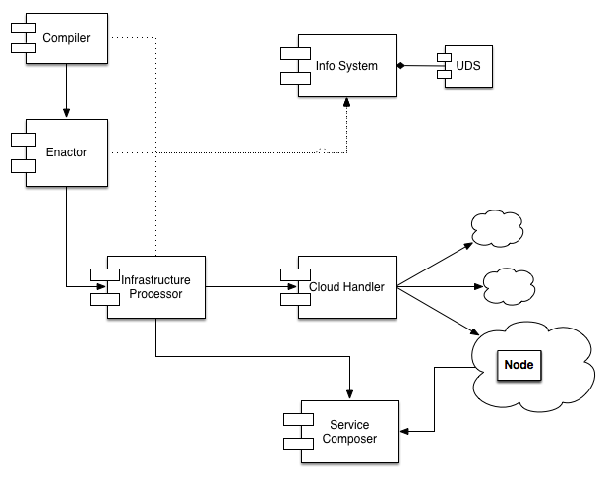
Architecture How do we achieve: Being flexible
Interchangeable internal components for flexibility
Each component has a well-defined role
Multiple implementations for the same role possible
E.g.: UDS (User Data Store)
Database manipulation abstraction layer
Can be implemented using RDMS, any kind of key-value-store, file system, mixed
Current implementation: Redis

Slide 10
Architecture How do we achieve: Being extensible
We want no vendor/technology lock-in
We need the abstraction of two external services:
Node handling: instantiation, status querying, management, destroying
Node configuration management: installing and configuring node instances
Internal data abstractions
Internal components must be oblivious to the content of offline descriptions
E.g.: a node of type ‘X’ has to be instantiated
Internal nodes may pass the definition of ‘X’ around, but must not rely on its content

Slide 11
Architecture How do we achieve: Being extensible
“External” services
Abstract external services for extensibility:
Cloud Handler
Responsible for node creation and management
Pluggable backends:
Boto EC2 done,
Etc. later
Service Composer
Responsible for node configuration
Pluggable backends:
Chef under development
Etc. later

Slide 12
Architecture How do we achieve: Being scalable?
Scalable architecture
Distributable and disposable components
Scalable algorithms in the implementation
E.g.: generators instead of lists wherever possible; explicit parallel implementation if preferable (Infrastructure Processor)
Message queues
Asynchronous communication wherever possible
Implicit parallelization of message processing (e.g. Cloud Handler)
The system can be split on any queue (distributed architecture)
Optional RMI
Every connection among classes is implemented with simple method calling (non-distributed, monolithic execution possible)
But the interfaces are designed with distributability in mind: inter-component connections are splittable: RMI through MQ (mostly distributed infrastructure)
Anything in-between
Notes:
Solving resumability for the IP could become a great feature: the IP could quit as a process after creating a node. Whenever an IP process is started, it must first check if it’s in a waiting session, and resume waiting if it is (i.e., check the node then quit again). So it will not use any resources.
Trivial part-solution: after starting a node, register this information in a database. When staring up, check there.
When failing/sleeping/anything (process exit), the message will remain in the queue. At next startup, this message will be delivered again automatically. This means that resuming is only a simple condition at the beginning of CreateNode.perform
This would also probably help aborting or changing the infrastructure while in a transient state: the Enactor could use this information too. (E.g.: consider the pending node as +1 for that node, and generate one less CreateNode instructions).

Slide 13
Architecture How do we achieve: Being robust?
Stateless and restartable components
Failing components can be simply restarted
Single critical point: between starting a node and waiting for it to become ready
Persistent message queues
Aborted tasks will not fail permanently
They remain in the message queue until ACK-ed or aborted explicitly

Slide 14
Components
InfoBroker (incl. the User Data Store)
Compiler
Enactor
InfraProcessor
ServiceComposer
CloudHandler

Slide 15
InfoBroker
In the architecture, as a role, the centralized source of all information
The implementation is not centralized
Hierarchical connection and aggregation of sub-brokers
Stand-alone, semantically closed, functionally disjoint info-broker modules (backends) can be implemented, then aggregated behind a single façade
The User Data Store (UDS), a persistent data store, is such a backend
Any connection in the hierarchy can be decoupled (remote info-brokers)
There will always be something to implement in the IB
User-friendly information about infrastructure
Depends heavily on semantics (the service), so this should be pluginable and specifyable in the node definition (analogous to synchronization).
This affects other components too.
Error information
Querying logs, console output, etc.
Very important for proper debugging of node definitions.
Again, strongly coupled with backend type/service.
See also: InfraProcessor
Caching (maybe not needed inside OCCO – should rather be done in a layer between UI and OCCO)
Sharding (simple to implement, in the general Provider; may not be optional)

Slide 16
Compiler
Passive component (essentially, just a library)
Loads an infrastructure description
Validates it against data in the UDS
The compiled and validated static description can be stored in the UDS
Currently quite trivial
Only a topological layering is implemented
No schema checking, no validation (P1)
If input is generated, this is only necessary for testing and easier development
Currently, variables are static data (P2)
Referencing other variables and dynamic information (ibget) needs a semantic sorting, in which order variables can be evaluated

Slide 17
Enactor
Passive component, acts only upon external trigger
Input: single infrastructure identifier
Loads the compiled static description of the infrastructure from the UDS
Acquires the dynamic state of the infrastructure through the InfoBroker
𝜹 := (dynamic state - static description)
𝜹 is a series of lists of instructions: list₁, list₂, …, list_{n}
Each list must be performed one after the other
Instructions in a list may be performed concurrently
𝜹 is pushed to the InfraProcessor
Changeable component
New behavior can be implemented if necessary (P1)
Event-based
Externally controlled
More complex decisions
etc.

Slide 18
InfraProcessor
Active component, processing a message queue
Synchronously performs instructions of the Enactor
Communicates with the InfoBroker, the CloudHandler, and the ServiceComposer to perform a single instruction
When creating a node, waits for the service to become available
Multiple strategies
The strategy required is specified in the node definition
One InfraProcessor handles one infrastructure
Includes a message queue dedicated to this infrastructure
Performs a list of instructions, and waits for all of them to finish
Instructions in a list may be performed concurrently
The next list in the sequence will be performed only after the previous list has finished
Missing features
Error handling, timeout (P4)
Distinguish fatal and transient errors
Errors that the backend reports, but will retry automatically, can be waited upon
Errors that the backend cannot handle must be treated as critical errors
How to handle critical errors? Tear down the infrastructure? Notify user and wait for manual intervention (maybe teardown, but not automatically)?
Error information (P3)
Many sources: error responses of course, log files on VMs, logs in the hypervisor, console output on VM, etc.
Cancellation (P5)
Resource allocation transaction
When an error or cancellation happens during node creation, resources already allocated must be freed to avoid leaking
Multiprocessing (P4)

Slide 19
CloudHandler
A service with a class of actuators as backends
Operations: start_node, drop_node, get_node_status
A single cloud handler backend can perform tasks specific to a given class of cloud
E.g.: the Boto EC2 VM cloud handler can perform EC2 specific operations on VMs
For each class of backend clouds a cloud handler must be implemented
E.g. Boto EC2, CloudSigma
Not about VMs; not even about cloud
I.e.: the operations declared can be interpreted in other environments
Not only VMs, but Floating IP-s specified as nodes in the graph (handler: BotoEC2-Net)
Back-ends could include local processes (start_node=start_process, drop_node=kill, etc.), Vagrant nodes, supervisord processes, whatever…
ResourceHandler would be a much suitable name
Missing features
Multi-tenancy: plugins are already supported, but there is no dispatching (P2) among them at the code level. This can be worked around using a MQ, but a dispatcher would be better for testing.

Slide 20
ServiceComposer
Component responsible of
Support composing nodes (if necessary; e.g. prepared images will not need it)
Connect interdependent nodes in an infrastructure
Chef plugin has been created, mostly works
Missing features
Like the CloudHandler: no dispatching (P2)
Chef feature: cookbook version specification in the Chef environment (P4)
Problem: contradicting node definitions (P1)
Possible solutions:
Wrapper cookbooks containing version constraints (tight coupling of wrapper cookbooks to node definitions)
More reliability (use tested, verified constellations of cookbooks)
Less reusability (version constraints specific to that node definition)
Other, offline vendoring strategies (chef solo, berkshelf – tight coupling of a specific set of cookbooks to the node definition)
No central server – no environment
Therefore, no dynamic connecting, reconnecting, currently no possibility to handle failures
Static connections (fix ipaddress, e.g.) still work

Slide 21
API
CLI
Main: infrastart, infrastop, nodestart, nodestop, ibclient, listnodes
Aux: redisload, redisload
Remote API
manager_service
Authentication, authorization (P5); UI/application will be responsible
Listing, querying, etc. (P4)

Slide 22
Overall
Standardizing resource and service statuses; backend independent, matching OCCO semantics (P5)
E.g.: unknown, pending, ready, permanently_failed, temporarily_failed, shutdown
Infrastructure/node details
Format and semantics tightly coupled with the service
Specified in node definition and infrastructure description
Including user-friendly summaries (like “BOINC server ops URL” in ocdemo) (P5)
Error information propagation
From deep inside the resources, to the UI
Queryable event log (P5)
So the user can see what happened, when
Timestamping everything (see above)
Trivial feature, but extremely useful, probably required

Slide 23
Summary
Node status standardization and upkeep
Error handling and propagation
Supplying user with information about infrastructure
ServiceComposer and CloudHandler dispatching
IP parallelization
IP cancellation (purge queue, abort, rollback)
Schema checking
Evaluable variables (semantic ordering, evaluation)
InfoBroker
Caching
Sharding
1 implicitly implements automatic healing (this is the only missing feature for this)
2 is very important for the user
2 needs 6/rollback
2 helps 6/abort (abortion is a special exception)
Using multiprocessing, 5 is ok with 6
9/caching may not be necessary at all
9/sharding is simple, short, and may be necessary
5 is an optimization
7 is necessary for human—service interaction only
7 is useful for machine—service interaction (testing, debugging)

Slide 24
Summary
P5 Node status standardization and upkeep
P4 Error handling and (P3) propagation
P5 Supplying user with information about infrastructure, event logging, timestamping
P2 ServiceComposer and CloudHandler dispatching
P4 IP parallelization
P5 IP cancellation (purge queue, abort, rollback)
P1 Schema checking
P2 Evaluable variables (semantic ordering, evaluation)
InfoBroker
Caching
Sharding
P1 Enactor: New behavior as needed by the Portal
P4->P1 Cookbook version specification
(X) P5 Authentication and Authorization; but UI will be responsible
P4 Listing, querying – as needed
Node status standardization and upkeep
Error handling and propagation
Supplying user with information about infrastructure
ServiceComposer and CloudHandler dispatching
IP parallelization
IP rollback
IP abort
IP cancellation (purge queue, abort, rollback)
Schema checking
Evaluable variables (semantic ordering, evaluation)
InfoBroker Caching
InfoBroker Sharding
1 implicitly implements automatic healing (this is the only missing feature for this)
2 is very important for the user
2 needs 6/rollback
2 helps 6/abort (abortion is a special exception)
Using multiprocessing, 5 is ok with 6
5 is an optimization
9/caching may not be necessary at all
9/sharding is simple, short, and may be necessary
7 is necessary for human—service interaction only
7 is useful for machine—service interaction (testing, debugging)

Slide 25
Summary
P5 Node status standardization and upkeep
P5 Supplying user with information about infrastructure, event logging, timestamping
P5 IP cancellation (purge queue, abort)
P4 Listing, querying – as needed
P4 Error handling
P4 InfoBroker Sharding
P4 IP parallelization
P3 Error information propagation
P2 ServiceComposer and CloudHandler dispatching
P2 IP rollback
P2 Evaluable variables (semantic ordering, evaluation)
P1 Schema checking
P1 InfoBroker Caching
P4->P1 Cookbook version specification (can be circumvented)
PX (was 1) Enactor: New behavior as needed by the Portal (X: as needed; not in scope now)
PX (was 5) Authentication and Authorization (X: UI will be responsible)

Slide 26
Summary
P5 Node status standardization and upkeep
P5 Supplying user with information about infrastructure, event logging, timestamping
P5 IP cancellation (purge queue, abort)
P4 Listing, querying – as needed
P4 Error handling
P4 InfoBroker Sharding
P4 IP parallelization
P3 Error information propagation
P2 ServiceComposer and CloudHandler dispatching
P2 IP rollback
P2 Evaluable variables (semantic ordering, evaluation)
P1 Schema checking
P1 InfoBroker Caching
P4->P1 Cookbook version specification (can be circumvented)

Slide 27
Summary
E P5 Finish mysql-wordpress demo (because it’s trivial work
E P5 Node status standardization and upkeep
E P5 Supplying user with information about infrastructure, event logging, timestamping
+ Error information propagation
E P5 IP cancellation (purge queue, abort)
P4 Listing, querying – as needed
E P4 Error handling
P4 InfoBroker Sharding
E P4 IP parallelization
E P2 ServiceComposer and CloudHandler dispatching
E P2 IP rollback
E P2 Evaluable variables (semantic ordering, evaluation)
E P1 Schema checking
P1 InfoBroker Caching
P1 Enactor: New behavior as needed by the Portal
P4->P1 Cookbook version specification (can be circumvented)

Slide 28
Summary
E P5 Finish mysql-wordpress demo (because it’s trivial work
E P5 Node status standardization and upkeep
E P5 Supplying user with information about infrastructure, event logging, timestamping
+ Error information propagation
E P5 IP cancellation (purge queue, abort)
P4 Listing, querying – as needed
E P4 Error handling
P4 InfoBroker Sharding (*Optimization)
E P4 IP parallelization
E P2 ServiceComposer and CloudHandler dispatching (*One down, one to go (~copy-paste)
E P2 IP rollback
E P2 Evaluable variables (semantic ordering, evaluation)
E P1 Schema checking
P1 InfoBroker Caching
P1 Enactor: New behavior as needed by the Portal
P4->P1 Cookbook version specification (can be circumvented)
++ CloudBroker plugin
++ Docker plugin
++ Fault tolerance and scalability by Junaid
++ Refactoring
Fix deployment issues (packaging)
Exceptions module, constants module
++ Documentation, code review, tidy Jira, handing over the project

Slide 29
Components
InfoBroker (incl. the User Data Store)
Architecturally centralized information source
Compiler
Translates an incoming infrastructure specification into internal representation
Enactor
Makes decisions about the infrastructure components, generates IP Commands
InfraProcessor
Knows how to perform a complex IP Command using its backends (SC and CH)
CloudHandler
Responsible for acquiring a resource
ServiceComposer
Responsible for setting up services on available resources

Slide 31
Development Environment
Python 2.7
Git [https://gitlab.lpds.sztaki.hu/groups/cloud-orchestrator]
Jira [https://jira.lpds.sztaki.hu/browse/OCD]
Documentation [http://c153-33.localcloud/util-doc/util.html]
Sphinx, docstrings
Testing: Python nosetests
Deployment: setuptools
Development pacakge repo: [http://c153-86.localcloud:8080/packages]
Works best with virtualenv
Package dependencies
PyYAML, argparse, python-dateutil, pika (for RabbitMQ), Boto, etc.
TODO: Integrating these into Jenkins
Automatic package repo updating
Automatic testing

Slide 32
Repositories
git
https://gitlab.lpds.sztaki.hu/groups/cloud-orchestrator
Each package has its own repository
Plus
Demo – containing standalone executables that can run OCCO (until an API package is released)
Documentation
Publications

Slide 33
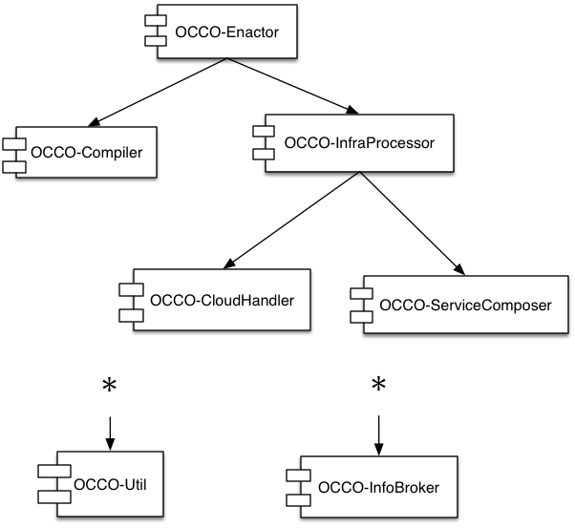
Deployment
Standard Python deployment: distutils
Each component has its own package
Independent components may not be installed
Package dependencies:
TODO: revise
E.g. We have namespace packages now

Slide 34
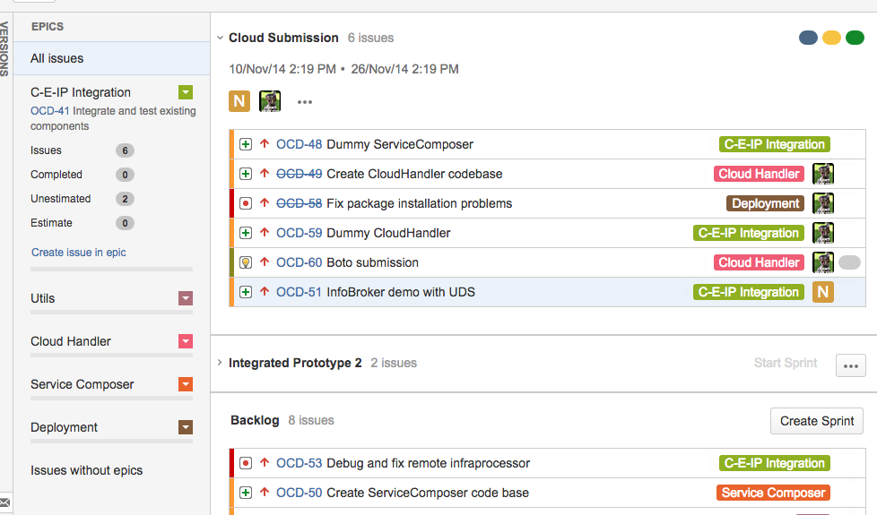
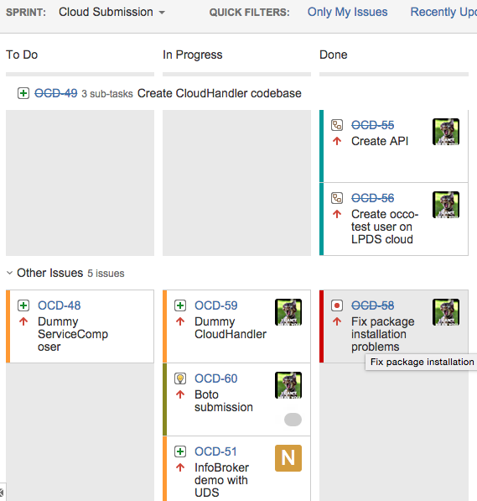
Development and Release
We’re using Jira with a Scrum board
https://jira.lpds.sztaki.hu/browse/OCD
https://jira.lpds.sztaki.hu/secure/RapidBoard.jspa?rapidView=14&view=planning.nodetail

Slide 35
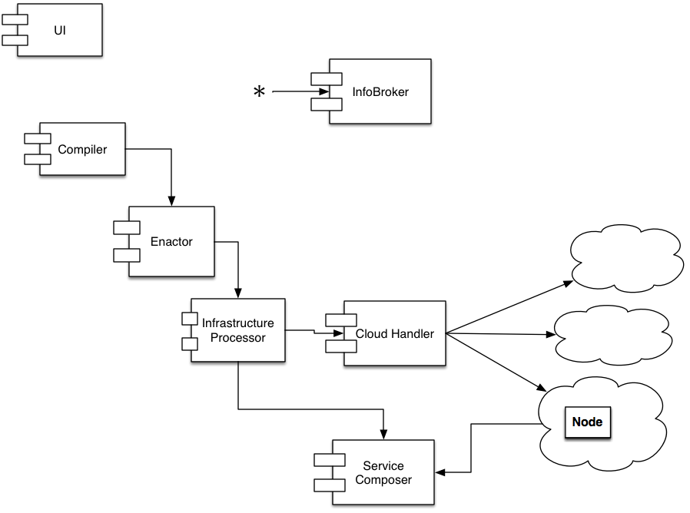
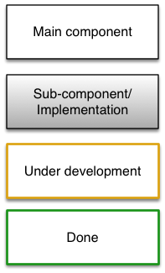
Components
Focus

Slide 36
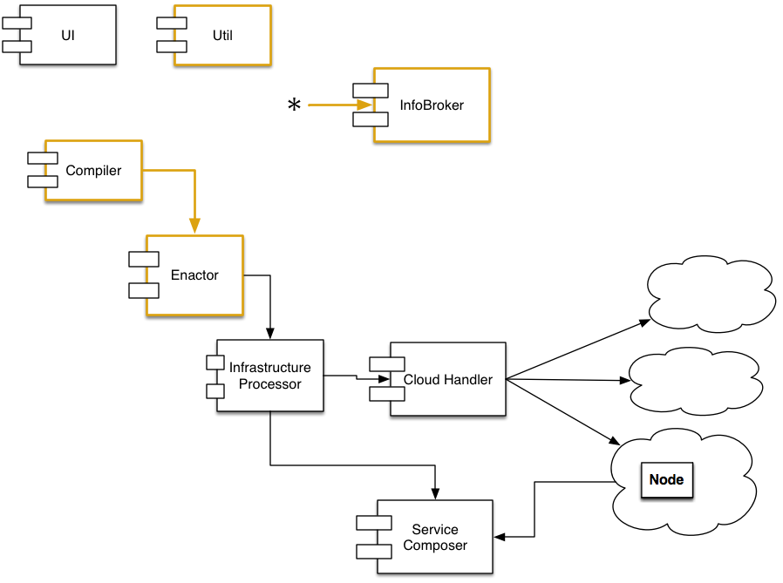
Codebase (May-August, ‘14)
Main goals:
Codebase skeleton
Packages, git repos, documentation, formal requirements, experimenting, utilities, testing
InfoBroker
Communications
By “accident”:
Compiler and Enactor
Focus

Slide 37
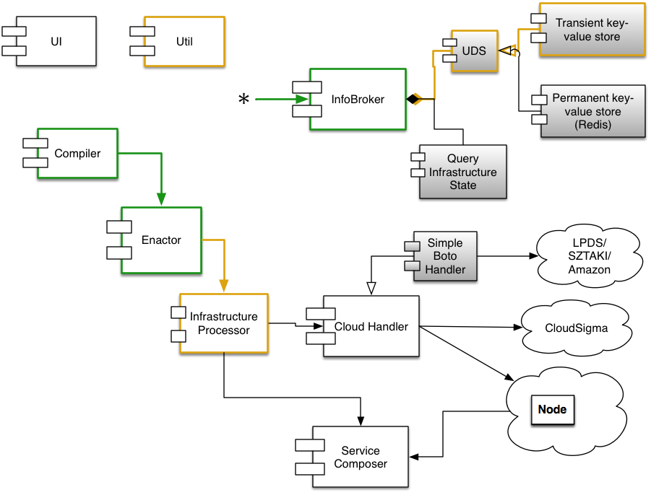
1st sprint (October, ‘14)
Main goals:
Infra Processor
Cooperation of existing components
Expected outcome:
Core prototype
The Compiler-Enactor-InfraProcessor triplet (the core) can work together using dummy cloud-handler and service composer; it simulates infrastructure creation successfully.
Focus

Slide 38
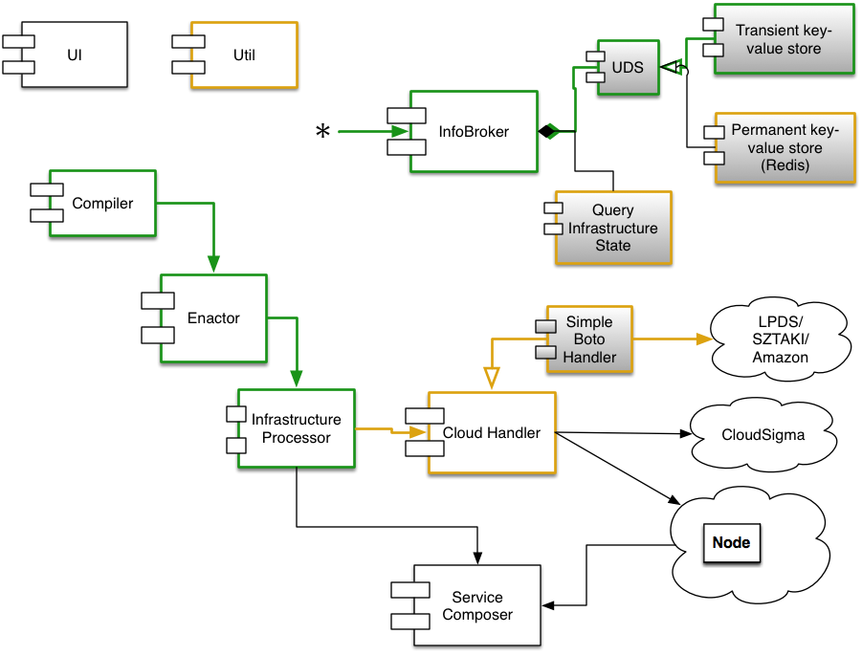
2nd sprint (November, ’14)
Main goals:
Cloud submitting without contextualization
Permanent UDS
Focus
Expected outcome:
Cloud submission prototype
OCCO can create an infrastructure using prepared images.
Using the service composer is not yet a goal.

Slide 39
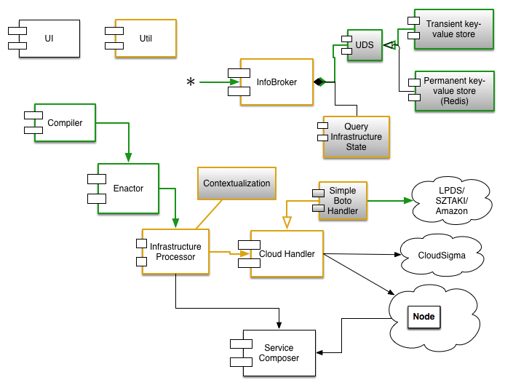
3rd sprint (December-January, ’14-15)
Main goals:
Integrating existing components
Excl.: ServiceComposer
Focus
Expected outcome:
Cloud submission prototype
OCCO can create an infrastructure using prepared images.
Using the service composer is not yet a goal.

Slide 40
Current Status
Aside the Service Composer and an API, OCCO is mostly functional
This means that an infrastructure can be instantiated from a description
VMs are started and contextualized as specified in the description [demo]
The codebase is about 80% extensively documented
Developer documentation: [http://c153-33.localcloud/util-doc] (from LPDS network only)
About 5000 lines of Python code, of which 3000 are documentation and comments; plus overhead (package definitions, etc.); plus lots of UML diagrams

Slide 41
Plans
Priority tasks (~in order)
Finishing documentation (2-3 days, immediate to-do; required to share code)
API to integrate the primitives provided by the existing system into coherent use-cases
Adam Novak
Update unit tests (they’ve been neglected in the sprinting)
Jenkins integration tests
Service Composer
Required before release

Slide 42
Acknowledgements
Mark Gergely, co-architect
Adam Novak, co-developer
Special thanks to:
Jozsef Kovacs, Gabor Kecskemeti

