Slide 1
Intro to Recommender systems
With R package “recommenderlab”
Notes:
The importance and the economic impact of research in this field is reflected by the Netflix Prize4, a challenge to improve the predictions of Netflix’s movie recommender system by more than 10% in terms of the root mean square error. The grand price of 1 million dollar was awarded in September 2009 to the Belcore Pragmatic Chaos team Areas:
E commerce
Streaming services (Netflix )
News feed in fb (based on history and things you like)

Slide 2
Types of Recommender Systems
Recommender Systems
Content-based Filtering
Collaborative Filtering
Model-based technique
Clustering techniques, Association techniques, Bayesian networks, Neural Networks
Item-based
User-based
Memory-based filtering
Hybrid Filtering
Notes:
Assumption behind Collaborative filtering:
The premise is that users who agreed on the rating for some items typically also agree on the rating for other items.
Collaborative filtering (CF) uses given rating data by many users for many items as the basis for predicting missing ratings and/or for creating a top-N recommendation list for a given user, called the active user.

Slide 3
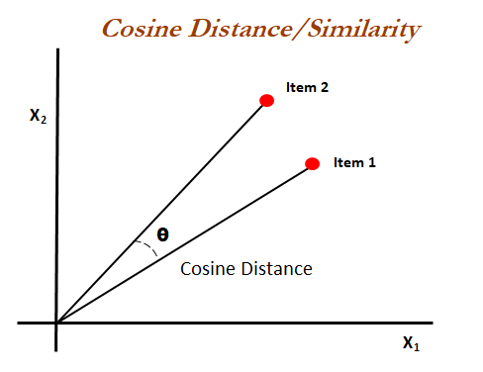
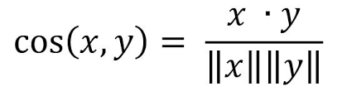
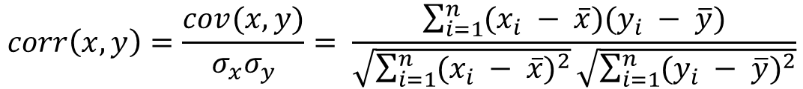
Similarity Measures
Pearson Correlation
Cosine similarity
$$corr\left(x, y\right)=\frac{cov(x,y)}{σ_{x}σ_{y}}= \frac{\sum_{i=1}^{n}{(x_{i} − \overline{x})(y_{i} − \overline{y})}}{\sqrt{\sum_{i=1}^{n}{{(x_{i} − \overline{x})}^{2}}}\sqrt{\sum_{i=1}^{n}{{(y_{i} − \overline{y})}^{2}}}}$$

Slide 4
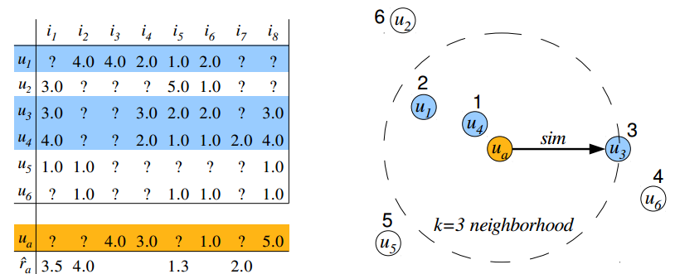
User-Based collaborative filtering (IBCF)
Step 1. Model:
Calculate similarity between users, select k nearest neighbors
Step 2. Prediction:
Compute the average ratings in the neighborhood for each item not rated by the active user.
(a) Rating matrix and estimated ratings for the active user
(b) user neighborhood formation
Notes:
The assumption is that users with similar preferences will rate items similarly. Thus missing ratings for a user can be predicted by first finding a neighborhood of similar users and then aggregate the ratings of these users to form a prediction.
! The two main problems of user-based CF are that (1) the whole user database has to be kept in memory (2) and that expensive similarity computation between the active user and all other users in the database has to be performed.

Slide 5
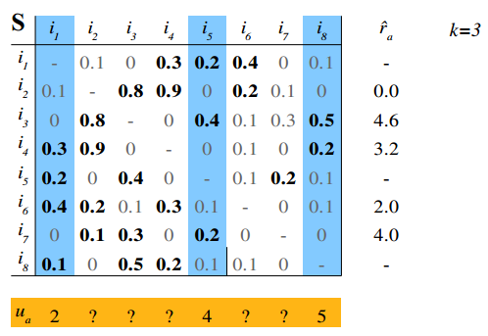
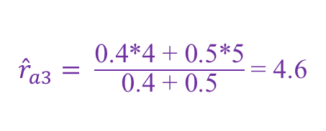
Item-Based collaborative filtering (IBCF)
Step 1. Model building:
calculate an item-to-item similarity matrix
for each item only store k most similar items and their similarity scores
(here k = 3 largest entries are stored per row, marked bold )
Step 2. Recommendation:
use the similarities to calculate a weighted sum of the user’s ratings for related items.
Recommend top n
${\hat{r}}_{a3}= \frac{\text{0.4∗4 + 0.5∗5}}{\text{0.4} \text{+} \text{0.5}}$ = 4.6
ua | 2 | 0 | 4.6 | 3.2 | 4 | 2 | 4 | 5
Notes:
IBCF produces recommendations based on the relationship between items inferred from the rating matrix.
The assumption behind this approach is that users will prefer items that are similar to other items they like.
Item-based CF is more efficient than user-based CF since the model (reduced similarity matrix) is relatively small (N × k) and can be fully precomputed IBCF is successfully applied in large scale recommender systems (e.g., by Amazon.com)

Slide 6

Evaluation of recommender systems
Precision = $\frac{\text{correctly} \text{recommended} \text{items} }{\text{total} \text{recommended} \text{items} }=\frac{TP}{TP+FP}$
Recall (TPR) = $\frac{\text{correctly} \text{recommended} \text{items} }{\text{total}\text{ \# }\text{of} \text{purchased} \text{items} }=\frac{TP}{TP+FN}$
FPR = $\frac{\text{in}\text{correctly} \text{recommended} \text{items} }{\text{total}\text{ \# }\text{of} \text{not} \text{purchased} \text{items} }=\frac{FP}{FP+TN}$

Slide 7
Real life e-commerce environment
huge amounts of data
high-quality recommendations in less that half a second
Very limited info on new customers
Customer data is volatile, new information needs immediate response
Notes:
> huge amounts of data (tens of millions of customers and millions of distinct catalog items)
Results in near real real time, (high-quality recommendations in >half a second)
New customers typically have extremely limited information (a few purchases or product ratings)
Customer data is volatile: Each interaction provides valuable customer data, and the algorithm must respond immediately to new information.

Slide 8
References
Michael Hahsler (2017). recommenderlab: Lab for Developing and Testing Recommender Algorithms. R package version 0.2-2. http://lyle.smu.edu/IDA/recommenderlab/
Ups and downs: Modeling the visual evolution of fashion trends with one-class collaborative filtering R. He, J. McAuley WWW, 2016
Image-based recommendations on styles and substitutes J. McAuley, C. Targett, J. Shi, A. van den Hengel SIGIR, 2015

Slide 9
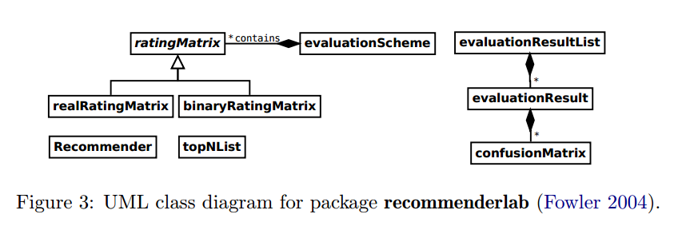
Back-up slide

