Slide 1

Explorative Data Analysis for E-commerce Business
Vodafone Idea Foundation(VIOS) For Tech
Leveraging Data for Strategic Decision-Making
Krit Prasad

Slide 2

PROBLEM STATEMENT
Problem:
The company needs to identify key drivers of sales and profits to optimize business operations.
There is a requirement to discover patterns and trends that can inform strategic decisions and identify loss-making areas for corrective actions.
Analyzing customer behavior and product performance to tailor marketing strategies effectively is crucial.

Slide 3
Project Description
Objective:
Conduct a thorough analysis of the superstore dataset to identify trends, patterns, and insights that can improve business performance.
Provide recommendations based on the data analysis to help the company make informed strategic decisions.
Scope:
The analysis covers sales trends, customer demographics, product performance, and regional analysis.
Focus on identifying high-profit and loss-making segments.
Offer recommendations for optimizing marketing strategies, product placement, and customer engagement based on data insights.

Slide 4

WHO ARE THE END USERS?
End Users:
Business Analysts: To interpret data and derive actionable insights for decision-making.
Marketing Teams: To develop targeted marketing campaigns based on customer segmentation and behavior analysis.
Sales Managers: To optimize sales strategies and improve overall performance.
Senior Management: To make informed strategic decisions that drive growth and profitability.
Supply Chain Managers: To enhance inventory management and distribution strategies.

Slide 5

Technology Used
1. Power BI: The primary tool used for creating interactive dashboards and visualizing key insights.
Visualizations Used:
Bar Charts: Comparing the performance of different product categories and identifying best-sellers and underperformers.
Pie Charts: Showing the distribution of sales and profits across various customer demographics, such as age, gender, and location.
Maps: Showing the distribution of sales over different cities of the world.

Slide 6
Key Insights from Dashboard
Sales Trends:
Monthly and yearly sales trends indicating peak sales periods and seasonal fluctuations.
Identification of factors contributing to sales spikes and dips.
Top Products:
Analysis of best-selling products and categories driving significant revenue.
Identification of products with high return rates or low profitability, suggesting areas for improvement.
Customer Analysis:
Demographic breakdown of customers, including age, gender, and location.
Customer segmentation based on purchasing behavior, preferences, and loyalty.
Profit Margins:
Detailed analysis of profit margins across different segments, products, and regions.
Identification of high-profit and low-profit areas, guiding strategic decisions to enhance profitability.

Slide 7
Detailed Analysis
Sales Performance:
Visuals showing monthly and yearly sales trends, highlighting peak periods and dips.
Analysis of factors contributing to sales performance, including promotions, holidays, and market trends.
Product Analysis:
Performance analysis of different product categories, highlighting best-sellers and underperformers.
Identification of products with high return rates or low profitability, suggesting potential areas for improvement.
Customer Insights:
Demographic analysis of customers, including age, gender, and location.
Segmentation of customers based on purchasing behavior, preferences, and loyalty, informing targeted marketing strategies.

Slide 8
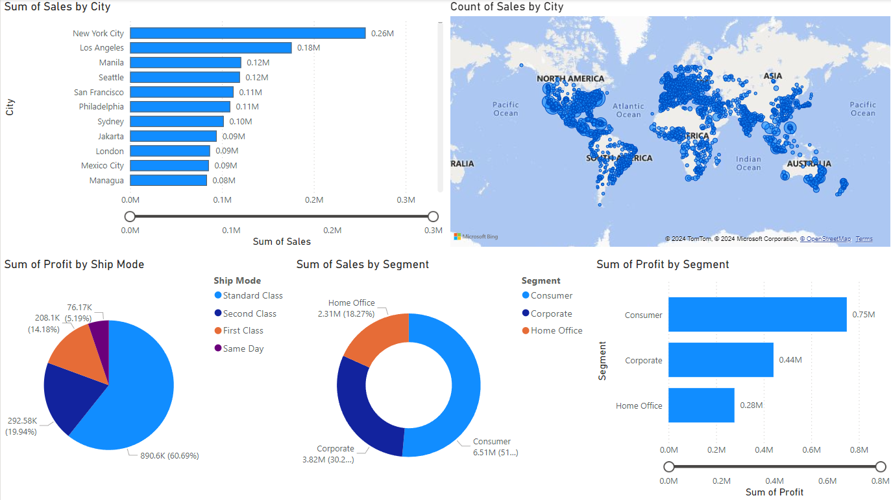
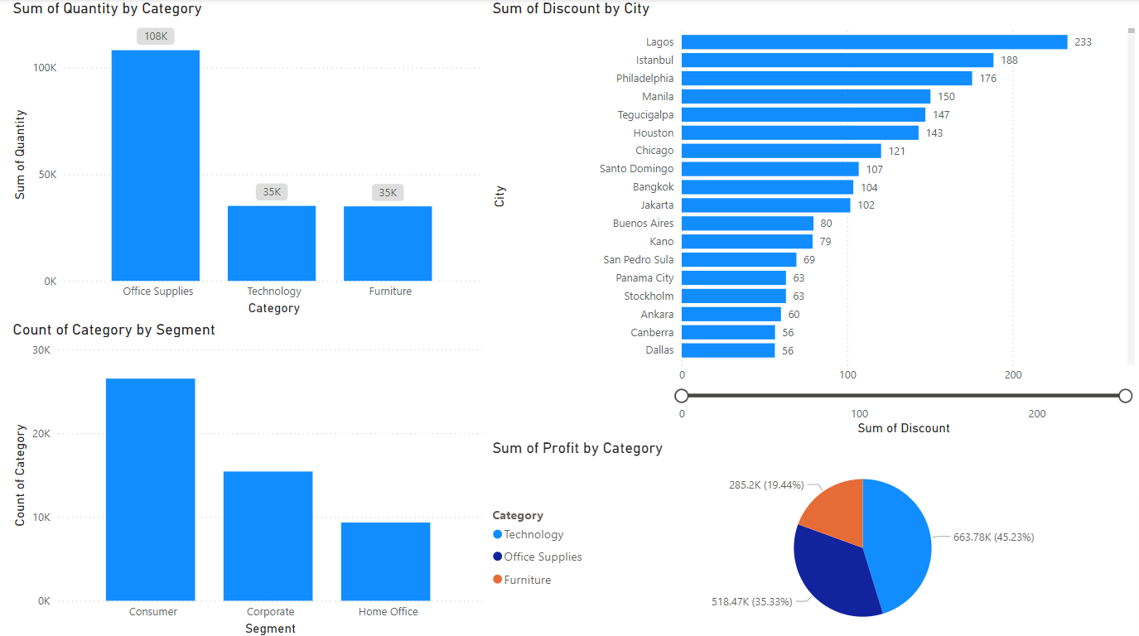
RESULTS
VIOSfortech_PowerBI_Project

Slide 9
Thank you
Thank you for the opportunity provided by VIOS (Vodafone Idea Foundation) for this project.
Special thanks to my mentor, Dushyant Kumar Singh, for his invaluable guidance and support.
I look forward to discussing these insights and recommendations further and collaborating on future projects.
.
.

