Slide 1
Housing Project
Kritanjay SINGH

Slide 2
Problem Statement
A US-based housing company named Surprise Housing has decided to enter the Australian market. The company uses data analytics to purchase houses at a price below their actual values and flip them at a higher price. For the same purpose, the company has collected a data set from the sale of houses in Australia.
Here, we need to build a model using Machine Learning in order to predict the actual value of the prospective properties and decide whether to invest in them or not. For this company wants to know:
1) Which variables are important to predict the price of houses?
2) How do these variables describe the price of the house?

Slide 3
Data sources and formats
We obtain our data from the US-based housing company named Surprise Housing. The data contain different features of houses in Australia and we need to do analysis of that data and make machine learning model.
This dataset contains train dataset and test dataset.
Train dataset have 1168 records and 81 features (Including target variable).
Test dataset have 292 records and 80 features (Does not include target variable).
All the variables are related to houses or properties in Australia.

Slide 4
Problem Solving Approaches
Data reading and understanding
Data cleaning
Data analysis
Handling outliers
Handling skewness
Encoding data
Scaling
Train test split
Machine learning algorithms

Slide 5
Data preparation and cleaning
We check null values present in the data and find many attributes have null values. So, we fill null values according to provided data description. For instance, Alley features have 1091 null values and according to data description NA means “no alley”, so we fill all null values in alley columns with “no alley”.
Then dropped Id and MiscFeature columns. Drop id column because it is not useful for our model and drop MiscFeature column because it contains extra categories of home and have almost 96% null values.
After that we found that some categorical variables data type is integer or float, so we convert them into object data type to treat them as a categorical data.

Slide 6
Contd…
After analysis of the data, we remove skewness of the data using log method, and encoding categorical data into numerical data using one hot encoding method.
At last, we scale data with mean = 0 and standard deviation = 1 using standard scaler method.

Slide 7
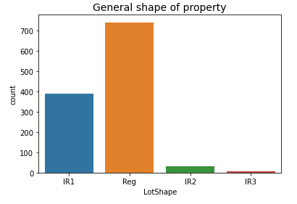
Data Analysis
Out of 1168 properties, Approximately 750 properties are in regular shape, while around 400 properties are slightly irregular. (Reg=Regular, IR1= slightly irregular, IR2=Moderately Irregular, IR3=Irregular)

Slide 8
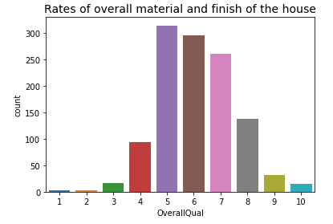
Contd…
From the plot we can see that, out of 1168 houses 314 houses overall quality is average and 295 houses overall quality is above average. (10=Very Excellent, 9=Excellent, 8=Very Good, 7=Good, 6=Above Average, 5=Average, 4=Below Average, 3=Fair, 2=Poor, 1=Very Poor)

Slide 9
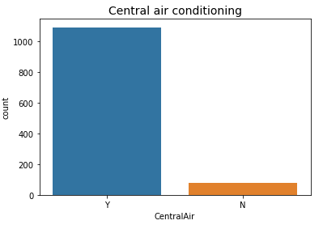
Contd…
From the count plot we can see that, most of the properties have central air conditioning system. (Y=yes, N=no)

Slide 10
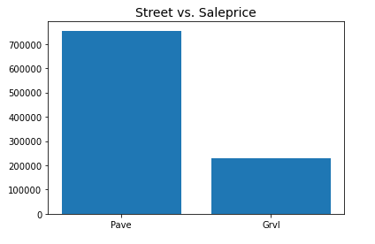
Contd…
Properties price is very high where street is paved, while price is low where street is gravel.

Slide 11
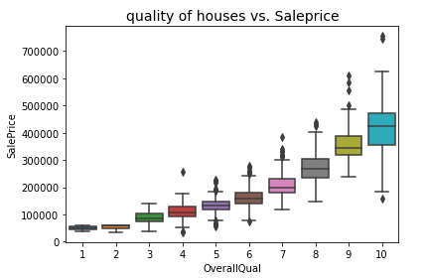
Contd…
From the box plot we can see that, price of the houses is very high where overall quality of the houses is very excellent and price decrease from going 10 to 1. (10=Very Excellent, 9=Excellent, 8=Very Good, 7=Good, 6=Above Average, 5=Average, 4=Below Average, 3=Fair, 2=Poor, 1=Very Poor)

Slide 12
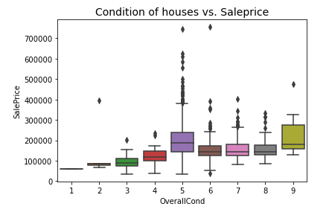
Contd…
From the box plot we can see that, houses price is high where overall condition of the houses is excellent, while price of the houses is almost same where condition of the houses is above average, good and very good.
Average condition houses price is higher than above average, good and very good condition houses.
(9=Excellent, 8=Very Good, 7=Good, 6=Above Average, 5=Average, 4=Below Average, 3=Fair, 2=Poor, 1=Very Poor)

Slide 13
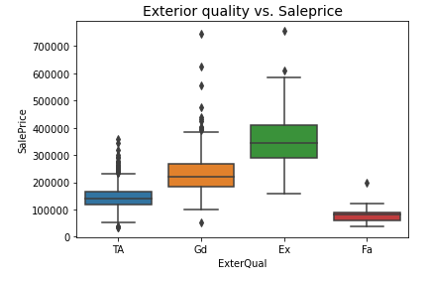
Contd…
Properties price is high where quality of the material on the exterior is excellent, while price is low where quality of the material on the exterior is fair. (Ex=Excellent, Gd=Good, TA=Average/Typical, Fa=Fair, Po=Poor)

Slide 14
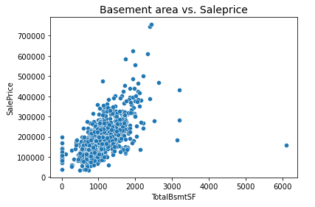
Contd…
From the scatterplot we can see that, total square feet of basement area and saleprice are positively correlated to each other. That means houses sale price is increase with increases of basement area size.

Slide 15
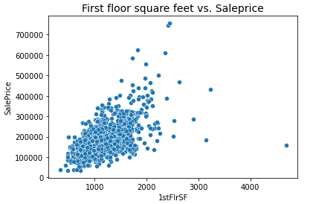
Contd…
From the scatterplot we can see that, First floor square feet and houses price are positively correlated to each other.

Slide 16
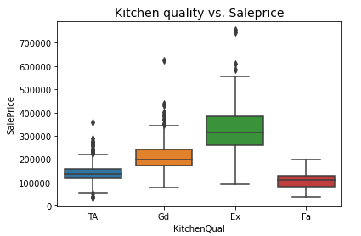
Contd…
From the box plot we can see that, houses price is higher where kitchen quality is excellent and price is lower where kitchen quality is fair compare to other categories. (Ex=Excellent, Gd=Good, TA=Typical/Average, Fa=Fair)

Slide 17
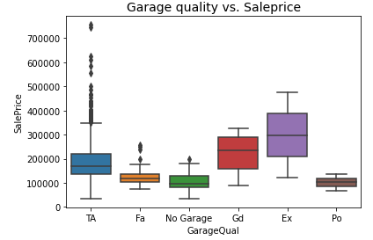
Contd…
Where garage quality is excellent, properties price is around 400000 dollar and price is around 100000 dollar where garage quality is poor. (Ex=Excellent, Gd=Good, TA=Typical/Average, Fa=Fair, Po=Poor, NA=No Garage)

Slide 18
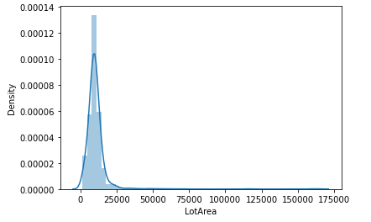
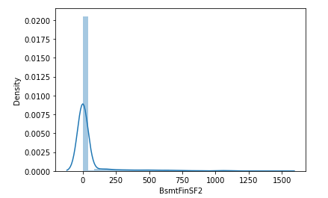
Handling Skewness
In this dataset some attributes are skewed and skewness is affecting our machine learning model. So, it is necessary to remove skewness. For solving this issue we use log method. This method follows a normal or near normal distribution of the data. we can see that skewed data of some variables in form of graphical representation:
After that we encoding categorical data into numerical data using one hot encoding method for further process.

Slide 19
Scaling Data
After encoding data, we need to scale our data. For this we use standard scaler method. This method normalizes our data and essential for machine learning algorithms that calculate distance between data.
This method is necessary, where large and small values present in our data. This method transform our data with mean = 0 and standard deviation = 1.

Slide 20
Train test split
we split our training dataset into two segments: training and testing. We take 75% data for training and 25% data for testing. For splitting data we use train test split method. Below is the code for splitting the data:
75% of the observation as training set--> x_train
The associated target for each observation in x_train --> y_train
25% of the observation as test set--> x_test
The target associated with the test set--> y_test.

Slide 21
Testing of identified approaches
The regression algorithm that we used is:
Linear regression
K-Neighbors regressor
Decision tree regressor
Extra tree regressor
Lasso regression
Ridge regression
Support vector regressor
Random forest regressor
Adaboost regressor
Gradient boosting regressor
Xgboost regressor
Catboost regressor

Slide 22
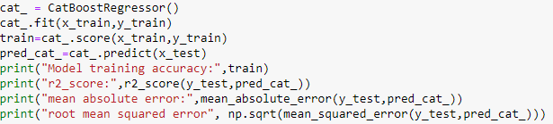
Building machine learning model
We use many algorithms to find best model, but here we describe only best model.
We find catboost regressor as a best model. Catboost builds upon the theory of decision trees and gradient boosting. The main idea of boosting is to sequentially combine many weak models and thus through greedy search create a strong competitive predictive model.
Below is the code of our model with catboost regressor:

Slide 23

Contd…
Output:
We get 99% training model accuracy and 84% test data r2_score accuracy; also we get good mean absolute error (17179.90) among all other algorithms. Now, we have to confirm that model is not going through underfitting or overfitting.
So, we check catboost regressor training model accuracy using cross validation to confirm that our model is not going through underfitting or overfitting.

Slide 24


Contd…
Below is the code for cross validation:
Here, we use CV = 10, that means our training set is divided into 10 parts and provide mean accuracy of those 10 parts.
Output:
We get 87% r2_score accuracy using cross validation that means our model is not underfitted or overfitted.

Slide 25
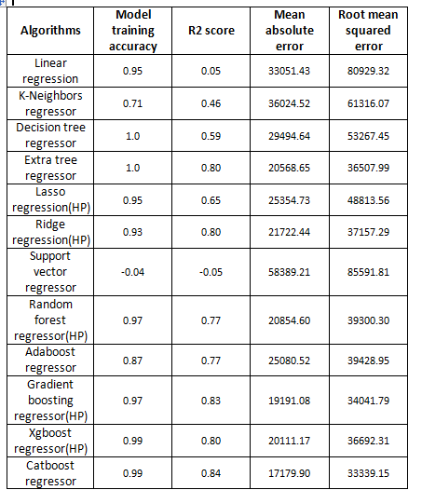
Contd…
Now, check accuracy of all used algorithms:

Slide 26
Conclusion
The purpose of this article was twofold: to understand the pattern of Australian real estate market and make predictive model, which is able to effectively predict the price of houses in Australia.
We use many algorithms to find best model and best result were observed of the catboost regressor with 84% r2 score accuracy.
There are many variables important to predict the price of houses. Like quality of houses, exterior quality, basement area, kitchen quality, total rooms above grade and many more.
In order to increase profit of surprise housing company, the company should start using of machine learning model.
By using machine learning model company can decide whether to invest in properties or not.

Slide 27
Thanks

