Slide 1
Whistleblowing

Slide 2
Whistleblowing
It is the act by an employee, informing the public or higher management of unethical or illegal behavior by an employee, or supervisor.
According to the codes of ethics of the professional engineering, societies, engineers have a duty to protect the health & safety of the public.
So in many cases, an engineer is compelled to blow the whistle on acts or projects that harm these values.
An engineers also have the professional right to disclose wrong doing within their organizations & expect to see appropriate action.

Slide 3
What is Whistle Blowing ?
“Whistle Blowing” is the term used to refer to unauthorized reporting or disclosure of confidential information in institutional settings.
The whistleblower steps outside the approved channels of communication to disclose information to an audience who normally would not be entitled to it.

Slide 4
The unauthorized public disclosure of privileged information by an employee to protect the public interest
  must be public
  must be information the employee has access to by virtue of their job position
    i.e. not simply personal opinion

Slide 5
Kinds of Whistle blowing:
Internal Whistle blowing is made to someone within the organization.
Personal Whistle blowing is blowing the whistle on the offender, here the charge is not against the organization or system but against one individual.
The impersonal, External Whistle Blowing: blowing the whistle against third party or organization.

Slide 6
Rarely whistleblower are honored as heroes by their fellow workers, for the following reasons:
They doubt the loyalty of the whistle blower
to the employer.
The whistleblower is perceived as a traitor, as someone who has damage the firm - the working family to which he/she belongs.

Slide 7
When should Whistleblowing be attempted
Need
Proximity
Capability
Last resort

Slide 8
When should Whistleblowing be attempted
Need: there must be clear & important harm that can be avoided by blowing the whistle. Employee must understand that you need not to blow the whistle about everything but just about the important issues.
Proximity: the whistleblower must be in a very clear position to report on the problem. Rumors are not adequate. Firsthand knowledge is essential to make an effective case about wrong doing.

Slide 9
Capability: the whistleblower must have a chance of success in stopping the harmful activity. You are not obligated to risk your career & the financial security of your family.
Last resort: whistle blowing should be attempted only if there is no one else capable or more proximate to blow the whistle & if you feel that all other lines of action within the context of the organization have explored & shut off.

Slide 10
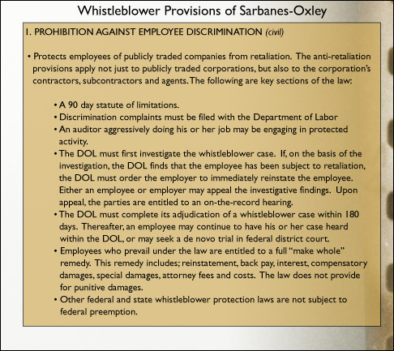
Whistleblower Provisions of Sarbanes-Oxley

Slide 11
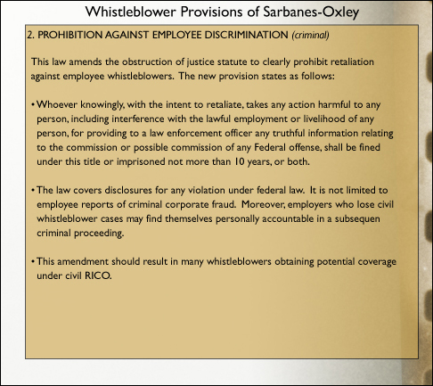
Whistleblower Provisions of Sarbanes-Oxley (continued)

Slide 12
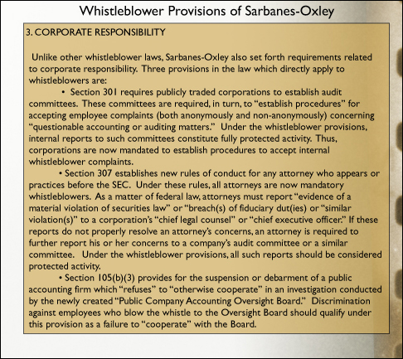
Whistleblower Provisions of Sarbanes-Oxley (continued)

Slide 13
Purpose of Whistle Blowing
To draw attention to unethical, inappropriate or incompetent conduct which has or may have detrimental effects either for the institution or for those affected by its functions.
It extends to situations where an individual believes that an activity is harmful while others involved are not aware of it or reject the perception that is involved.

Slide 14
Characteristics of Whistle Blowing
The whistleblowers are prepared to take full responsibility for their actions.
Implies a concern for the preservation of ethical values which overrides a concern for self-preservation.
Whistleblowers open themselves to the risk of losing personal and financial security, and isolation and yet they feel compelled to make the disclosure and to stand by it.

Slide 15
Criteria – Is Whistle-Blowing Justified?
Is the whistle-blower acting in the public interest?
  what is the public interest?
    life
    health
    safety
    environment?
    wasting tax dollars?
  who should judge?
    the whistle-blower?
    the government
    a third party

Slide 16
Laws Protecting Whistle Blowers
Whistle Blowers in some areas are not without legal support. In United States, both federal and state laws are aimed at protecting those who undertake whistle blowing.
However, even with this support, the potential whistle blower must still contemplate a difficult and dangerous path.
The primary protection law is the Federal Whistle Blower Protection Act of 1989.
Another Federal Law is the False Claims Act, which has been around since 1863.
Many state governments have passed their own whistle blower protection acts.

Slide 17
Conclusion
A whistle blowing incident is probably the most emotionally difficult thing you can experience as a professional.
Not every incident that should result in whistle blowing does, sometimes the whistle is “swallowed” rather than blown
In some cases, there are federal and state laws meant to provide protection for the whistle blowers
If you find yourself in a possible whistle-blowing incident, you should exhaust all internal alternatives for addressing the problem and accumulate all documentation possible. If blowing the whistle becomes the only alternative, then you should anticipate a job change and you should get good legal representation

