Slide 1
Cost Analysis
Types of Costs
  Short-Run
    Fixed costs (FC)
    Sunk costs
    Short-run variable costs (VC)
    Short-run total costs (TC)
  Long-Run
    All costs are variable
    No fixed costs

Slide 2
Total and Variable Costs
C(Q): Minimum total cost of
producing alternative levels of output:
Cost
C(Q) = VC + FC
C(Q) = VC(Q) + FC
VC(Q)
VC(Q): Costs that vary with output.
FC: Costs that do not vary with output.
FC
0
Q

Slide 3
Fixed and Sunk Costs
FC: Costs that do not change as output changes.
Cost
C(Q) = VC + FC
Sunk Cost: A cost that is forever lost after it has been paid.
VC(Q)
Decision makers should ignore sunk costs to maximize profit or minimize losses
FC
Q

Slide 4
Some Definitions
Average Total Cost ATC = AVC + AFC
Cost
ATC = C(Q)/Q
MC
ATC
AVC
Average Variable Cost AVC = VC(Q)/Q
Average Fixed Cost AFC = FC/Q
MR
Marginal Cost MC = DC/DQ
AFC
Q
5-22

Slide 5
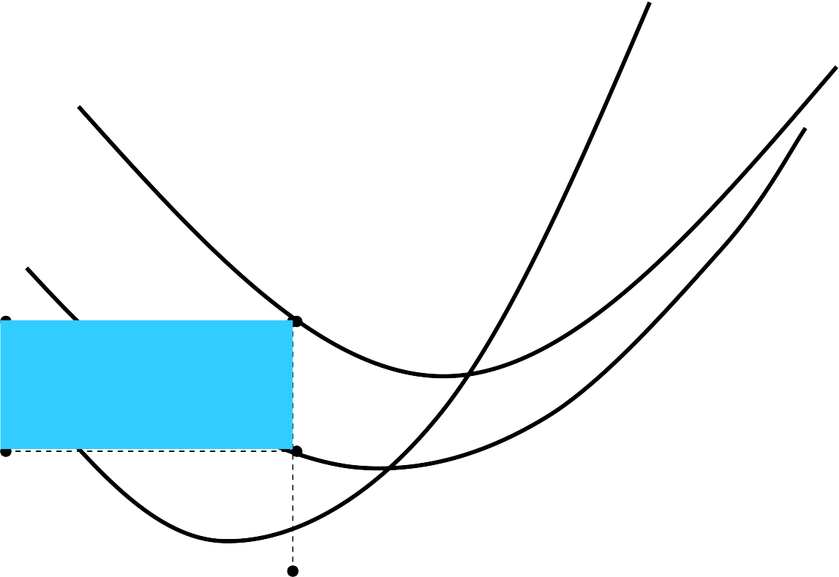
Fixed Cost
MC
Cost
ATC
AVC
ATC
AFC
Fixed Cost
AVC
Q₀
Q

Slide 6
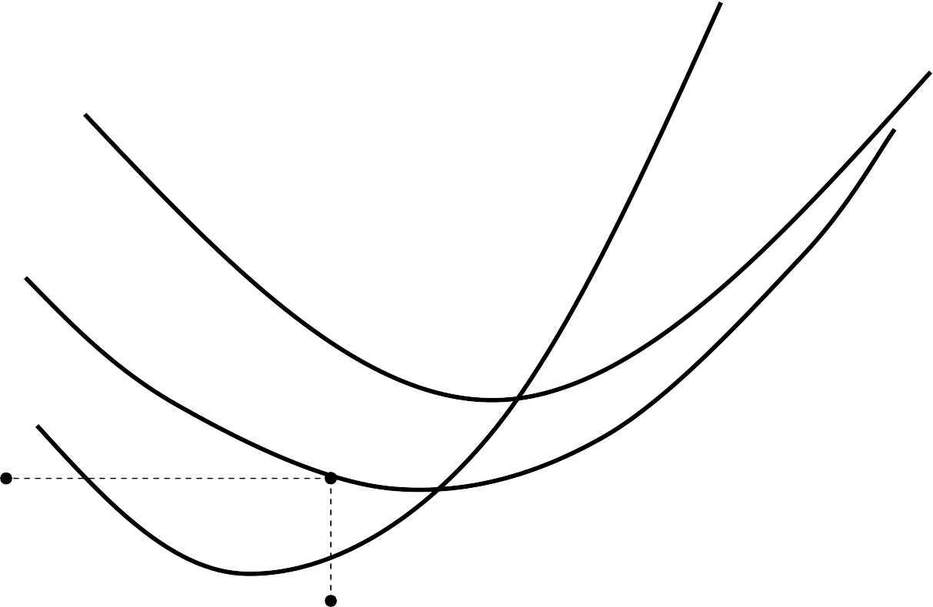
Variable Cost
Cost
MC
ATC AVC
AVC
Variable Cost
Minimum of AVC
Q₀
Q

Slide 7
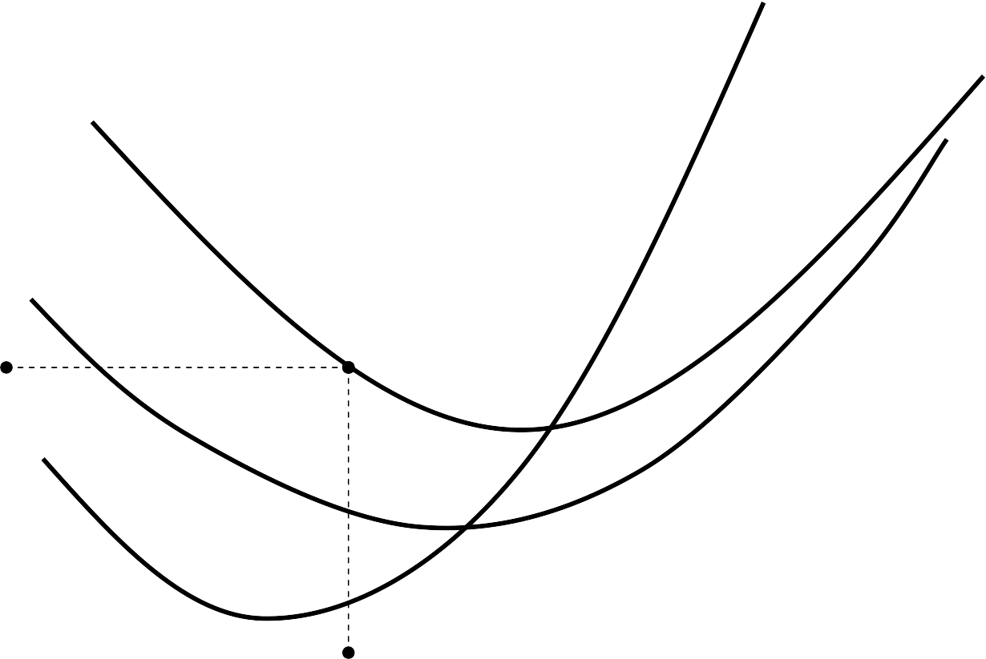
Total Cost
MC
Cost
ATC AVC
ATC
Total Cost
Minimum of ATC
Q₀
Q

Slide 8
Long-Run Average Costs
Cost
LRAC
Economies of Scale
Diseconomies of Scale
Q*
Q

Slide 9
Fixed, variable, and total costs

Slide 10
Average and marginal costs

Slide 11
Conclusion
To maximize profits (minimize costs) managers must use inputs such that the value of marginal of each input reflects price the firm must pay to employ the input.
Cost functions are the foundation for helping to determine profit-maximizing behavior in future chapters.

