Slide 1
SUPPLY

Slide 2
SUPPLY
Supply is a full description of how the quantity supplied of a commodity responds to changes in its price.
Quantity supplied is the amount of a good that sellers are willing and able to sell in the market.
Notes:
25

Slide 3
Supply schedule and Supply curve
Price of
Ice-Cream
Cones
Supply curve
$3.00
Price of Ice-cream cone | Quantity of Cones supplied
$0.00 0.50 1.00 1.50 2.00 2.50 3.00 | 0 cones 0 1 2 3 4 5
2.50
1. An increase
in price . . .
2.00
1.50
2. . . . increases quantity
of cones supplied.
1.00
0.50
0
1
2
3
4
5
6
7
8
9
10
11
12
Quantity of Ice-Cream Cones

Slide 4
Market supply and individual supplies
Price of ice-cream cone | A |  | B |  | Market
$0.00 0.50 1.00 1.50 2.00 2.50 3.00 | 0 0 1 2 3 4 5 | + | 0 0 0 2 4 6 8 | = | 0 0 1 4 7 10 13

Slide 5
Market supply and individual supplies
A’s
supply
+
B’s
supply
=
Market
supply
Price of
Ice
Cream
Cones
Price of
Ice
Cream
Cones
Price of
Ice
Cream
Cones
S_{A}
$3.00
$3.00
$3.00
S_{Market}
S_{B}
2.50
2.50
2.50
2.00
2.00
2.00
1.50
1.50
1.50
1.00
1.00
1.00
0.50
0.50
0.50
0
1
2
3
4
5
6
7
8
9
10
11
12
0
1
2
3
4
5
6
7
0
2
4
6
8
10
12
14
16
18
Quantity of Ice-Cream Cones
Quantity of
Ice-Cream Cones
Quantity of Ice-Cream Cones

Slide 6
Law of Supply
The law of supply states that, the quantity supplied of a good rises when the price of the good rises, as long as all other factors that affect suppliers’ decisions are unchanged or considering other factors to be constant.

Slide 7
Shifts in the Supply Curve: What causes them?
Price of
Ice-Cream
Supply curve,
S
3
Supply
Cone
curve,
S
1
Supply
Decrease
curve,
S
2
in supply
Increase
in supply
0
Quantity of
Ice-Cream Cones

Slide 8
Supply Shift
Supply Schedule
Price ($) | Quantity Supplied
 | Before | After
0.00 | 0 | 0
0.50 | 0 | 1
1.00 | 1 | 2
1.50 | 2 | 3
2.00 | 3 | 4
2.50 | 4 | 5
3.00 | 5 | 6
Anything that reduces production costs, shifts supply to the right.

Slide 9
Determinants of Supply
Price of the Commodity
Cost of Production
Profitability in alternative good
Profitability in Joint good
Future expected Price
Natural Calamities
Man made Calamities
Number of Suppliers

Slide 10
Shifts in the Supply Curve
Due to changes in
  Input prices
  Technology
  Number of sellers (short run)
The market supply will shift right if
  Raw materials or labor becomes cheaper
  The technology becomes more efficient
  Number of sellers increases
Notes:
27

Slide 11
Interaction of demand and supply/Equilibrium Point
We have seen what demand and supply are
We have seen why demand and supply may shift
Now it is time to say something about how buyers and sellers collectively determine the market outcome
To do this, we assume equilibrium

Slide 12
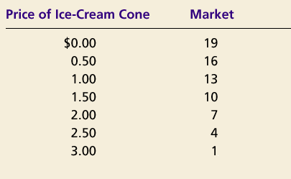
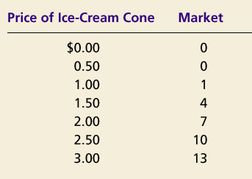
SUPPLY AND DEMAND TOGETHER
Demand Schedule
Supply Schedule
At $2.00, the quantity demanded is equal to the quantity supplied!
Notes:
36

Slide 13
Equilibrium of supply and demand
Price of
Ice-Cream
Cones
Supply
$3.00
2.50
Equilibrium
price
Equilibrium
2.00
1.50
1.00
Equilibrium
quantity
Demand
0.50
0
1
2
3
4
5
6
7
8
9
10
11
12
Quantity of Ice-Cream Cones

Slide 14
Markets Not in Equilibrium
(a) Excess Supply
Price of
Ice-Cream
Supply
Cone
Surplus
$2.50
2.00
Demand
0
4
7
10
Quantity of
Quantity
Quantity
Ice-Cream
demanded
supplied
Cones

Slide 15
Markets Not in Equilibrium
(b) Excess Demand
Price of
Ice-Cream
Supply
Cone
$2.00
1.50
Shortage
Demand
0
4
7
10
Quantity of
Quantity
Quantity
Ice-Cream
supplied
demanded
Cones
SUPPLY AND DEMAND

Slide 16
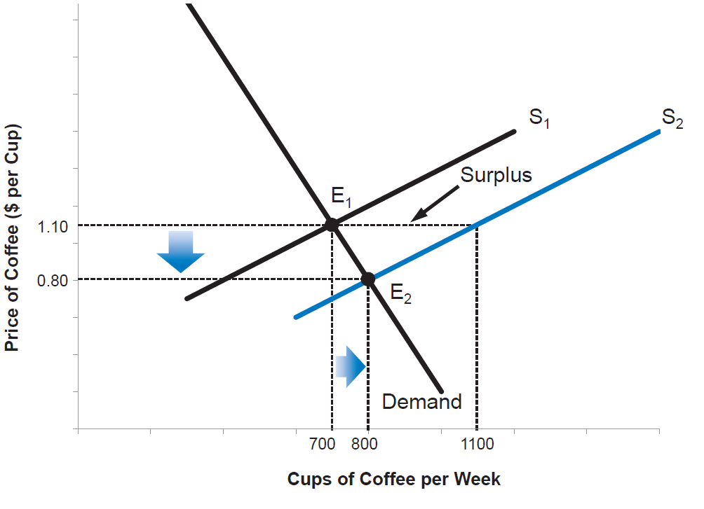
Market Adjustment to an Increase in Supply
Notes:
An increase in supply creates a surplus, and downward pressure on price. The new equilibrium occurs at point E2, with a lower price and a higher quantity sold.

Slide 17
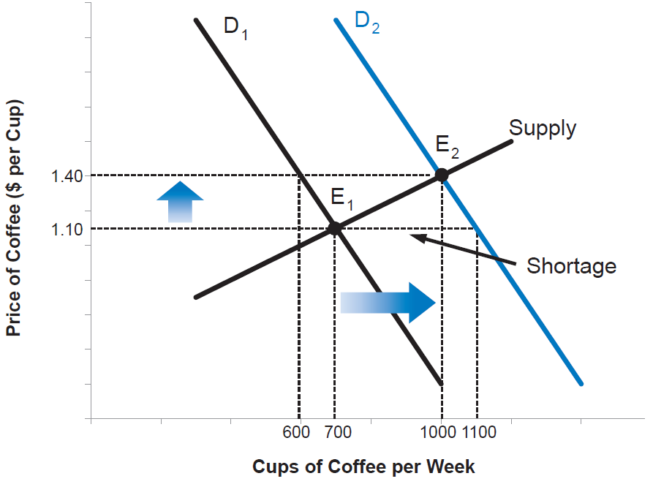
Market Adjustment to an Increase in Demand
Notes:
An increase in demand creates a shortage, and upward pressure on price. The new equilibrium occurs at point E2, with a higher price and a higher quantity sold.

Slide 18
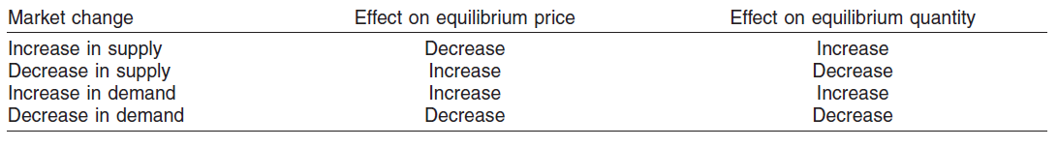
Market Effects of Shifts in Supply and Demand

Slide 19
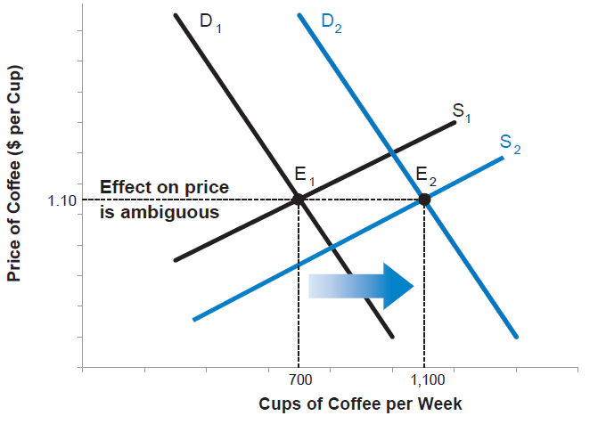
Market Adjustment with an Increase in Both Supply and Demand
Notes:
An increase in both supply and demand moves the equilibrium to point E2. The quantity sold has clearly increased but the effect on price is ambiguous.

Slide 20
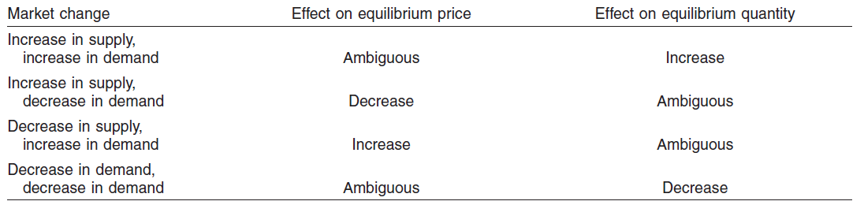
Market Effects When Both Supply and Demand Shift

