Slide 1
5G WIRELESS COMMUNICATION
(UEC 719)
Dr. Amit Mishra
Associate Professor,
TIET, Patiala
Dr. Surbhi Sharma
Associate Professor,
TIET, Patiala

Slide 2
Lecture: 4 to 6
Waveform for 5G
(OFDM)

Slide 3
Contents of Lecture
Need of multi-carrier communication system
Frequency Selective and Flat Fading Channel Characteristic
Orthogonal Frequency Division Multiplexing (Introduction)
Historical Development of OFDM
OFDM principle
Principle of Orthogonality
Advantages of OFDM System
Major Challenges of OFDM System

Slide 4
Need of multi-carrier communication system
[T. S. Rappaport (2002)]
The main limitation of FDMA and TDMA are the capacity.
CDMA techniques can potentially accommodates more users than either TDMA or FDMA.
W-CDMA is a 3G wireless standard, evolved from CDMA to support the wideband services at data rate as high as 2 Mbps.
CDMA used in 2G systems and W-CDMA used in 3G systems have a common problem of frequency selective multipath fading.
Frequency selective multipath fading is common in urban and indoor environment and is significant source of performance degradation.
The performance degrade more if the number of users increases.

Slide 5
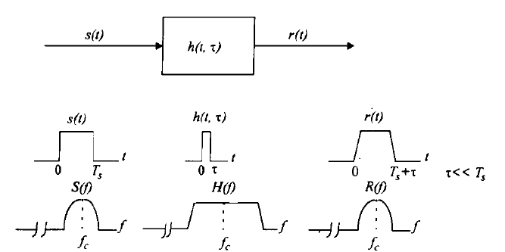
Flat Fading
[T. S. Rappaport (2002)]
Symbol Period > delay spread of channel
or
Band Width of Signal < Bandwidth of Channel

Slide 6
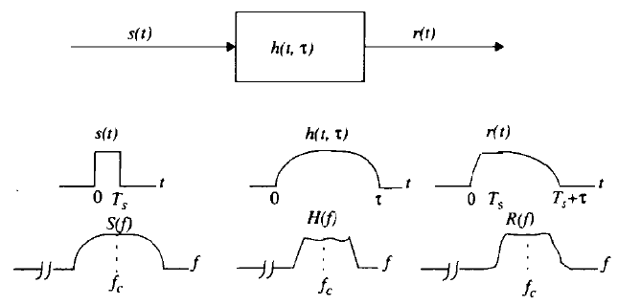
Frequency Selective Fading
[T. S. Rappaport (2002)]
Symbol Period < delay spread of channel
or
Band Width of Signal > Bandwidth of Channel

Slide 7
Evolution of Multi-Carrier Communication
The solution of frequency selective fading is to use narrow band (large duration) signal.
But broad band signals are required for multimedia applications (for 3G and 4G)
Hence parallel transmission with multi-carrier modulation has been proposed to solve the problem.
Two such systems are
OFDM (Orthogonal Frequency Division Multiplexing)
MC-CDMA (Multi Carrier-CDMA)

Slide 8
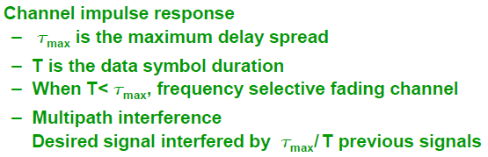
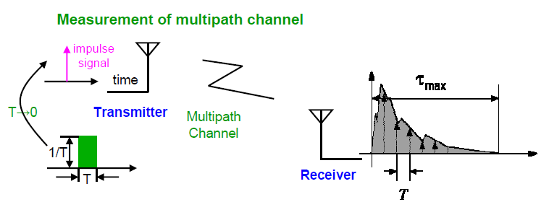
Illustration of Multipath Interference

Slide 9
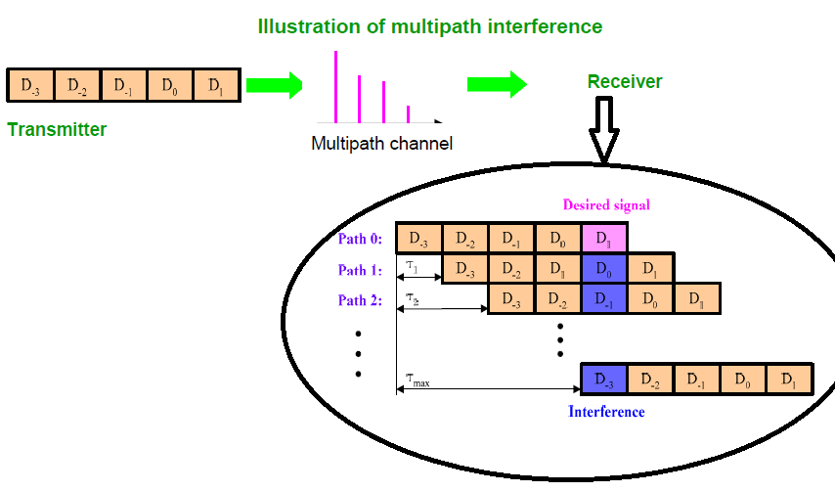
Illustration of Multipath Interference

Slide 10
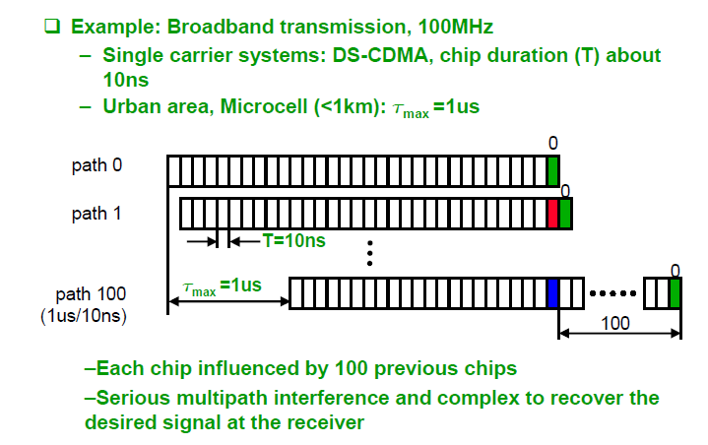
Illustration of Multipath Interference

Slide 11
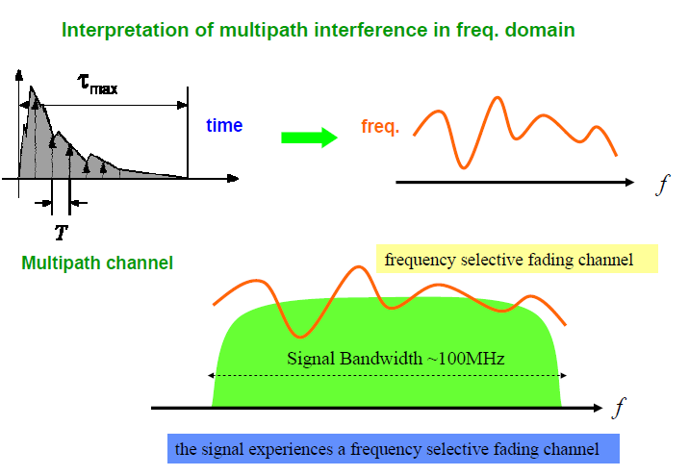
Illustration of Multipath Interference

Slide 12
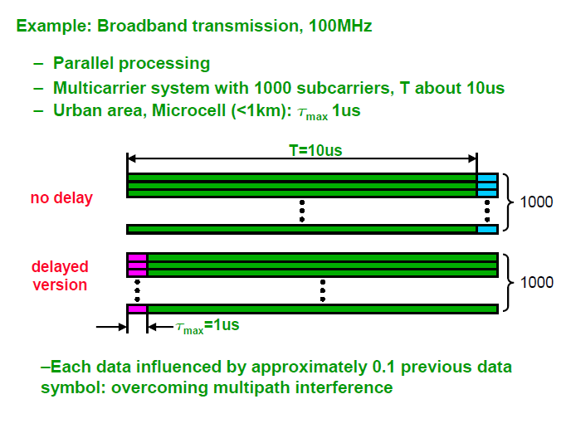
Illustration of Multipath Interference

Slide 13
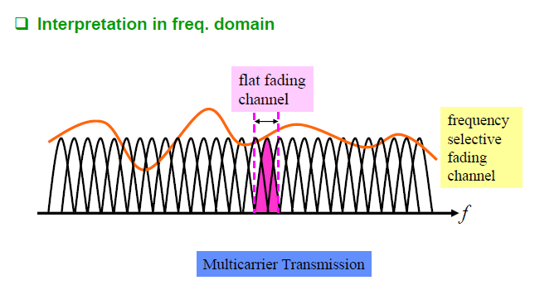
Illustration of Multipath Interference

Slide 14
Orthogonal Fréquence Division Multiplexing
[S. Hara and R. Prasad (2003)]
OFDM is a popular DFT-based technique initially proposed in the 1971 by S. B. Weinstein and P. M. Ebert.
It is a special case of multicarrier modulation (MCM) in which multiple user symbols are transmitted in parallel using different subcarriers with overlapping frequency bands that are mutually orthogonal.
Adopted as a major data transmission technique by many wireless communication standards:
  5G NR
  4G LTE
  IEEE 802.11a/g, (WiFi or WLAN)
  IEEE 802.16a/e (WiMAX)
  Terrestrial digital video broadcasting (DVB-T)
  Digital Audio Broadcasting (DAB)
  HIPERLAN

Slide 15
Historical Development of OFDM
[S. Hara and R. Prasad (2003)]
A U.S. patent in which the name of “OFDM” was first appeared was issued in January 1970.
But it gained more popularity and attentions only after the use of the discrete Fourier transform (DFT) to generate orthogonal sub-carriers at the transmitter as — suggested by Weinstein and Ebert in 1971
The DAB standard was the first OFDM-based standard (project started in 1988 by ETSI and completed in 1995).
A number of studies regarding the commercial applications of OFDM were made during 1990s like
  High Bit rate Digital Subscriber Lines (HDSL; 1.6 Mbps),
  Asymmetric Digital Subscriber Lines (ADSL; 6 Mbps),
  Very High Speed Digital Subscriber Lines (VDSL; 100 Mbps),
  DAB and High Definition Television (HDTV) terrestrial broadcasting.

Slide 16
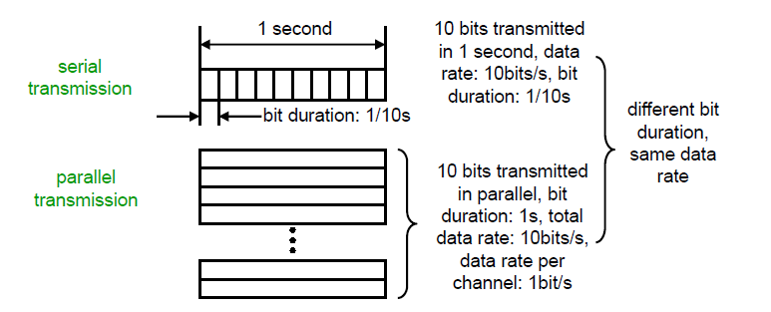
OFDM principle
The basic principle of OFDM is to split a high data rate streams into a number of lower data rate streams and then transmitted these streams in parallel using several orthogonal sub-carriers (parallel transmission).
Due to this parallel transmission, the symbol duration increases thus decreases the relative amount of dispersion in time caused by multipath delay spread.
Transform high-speed serial transmission to low-speed parallel transmission
Increase symbol duration, robust to multipath interference

Slide 17
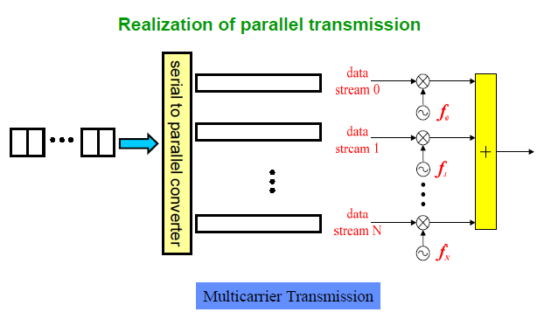
OFDM principle

Slide 18
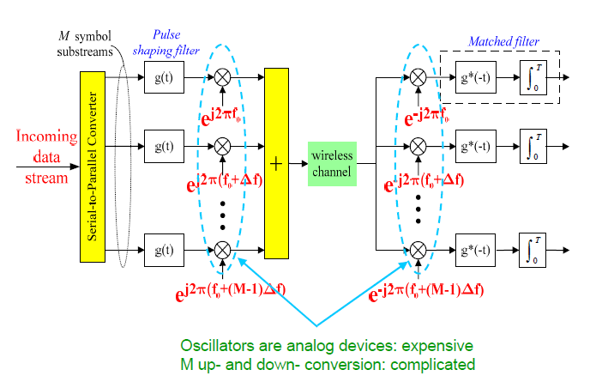
Basic Structure of Multi-carrier Transmission

Slide 19
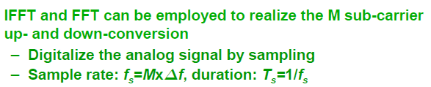
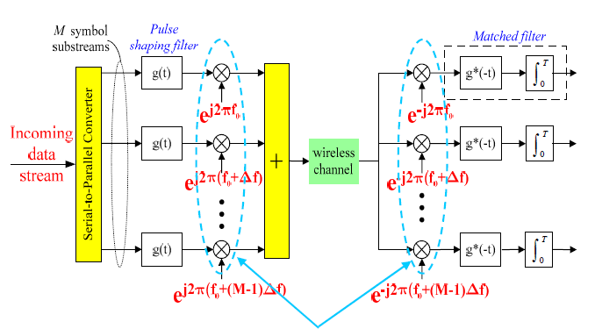
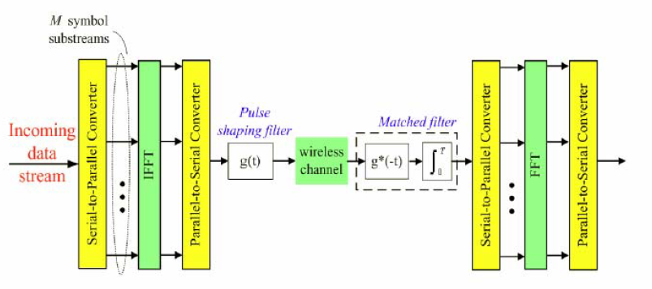

Slide 20
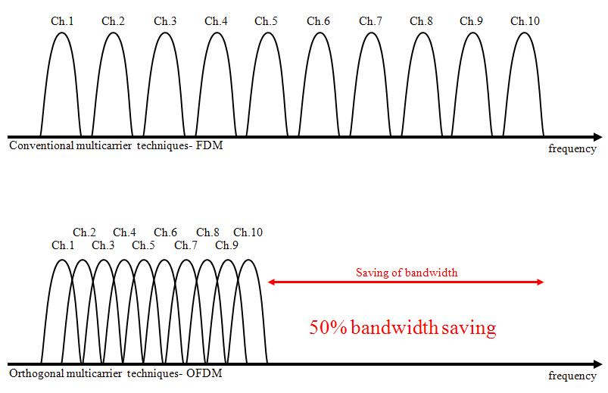
Improved Spectral efficiency
The concept of OFDM is very much similar to the well known and extensively used technique of Frequency Division Multiplexing (FDM).
OFDM uses the principles of FDM to allow multiple messages to be sent over a single radio channel.
It is however in a much more controlled manner, allowing an improved spectral efficiency.

Slide 21
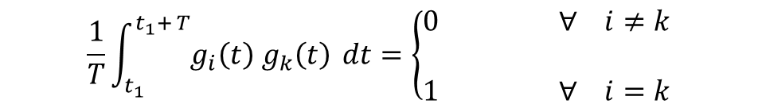
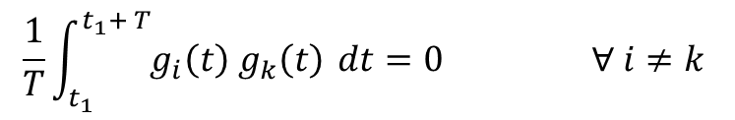
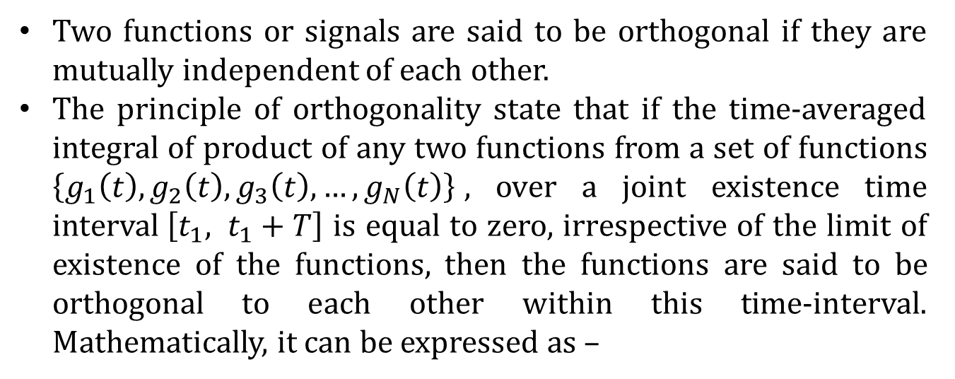
principle of orthogonality
Two functions or signals are said to be orthogonal if they are mutually independent of each other.
The principle of orthogonality state that if the time-averaged integral of product of any two functions from a set of functions $\left\{g_{1}\left(t\right), g_{2}\left(t\right), g_{3}\left(t\right),…, g_{N}\left(t\right)\right\}$, over a joint existence time interval$\left[t_{1}, t_{1}+T\right]$ is equal to zero, irrespective of the limit of existence of the functions, then the functions are said to be orthogonal to each other within this time-interval. Mathematically, it can be expressed as –
$$\frac{1}{T}\int_{t_{1}}^{t_{1}+ T}{g_{i}\left(t\right) g_{k}\left(t\right)} dt=0 ∀ i≠k$$
Similarly, if the set of functions are to be an orthonormal set then they have to be orthogonal as well as being normalized, i.e.,
$$\frac{1}{T}\int_{t_{1}}^{t_{1}+ T}{g_{i}\left(t\right) g_{k}\left(t\right)} dt=\left\{\begin{aligned}0 ∀ i≠k \\ \\ 1 ∀ i=k\end{aligned}\right.$$

Slide 22
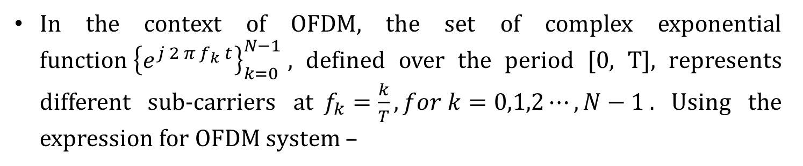
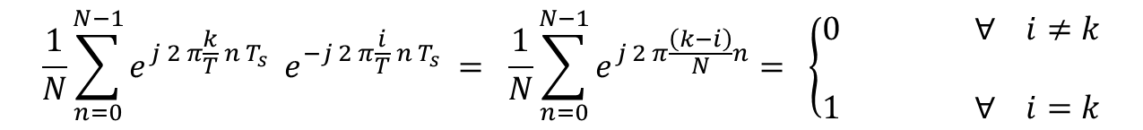
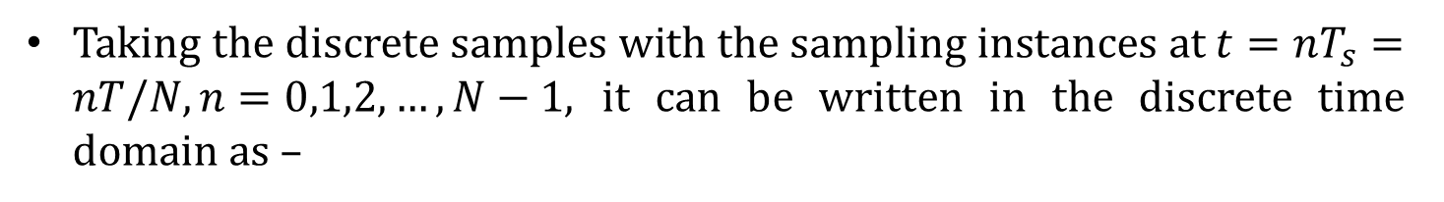
principle of orthogonality for ofdm
In the context of OFDM, the set of complex exponential function${\left\{e^{j 2 π f_{k} t}\right\}}_{k=0}^{N−1}$, defined over the period [0, T], represents different sub-carriers at$f_{k}=\frac{k}{T}, for k=0,1,2⋯,N−1$. Using the expression for OFDM system –
$$\frac{1}{T}\int_{0}^{T}{e^{j 2 π f_{k} t}{ e}^{−j 2 π f_{i} t} dt} = \frac{1}{T}\int_{0}^{T}{e^{j 2 π \frac{k t}{T}}{ e}^{−j 2 π \frac{i t}{T}} dt}= \frac{1}{T}\int_{0}^{T}{e^{j 2 π \frac{t (k−i) }{T}} dt}$$
Taking the discrete samples with the sampling instances at$t=nT_{s}=nT/N, n=0,1,2,…, N−1,$ it can be written in the discrete time domain as –
$$\frac{1}{N}\sum_{n=0}^{N−1}{e^{j 2 π\frac{k}{T} n T_{s}} e^{−j 2 π\frac{i}{T} n T_{s}}} = \frac{1}{N}\sum_{n=0}^{N−1}{e^{j 2 π\frac{\left(k−i\right)}{N}n}= \left\{\begin{aligned}0 ∀ i≠k \\ \\ 1 ∀ i=k\end{aligned}\right.}$$

Slide 23
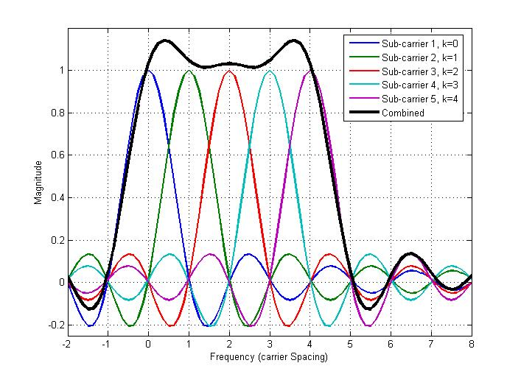
principle of orthogonality for ofdm
Frequency response of the sub-carriers in a 5 tone OFDM signal

Slide 24
OFDM System Model
[S. Hara and R. Prasad (2003)]
Encoder
(M-PSK,
M-QAM etc)
S/P
N-Point
IFFT
P/S
Add
Cyclic Prefix
Input bit
stream
Fading Channel
White Gaussian Noise
output bit
stream
Decoder
(M-PSK,
M-QAM etc)
P/S
MMSE Equalizer
N
Point
FFT
S/P
Remove
Cyclic Prefix
Channel
Estimation

Slide 25
ADVANTAGES OF OFDM SYSTEM
Less Implementation Complexity:
--- For a given delay spread of multipath fading channel, the implementation complexity is
significantly lower than that of single carrier system with an equalizer (single tap equalizer is
required in OFDM system).
Robustness Against Narrowband Interference:
-- OFDM is more robust against narrowband interference because in a single carrier system,
--- a single fade or interferer can cause the entire link to fail, but in OFDM, only a small percentage of
subcarriers will be affected.
-- Efficient Modulation and demodulation of OFDM symbol are possible with the help of IFFT and FFT.

Slide 26
Immune to Frequency Selective Fading:
-- OFDM is highly immune to frequency selective fading because of parallel transmission
-- Each sub-carrier has narrow bandwidth in comparison to overall bandwidth of signal.
-- It converts a frequency selective fading channel into several nearly flat fading channels.
High Spectral Efficiency:
-- Due to orthogonal nature of each sub-carrier, large number of sub-carriers can be accomadate in a very narrow spectral region thus increasing the spectral efficiency.

Slide 27
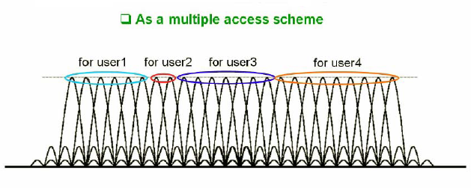
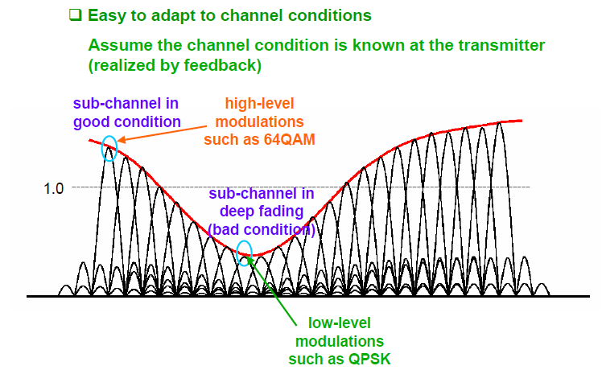
Flexibility of OFDM

Slide 28
Major Challenges of OFDM System
Modulation
Source Coding General to
Channel Coding all system
Channel Estimation
Synchronization
    Timing Synchronization Dominates in
    Frequency Synchronization OFDM
High PAPR

Slide 29
Major Challenges of OFDM System
Symbol Timing Offset (STO):
  OFMD is highly sensitive to STO.
  Due to the use of IFFT and FFT for modulation and demodulation at transmitter and receiver respectively, correct timing (start of FFT window) is required at the receiver otherwise one FFT window will take sample from two transmitted OFDM symbol.
  This deteriorates the performance of OFDM system.
Carrier Frequency Offset (CFO):
  OFDM is highly sensitive to carrier frequency offset.
  Most of the advantages of OFDM are due to the orthogonal nature of sub-carriers and this orthogonality between sub carriers will be destroyed if frequency offset arises between them.
  The major cause of CFO is Doppler shifts (due to relative motion between transmitter and channel).

Slide 30
High Peak-to-Average Power Ratio (PAPR):
  The transmitted signal of OFDM exhibits a high Peak-To-Average Power Ratio (PAPR).
  This high PAPR reduces the efficiency of high power amplifier and degrades the performance of the system.
Inter-Carrier Interference (ICI):
  The result of all above mention problem will appear in the form of Inter-Carrier Interference (ICI) at the receiver.
  The ICI decreases the SNR and degrades the BER performance of OFDM system.

Slide 31
Major Challenges of OFDM System
Timing Synchronization
Frequency Synchronization
High PAPR
Inter Carrier Interference
  (ICI)

Slide 32
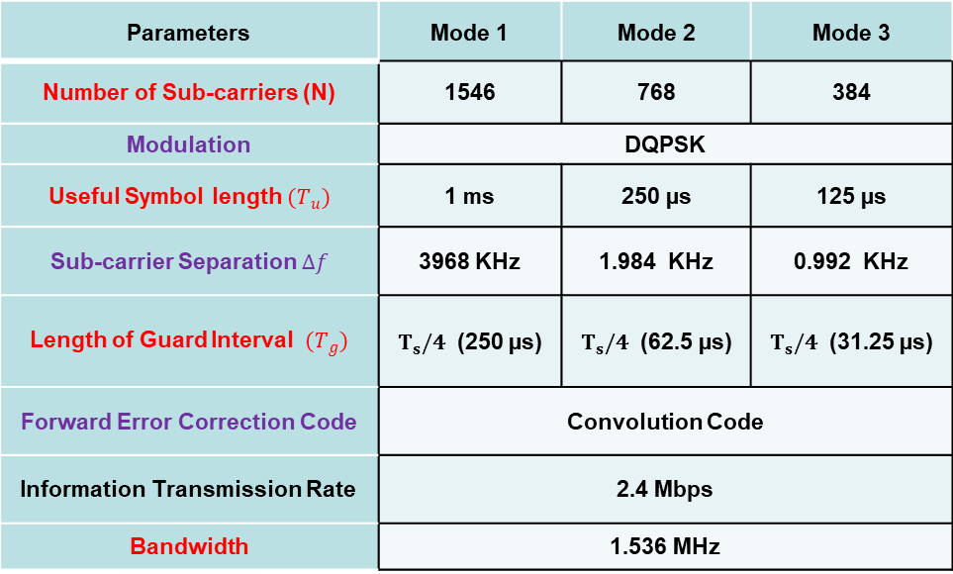
Digital Audio Broadcasting Standard
Parameters | Mode 1 | Mode 2 | Mode 3
Number of Sub-carriers (N) | 1546 | 768 | 384
Modulation | DQPSK
 | 1 ms | 250 µs | 125 µs
 | 3968 KHz | 1.984 KHz | 0.992 KHz
Forward Error Correction Code | Convolution Code
Information Transmission Rate | 2.4 Mbps
Bandwidth | 1.536 MHz

Slide 33
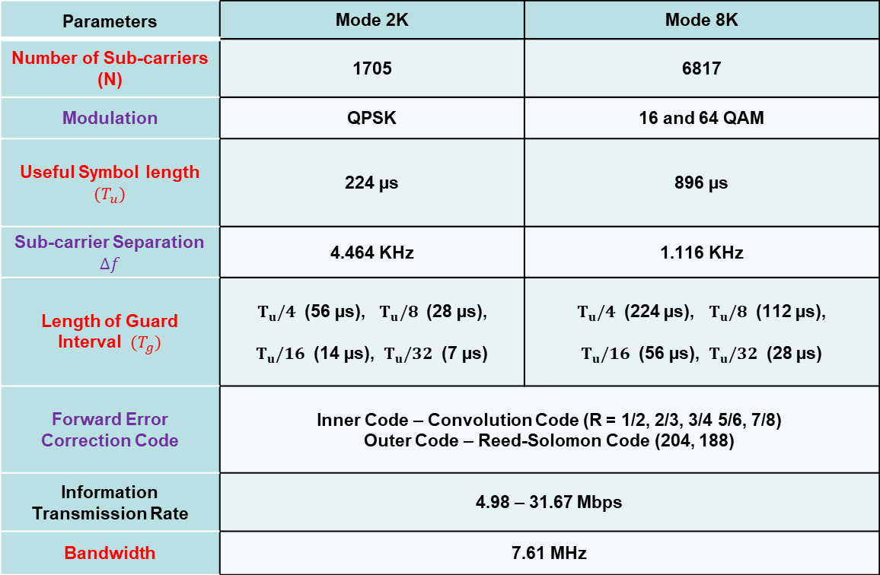
Key Parameters of Different Standards based on OFDM
Terrestrial Digital Video Broadcasting (DVB-T)
Parameters | Mode 2K | Mode 8K
Number of Sub-carriers (N) | 1705 | 6817
Modulation | QPSK | 16 and 64 QAM
 | 224 µs | 896 µs
 | 4.464 KHz | 1.116 KHz
Forward Error Correction Code | Inner Code – Convolution Code (R = 1/2, 2/3, 3/4 5/6, 7/8) Outer Code – Reed-Solomon Code (204, 188)
Information Transmission Rate | 4.98 – 31.67 Mbps
Bandwidth | 7.61 MHz

Slide 34
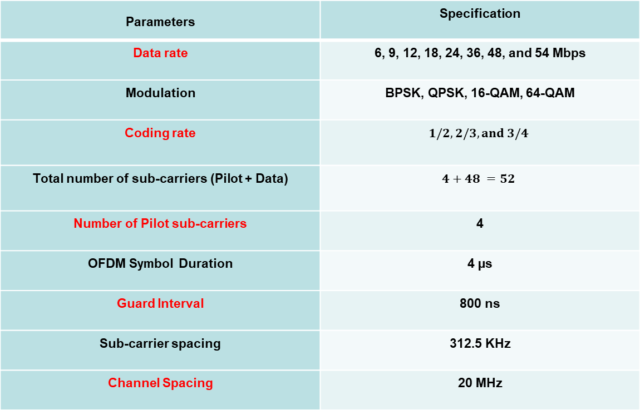
Key Parameters of Different Standards based on OFDM
IEEE 802.11 and HIPERLAN/2
Parameters | Specification
Data rate | 6, 9, 12, 18, 24, 36, 48, and 54 Mbps
Modulation | BPSK, QPSK, 16-QAM, 64-QAM
Coding rate
Total number of sub-carriers (Pilot + Data)
Number of Pilot sub-carriers | 4
OFDM Symbol Duration | 4 µs
Guard Interval | 800 ns
Sub-carrier spacing | 312.5 KHz
Channel Spacing | 20 MHz

