Slide 1
5G WIRELESS COMMUNICATION
(UEC 719)
Dr. Amit Mishra
Associate Professor,
TIET, Patiala
Dr. Surbhi Sharma
Associate Professor,
TIET, Patiala

Slide 2
Lecture: 9-11
OFDM-SYSTEM MODEL
OFDM-Waveform for 5G

Slide 3
Contents
OFDM System Model
OFDM Signal Generation
Cyclic Prefix or Guard Band Insertion
Why Cyclic Prefix?
OFDM Receiver Model
OFDM Receiver (Detailed Mathematical Explanation of Each Block)

Slide 4
OFDM System Model
[S. Hara and R. Prasad (2003)]
Encoder
(M-PSK,
M-QAM etc)
S/P
N-Point
IFFT
P/S
Add
Cyclic Prefix
Input bit
stream
Fading Channel
White Gaussian Noise
output bit
stream
Decoder
(M-PSK,
M-QAM etc)
P/S
MMSE Equalizer
N
Point
FFT
S/P
Remove
Cyclic Prefix
Channel
Estimation

Slide 5
OFDM Signal Generation

Slide 6

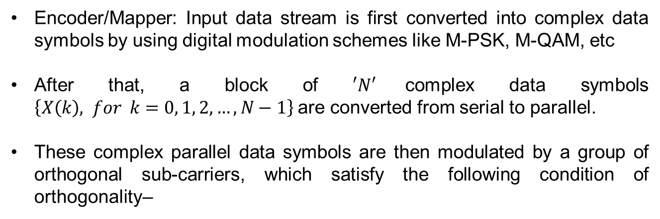
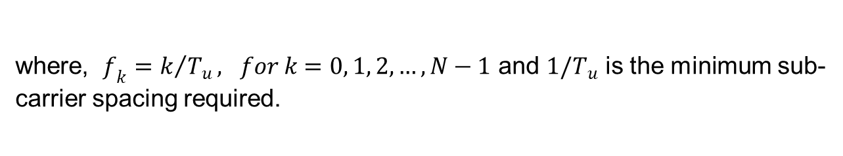
OFDM Signal Generation
Encoder/Mapper: Input data stream is first converted into complex data symbols by using digital modulation schemes like M-PSK, M-QAM, etc
After that, a block of $′N′$complex data symbols $\left\{X\left(k\right), for k=0, 1, 2, …, N−1\right\}$are converted from serial to parallel.
These complex parallel data symbols are then modulated by a group of orthogonal sub-carriers, which satisfy the following condition of orthogonality–
$$\frac{1}{T_{u}}\int_{0}^{T_{u}}{e^{j2πf_{k}t} e^{j2πf_{m}t} dt} = \left\{\begin{aligned}1, k=m \\ \\ 0, k≠m\end{aligned}\right. ,$$
where, $f_{k}=k/{T_{u}}, for k=0, 1, 2, …, N−1$ and $1/T_{u}$ is the minimum sub-carrier spacing required.

Slide 7
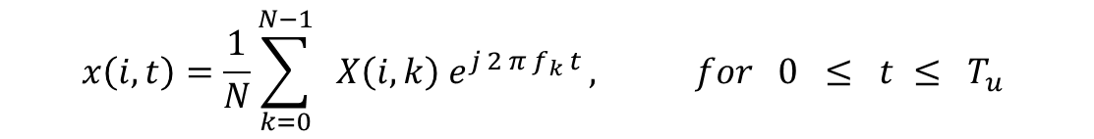
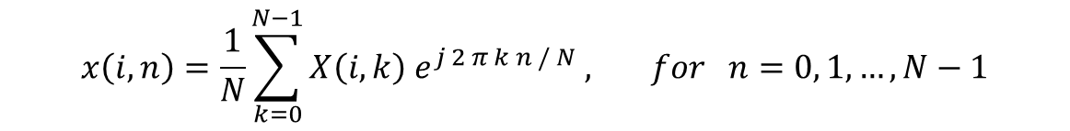
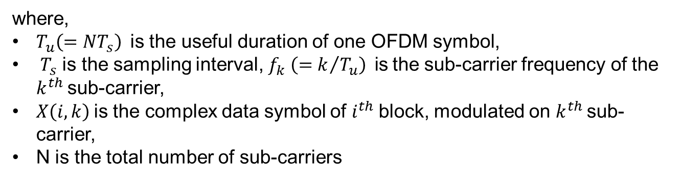
OFDM Signal Generation
The baseband OFDM signal transmitted during $i^{th}$ block can be written as-
$$x\left(i,t\right)=\frac{1}{N}\sum_{k=0}^{N−1}{ X\left(i,k\right){ e}^{j 2 π f_{k }t}}, for 0 ≤ t ≤ T_{u}$$
where,
$T_{u}\left(=NT_{s}\right)$is the useful duration of one OFDM symbol,
${ T}_{s}$ is the sampling interval,${ f}_{k} \left({=k}/{T_{u}}\right)$is the sub-carrier frequency of the $k^{th}$sub-carrier,
$X\left(i,k\right)$is the complex data symbol of $i^{th}$block, modulated on $k^{th}$sub-carrier,
N is the total number of sub-carriers
The discrete version of the baseband OFDM signal $x\left(i,n\right)$can be expressed as –
$$x\left(i,n\right)=\frac{1}{N}\sum_{k=0}^{N−1}{X\left(i,k\right) e^{j 2 π k n / N} ,} for n=0, 1,…, N−1$$

Slide 8
Cyclic Prefix or
Guard Band Insertion

Slide 9
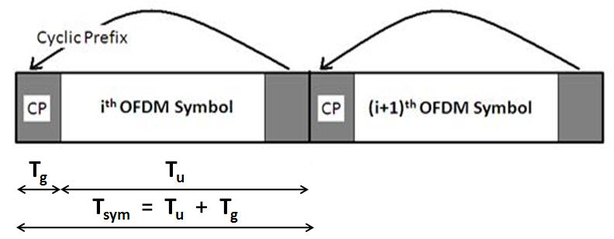
Cyclic Prefix or Guard Band Insertion
A guard band interval is usually inserted between successive OFDM symbols to avoid the inter-symbol interference (ISI) caused due to the delay spread of multipath channel.
If a guard band interval with no signal transmission is inserted then the ISI can be eliminated almost completely, but a sudden change of waveform contains higher spectral components, so they result in ICI.
Therefore the guard interval insertion technique with cyclic prefix (CP) is generally used to avoid ICI.
This scheme was first introduced by Peled and Ruiz in 1980.
A technique of cyclic extension (CE) (more commonly referred to today as CP) was suggested as a solution of maintaining the orthogonality when signal is passed through multipath fading channel.
In this method, the OFDM symbol is cyclically extended in the guard time.
The CP insertion is shown in Figure

Slide 10
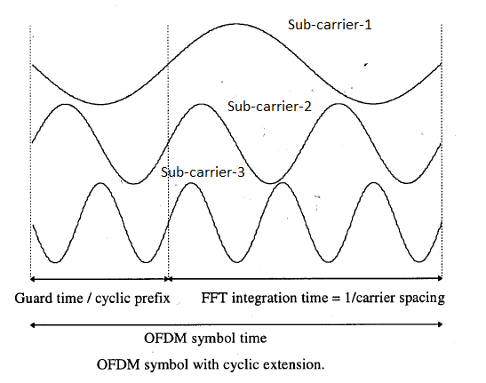

Slide 11
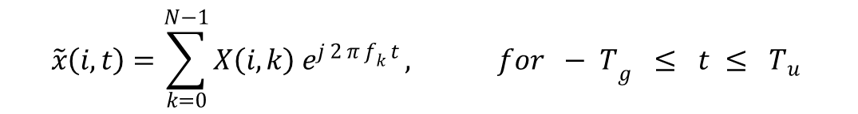
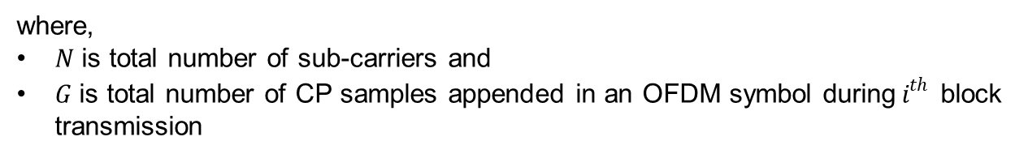
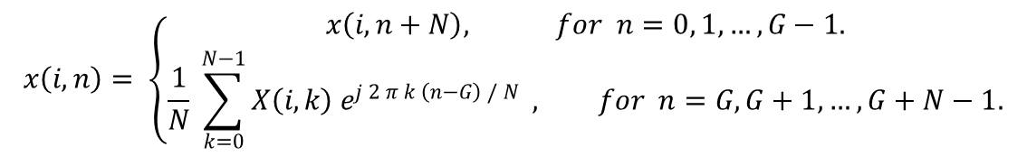
Cyclic Prefix or Guard Band Insertion
Due to CP insertion; the transmitted signal is extended to ${T_{sym}=T}_{u}+T_{g }$ and can be expressed as –
$$\tilde{x}\left(i,t\right)=\sum_{k=0}^{N−1}{X\left(i,k\right){ e}^{j 2 π f_{k }t}}, {for − T}_{g} ≤ t ≤ T_{u}$$
where,$\tilde{x}\left(i,t\right)=x\left(i, t+T_{u}\right), for {− T}_{g} ≤ t ≤ 0$
The discrete version of the baseband OFDM signal with CP can be expressed as –
$$x\left(i,n\right)= \left\{\begin{aligned}x\left(i,n+N\right), for n=0, 1,…,G−1. \\ \frac{1}{N} \sum_{k=0}^{N−1}{X\left(i,k\right) e^{j 2 π k \left(n−G\right) / N} }, for n=G, G+1,…,G+N−1.\end{aligned}\right.$$
where,
$N$ is total number of sub-carriers and
$G$ is total number of CP samples appended in an OFDM symbol during${ i}^{th}$ block transmission

Slide 12


Why Cyclic Prefix ?
Two benefits of using a cyclic prefix between subsequent OFDM symbols:
The CP isolates different OFDM blocks from each other when the wireless channel contains multiple paths, i.e. is frequency-selective.
The length of guard interval or CP plays an important role.
If the length of the CP < maximum delay of a multipath channel,
the tail part of an OFDM symbol affects the head part of the next symbol, resulting in the ISI.
If the length of the CP > maximum delay of multipath channel
It increases the overhead of the system.
2. The CP turns the linear convolution with the channel into a Circular convolution.
Only with a circular convolution, we can use the single-tap equalization OFDM is so famous for.
without CP
$y=x∗h$
---- Linear Convolution of x with channel impulse response
With CP
$y=x_{cp}∗h$
---- Linear Convolution of x_cp with channel impulse response
*** This Linear Convolution of x_cp with channel impulse response is equal to circular convolution of x with h

Slide 13
Receiver Model

Slide 14
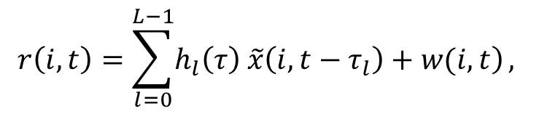
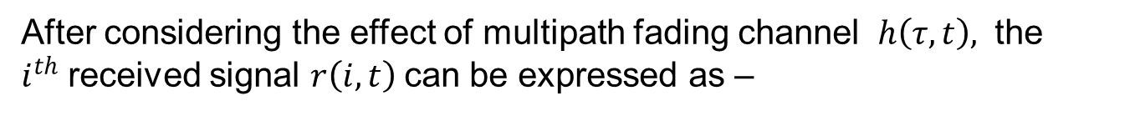
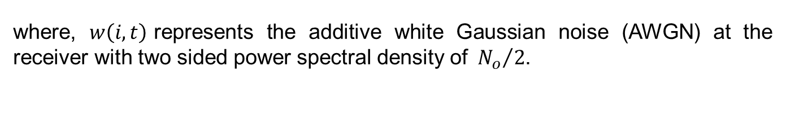
Receiver Model
At the receiver, after finding the start of frame (using timing estimation and correction), the CP is removed and the sample of OFDM symbol is converted from serial to parallel.
Then these parallel samples are applied for FFT operation.
After FFT, the channel equalization has been done.
These equalized data is applied for decoding process to recover information symbol.
After considering the effect of multipath fading channel $h\left(τ,t\right),$ the $i^{th}$received signal $r\left(i, t\right)$can be expressed as –
$$r\left(i,t\right)=\sum_{l=0}^{L−1}{\left.h_{l}\left(τ\right) \tilde{x}\left(i,t−τ_{l}\right)+w(i,t\right)},$$
where, $w\left(i,t\right)$represents the additive white Gaussian noise (AWGN) at the receiver with two sided power spectral density of${N_{o}}/2$.

Slide 15
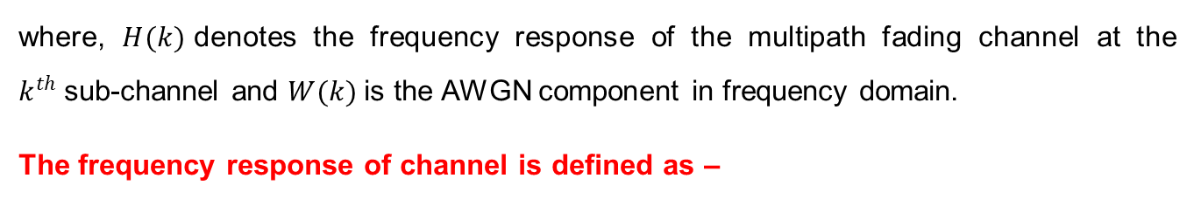
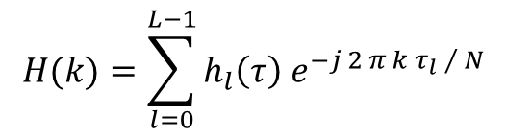
Receiver Model
If the length of CP is more than the maximum delay spread of multipath channel and if there is no timing and frequency offsets or the timing and frequency offsets are correctly estimated and corrected then the OFDM symbol can be correctly recovered from the received signal.
By considering above condition and after removing the CP, the received signal is given to the FFT block.
The output of FFT, X ̂(i,k), can be expressed as –
$\hat{X}\left(i,k\right)=H\left(k\right) X\left(i,k\right)+W\left(i,k\right), for k=0, 1,…, N−1$
where, $H(k)$denotes the frequency response of the multipath fading channel at the $k^{th}$sub-channel and $W(k)$is the AWGN component in frequency domain.
The frequency response of channel is defined as –
$$H(k)=\sum_{l=0}^{L−1}{h_{l}\left(τ\right) e^{−j 2 π k τ_{l} / N}}$$

Slide 16
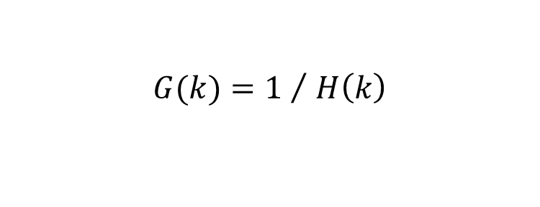
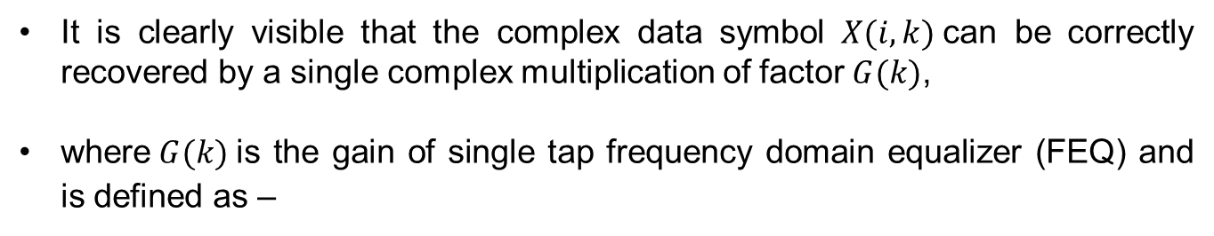
Receiver Model
It is clearly visible that the complex data symbol $X(i,k)$can be correctly recovered by a single complex multiplication of factor$G(k)$,
where$G(k)$is the gain of single tap frequency domain equalizer (FEQ) and is defined as –
$$G(k)={1 }/{ H\left(k\right)}$$

Slide 17
OFDM Receiver Model
(Detail Mathematical Explanation of Each Block)

Slide 18
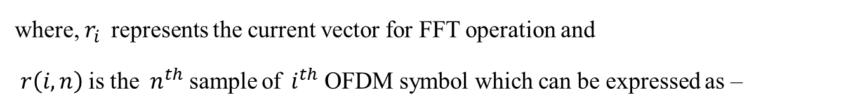
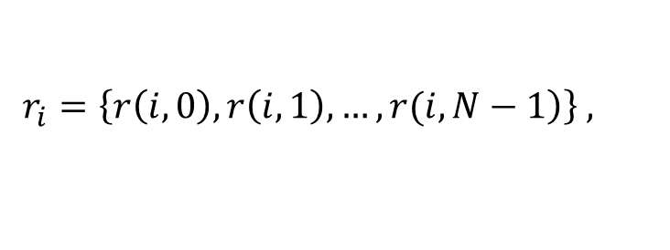

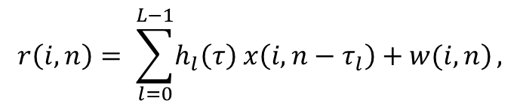
Receiver Model (Detail Mathematical Explanation of Each Block)
First consider the case when there is no timing error (i.e. timing offset δ = 0).
This is the case when the estimated starting point of OFDM symbol coincides with the exact timing, preserving the orthogonality among sub-carriers, therefore the OFDM symbol can be perfectly recovered without any type of interference.
The received sampled signal, after removing the cyclic prefix during the time of one complete OFDM symbol, can be expressed in the form of a vector as –
$$r_{i}=\left\{\left.r\left(i,0\right),r\left(i,1\right),…,r(i,N−1\right)\right\} ,$$
where, $r_{i}$represents the current vector for FFT operation and
$r\left(i,n\right)$is the$n^{th}$sample of${ i}^{th}$OFDM symbol which can be expressed as –
$$r\left(i,n\right)= \sum_{l=0}^{L−1}{\left.h_{l}\left(τ\right) x\left(i,n−τ_{l}\right)+w(i,n\right)},$$
$$for n=−G,−G+1,…, 0, 1,…, N−1$$

Slide 19
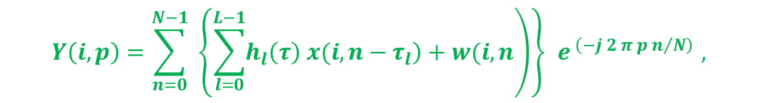


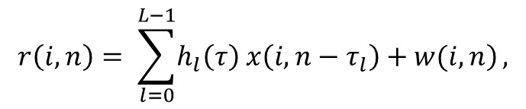

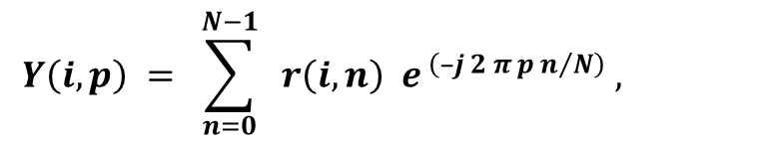
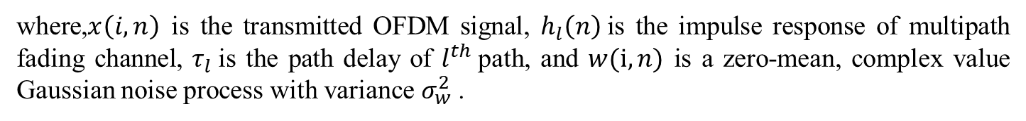
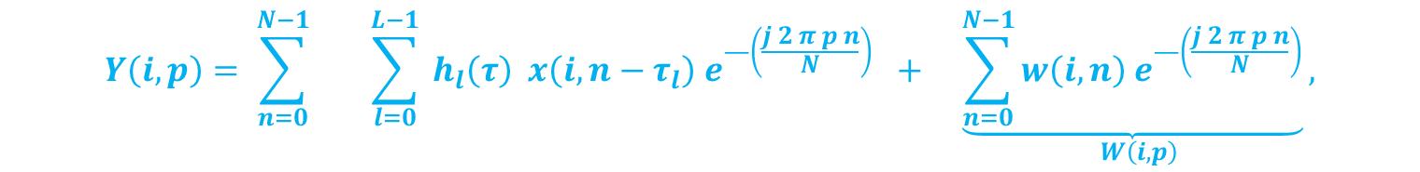
Receiver Model (Detail Mathematical Explanation of Each Block)
$$r\left(i,n\right)= \sum_{l=0}^{L−1}{\left.h_{l}\left(τ\right) x\left(i,n−τ_{l}\right)+w(i,n\right)},$$
$$for n=−G,−G+1,…, 0, 1,…, N−1$$
where,$x\left(i,n\right)$is the transmitted OFDM signal, $h_{l}\left(n\right)$is the impulse response of multipath fading channel, $τ_{l}$is the path delay of $l^{th}$path, and $w(i,n)$ is a zero-mean, complex value Gaussian noise process with variance $σ_{w}^{2}$.
The output of FFT can be written as-
$$Y\left(i,p\right) = \sum_{n=0}^{N−1}{ r\left(i,n\right){ e}^{ \left(–j 2 π p n/N\right)} , }$$
After substituting$r\left(i,n\right)$, it becomes –
$$for p=0, 1,…, N−1$$
$$Y\left(i,p\right)=\sum_{n=0}^{N−1}{ \left\{\left.\sum_{l=0}^{L−1}{\left.h_{l}\left(τ\right) x(i, n−τ_{l}\right)}+w(i,n\right)\right\}{ e}^{ \left(−j 2 π p n/N\right)} ,}$$
After separating the AWGN term –
$$Y\left(i,p\right)= \sum_{n=0}^{N−1}{ \sum_{l=0}^{L−1}{{ h}_{l}\left(τ\right) x\left(i,n−τ_{l}\right) e^{—\left(\frac{j 2 π p n}{N}\right)}}} + \underset{W\left(i, p\right)}{\underbrace{\sum_{n=0}^{N−1}{w\left(i,n\right) e^{—\left(\frac{j 2 π p n}{N}\right)}}},}$$

Slide 20
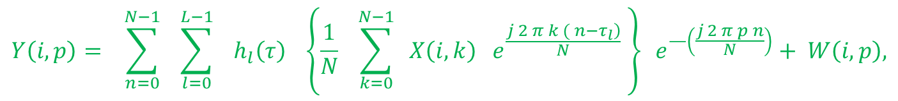

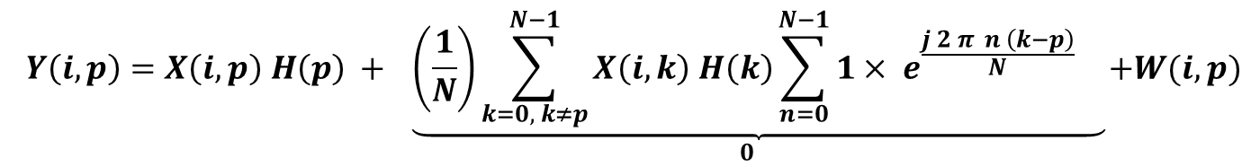
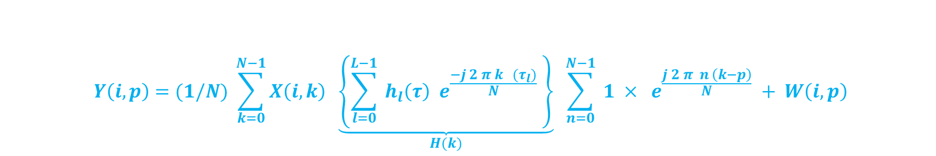
Now, put the value of$x\left(i,n−τ_{l}\right)$
$$Y\left(i,p\right)= \sum_{n=0}^{N−1}{ \sum_{l=0}^{L−1}{ { h}_{l}\left(τ\right) \left\{\frac{1}{N} \sum_{k=0}^{N−1}{ X\left(i,k\right) e^{\frac{\left.j 2 π k ( n−τ_{l}\right)}{N}} }\right\} e^{—\left(\frac{j 2 π p n}{N}\right)}}}+ W\left(i, p\right),$$
After interchanging the summation, it can be expressed as -
$$Y\left(i,p\right)=(1/N) \sum_{k=0}^{N−1}{X\left(i,k\right) \underset{H(k)}{\underbrace{\left\{\sum_{l=0}^{L−1}{{ h}_{l}\left(τ\right) e^{\frac{−j 2 π k (τ_{l})}{N}} }\right\}}} }\sum_{n=0}^{N−1}{ 1 × e^{\frac{j 2 π n \left(k−p\right)}{N}} }+ W\left(i, p\right)$$
After rearranging
$$Y\left(i,p\right)=X\left(i,p\right) H\left(p\right) +\underset{0}{\underbrace{\left(\frac{1}{N}\right)\sum_{k=0, k≠p}^{N−1}{X\left(i,k\right) H\left(k\right)\sum_{n=0}^{N−1}{1× e^{\frac{j 2 π n \left(k−p\right)}{N}} } }}}+W(i,p)$$
Finally the output of FFT can be expressed as –
$$Y\left(i,p\right)=H\left(p\right) X\left(i,p\right) + W\left(i,p\right), for p=0, 1,…, N−1$$

Slide 21
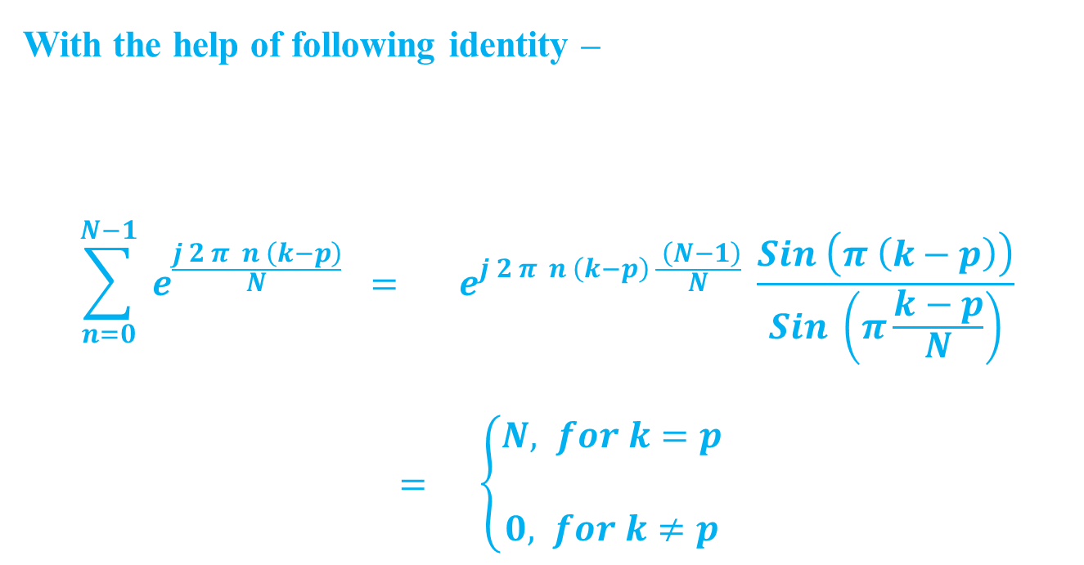
With the help of following identity –
$$\sum_{n=0}^{N−1}{ e^{\frac{j 2 π n \left(k−p\right)}{N}} } = e^{j 2 π n \left(k−p\right) \frac{ \left(N−1\right)}{N}} \frac{Sin \left(π \left(k−p\right)\right)}{Sin \left(π\frac{k−p}{N}\right)}$$
$= \left\{\begin{aligned}N, for k=p \\ \\ 0, for k≠p\end{aligned}\right.$

Slide 22
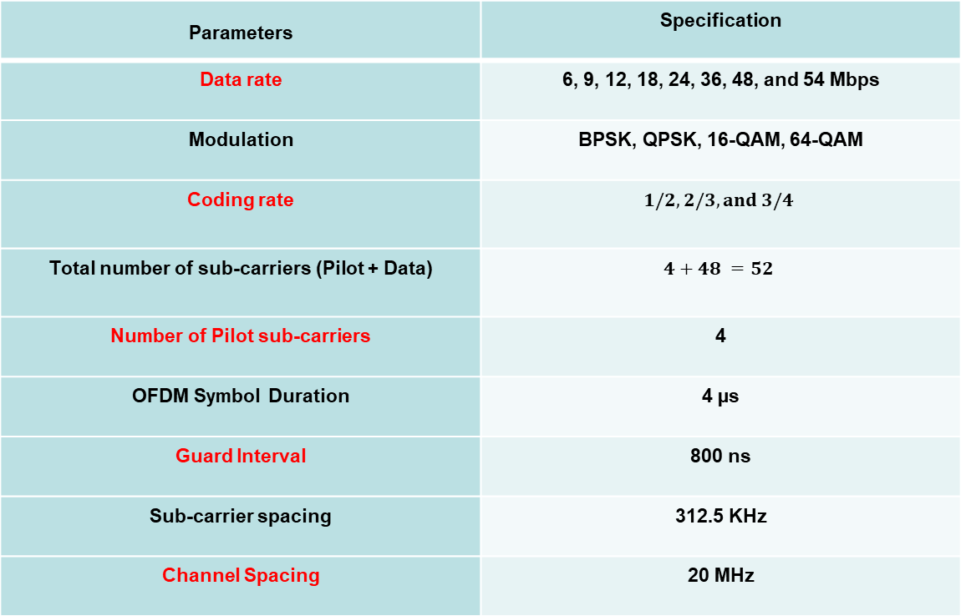
Key Parameters of Different Standards based on OFDM
IEEE 802.11 and HIPERLAN/2
Parameters | Specification
Data rate | 6, 9, 12, 18, 24, 36, 48, and 54 Mbps
Modulation | BPSK, QPSK, 16-QAM, 64-QAM
Coding rate
Total number of sub-carriers (Pilot + Data)
Number of Pilot sub-carriers | 4
OFDM Symbol Duration | 4 µs
Guard Interval | 800 ns
Sub-carrier spacing | 312.5 KHz
Channel Spacing | 20 MHz

