Slide 1
5G WIRELESS COMMUNICATION
(UEC 719)
Dr. Amit Mishra
Associate Professor,
TIET, Patiala
Dr. Surbhi Sharma
Associate Professor,
TIET, Patiala
1

Slide 2
Lecture: 12
Selection of OFDM Parameters
OFDM-Waveform for 5G

Slide 3
Contents
OFDM SYSTEM MODEL
Delay Spread Values
Selection of OFDM Parameters
Steps to decide the OFDM parameters
Examples

Slide 4
OFDM System Model
[S. Hara and R. Prasad (2003)]
Encoder
(M-PSK,
M-QAM etc)
S/P
N-Point
IFFT
P/S
Add
Cyclic Prefix
Input bit
stream
Fading Channel
White Gaussian Noise
output bit
stream
Decoder
(M-PSK,
M-QAM etc)
P/S
MMSE Equalizer
N
Point
FFT
S/P
Remove
Cyclic Prefix
Channel
Estimation

Slide 5
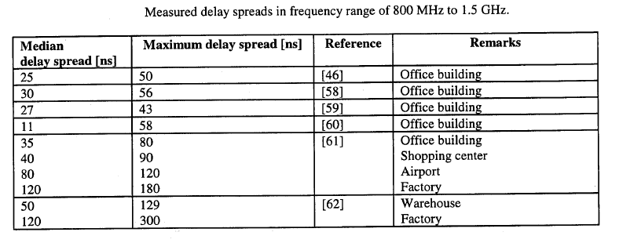
Delay Spread Values
Reference: Book on OFDM for Wireless Multimedia Communications
by R Van Nee and Ramjee Prasad

Slide 6
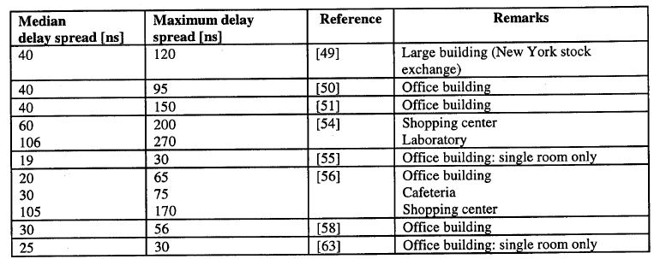
Delay Spread Values
Reference: Book on OFDM for Wireless Multimedia Communications
by R Van Nee and Ramjee Prasad

Slide 7
Selection of OFDM Parameter
The choice or selection of various OFDM parameters is a tradeoff between various conflicting requirements like:
  Bandwidth; Bit Rate; Delay Spread
The delay spread value directly decide the value of Guard Time
As a rule, Guard time should be about two to four times of rms value of delay spread.
After Guard Time selection, the symbol duration can be fixed.
Symbol duration must be larger than the guard time to minimize the signal-to-noise ratio (SNR) by the guard time.
But a larger symbol duration means -- more sub-carriers with a smaller sub-carrier spacing,
  A larger implementation complexity
  More sensitivity to phase noise and frequency offset
  Increased peak-average-power ratio (PAPR)
Hence, a practical design choice is :
Symbol duration should be at least five times of Guard Time

Slide 8

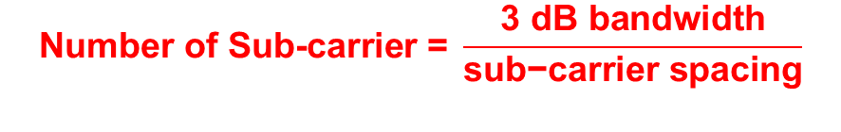
After Symbol duration, Number of Sub-carriers will be decided by following rule:
  $$\text{Number} \text{of} \text{Sub}\text{−}\text{carrier}\text{ = }\frac{\text{3 }\text{dB} \text{bandwidth}}{\text{sub}\text{−}\text{carrier} \text{spacing}}$$
Number of bits per OFDM symbol required to achieve given date rate is obtained from following relationship:
$$\frac{No of bits per OFDM symbol}{Total Symbol Duration}=data rate$$
If M-QAM is used with r code rate then
[ Log2(M) * r ] bits of information per QAM symbol per sub-carrier
$$No of sub−carrier=code rate ∗No of bits per OFDM symbol$$

Slide 9
Steps to Decide the OFDM parameters
Select the application
Select the Environment (outdoor or indoor)
Determine the delay spread value of that environment
Determine the guard time
(2 to 4 times of delay spread)
SNR loss should be less than 1 dB
Determine the number of sub-carrier using 3-dB bandwidth and sub-carrier spacing
Determine the symbol duration (~ 4 𝑡𝑜 5 𝑡𝑖𝑚𝑒𝑠 𝑜𝑓 𝑔𝑢𝑎𝑟𝑑 𝑡𝑖𝑚𝑒)

Slide 10

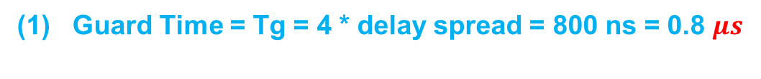


Example
Determine the OFDM parameters for the following given condition:
    Bandwidth = 15 MHz
    Bit Rate < 20 Mbps
    Delay Spread = 200 ns
(1) Guard Time = Tg = 4 * delay spread = 800 ns = 0.8 $μs$
(2) Total Symbol Duration =Ts = 6 * Guard time = 4.8 $μs$
(3) Useful Symbol Duration =Tu = Ts-Tg= (4.8 – 0.8 )$μs$
SNR loss should be less than 1 dB
Calculation of SNR Loss due to CP
SNR Loss= $\frac{T_{u}}{T_{s}}$
(4) The SNR loss in decibels (dB)
= $10 log10 \left(\frac{T_{s}}{T_{u}}\right)$ = 10 * log10(4.8/4) = 0.79 dB
(5) Sub-carrier Spacing = $\frac{1}{T_{u}}$ = 250 kHz
(6) Number of Sub-carrier

Slide 11

Number of Sub-carrier
Number of bits per OFDM symbol required to achieve 20 Mbps date rate is obtained from following relationship:
$$\frac{No of bits per OFDM symbol}{Total Symbol Duration}=data rate$$
$$No of bits per OFDM symbol=20 ∗10^{6} ∗4.8 ∗10^{−6}=96 bits$$
If 16-QAM is used with 1/2 code rate then
2 bits of information per QAM symbol per sub-carrier
This require 48 sub-carrier to get 96 bits per OFDM symbol
$$No of sub−carrier=code rate ∗No of bits per OFDM symbol$$

Slide 12


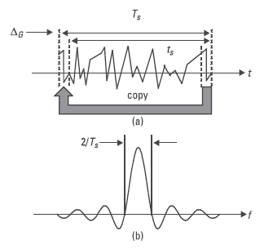
Bandwidth of OFDM

Slide 13
IEEE 802.11a Overview
Carrier frequency= 5 GHz
Total allotted bandwidth= 20 MHz x 10 = 200MHz
Size of the FFT= 64
Number of data subcarriers= 48
Number of Pilot subcarriers= 4
FFT period= 3.2 µs
Channel bandwidth used= 64/3.2 µs => 20 MHz

Slide 14
Typical Configuration
52 subcarriers, 64 point FT/IFFT
Symbol time 4 µs
Guard time 800 ns
BPSK, QPSK, 16-QAM, 64-QAM
Coding rates 1/2,3/4,2/3
Bit rates 6,12,18,24,36,48,54 Mbps
Channel spacing 20 MHz
Tolerable delay spread about 250 ns at 24 Mbps

Slide 15
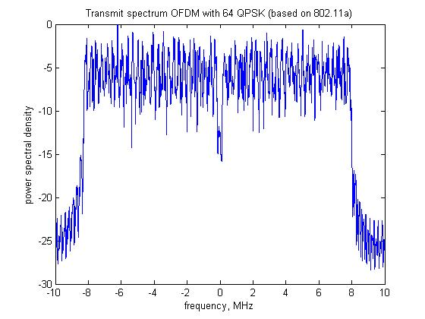
Simulation work
Transmitter of OFDM system which is based on IEEE 802.11 has been simulated

