Slide 1
5G WIRELESS COMMUNICATION
(UEC 719)
Course Instructor
Dr. Hem Dutt Joshi
Dr. Surbhi Sharma
Associate Professor,
TIET, Patiala

Slide 2
5G WIRELESS COMMUNICATION
(UEC 719)
Dr. Amit Mishra
Associate Professor,
TIET, Patiala
Dr. Surbhi Sharma
Associate Professor,
TIET, Patiala

Slide 3
Lecture: 13
5G NR
Numerology and Resource Block

Slide 4
Contents
OFDM SYSTEM MODEL
5G NR Numerologies,
Sub Carrier Spacing
Resource Block

Slide 5
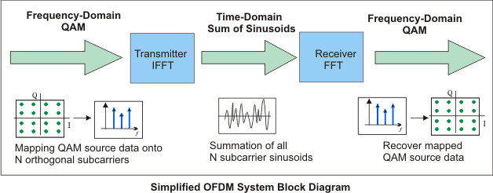
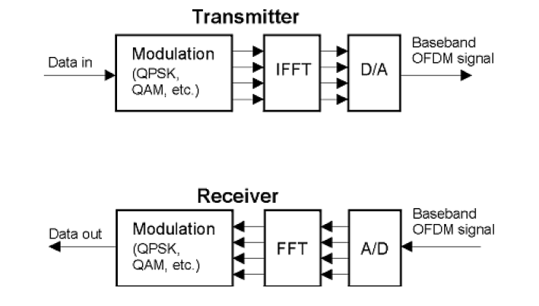
OFDM System
IFFT takes frequency-domain input data (complex numbers representing the modulated subcarriers) and converts it to the time-domain output data
(analog OFDM symbol waveform)
Thus, the IFFT block provides a simple way to modulate data onto N orthogonal subcarriers.

Slide 6
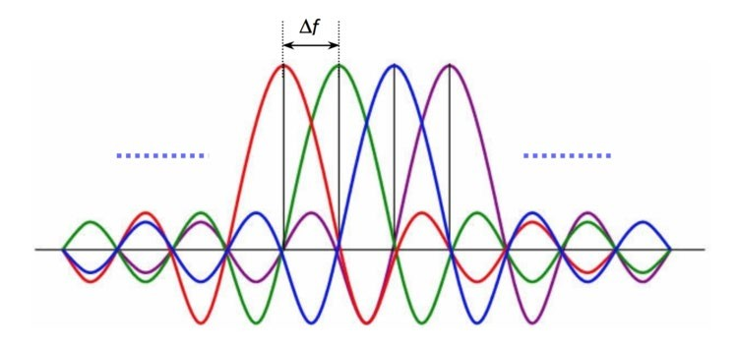
Numerologies in 5G NR
5G NR supports QPSK, 16 QAM, 64 QAM and 256 QAM modulation
5G New Radio uses OFDM wave form
It uses variable sub carrier spacing
In 4G LTE, subcarrier spacing used is 15KHz
In 5G, possible sub carrier spacings are
  15KHz, 30KHz,
  60KHz, 120KHz
  240KHz

Slide 7
Numerology and Sub Carrier Spacing
Sub Carrier Spacing = 2^{µ} x 15 KHz
µ=1 (Numerology 1 )
SCS = 30 KHz
µ=2 (Numerology 2 )
SCS = 60 KHz
µ=3 (Numerology 3 )
SCS = 120 KHz
µ=4 (Numerology 4 )
SCS = 240 KHz

Slide 8
Resource Block

Slide 9

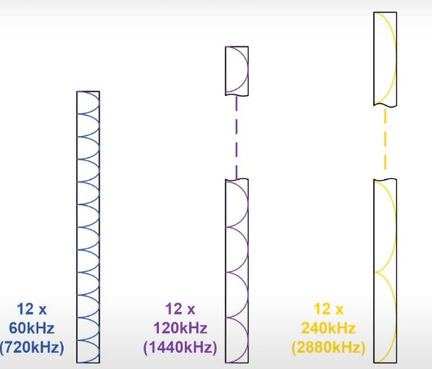
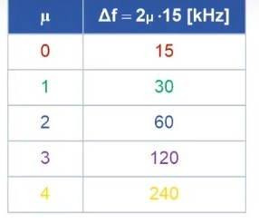

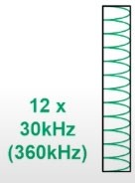

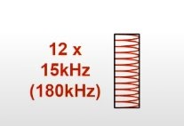
Resource Block and its Bandwidth
12 Consecutive Sub carriers constitute one Resource Block (RB)
Sub Carrier Spacing = 2^{µ} x 15 KHz

Slide 10
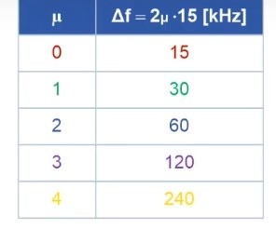
Recourse Block and its BW
RB = 12 contiguous Sub Carriers
BW of RG for various Numerologies
=SCSx12
µ=0 (Numerology 0 )
µ=1 (Numerology 1 )
µ=2 (Numerology 2)
µ=3 (Numerology 3 )
µ=4 (Numerology 4 )

Slide 11

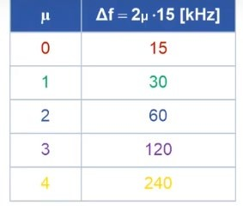
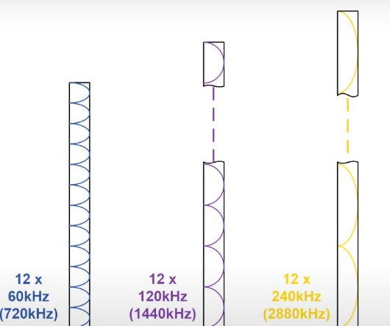

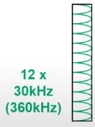

Numerology , Sub Carrier Spacing and Resource Block

Slide 12
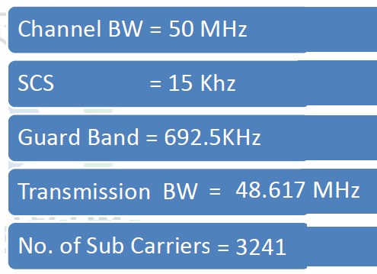
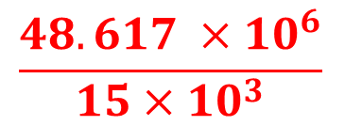
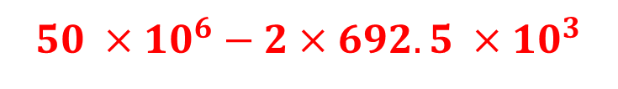
Example
For the following parameters: Channel BW=50 MHz, Numerology =0, and Guard Band = 692.5 KHz; Determine Transmission BW and No. of Sub-carriers.
^{µ = 0}
2^{µ} =1
Sub Carrier Spacing = 2^{µ} x 15 KHz
$$50 ×{10}^{6}−2×692.5 ×10^{3}$$
$$\frac{48.617 ×10^{6}}{15×10^{3}}$$
= 135

Slide 13
Example
Given Parameters:
Channel BW = 100 MHz
Numerology-2 (µ=2) --- SCS = 60KHz
Guard Band = 1370 KHz
Determine Transmission BW, No. of Sub-carriers and Resource Block , Bandwidth of RB
Transmission BW = 97.26 MHz (100 MHz- 2 * 11370 kHz)
No. of Sub-Carriers = 1621 (97.26 * 10^6 / 60 KHz)
No. of RBs = 1621/12 = 135
Band width of one RB = 12 * 60 = 720 KHz

Slide 14

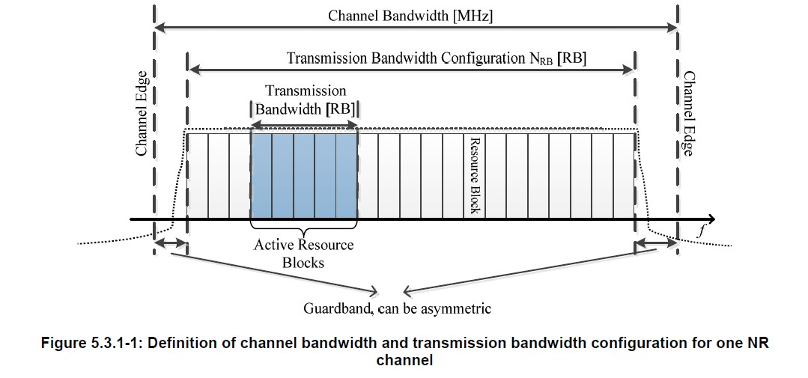



UE Channel Bandwidth
The UE channel bandwidth supports a single NR RF carrier
BS supports different UE channel bandwidths within the same BS spectrum.
BS supports Transmission of multiple carriers to the same UE (CA) or multiple carriers to different UEs within BS Channel BW
UE is configured with one or more BWP / carriers, each with its own UE channel BW
3GPP TS38.101-1

Slide 15
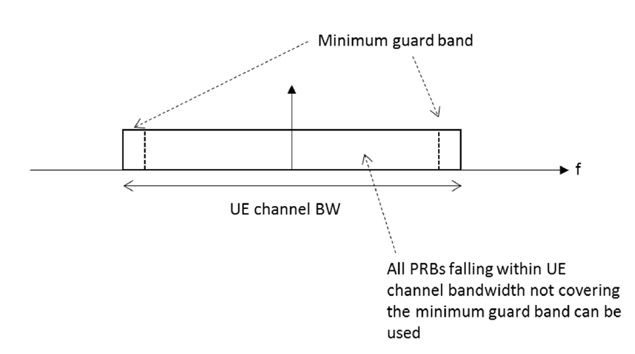
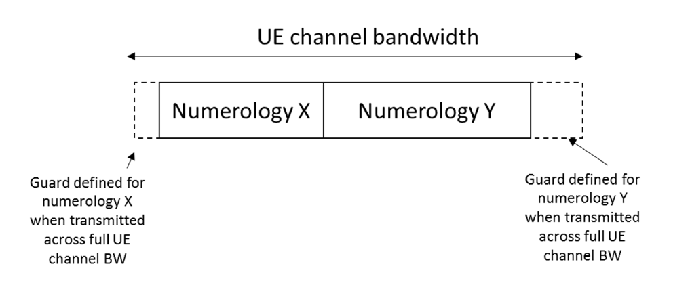
UE Channel Bandwidth
3GPP TS38.101-1

Slide 16

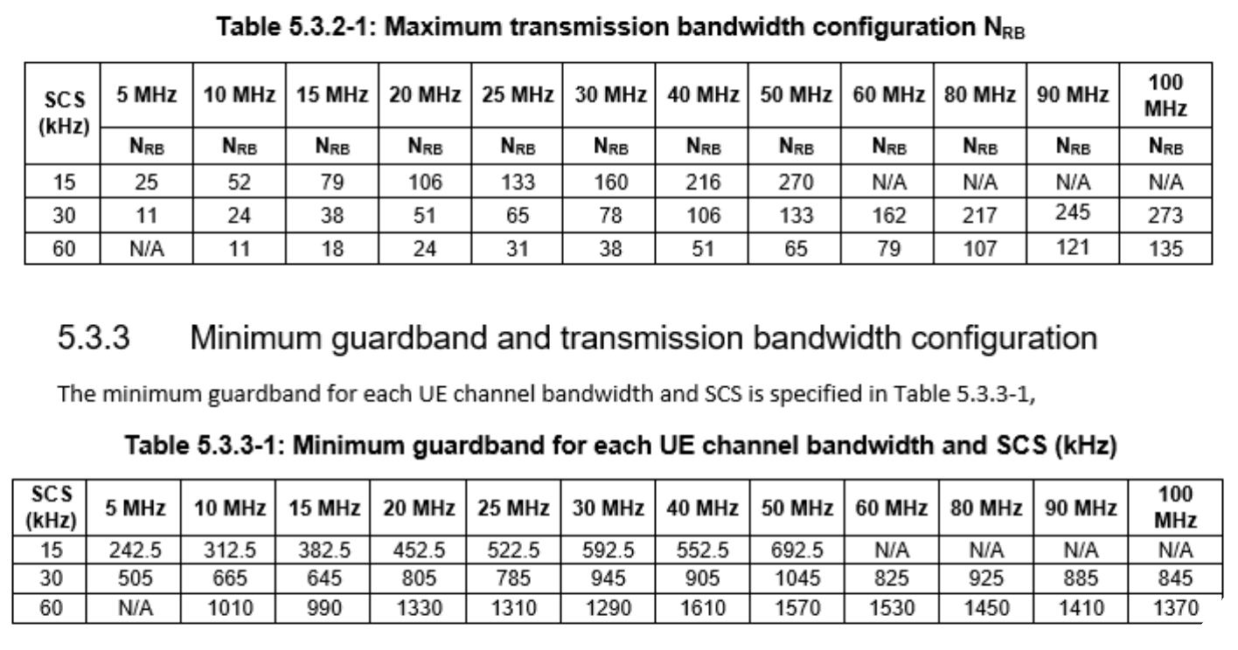
Maximum Transmission Bandwidth FR1
3GPP has specified Channel bandwidths for each NR band
3GPP TS38.101-1

Slide 17
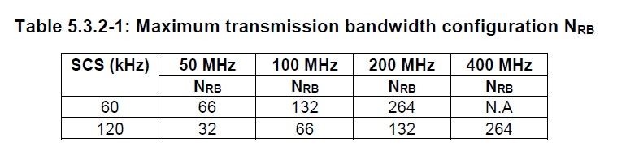
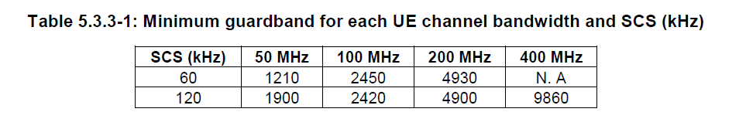
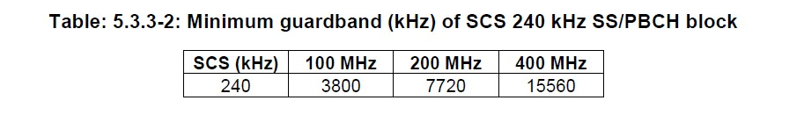
Maximum Transmission Bandwidth FR2
3GPP TS38.101-2

Slide 18
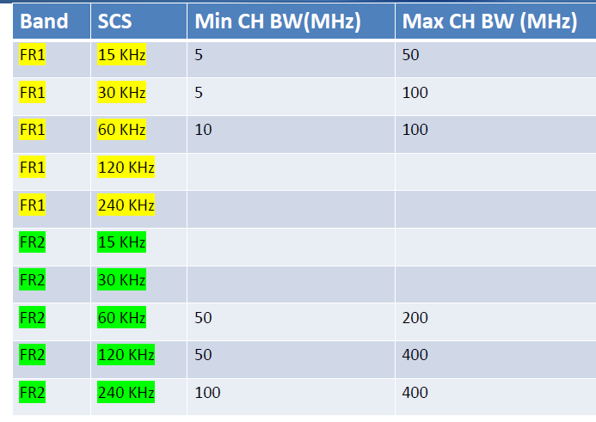
Min and Max Channel BW

Slide 19











Maximum Supported BW for each Numerology
SCS =15 KHz
50 MHz
FR1
SCS = 30 KHz
100 MHz
SCS = 60 KHz
100 MHz
SCS = 240 KHz
SCS =60 KHz
SCS = 60 KHz
200 MHz
FR2
SCS = 120 KHz
400 MHz
SCS = 240 KHz
400 MHz

Slide 20

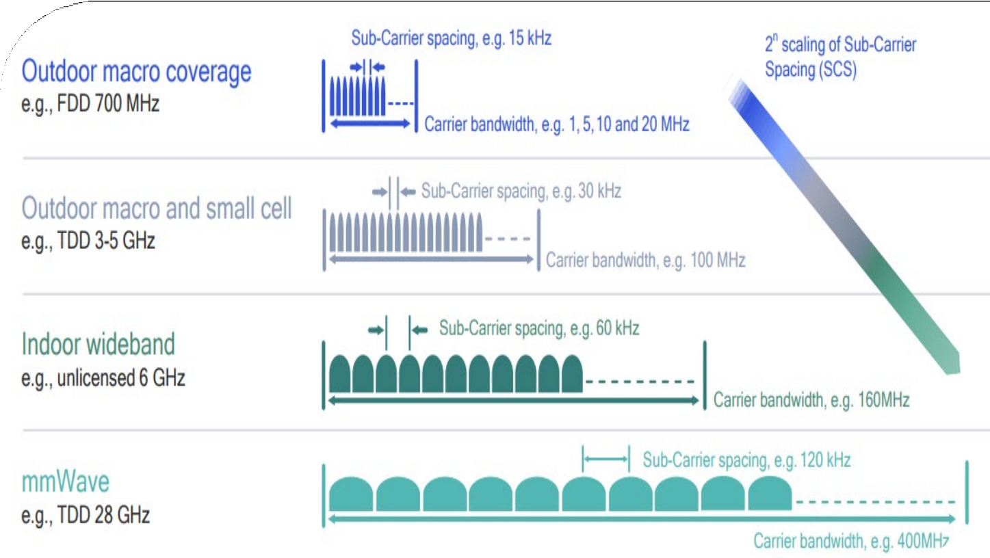
Usage example of numerologies, Spectrum Band and cell size

Slide 21

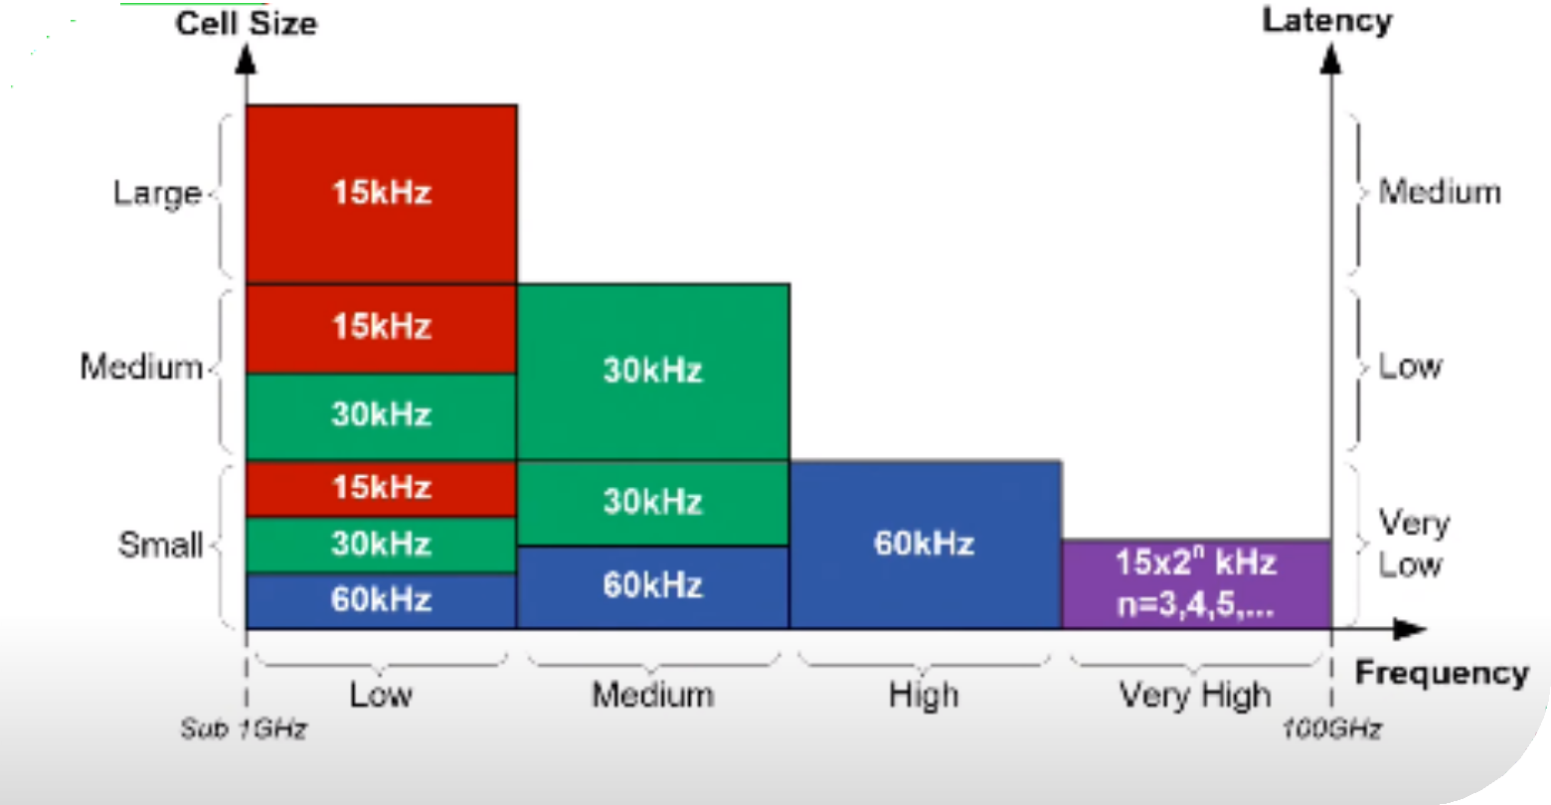
Usage example of Frequency Band and SCS

