Slide 1
5G WIRELESS COMMUNICATION
(UEC 719)
Dr. Amit Mishra
Associate Professor,
TIET, Patiala
Dr. Surbhi Sharma
Associate Professor,
TIET, Patiala
1

Slide 2
Lecture: 14
5G NR
Carrier Aggregation

Slide 3
Contents
Carrier Aggregation

Slide 4
Carrier Aggregation (CA) Concept
Carrier aggregation (CA) is a technique that uses multiple carriers simultaneously to increase bandwidth and data rates for mobile networks.
Carrier Aggregation is a software functionality in Radio Access Networks and user devices which allows Mobile Network Operators (MNOs) to combine the capabilities of radio cells at distinct frequency allocations to enhance the end user experience.
It is a key technology of the LTE-Advanced networks
Carrier Aggregation enabled the evolution to Gigabit-LTE, achieving user data rates of more than 1 Gbps.
In 5G networks, Carrier Aggregation will enable the evolution to multi-Gigabit-5G, reaching user data rates of about 4 Gbps and above.
5G Carrier Aggregation is also capable of improving the geographic availability, more commonly referred to as coverage, of high data rates.

Slide 5
Carrier Aggregation (CA) Concept
Each carrier has specific characteristics in terms of coverage (the range around the antenna where signals can still be received) and capacity (bandwidth, data rates, throughput).
Higher frequency ranges typically provide greater capacity,
while carriers in the lower range provide wider or deeper coverage.
Lower frequency bands are typically used in FDD (Frequency Division Duplex) mode, which has higher uplink signal strength compared to TDD (Time Division Duplex) mode, which is almost exclusively used for cellular allocations above 2.5 GHz.
Reference --https://www.nokia.com/about-us/newsroom/articles/5g-carrier-aggregation-explained/

Slide 6
Carrier Aggregation (CA) Concept
At the cell edge, Carrier Aggregation brings another benefit to the user.
Because coverage is typically limited by uplink, not by downlink.
That means that in downlink the cell could reach further than in uplink.
But for a stable connection one needs both, downlink and uplink.
And this is where Carrier Aggregation comes in: it allows the use of downlink for all aggregated cells,
while securing the connection stability through a common uplink on the lower aggregated carrier.
Especially when aggregating low and mid bands, Carrier Aggregation does not only boost data rates, but also the range in which the user will benefit from it.

Slide 7
Key benefits of 5G Carrier Aggregation t
Improved data speeds and throughput
Greater cell coverage
Enhanced energy efficiency
Greater ROI
Carrier aggregation (CA) is a technique that uses multiple carriers simultaneously to increase bandwidth and data rates for mobile networks.

Slide 8
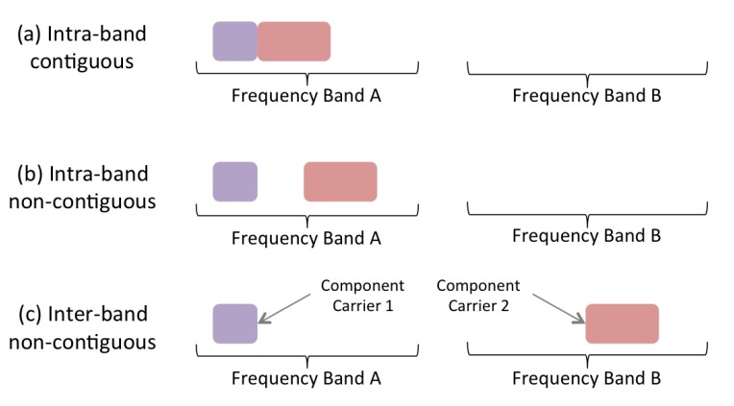
Carrier Aggregation (CA) Concept

Slide 9

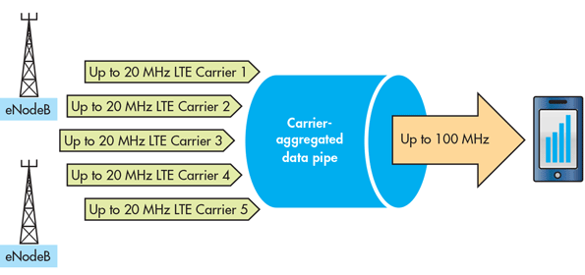


Carrier Aggregation in LTE Advanced / Pro
CA concept introduced in LTE Advanced ( Release-10) with 5 Carriers Components (CC)
Max Channel bandwidth with 5 Carrier component of 20MHz was 100MHz
LTE R-13 (LTE Advanced-PRO),
supports 32 CCs (Max Ch BW = 640 MHz)

Slide 10
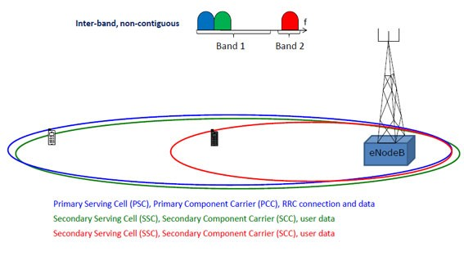
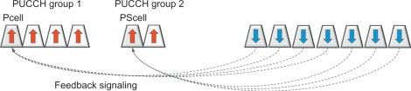
Carrier Aggregation Concept
gNB
Source : https://www.3gpp.org/technologies/keywords-acronyms/101-carrier-aggregation-explained

Slide 11







Carrier Aggregation (CA) in 5G
5G NR supports CA with 16 CCs (both contiguous and non- contiguous) in both FR1 and FR2 bands
Carrier aggregation of LTE and 5G NR carriers is known as Dual Connectivity (DC).
Up to 1.2 GHz of spectrum can be aggregated.
CCs can use different numerologies
CA in both TDD and FDD possible
CA with Licensed and Unlicensed band Possible
CA with SUL/SDL Possible

Slide 12

Carrier aggregation and supplementary uplink
Carrier aggregation (up to 16 carriers)
– Main use case: bandwidth extension
Carrier aggregation
Supplementary uplink
– Main use case: uplink coverage
Supplementary uplink
Cell #1
Cell #2
A single cell

Slide 13
Carrier Aggregation Use Cases

Slide 14


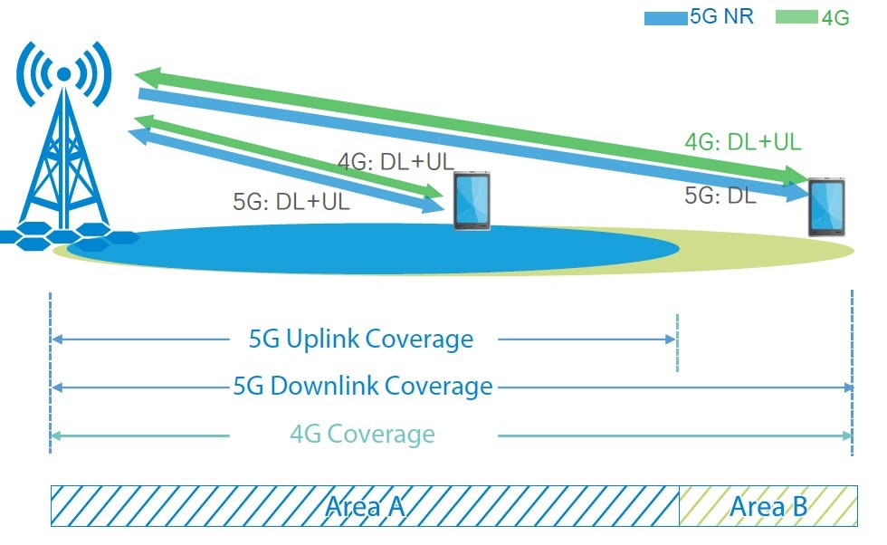



Dual Connectivity
4G LTE on 2.1 Ghz band 5G on 3.5GHz band
There is difference in 4G and 5G coverage, due to frequency used
In area A, UE transmit (UL) data on 4G and 5G both
In area B, because there is only 4G coverage, UE can only transmit (UP)data via LTE.

Slide 15

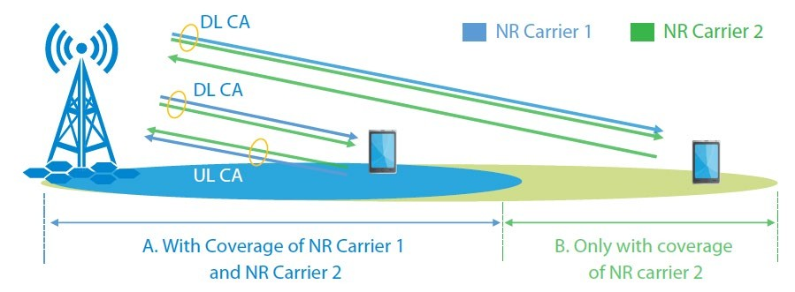


Inter-Band Carrier Aggregation (Inter-Band CA)
CA with 2.1 GHz and 3.5GHz
In area A: with coverage of two carriers. UL CA can be activated;
In area B: only with the coverage of one carrier. UE uses one carrier to transmit date.

Slide 16

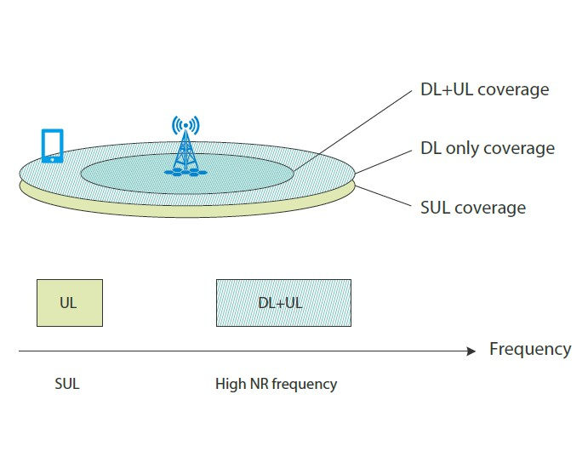



5G Supplementary Uplink (SUL)
Extends the uplink With SUL
One DL frequency band and two uplink frequency bands (one NR frequency band and one SUL frequency band) are used.
When the uplink coverage of the NR carrier is good, UE uses the NR carrier to send and receive data.
When the UE is moving beyond the uplink coverage of the NR carrier, UE uses the SUL carrier for transmitting data

Slide 17
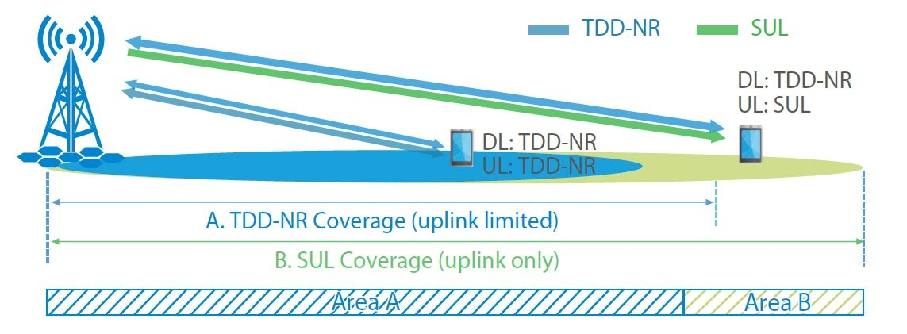
5G Supplementary Uplink (SUL)

Slide 18
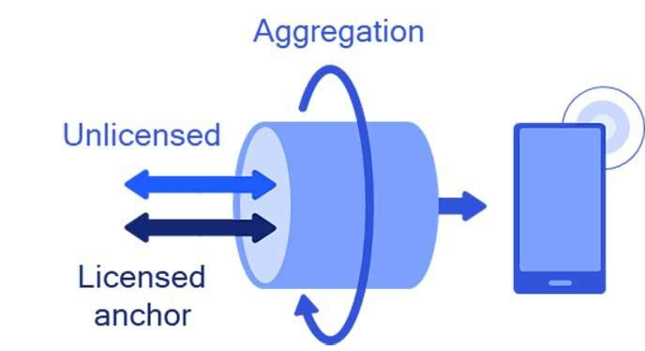


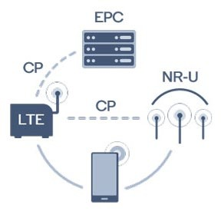
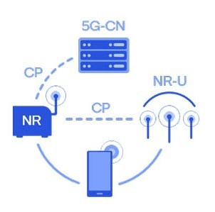

CA in unlicensed Band
CA of licensed and un-licensed spectrums possible
LTE – NR Dual Connectivity
NR – NR Dual Connectivity

