Slide 1
5G WIRELESS COMMUNICATION
(UEC 719)
Dr. Surbhi Sharma
Associate Professor,
TIET, Patiala
Dr. Amit Mishra
Associate Professor,
TIET, Patiala
1

Slide 2
Lecture: 15
5G NR
Bandwidth Part (BWP)

Slide 3
Contents
Bandwidth Part (BWP)

Slide 4







Bandwidth part
LTE
NR
All UEs support full carrier BW
A UE can support less than the carrier BW
20 MHz
Up to 400 MHz
A bandwidth part is a subset of contiguous common physical resource blocks (PRBs).
Each bandwidth part (BWP) has its own numerology (i.e. cyclic prefix length and subcarrier spacing)
A UE can be configured with up to four BWPs in the uplink or four BWPs in the downlink.
A An additional four BWPs can be configured in a supplementary uplink.
Only one BWP in the UL and one in the DL are active at a given time.

Slide 5
Bandwidth Part Use Cases
1) Supporting reduced UE bandwidth capability
2) Supporting reduced UE energy consumption
Overall carrier
Overall carrier
BWP # 2
BWP
BWP # 1
3) Supporting FDM of different numerologies
Overall carrier
BWP # 1
(num erology # 1)
BWP # 2
(num erology # 2)

Slide 6
Bandwidth Part Use Cases
5) Supporting forward compatibility
4) Supporting non-contiguous spectrum
Overall carrier
Overall carrier
?
BWP # 1
BWP # 2
BWP
Something new and not yet defined
Something completely unknown

Slide 7
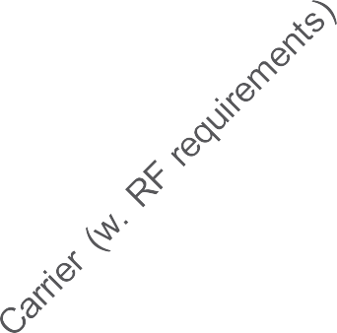

Bandwidth parts
BWP #1 active
BWP #2 active
BWP #1 active
frequency
Switch of active bandwidth part
time

Slide 8
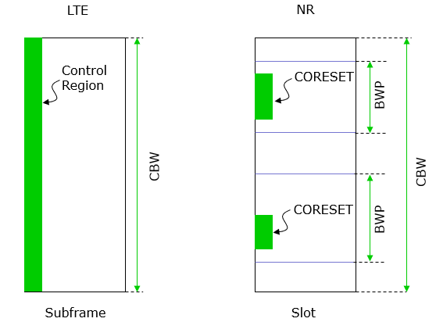
CORSET in BWP

