Slide 1
5G WIRELESS COMMUNICATION
(UEC 719)
Dr. Amit Mishra
Associate Professor,
TIET, Patiala
Dr. Surbhi Sharma
Associate Professor,
TIET, Patiala
1

Slide 2
Lecture: 17
Handover in 5G

Slide 3
Contents
Basic Definition of Handover
Handover scenario in 2G

Slide 4
Basic Definition of Handover
Single cell do not cover the whole service area
Smaller the cell size, faster the movement of MS, but more handovers
However, a handover should not cause a cut-off
GSM aims at maximum handover duration of 60 ms
Two reasons to use handover
– Maintain same quality of radio link at receiver
– Load balancing

Slide 5
Handoff
When mobile station moves from one cell to another is called Handoff
MSC hands off the call to different base station and new frequency/ channel is
assigned
1G : Locator Receiver in BS and monitors RSS of user of adjacent cell
The separate receiver called locator receiver is controlled by the MSC and is used to
monitor the signal strength of users in neighboring cells which appear to be in
need of handoff
2G: Mobile assisted hand off (MAHO)
  Mobile Monitors RSS from the neighboring cells
  Report backs to MSC

Slide 6
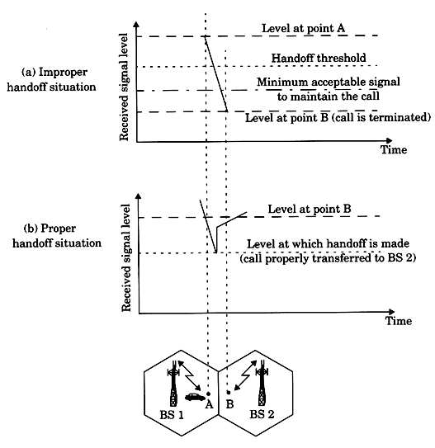
Handoffs – the basics

Slide 7
HAND OFF (Contd….)
System designers must specify an optimum level at which handoff is initiated.
A slightly strong signal is used as threshold at which a handoff is made
Δ = P_{r handoff -} P_{r minimum} _{usable}
Value of delta must be selected carefully before handoff ensure that fading is not
momentary
Information of Speed of vehicle that can be computed from statistics of received signal
short term fading signal.

Slide 8
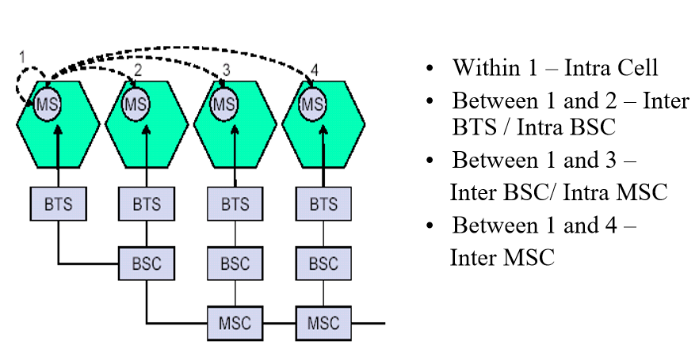
Handover scenario in 2G

Slide 9
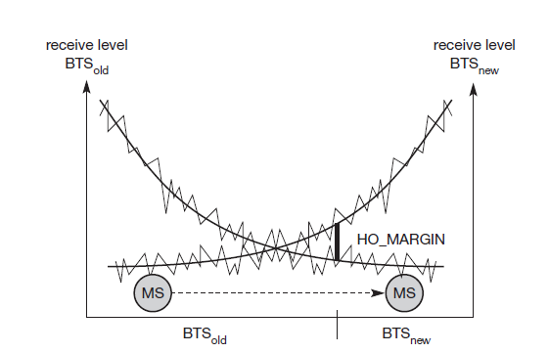
Handover Decision

Slide 10
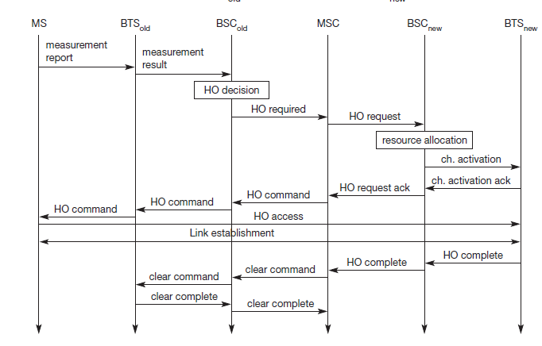
Intra-BSC Handover

Slide 11
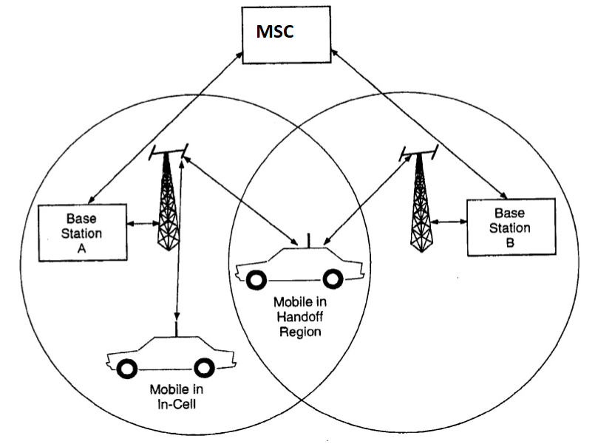
System model for Cellular Handoff

Slide 12
Practical Handoff Considerations
Dwell time:
The time over which call is maintained within a cell without hand-off.
It depends upon propagation, interference, distance between subscriber and
station, speed of car .
Dwell time is different for user moving in car and user in dense area.
Intersystem handoff:
Mobile moves from one cellular system to different cellular system maintained by
different MSC
To improve the quality of service as perceived by the users, various methods have been
devised to prioritize handoff requests over call initiation requests when allocating voice
channels.

Slide 13
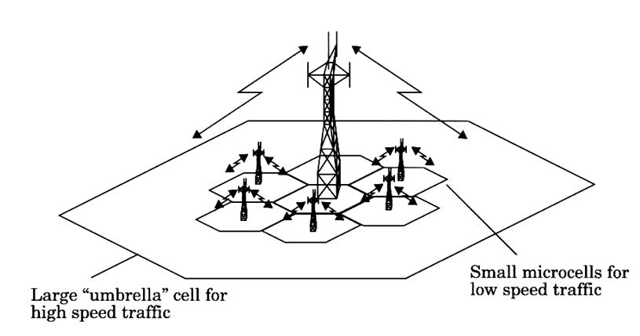
Practical Handoff Considerations
Umbrella cell approach :
  Different antenna height and different power levels
  Speed of user is estimated by base station /MSC by evaluating, how rapidly the short term average signal strength on RVC is varying.

Slide 14
Practical Handoff Considerations
Concept of Cell Dragging:
  Cell dragging results from pedestrian users that provide a very strong signal to the base station. Such a situation occurs in an urban environment when there is a line-of-sight (LOS) radio path between the subscriber and the base station.

Slide 15
Handoff in 5G

Slide 16
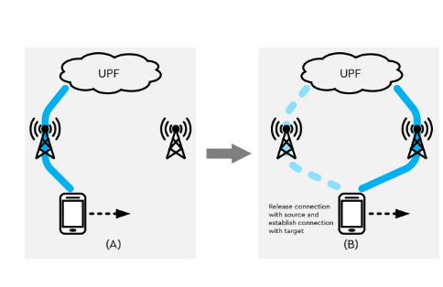
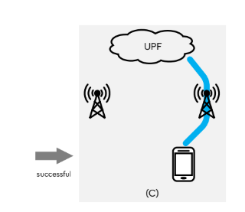
Handoff in 5G

Slide 17
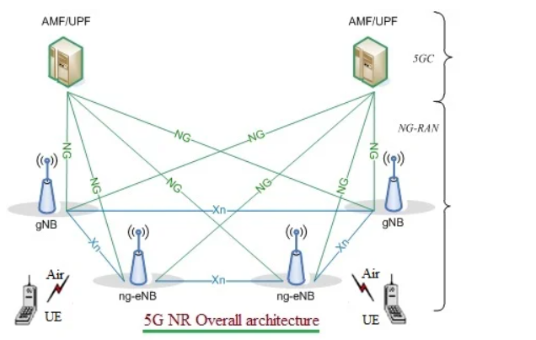
5G NR network interfaces-Xn,NG,E1,F1,F2 interface types in 5G
Xn interface exists between these base stations viz. between gNB-gNB, between (gNB)-(ng-eNB) and between (ng-eNB)-(ng-eNB). Xn is the network interface between NG-RAN nodes. Xn-U stands for Xn User Plane interface and Xn-C stands for Xn Control Plane interface.
• NG interface exists between 5GC and these base stations (i.e. gNB & ng-eNB).

Slide 18
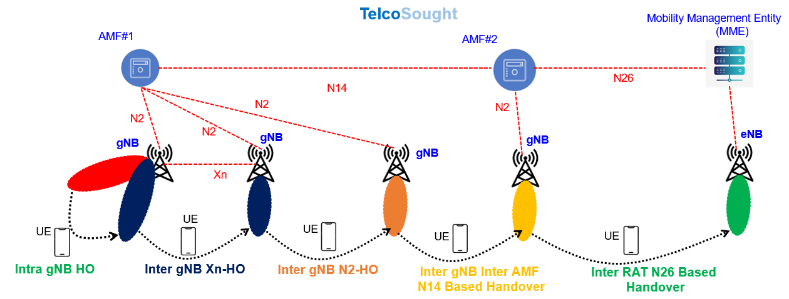
Handover scenario in 5G

Slide 19
Handover scenario in 5G
Types of handovers:
Intra-gNB: UE moves from one cell/DU to another while anchored at the same CU.
Xn-Based Inter-gNB: Source and target gNBs are connected via the Xn interface. Signalling and data packet forwarding are coordinated within the NG-RAN.
N2-Based Inter-gNB: If source and target gNBs lack the Xn interface, then handover is coordinated via the AMF. N2 interface connecting gNB to AMF is used.
If source and target gNBs are connected to two different AMFs, then N14 interface connecting those AMFs is also used. The two AMFs can belong to different operators or PLMNs.

Slide 20
Handover scenario in 5G
Inter-System: UE moves from gNB to eNB (5GS-to-EPS handover) using the N26 interface that connects 5GC AMF to EPC MME. The same interface is used for EPS-to-5GS handover.
Inter-RAT(radio acess technology: UE moves from NR to E-UTRA while staying on 5G Core.
NSA/MR-DC: In NSA/MR-DC configurations, handover can happen for master and/or secondary nodes.
Non-3GPP Access: UE moves from 5GS to trusted or untrusted non-3GPP access, and vice versa.

Slide 21
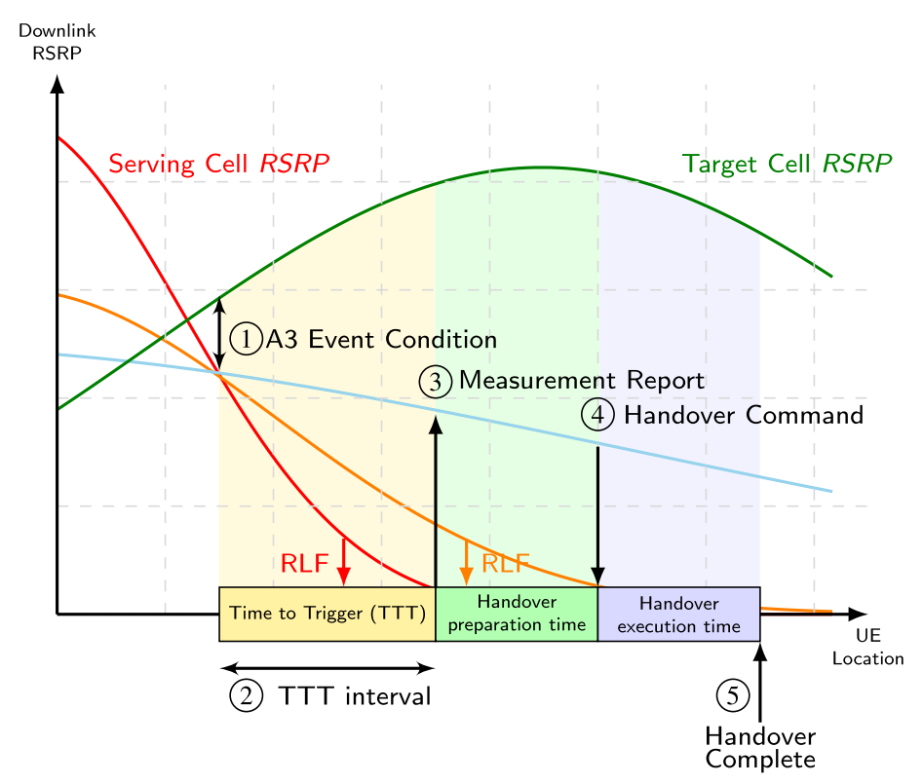
What conditions trigger handovers in 5G?

Slide 22
Handover can be triggered due to changing radio conditions. UE's connection with the source cell may weaken. Once a certain threshold has been reached, the network decides to handover the UE to another cell that has better radio conditions.
The network knows these conditions based on measurement reports sent by the UE. The figure shows A3 event for which the target cell is better than the source cell by a certain threshold for at least TTT duration.It might happen that a certain gNB is highly loaded.
For load balancing purpose, a handover can be triggered.
Sometimes a specific service may be unavailable in the source cell or system. If such a service is requested, a handover may be performed.
An example is a voice call. Initial 5G deployments may not support VoNR. Hence, request for a voice call triggers a handover to 4G (EPS Fallback). There's also 5G-SRVCC (5G NR to 3G UTRAN handover) but this is triggered due to radio conditions.

Slide 23
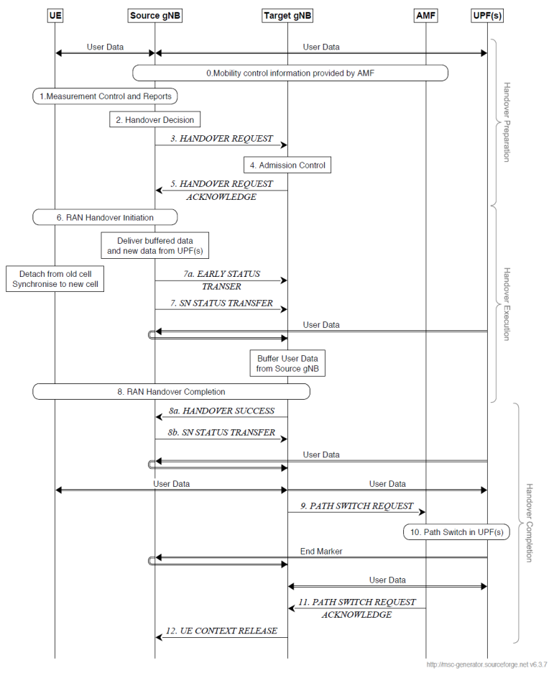

Slide 24
The figure assumes source and target gNBs are interconnected via the Xn interface. Source gNB decides to handover. Handover can be divided into three phases:
Handover Preparation: The target system is prepared to receive the UE. Target gNB does admission control based on slice information. If UE is admitted, target gNB informs source gNB along with an RRC message that's to be sent transparently to the UE.
Handover Execution: Source gNB sends handover command to UE. UE disconnects from the source gNB and connects to the target gNB. Any data that source gNB receives during this period is forwarded to the target gNB. Source gNB sends SN Status Transfer message to target gNB. This relates to PDCP SN.
Handover Completion: UE sends uplink data on target gNB. For downlink data, target gNB sends Path Switch Request to AMF, which triggers UPFs to update paths to target gNB. Once AMF acknowledges that path switch is done, target gNB informs source gNB to release UE context.

Slide 25


