Slide 1
5G WIRELESS COMMUNICATION
(UEC 719)
Dr. Amit Mishra
Associate Professor,
TIET, Patiala
Dr. Surbhi Sharma
Associate Professor,
TIET, Patiala
1

Slide 2
Topics covered in previous modules
GSM –Overview
GSM –Services
GSM- Architecture
Multiplexing techniques

Slide 3
Topics to be covered in this modules
GSM Frame structure-1

Slide 4
GSM Specifications
GSM 900
Mobile to BTS (uplink) : 890-915 Mhz
BTS to Mobile(downlink) : 935-960 Mhz
Bandwidth : 2 * 25 Mhz
Access Method : TDMA/FDMA
Carrier Separation : 200 Khz
Modulation data rate : 270.833 Kbps
The available forward and reverse frequency bands are divided into 200 kHz wide channels called ARFCNs (Absolute Radio Frequency Channel Numbers).
The ARFCN denotes a forward and reverse channel pair which is separated in frequency by 45 MHz and each channel is time shared between as many as eight subscribers using TDMA.

Slide 5
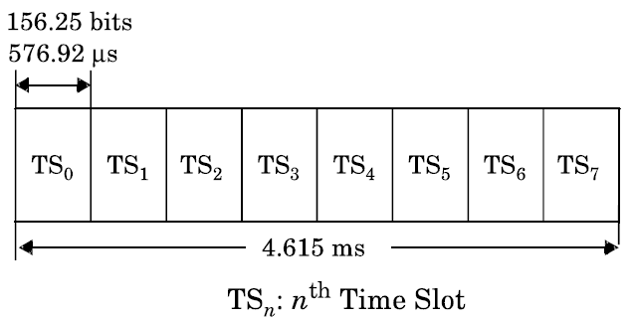
Each of the eight subscribers uses the same ARFCN and occupies a unique timeslot (TS)
per frame
Each TS has an equivalent time allocation of 156.25 channel bits, but of this, 8.25 bits of
guard time and six total start and stop bits are provided to prevent overlap with
adjacent time slots.
Therefore 148 bits has been actually used for data transmission.
The combination of a TS number and an ARFCN constitutes a physical channel for both
the forward and reverse link. Each physical channel in a GSM system can be mapped
into different logical channels at different times

Slide 6
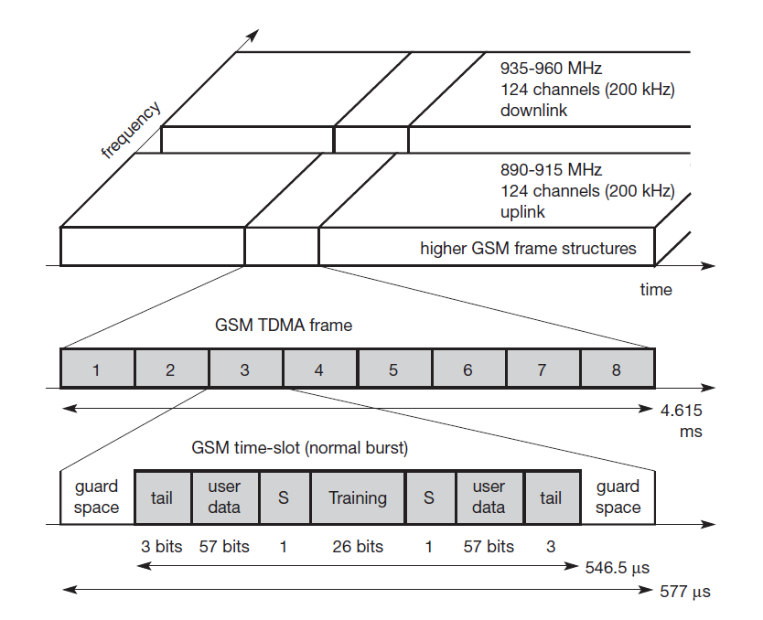
GSM Frame Structure

Slide 8
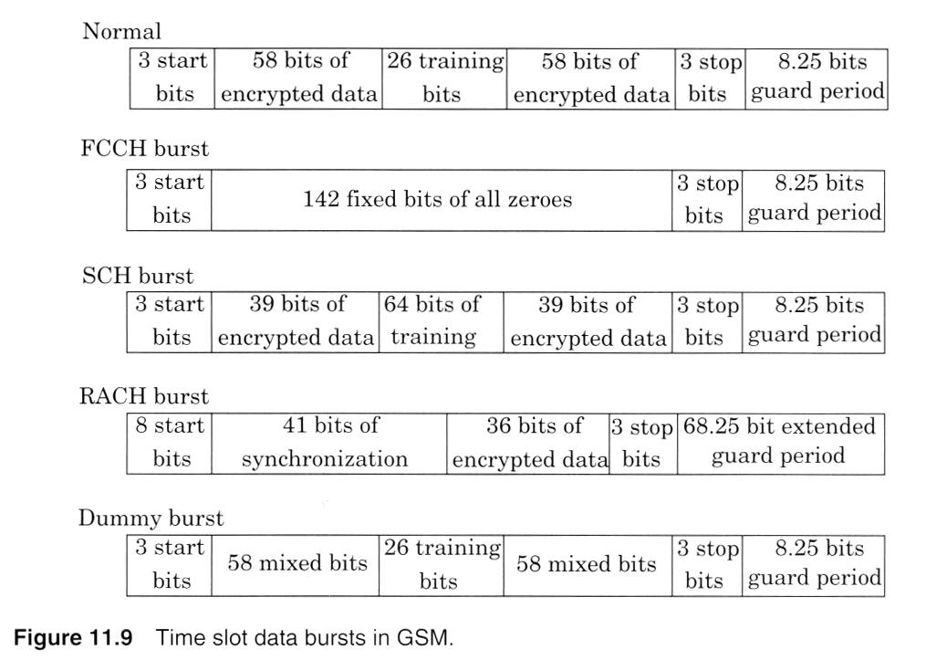
Types of bursts

Slide 9
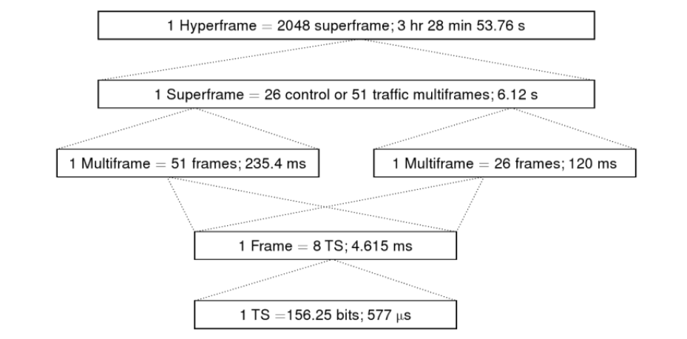
GSM Frame Hierarchy

Slide 10
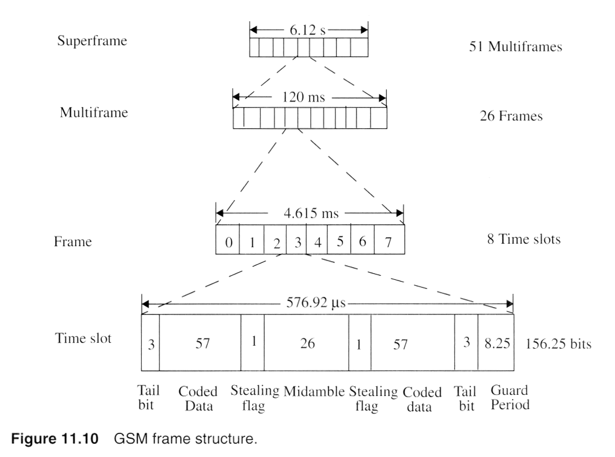
GSM Frame Hierarchy

Slide 11
GSM Data Rate calculations

Slide 12
GSM Data Rate calculations
Date Rate Per User
Total no. of bits in a slot = 156.25
No. of Time Slots in a frame = 8
Therefore total no. bits per frame = 156.25 X 8 = 1250 bits/frame
In one second, total no. of frames transmitted = 1000/ 4.6 = 216.6 frames/sec
(Where 4.6 ms is the time period of one frame)
Hence the data rate on channel = 216.6 X 1250 = 270.8 kbps
Data rate per user = 270.8/ 8 = 33.8 kbps
Gross Channel Data rate
Total no. of data bits transmitted per slot = 114 bits
Number of timeslots per multi-frame =24
Number of bits per multi-frame =24 X 114 bits= 2736 bits
Time duration of one multi-frame =120 ms
Gross data rate=2736 bits /120 ms= 22.8 kbps (for full rate)
              = 11.4 kbps (for half rate)

Slide 13


