Slide 1
5G WIRELESS COMMUNICATION
(UEC 719)
Dr. Amit Mishra
Associate Professor,
TIET, Patiala
Dr. Surbhi Sharma
Associate Professor,
TIET, Patiala
1

Slide 2
Topics covered in previous modules
In Module-2 video-1 (M2V1)
GSM –Overview
GSM –Services
GSM- Architecture
In Module-2 video-2 (M2V2)
Multiplexing techniques
In Module-2 video-3 (M2V3)
MTC_MOC
In Module-2 video-4 (M2V4)
GSM Frame structure
  Physical separation of medium into duplex channel

Slide 3
Topics to be covered in this module
GSM Frame structure-II
  Traffic channel
  Control channel

Slide 4
GSM Channel Types
There are two types of GSM logical channels
  Traffic channels
  control/Signaling channels
Traffic channels carry digitally encoded user speech or user data and have identical
functions and formats on both the forward and reverse link.
Control channels carry signaling and synchronizing commands between the base
station and the mobile station.
  Certain types of control channels are defined for just the forward or reverse link.

Slide 5
LOGICAL CHANNELS
TRAFFIC
CONTROL /SIGNALLING
FULL RATE
Bm 22.8 Kb/S
HALF RATE
Lm 11.4 Kb/S
BROADCAST
COMMON CONTROL
DEDICATED CONTROL
FCCH
SCH
BCCH
RACH
AGCH
PCH
FCCH -- FREQUENCY CORRECTION CHANNEL
SCH -- SYNCHRONISATION CHANNEL
BCCH -- BROADCAST CONTROL CHANNEL
PCH -- PAGING CHANNEL
RACH -- RANDOM ACCESS CHANNEL
AGCH -- ACCESS GRANTED CHANNEL
SDCCH -- STAND ALONE DEDICATED CONTROL CHANNEL
SACCH -- SLOW ASSOCIATED CONTROL CHANNEL
FACCH -- FAST ASSOCIATED CONTROL CHANNEL
SDCCH
SACCH
FACCH
FORWARD LINK ONLY
REVERSE LINK ONLY
BOTH LINKS

Slide 6
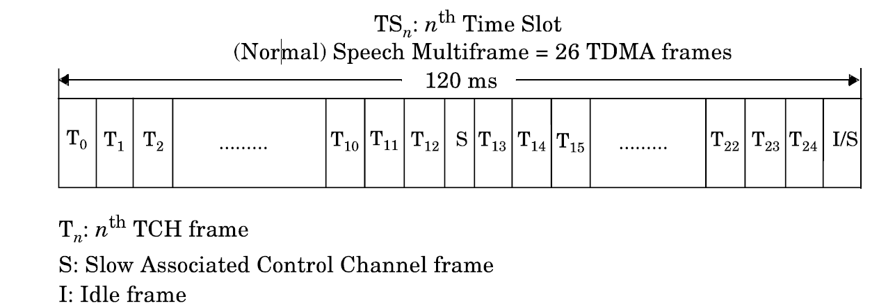
Traffic Channel-TCH

Slide 7
Control/signaling Channel - CCH
Broadcast Channel

Slide 8
Control/signaling Channel - CCH
1. Broadcast Channel
Broadcast control channel (BCCH) is a base to mobile channel which provides general information about the network, the cell in which the mobile is currently located and the adjacent cells
Frequency correction channel (FCCH) is a base to mobile channel which provides information for carrier synchronization
Synchronization channel (SCH) is a base to mobile channel which carries information for frame synchronization and identification of the base station transceiver

Slide 9
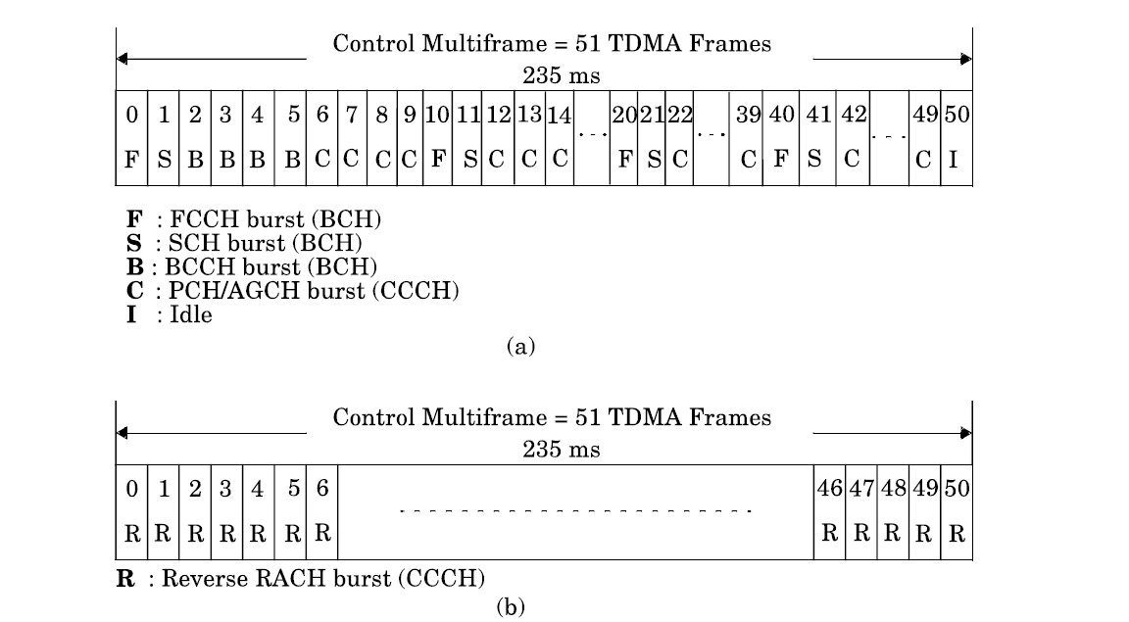
Common control multi-frame for forward and reverse link

Slide 10
2. Common Control Channel - CCH

Slide 11
2. Common Control Channel - CCH
Paging channel (PCH) is a base to mobile channel used to alert a mobile to a call originating from the network
Random access channel (RACH) is a mobile to base channel used to request for dedicated resources

Slide 12
2. Common Control Channel - CCH
Access grant channel (AGCH) is a base to mobile which is used to assign dedicated resources (SDCCH or TCH)
It carries data which instructs the mobile to operate in a particular physical Channel (Time slot).
The AGCH is used by the network to grant, or deny, an MS access to the network by supplying it with details of a dedicated channel, i.e. TCH or SDCCH, to be used for subsequent communications

Slide 13
3. Dedicated Control Channel - DCCH
Stand-alone dedicated control channel (SDCCH) is a bi-directional channel allocated to a specific mobile for exchange of location update information and call set up information
Slow associated control channel (SACCH) is a bi-directional channel used for exchanging control information between base and a mobile during the progress of a call set up procedure. The SACCH is associated with a particular traffic channel or stand alone dedicated control channel
Fast associated control channel (FACCH) is a bi-directional channel which is used for exchange of time critical information between mobile and base station during the progress of a call. The FACCH transmits control information by stealing capacity from the associated TCH

Slide 14
3. Dedicated Control Channel - DCCH
Stand-alone dedicated control channel (SDCCH) is a bi-directional channel allocated to a specific mobile for exchange of location update information and call set up information
Slow associated control channel (SACCH) is a bi-directional channel used for exchanging control information between base and a mobile during the progress of a call set up procedure. The SACCH is associated with a particular traffic channel or stand alone dedicated control channel
Fast associated control channel (FACCH) is a bi-directional channel which is used for exchange of time critical information between mobile and base station during the progress of a call. The FACCH transmits control information by stealing capacity from the associated TCH

Slide 15
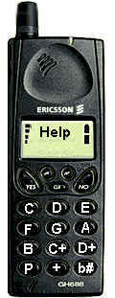
Mobile Terminated Call scenario
Mobile looks for BCCH after switching on
RACH send channel request
AGCH receive SDCCH
SDCCH send call establishment request
SDCCH do the authentication and TMSI allocation
SDCCH send the setup message and desired number
SDCCH require traffic channel assignment
FACCH switch to traffic channel and send ack (steal bits)
FACCH receive alert signal ringing sound
FACCH receive connect message
FACCH acknowledge connect message and use TCH
TCH conversation continues

Slide 16
Mobile Originated Call scenario
Mobile looks for BCCH after switching on
Mobile receives paging message on PCH
Generate Channel Request on RACH
Receive signaling channel SDCCH on AGCH
Answer paging message on SDCCH
Receive authentication request on SDCCH
Authenticate on SDCCH
Receive setup message on SDCCH
Receive traffic channel assignment on SDCCH
FACCH switch to traffic channel and send ack (steal bits)
Receive alert signal and generate ringing on FACCH
Receive connect message on FACCH
FACCH acknowledge connect message and switch to TCH

Slide 17


