Slide 1
5G WIRELESS COMMUNICATION
(UEC 719)
Course Instructor
Dr. Hem Dutt Joshi
Dr. Surbhi Sharma
Associate Professor,
TIET, Patiala

Slide 2
Lecture:
Introduction to MIMO
(Multiple-Input Multiple-Output)

Slide 3
Contents
Motivation behind MIMO Systems
Introduction to MIMO wireless communication,
Historical Development of MIMO
Application of MIMO System
Advantages of MIMO System
Array Gain
Spatial Multiplexing

Slide 4
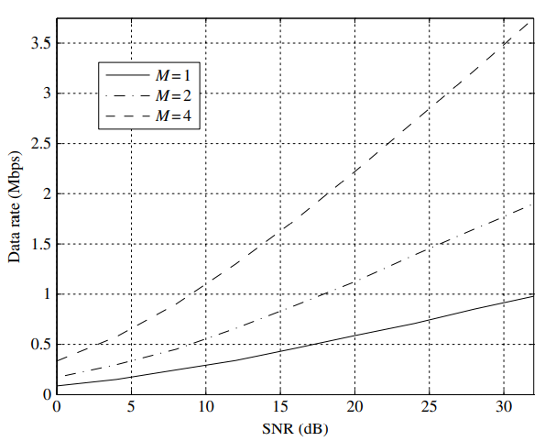
Motivation behind MIMO Systems
Previous wireless systems
  – Capacity constrained networks
  – Issues related to quality and coverage
Capacity Enhancement: MIMO exploits the space dimension to improve wireless systems capacity, range and reliability
MIMO technology solve the challenges posed by both the impairments in the wireless channel as well as resource constraints.
In addition to the time and frequency dimensions that are exploited in conventional single-input single-output wireless systems, the leverages of MIMO are realized by exploiting the spatial dimension (provided by the multiple antennas at the transmitter and the receiver).
Plot shows the data rate versus the receive signal-to-noise ratio (SNR) in a 100 kHz channel for an M × M fading link with M = 1 2 4.

Slide 5
Introduction to MIMO wireless communication
The use of multiple antennas at the transmitter and receiver in wireless systems, popularly known as MIMO (multiple-input multiple-output) technology, has rapidly gained in popularity over the past decade due to its powerful performance-enhancing capabilities.
MIMO systems provide tremendous capacity gains, which has spurred significant activity to develop transmitter and receiver techniques that realize these capacity benefits and exploit diversity–multiplexing trade-offs.
Various MIMO systems have been developed during last three decades which comes under three general categories:
Spatial multiplexing,
Diversity transmission,
and hybrid transmission

Slide 6
Spatial multiplexing
The Bell Laboratories layered space-time (BLAST) architecture is an example of spatial multiplexing which provides high multiplexing gain but at the cost of high decoding complexity.
Diversity Transmission
Under the second category of MIMO techniques, the class of Space-Time Block Codes (STBCs) was developed to provide high diversity gain. However, high diversity gain is achieved at the cost of transmission rate.
Full rate transmission is only possible for two transmit antennas (complex constellations) and eight or less transmit antennas (real constellations).
Hybrid transmission
Third categories of MIMO techniques integrate both spatial multiplexing and diversity concepts.
For example, Tarokh et.al provides multi-layered space time coding which increase both transmission rate and diversity gain but at the cost of increased decoding complexity.
Another example comes under this category is Linear Dispersion Codes (LDCs) proposed by Hassibi and Hochwald in 2002. It provides a flexible trade-off between achievable multiplexing and diversity gain. Later on various variant of LDCs was given by researchers to further improve the performance of MIMO system \cite{Paulraj}.

Slide 7
Historical Development
The multiplexing-oriented MIMO concept was proposed by Paulraj and Kailath in 1993, where a high data-rate transmission was carried out by splitting it into low data-rate signals transmitted by spatially separated Space-Division Multiple Access (SDMA) users
In order to pursue the multiplexing gain using co-located antennas, Foschini et.al. proposed the ground-breaking layered spacetime architecture in 1996, which was later termed as the BLAST
In order to simplify the real-time implementation, in 1998, Wolniansky et al. proposed V-BLAST that invokes vertical-encoding.
A. J. Paulraj and T. Kailath, ‘‘Increasing capacity in wireless broadcast systems using distributed transmission/directional reception,’’ U.S. Patent 5 345 599, Sep. 6, 1994.
G. J. Foschini and M. J. Gans, ‘‘On limits of wireless communications in a fading environment when using multiple antennas,’’ Wireless Pers. Commun., vol. 6, no. 3, pp. 311–335, Mar. 1998
CHAO XU , SHINYA SUGIURA , SOON XIN NG , PEICHANG ZHANG , LI WANG , AND LAJOS HANZO1 , “Two Decades of MIMO Design Tradeoffs and Reduced-Complexity MIMO Detection in Near-Capacity Systems”, IEEE Access, VOLUME 5, 2017

Slide 8
An Introduction to Arogyaswami J. Paulraj
Arogyaswami J. Paulraj (born 14 April 1944) is an Indian-American electrical engineer, academic.
He is a Professor Emeritus in the Dept. of Elect. Engg. at Stanford University.
He moved to US in 1992 after completing his service in Indian Navy.
Paulraj was awarded the prestigious Marconi Prize in 2014 for "his pioneering contributions to developing the theory and applications of MIMO antennas.
His idea for using multiple antennas at both the transmitting and receiving stations – which is at the heart of the current high speed WiFi and 4G mobile systems – has revolutionized high speed wireless.

Slide 9
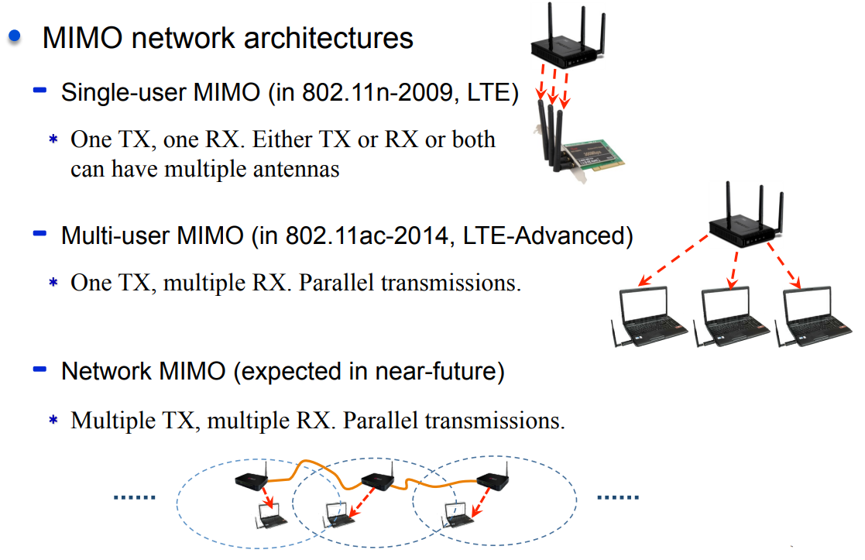
MIMO-Applications

Slide 10
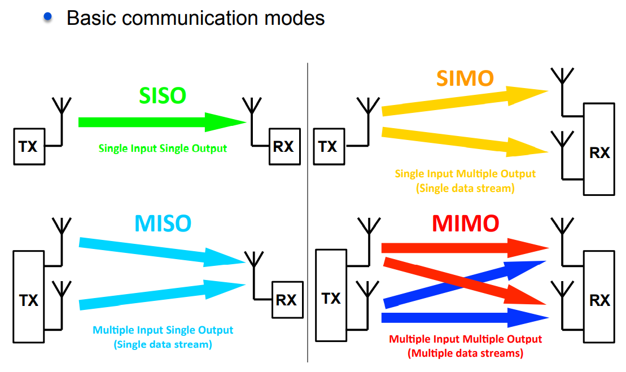
MIMO (multiple-input multiple-output)

Slide 11
Advantages of MIMO technology
Array gain
Diversity gain
  Receiver diversity
  Transmit diversity
Multiplexing gain
  Spatial multiplexing

Slide 12
Array Gain
Array gain is the increase in receive SNR that results from a coherent combining effect of the wireless signals at a receiver.
The coherent combining may be realized through spatial processing at the receive antenna array and/or spatial pre-processing at the transmit antenna array.
Array gain
  improves resistance to noise,
  thereby improving the coverage
  and the range of a wireless network.

Slide 13
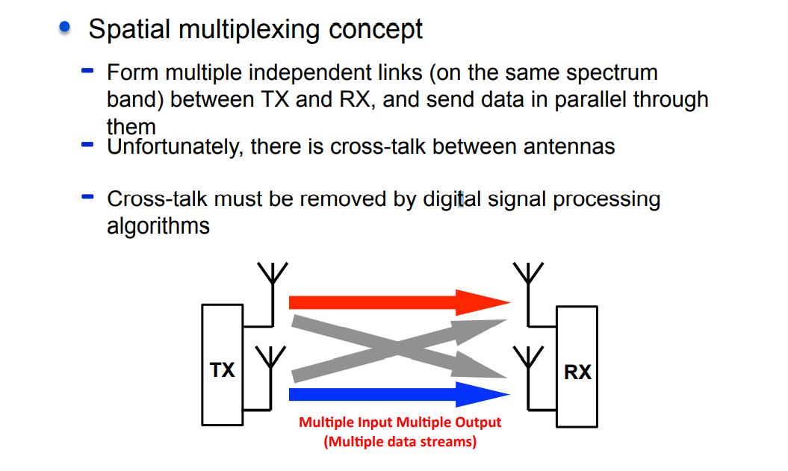
Spatial multiplexing

Slide 14
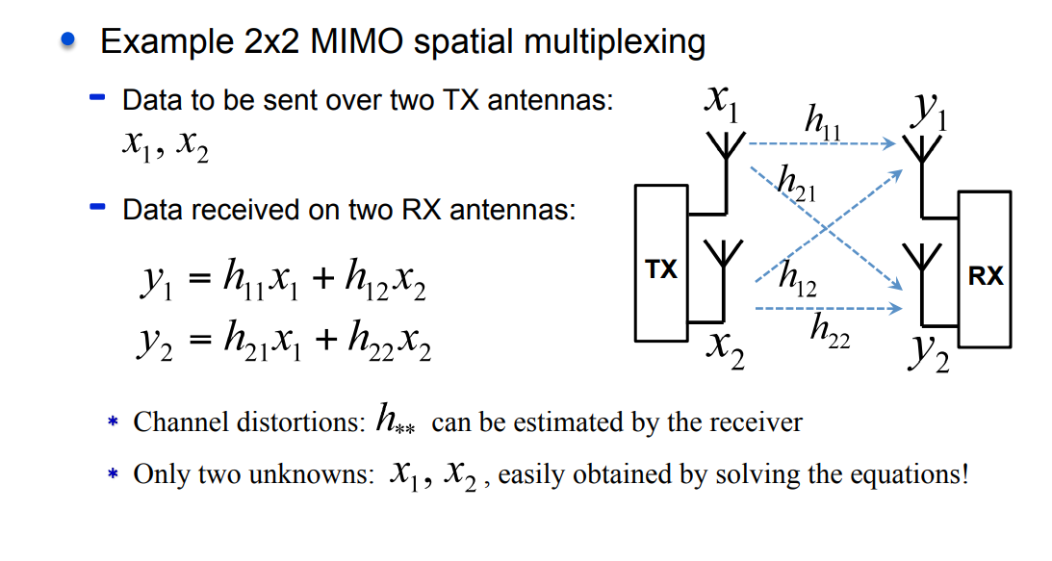
Spatial multiplexing – Signal Processing

Slide 15
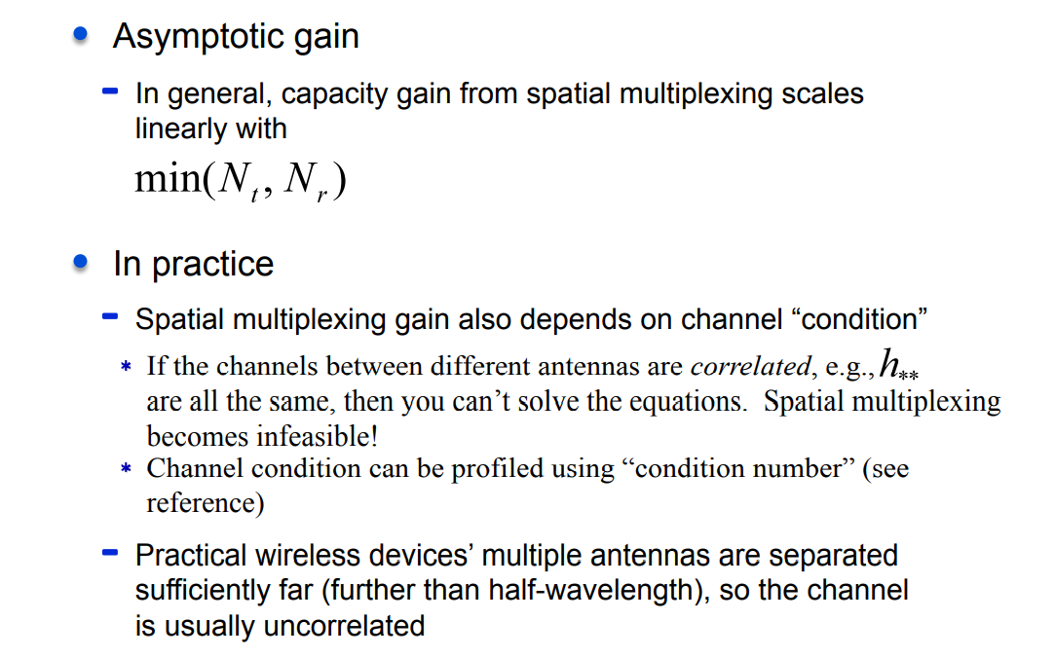
Spatial multiplexing Gain

Slide 16
References
Text Books:
E.G. Larsson and P. Stoica, “Space-Time Block Coding for Wireless Communications”, Cambridge University Press 2008.
Ezio Biglieri , Robert Calder bank et al “MIMO Wireless Communications” Cambridge University Press 2007
Reference Books:
David Tse and Pramod Viswanath, “Fundamentals of Wireless Communication”, Cambridge University Press 2005.
Hamid Jafarkhani, “Space-Time Coding: Theory and Practice”, Cambridge University Press 2005
Paulraj, R. Nabar and D. Gore, “ Introduction to Space-Time Wireless Communications”, Cambridge University Press 2003

