Slide 1
Wireless and Mobile Communication
(UEC 804)
Reference Text book
“Wireless communication_ principles and practices” (Second Edition )
Author: Theodore s Rapport
Publisher: Prentice Hall (2002)

Slide 2
MODULE -IV

Slide 3
Topics to be covered in this video
Propagation Basics

Slide 4
Introduction to Radio Wave Propagation
When electrons move, they create electromagnetic waves that can propagate through space. By attaching appropriate antenna, these waves can be broadcast efficiently . But when we transmit these ways wirelessly,
Mobile radio channel places fundamental limitations on the performance of wireless
communication systems
Paths can vary from simple line-of-sight to ones that are severely obstructed by buildings, mountains, and foliage
Radio channels are extremely random and difficult to analyze
The speed of motion also impacts how rapidly the signal level fades as a mobile terminals moves about.

Slide 5
Properties of Radio wave
Are easy to generate
Can travel long distance
Can penetrate buildings
May be used for both indoor and outdoor communication
Are omni-directional-can travel in all directions
Can be narrowly focused at high frequencies (greater than 100 MHz) using parabolic antenna(like satellite dishes)

Slide 6
Properties of Radio wave
Frequency-dependence
  Behave more like light at higher frequencies
    Difficulty in passing obstacles
    More direct path
    Absorbed by rain
    Behave more like radio at lower frequencies
      Can pass obstacles
      Power falls off sharply with distance from Source
      Subject to interference from other radio sources

Slide 7
Problems Unique to Wireless systems
Interference from other service providers, Interference from other users (same network)
CCI due to frequency reuse
ACI due to Tx/Rx design limitations large users sharing finite BW
Obstructions to line-of-sight paths cause areas of weak received signal strength
Fading
When no clear line-of-sight path exists, signals are received that are reflections off
obstructions and diffractions around obstructions, multipath signals can be received that interfere with each other
Solution
For fixed Wireless Channel , modeling of random unpredictable channel must be characterized in a statistical fashion
Field measurements often needed to characterize radio channel performance

Slide 8
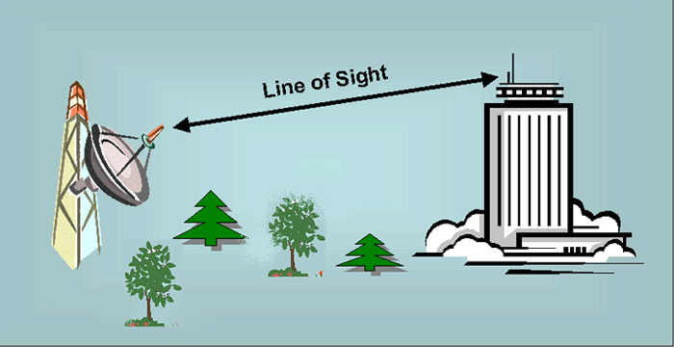
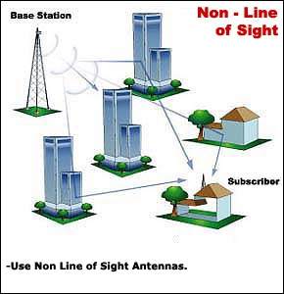
Transmission path between Tx and Rx
Line of Sight (LOS)
Non Line of Sight (NLOS)

Slide 9
Mechanisms that affect the radio propagation
Reflection
Diffraction
Scattering
In urban areas, there is no direct line-of-sight path between the transmitter and the receiver, and where the presence of high- rise buildings causes severe diffraction loss Multiple reflections cause multi-path fading

Slide 10
Mechanisms that affect the radio propagation
Reflections arise when the plane waves are incident upon a surface with dimensions that are very large compared to the wavelength
Diffraction occurs according to Huygens's principle when there is an obstruction between the transmitter and receiver antennas, and secondary waves are generated behind the obstructing body
Scattering occurs when the plane waves are incident upon an object whose dimensions are on the order of a wavelength or less, and causes the energy to be redirected in many directions.
  Scattering is produced by small objcts , rough surfaces and other irregularitirs in channel and causes the transmitted energy to be radiated in many directions. E.g lamp post and street signs may cause scattering

Slide 11
Mobile Radio Propagation mechanisms
The relative importance of these three propagation mechanisms depends on the particular propagation scenario. As a result of the above three mechanisms, macro cellular radio propagation can be roughly characterized by three nearly independent phenomenon
Path loss variation with distance (Large Scale Propagation )
Slow log-normal shadowing (Medium Scale Propagation )
Fast multipath fading. (Small Scale Propagation )
Each of these phenomenon is caused by a different underlying physical principle and each must be accounted for when designing and evaluating the performance of a cellular system.

Slide 12
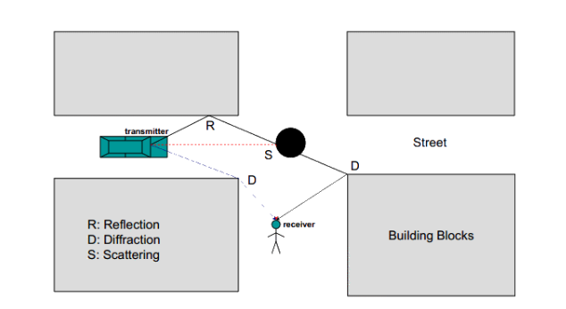
Mobile Radio Propagation mechanisms

Slide 13


