Slide 1
Wireless and Mobile Communication
(UEC 804)
Reference Text book
“Wireless communication_ principles and practices” (Second Edition )
Author: Theodore s Rapport
Publisher: Prentice Hall (2002)

Slide 2
MODULE -IV

Slide 3
Topics to be covered in this module
Propagation Basics
Antenna Basics
Topics to be covered in this video
Reflection

Slide 4
Wireless Propagation Mechanisms
Reflection
Wireless Propagation Mechanisms
Diffraction
Scattering

Slide 5
Wireless Propagation Mechanisms
Reflection occurs when the electro-megnatic wave impinges on an object which has very large dimensions as compared to the wavelength. e.g the surface of earth , buildings, wall etc
Diffraction occurs when the radio path between transmitter and receiver is obstructed by a surface that has sharp edges
    Explains how radio signal can travel urban and rural environment without a line of sight path
Scattering occurs when the medium has object that are smaller or comparable to the wavelength (small objects, rough surface and other irregularities on the channel

Slide 6
Wireless Propagation Mechanisms
When a radio wave propagating in one medium impinges upon another medium having different electrical properties, the wave is partially reflected and partially transmitted.
If the plane wave is incident on a perfect dielectric, part of the energy is transmitted into the second medium and part of the energy is reflected back into the first medium, and there is no loss of energy in absorption.
If the second medium is a perfect conductor, then all incident energy is reflected back into the first medium without loss of energy.
The electric field intensity of the reflected and transmitted waves may be related to the incident wave in the medium of origin through the Fresnel reflection coefficient ( ). The reflection coefficient is a function of the material properties, and generally depends on the wave polarization, angle of incidence, and the frequency of the propagating wave.

Slide 7
Wireless Propagation Mechanisms
In general , electromagnetic waves are polarized i.e.
  They have instantaneous electric field components in orthogonal directions in space
A polarized wave can be represented as a sum of two spatially orthogonal components
  Vertical or horizontal
  Left hand or right hand circularly polarized
Polarization can also be used as a degree of freedom for frequency planning

Slide 8
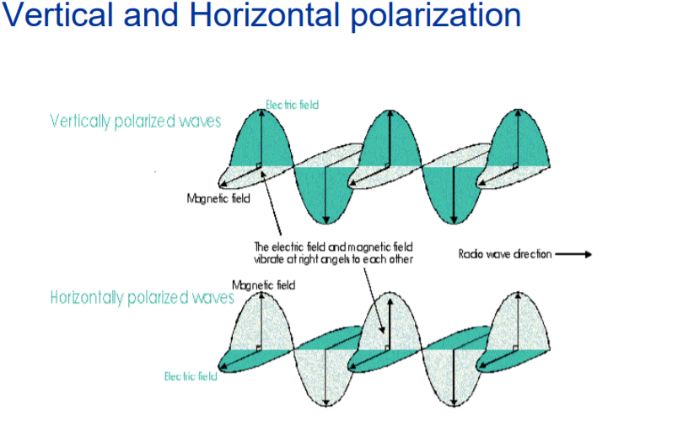
Reflection from Dielectrics

Slide 9
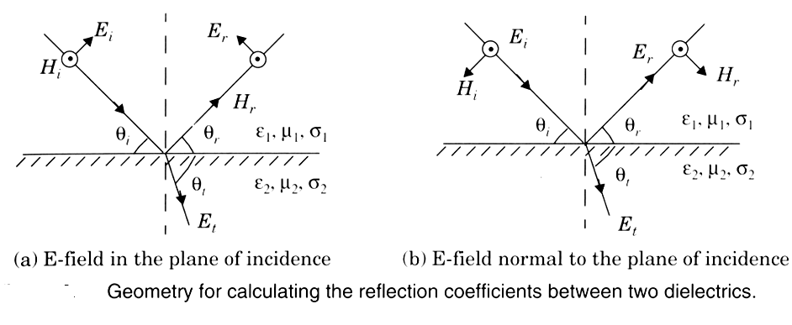
Reflection from Dielectrics

Slide 10
Reflection from Dielectrics

Slide 11
Reflection from Dielectrics

Slide 12
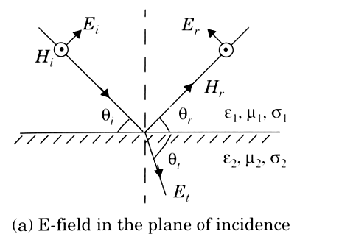
Reflection from Dielectric
The E-field polarization is parallel with the plane of incidence (that is, the E-field has a vertical polarization, or normal component, with respect to the reflecting surface)

Slide 13
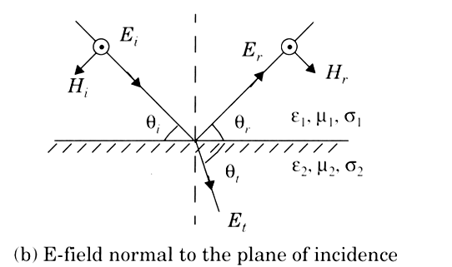
Reflection from Dielectric
The E-field polarization is perpendicular to the plane of incidence (that is, the incident E-field is pointing out of the page toward the reader, and is perpendicular to the page and parallel to the reflecting surface).

Slide 14


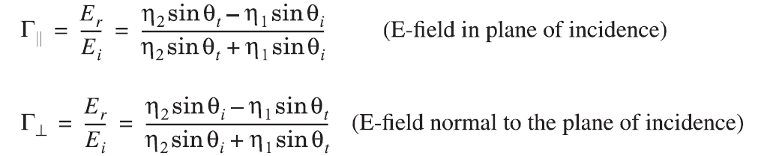

Reflection from Dielectric
If a dielectric material is lossy, it will absorb power and may be described by a complex dielectric constant given by
where
The reflection coefficients for the two cases of parallel and perpendicular E-field polarization at the boundary of two dielectrics are given by
where

Slide 15
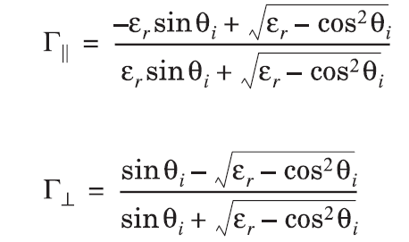
Reflection from Dielectric
For the case when the first medium is free space and µ₁ = µ₂ , the reflection coefficients for the two cases of vertical and horizontal polarization can be simplified to

Slide 16

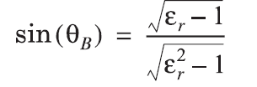
Brewster Angle
The Brewster angle is the angle at which no reflection occurs in the medium of origin. It occurs when the incident angle θ_{B} is such that the reflection coefficient Γ_{II} is equal to zero. The Brewster angle is given by the value of θ_{B} which satisfies
For the case when the first medium is free space and the second medium has a relative permittivity ε_{r} , The Brewster angle is given by

Slide 17


Reflection from Perfect Conductors
Since electromagnetic energy cannot pass through a perfect conductor a plane wave incident on a conductor has all of its energy reflected.
For the case when E-field polarization is a in the plane of incidence, the boundary conditions require that
Similarly, for the case when the E-field is horizontally polarized, the boundary conditions
require that

Slide 18


