Slide 1
Wireless and Mobile Communication
(UEC 804)
Reference Text book
“Wireless communication_ principles and practices” (Second Edition )
Author: Theodore s Rapport
Publisher: Prentice Hall (2002)

Slide 2
MODULE -IV

Slide 3
Topics covered till now in this module
Propagation Basics
Antenna Basics
Reflection
Topics to be covered in this video
Two Ray Model

Slide 4
Why Two Ray model needed
Rappaport develops a theoretical model for propagation slightly better than the free space assumption.
This model includes not just one path, but also another path that reflects off of the ground. “The World Is Flat”, if you will.
The model isn’t hard to develop, and provides an important theoretical underpinning to the multiple breakpoint model we covered in free space model.
Remember, powers of multipath DON’T add together. Only voltages or field strength of multipath actually add together. The voltage on the antenna is proportional to the electric field at the antenna position. So let’s talk about adding electric fields

Slide 5
Wireless Propagation Mechanisms
The two-ray ground reflection model is a useful propagation model that is based on geometric optics.
Considers both the direct path and a ground reflected propagation path between transmitter and receiver.
This model has been found to be reasonably accurate for predicting the large-scale signal strength over distances of several kilometers for mobile radio systems that use tall towers (heights which exceed 50 m), as well as for line-of-sight microcell channels in urban environments
In most mobile communication systems, the maximum T-R separation distance is at most only a few tens of kilometers, and the earth may be assumed to be flat.

Slide 6
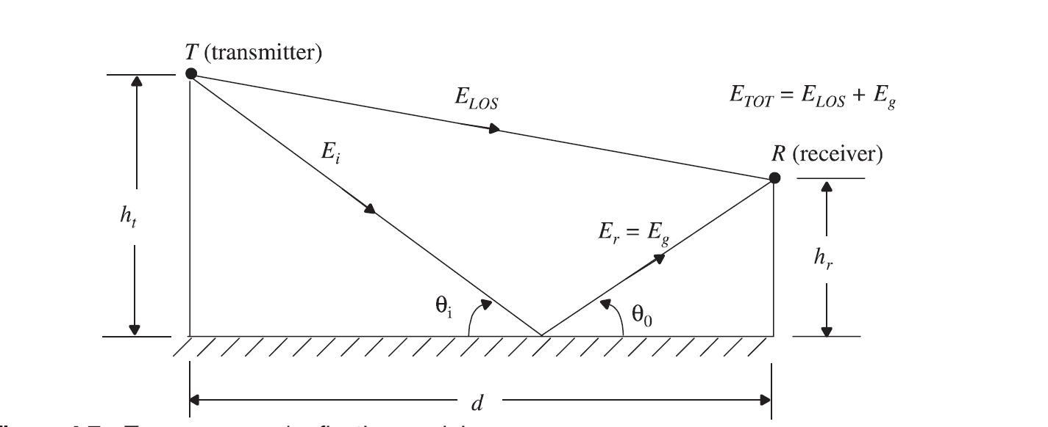
Two Ray Model

Slide 7
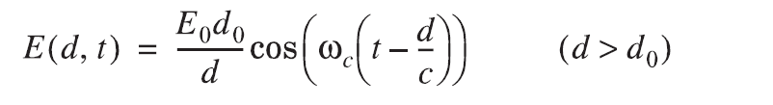
Wireless Propagation Mechanisms
If E₀ is the free space E-field (in units of V/m) at a reference distance d₀ from the transmitter, then for d > d₀ , The free space propagating E-field is given by

Slide 8
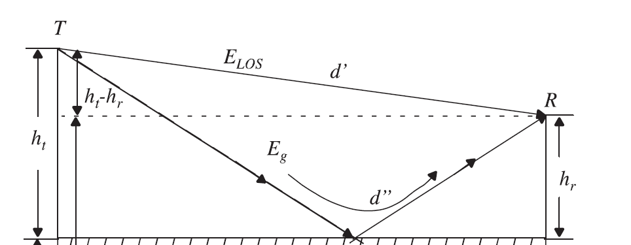
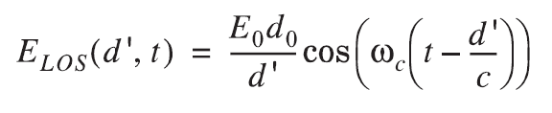
Signal received at receiver from Direct Path
The direct wave that travels a distance d’. The E-field due to the line-of-sight component at
the receiver can be expressed as

Slide 9
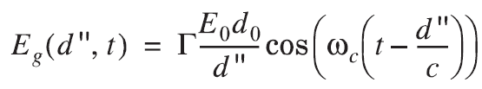

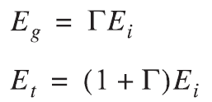
Signal received at receiver from Ground Reflected Path
The E-field for the ground reflected wave, which has a propagation distance of d", can be expressed as
According to laws of reflection in dielectrics and
For small values of θ_{i} ,the reflected wave is equal in magnitude and 180° out of phase with the incident wave,
The resultant E-field, assuming perfect horizontal E-field polarization and ground reflection (i.e., Γ = -1 and E_{i} = 0), is the vector sum of E_{Los} and E_{g},

Slide 10

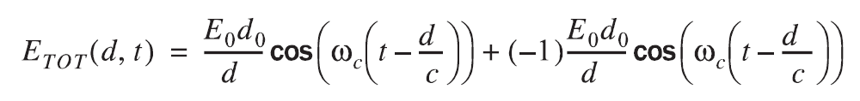
Signal received at Receiver
The resultant total E-field envelope is given by
The electric field E_{TOT}(d, t) can be expressed

Slide 11

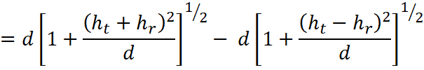

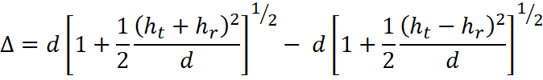
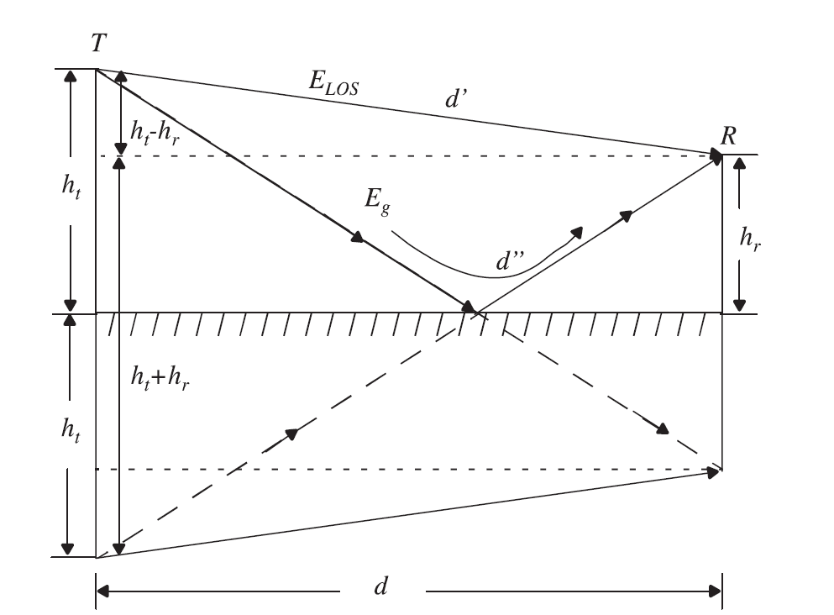



Path Difference Between LOS and ground reflected path
Using Taylor series expansion

Slide 12


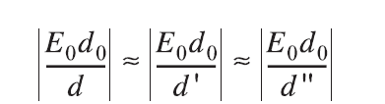
Phase Difference Between LOS and ground reflected path
Once the path difference is known, the phase difference θ∆between the two E-field components and the time delay τ_{d} between the arrival of the two components can be easily computed using the following relations
and
It should be noted that as ‘d’ becomes large, the difference between the distances d' and
d" becomes very small, and the amplitudes of E_{LOS} and E_{g} are virtually identical and differ only in phase. That is

Slide 13
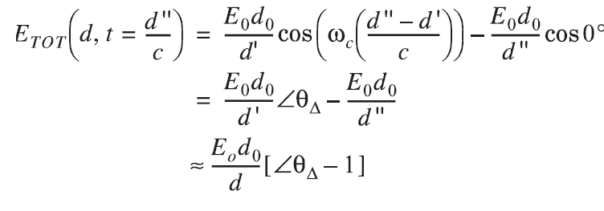
Total E field
If the received E-field is evaluated at some time, say at t = d“/ c, then

Slide 14
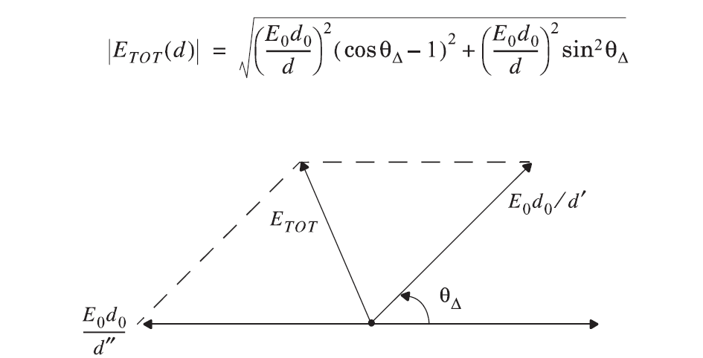
Total E field
The path loss for the two-ray model (with antenna gains) can be expressed in dB as

Slide 15


