Slide 1
Wireless and Mobile Communication
(UEC 804)
Reference Text book
“Wireless communication_ principles and practices” (Second Edition )
Author: Theodore s Rapport
Publisher: Prentice Hall (2002)

Slide 2
MODULE -IV

Slide 3
Topics covered till now in this module
Propagation Basics
Antenna Basics
Reflection
Two Ray Model
Topics to be covered in this video
Diffraction

Slide 4
Diffraction
Diffraction occurs when the signal hits the sharp edge surfaces .
Diffraction allows radio signals to propagate around the curved surface of the earth, beyond the horizon, and to propagate behind obstructions.
Although the received field strength decreases rapidly as a receiver moves deeper into the obstructed (shadowed) region, the diffraction field still exists and often has sufficient strength to produce a useful signal.

Slide 5
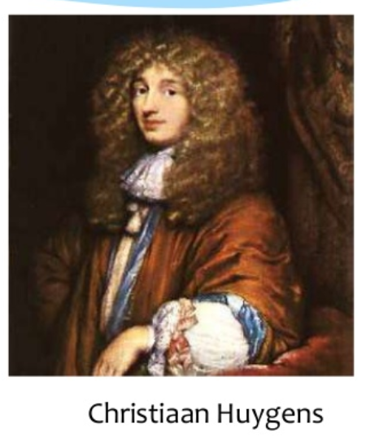
Huygens Principle
In seventeenth century Dutch mathematician and scientist, Huygens proposed that every point on the wave front of a wave was a source of spherical wave
The resultant wave is determined by adding all the waves from the point sources.

Slide 6
Huygens Principle
The phenomenon of diffraction explained by Huygen's principle, states that all points on a wave-front can be considered as point sources for the production of secondary wavelets, and that these wavelets combine to produce a new wave-front in the direction of propagation.
Diffraction is caused by the propagation of secondary wavelets into a shadowed region.
The field strength of a diffracted wave in the shadowed region is the vector sum of the electric field components of all the secondary wavelets in the space around the obstacle.

Slide 7
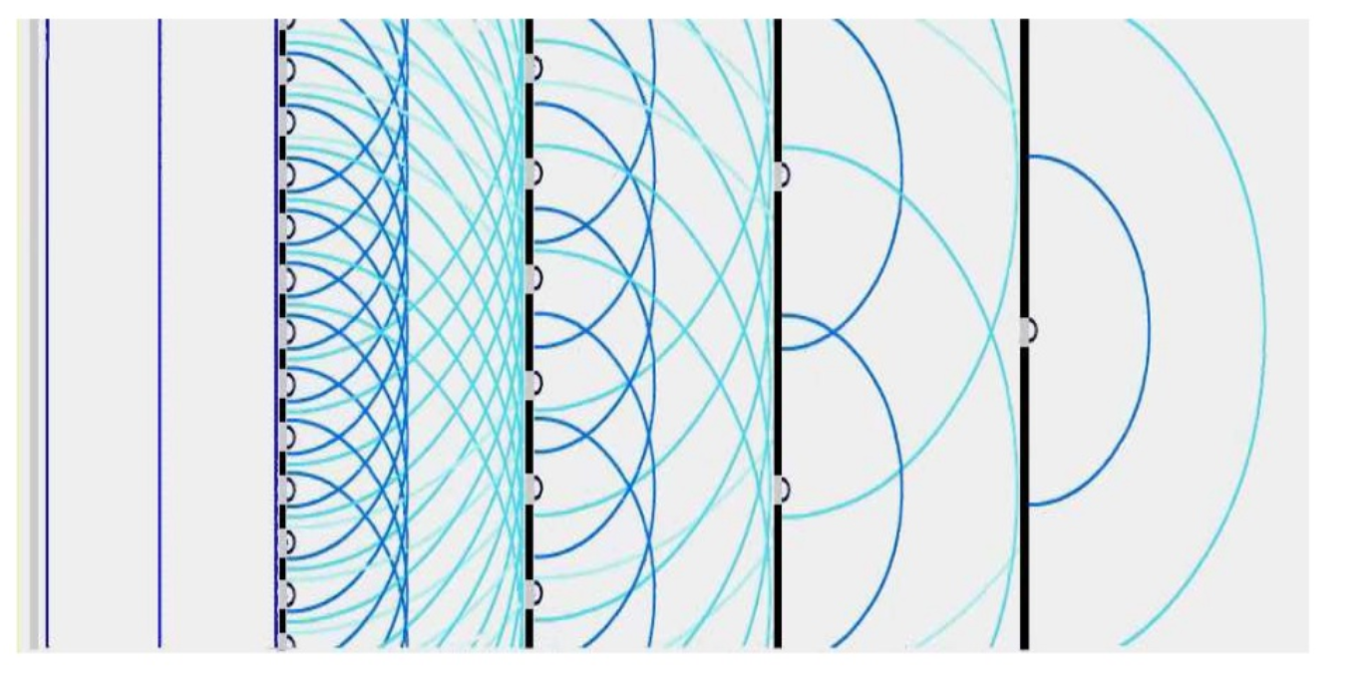
Huygens Principle

Slide 8
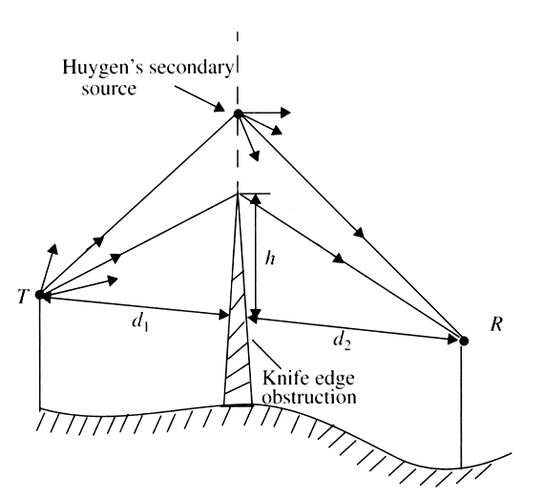
Knife Edge Diffraction

Slide 9
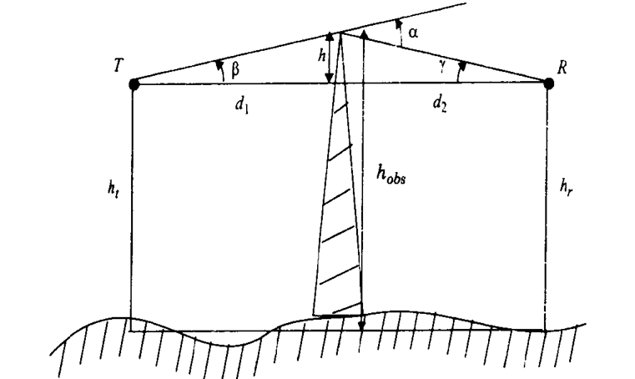
Excess path length and Phase difference
Consider a transmitter and receiver separated in free space as shown in Figure above. Let an obstructing screen of effective height ‘h’ with infinite width be placed between them at a distance d₁ from the transmitter and d₂ from the receiver.
Assuming h « d₁, d₂ and h » A., then the difference between the direct path and the diffracted path, called the excess path length (A).

Slide 10







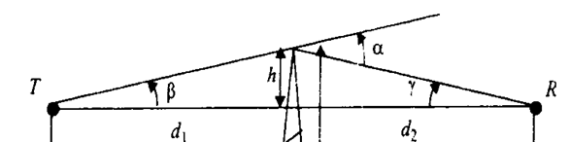
Calculating excess path
=
=
Since
then using taylor series approximation, we have

Slide 11
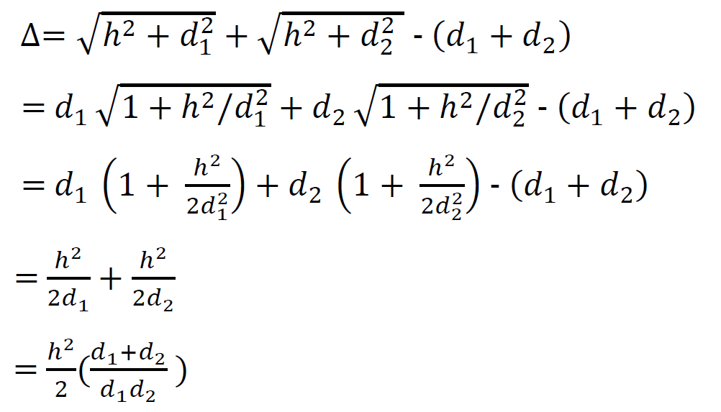
Calculating excess path

Slide 12
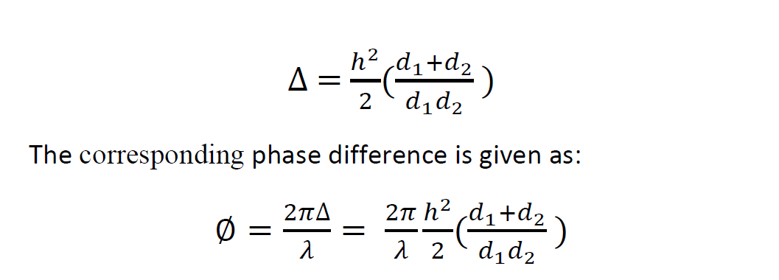
Calculating excess path

Slide 13
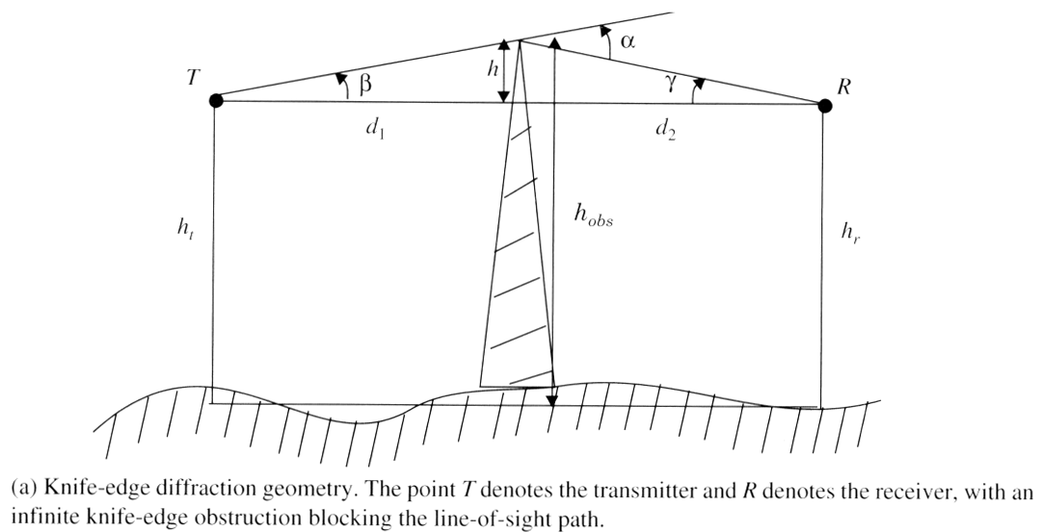
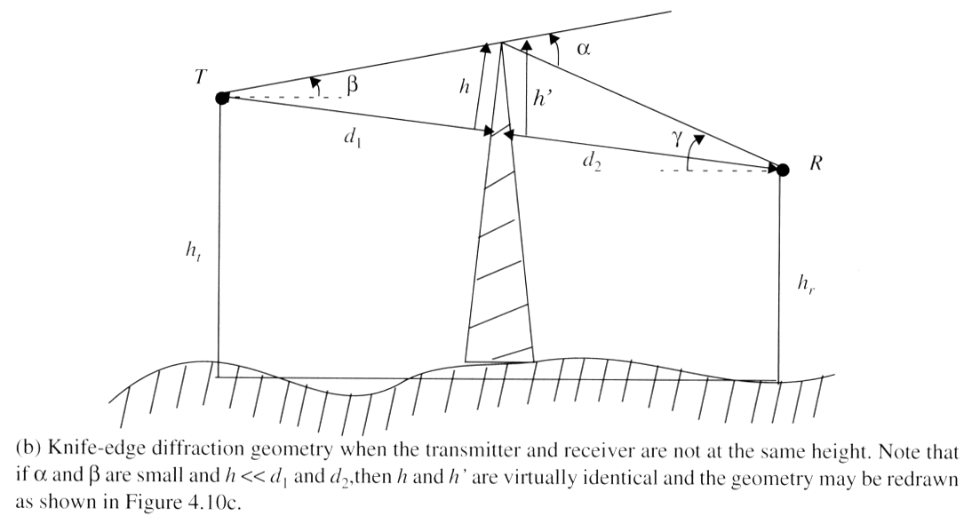
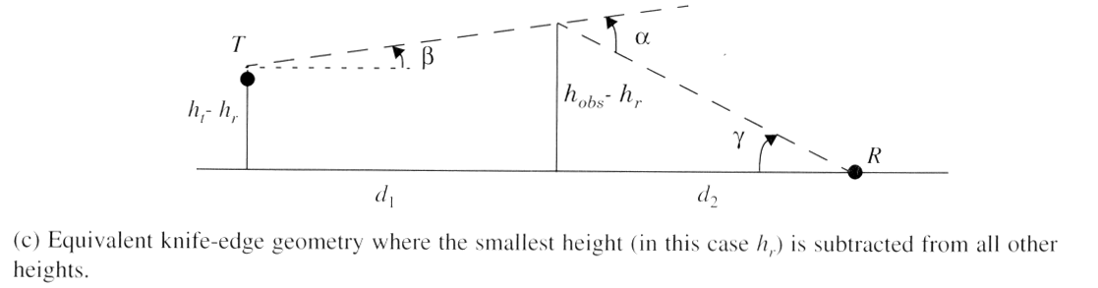
Diffraction Geometry

Slide 14
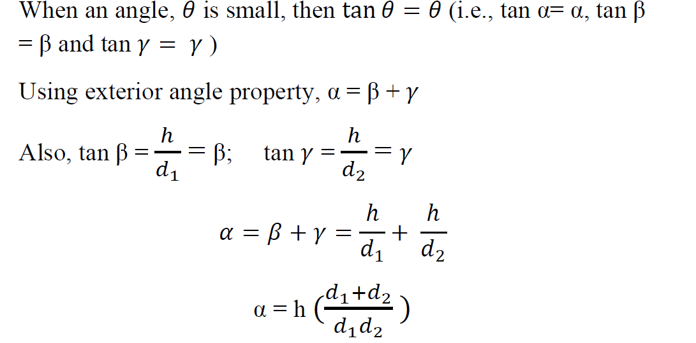
Diffraction Geometry

Slide 15
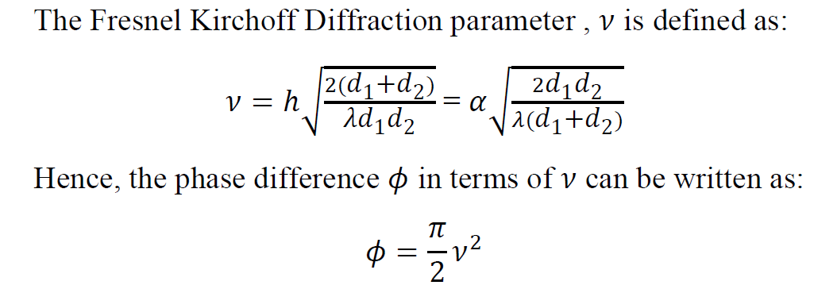
Fresnel Kirchoff diffraction parameter
It characterize the phase difference between two propagating waves.
The phase difference between a direct line-of-sight path and diffracted path is a function of height and position of the obstruction, as well as the transmitter and receiver location.

Slide 16
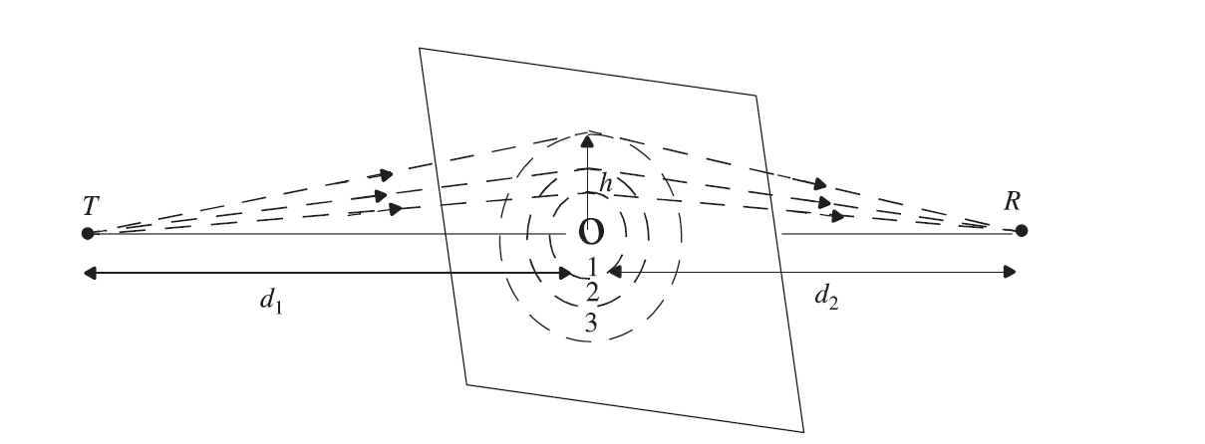
Fresnel zones
Fresnel zones represent successive regions where secondary waves have a path length from the transmitter to receiver which are nλ/2 greater than the total path length of a line-of-sight path.
Figure demonstrates a transparent plane located between a transmitter and receiver. The concentric circles on the plane represent the loci of the origins of secondary wavelets which propagate to the receiver such that the total path length increases by λ/2 for successive circles. These circles are called Fresnel zones.

Slide 17
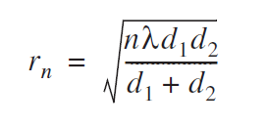
Fresnel zones
The successive Fresnel zones have the effect of alternately providing constructive and destructive interference to the total received signal.
The radius of the nth Fresnel zone circle is denoted by r_{n} can be expressed in terms of n, λ, d₁and d₂ by

Slide 18
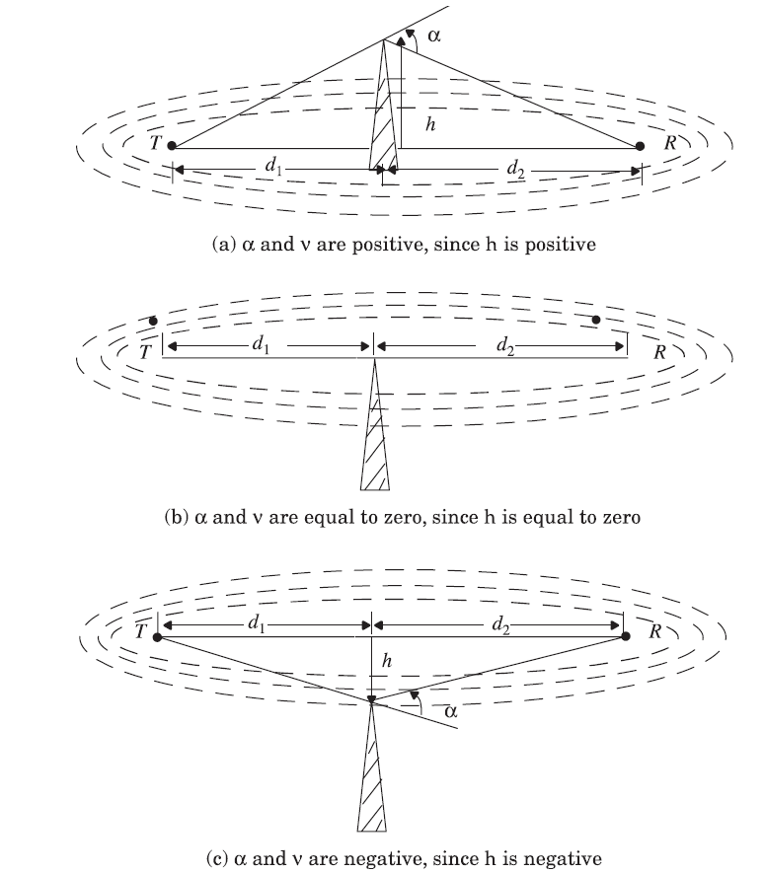
Fresnel zones for different knife-edge diffraction scenarios

Slide 19
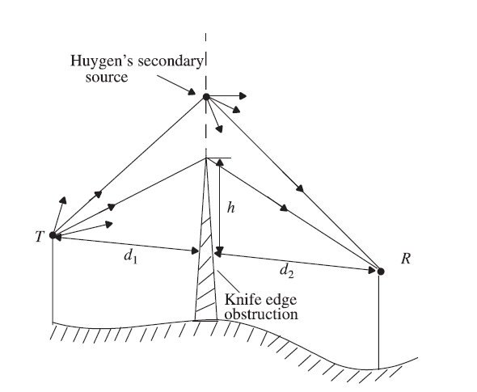
Knife-edge diffraction geometry.
When the receiver R is located in the shadow region.

Slide 20

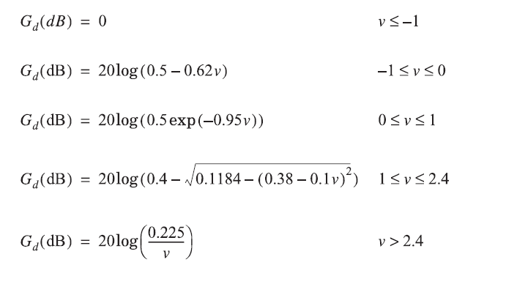
Knife-edge diffraction geometry.
The diffraction gain due to the presence of a knife edge, as compared to the free space E-field, is given by

Slide 21
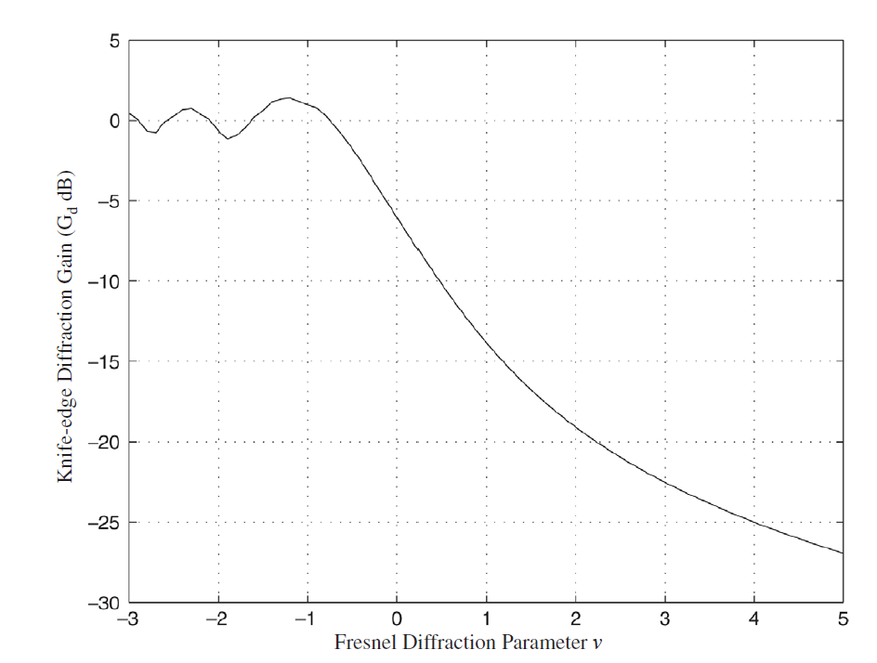
A graphical representation of gain as a function of v

Slide 22


